Slide 1



“Evaluation of Video Summarization”
Mikołaj Leszczuk, Lucjan Janowski
October 2019

Slide 2
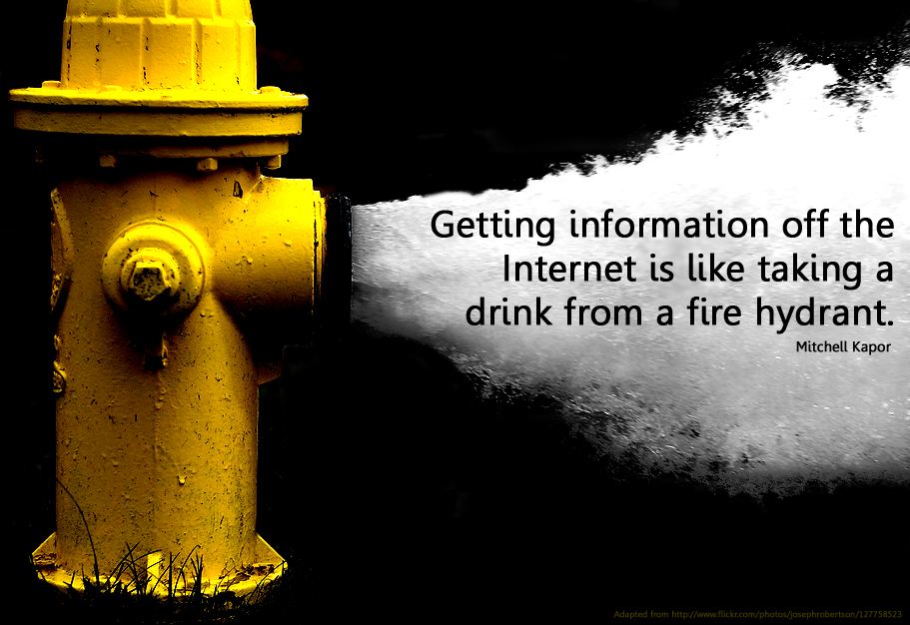
Infobesity

Slide 3

Videos
Images
Automatic
Summarization
Documents

Slide 4

Multimedia Content
Translation (from
Arabic) and
Summarization

Slide 5
Video Translation and Summarisation
We need a shorter version of news
Processing:
Speech
Text
Translation
Summary

Slide 6
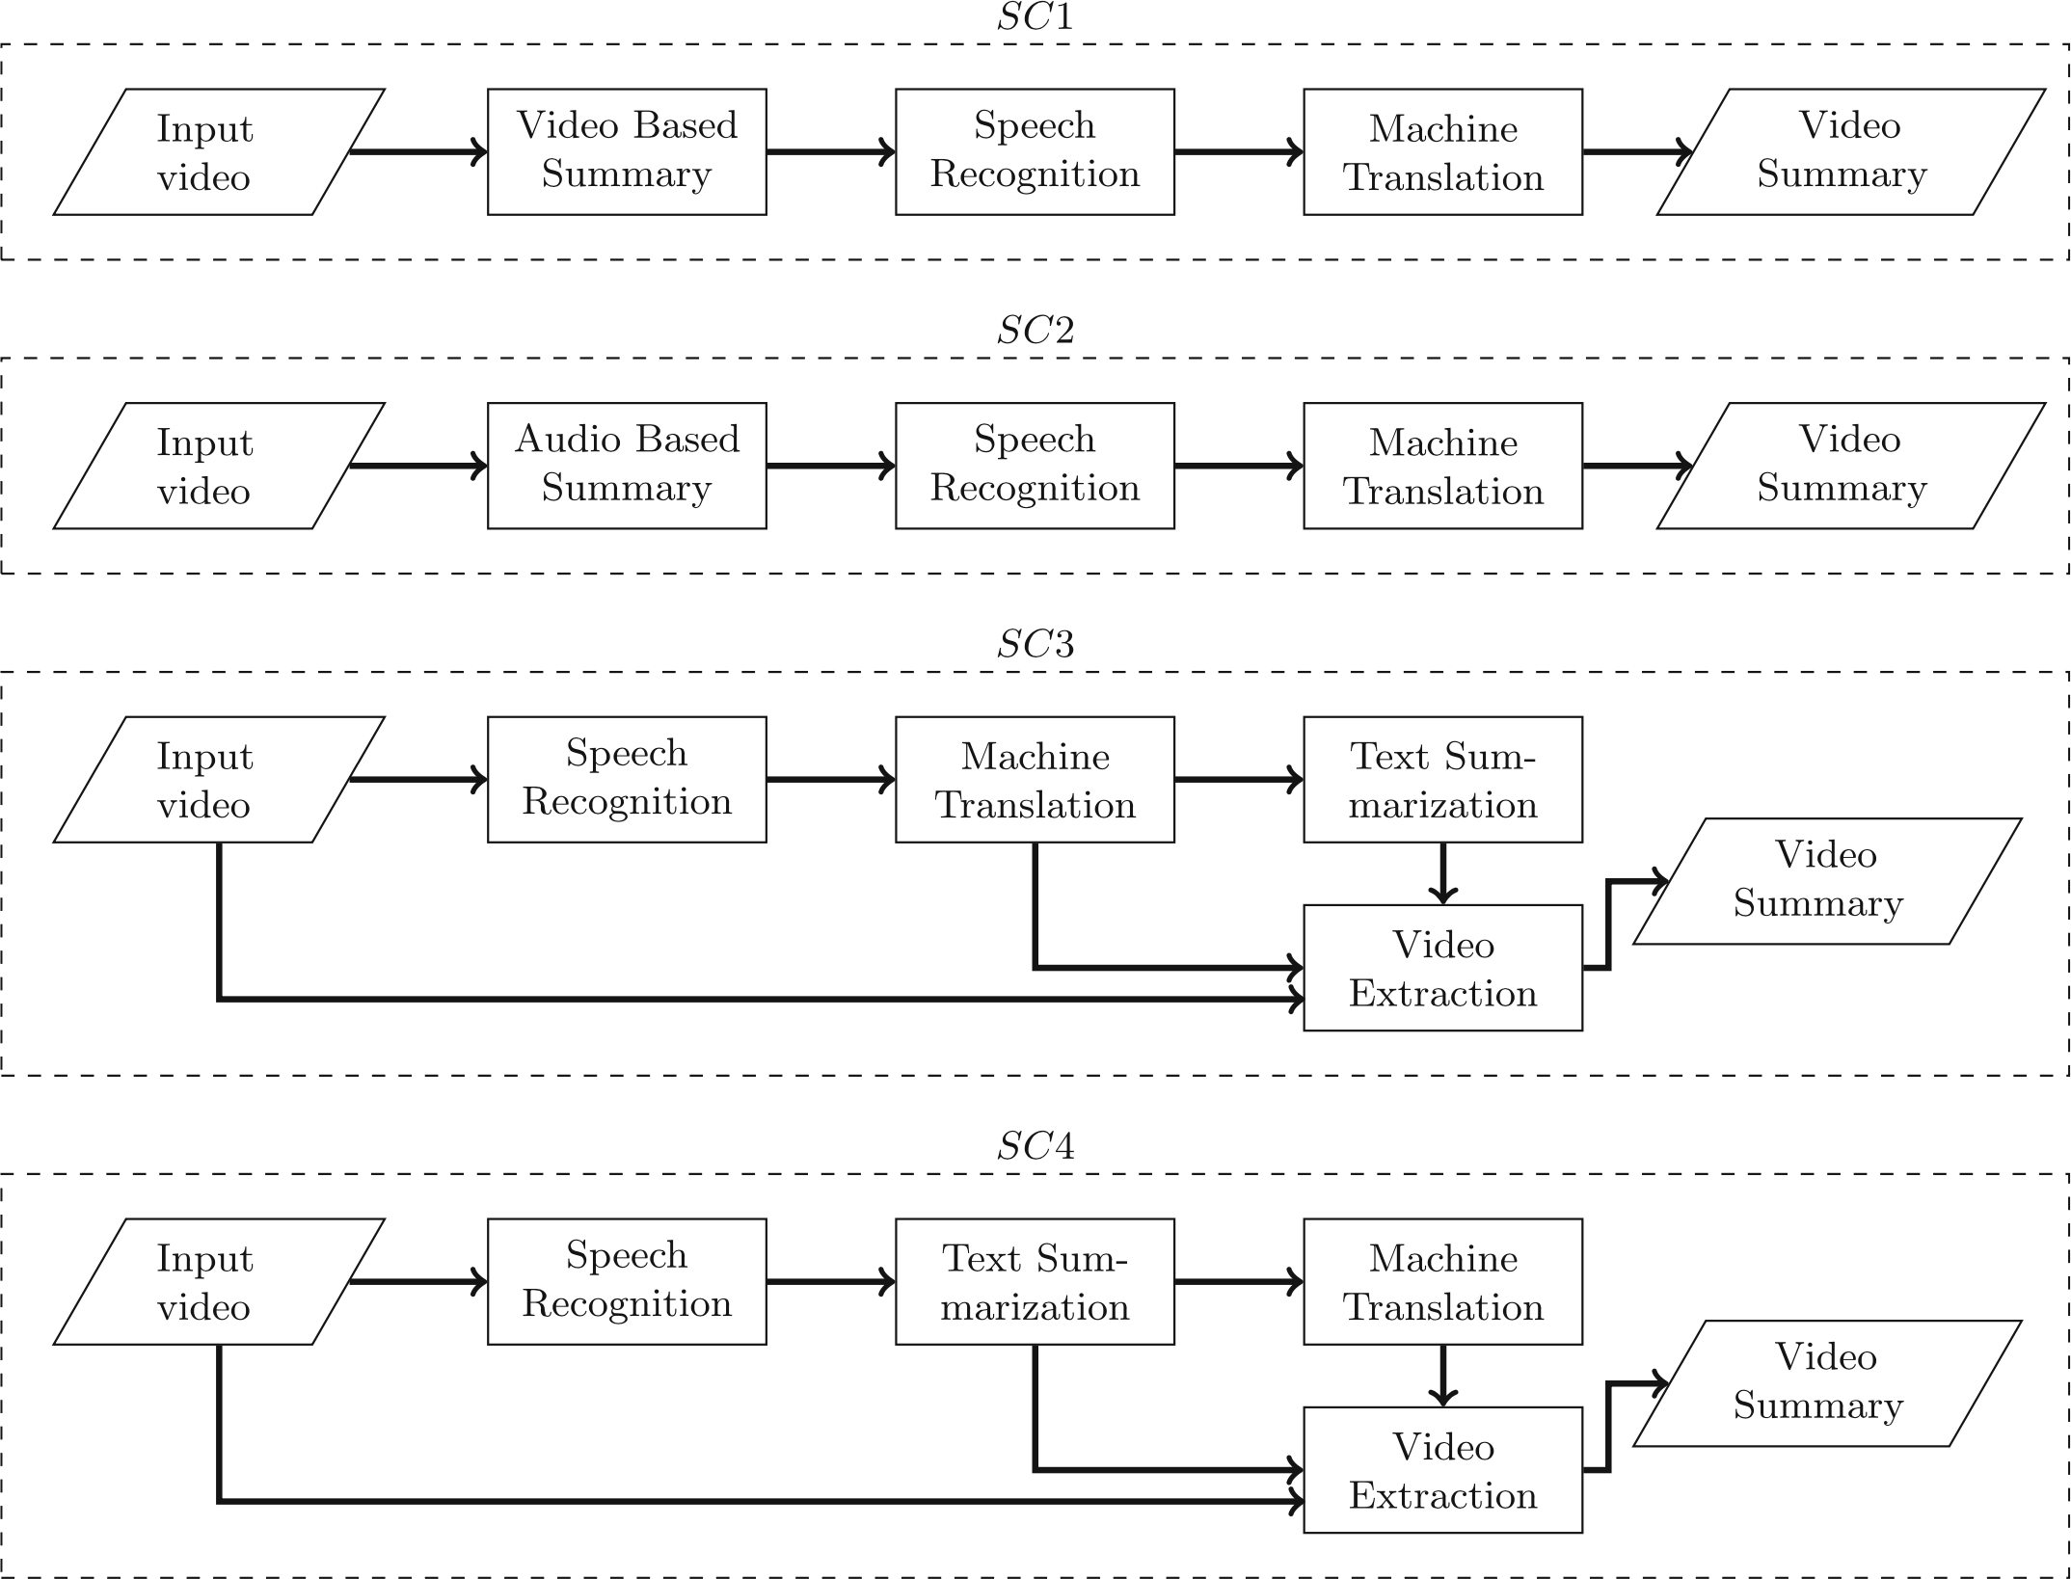
Different Architectures (SCenarios) for
Summarizing Video to Target Language

Slide 7

How to Evaluate (Compare) Video Summarization Algorithms?

Slide 8
Experiment Assumptions
Subjective crowdsourcing test: colleagues, students, other target groups
Absolute Category Rating (ACR), only for relative SCenario comparison
9 SRCs, 4 HRCs (SCenarios), 36 PVSs
1 base SCR/test (9 PVSs/test)
~1 min/PVS, 10 min/test

Slide 9
SRC/HRC/PVS Matrix
 | SRC1 | SRC2 | SRC3 | SRC4 | SRC5 | SRC6 | SRC7 | SRC8 | SRC9
HRC1 (SC1) | PVS1.1 | PVS2.1 | PVS3.1 | PVS4.1 | PVS5.1 | PVS6.1 | PVS7.1 | PVS8.1 | PVS9.1
HRC1 (SC2) | PVS1.2 | PVS2.2 | PVS3.2 | PVS4.2 | PVS5.2 | PVS6.2 | PVS7.2 | PVS8.2 | PVS9.2
HRC1 (SC3) | PVS1.3 | PVS2.3 | PVS3.3 | PVS4.3 | PVS5.3 | PVS6.3 | PVS7.3 | PVS8.3 | PVS9.3
HRC1 (SC4) | PVS1.4 | PVS2.4 | PVS3.4 | PVS4.4 | PVS5.4 | PVS6.4 | PVS7.4 | PVS8.4 | PVS9.4

Slide 10
SRC/HRC/PVS Matrix
Tester 1
 | SRC1 | SRC2 | SRC3 | SRC4 | SRC5 | SRC6 | SRC7 | SRC8 | SRC9
HRC1 (SC1) | PVS1.1 | PVS2.1 | PVS3.1 | PVS4.1 | PVS5.1 | PVS6.1 | PVS7.1 | PVS8.1 | PVS9.1
HRC1 (SC2) | PVS1.2 | PVS2.2 | PVS3.2 | PVS4.2 | PVS5.2 | PVS6.2 | PVS7.2 | PVS8.2 | PVS9.2
HRC1 (SC3) | PVS1.3 | PVS2.3 | PVS3.3 | PVS4.3 | PVS5.3 | PVS6.3 | PVS7.3 | PVS8.3 | PVS9.3
HRC1 (SC4) | PVS1.4 | PVS2.4 | PVS3.4 | PVS4.4 | PVS5.4 | PVS6.4 | PVS7.4 | PVS8.4 | PVS9.4

Slide 11
SRC/HRC/PVS Matrix
Tester 1, Tester 2
 | SRC1 | SRC2 | SRC3 | SRC4 | SRC5 | SRC6 | SRC7 | SRC8 | SRC9
HRC1 (SC1) | PVS1.1 | PVS2.1 | PVS3.1 | PVS4.1 | PVS5.1 | PVS6.1 | PVS7.1 | PVS8.1 | PVS9.1
HRC1 (SC2) | PVS1.2 | PVS2.2 | PVS3.2 | PVS4.2 | PVS5.2 | PVS6.2 | PVS7.2 | PVS8.2 | PVS9.2
HRC1 (SC3) | PVS1.3 | PVS2.3 | PVS3.3 | PVS4.3 | PVS5.3 | PVS6.3 | PVS7.3 | PVS8.3 | PVS9.3
HRC1 (SC4) | PVS1.4 | PVS2.4 | PVS3.4 | PVS4.4 | PVS5.4 | PVS6.4 | PVS7.4 | PVS8.4 | PVS9.4

Slide 12
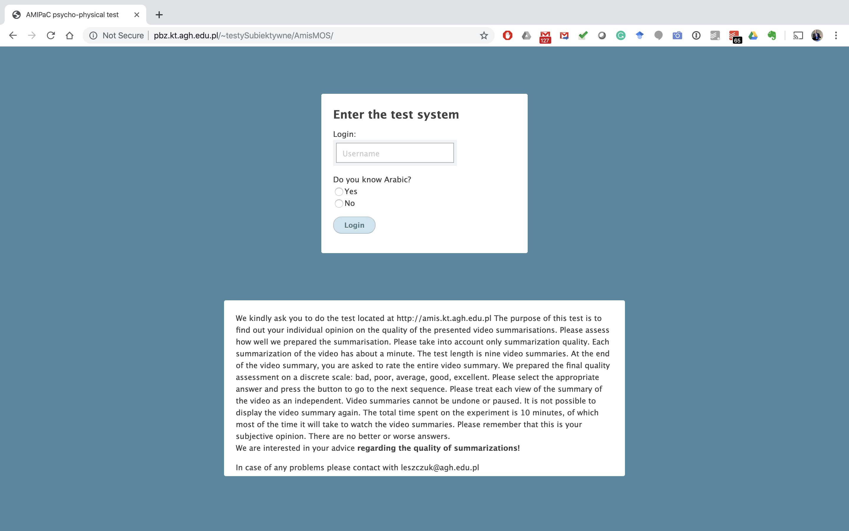
Entering Test System Including Arabic Mother Tongue Check

Slide 13
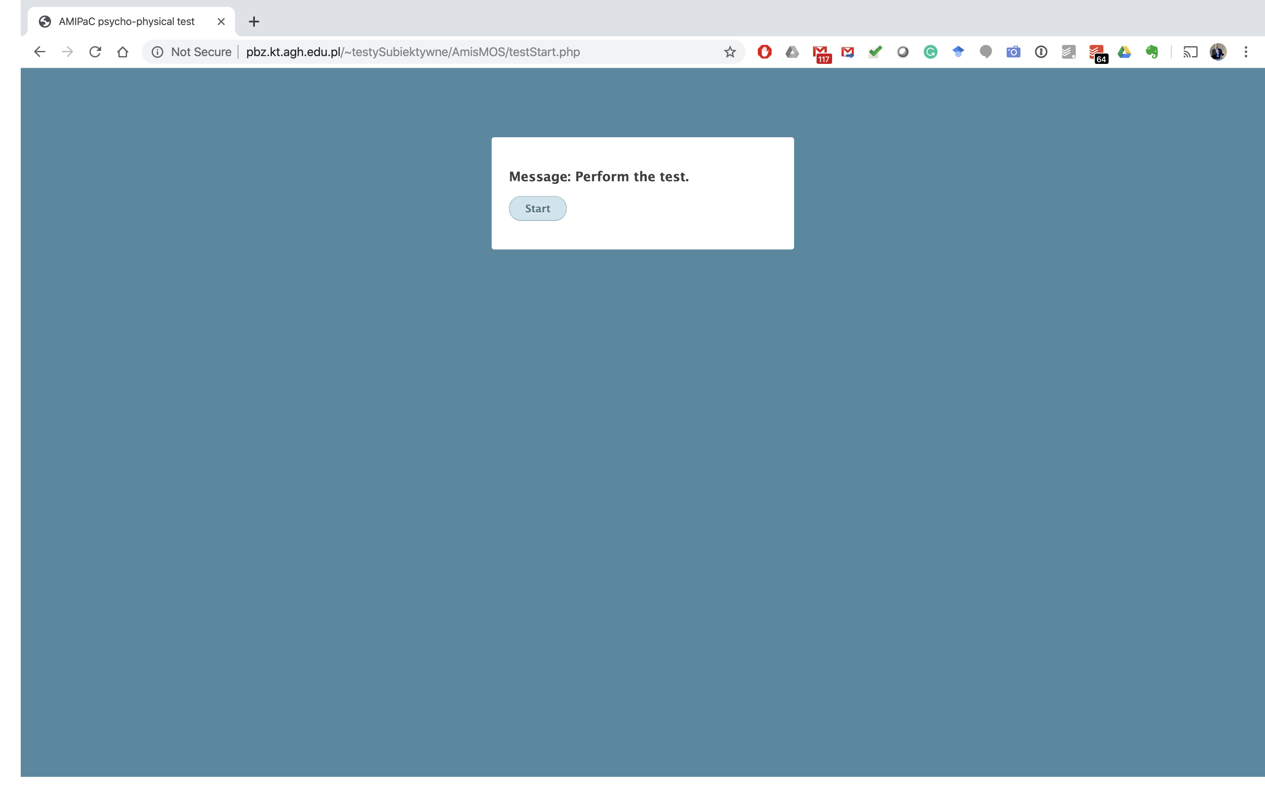
Starting Test

Slide 14
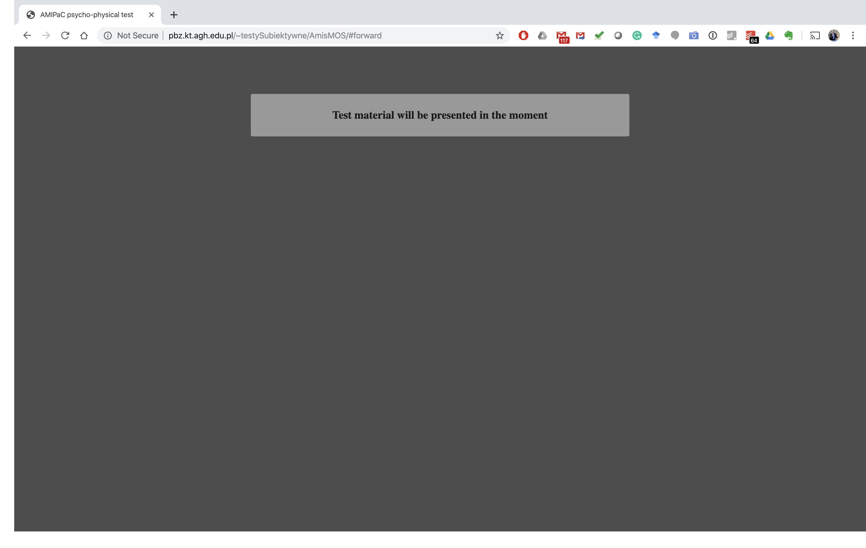
“Chillout” Screen

Slide 15
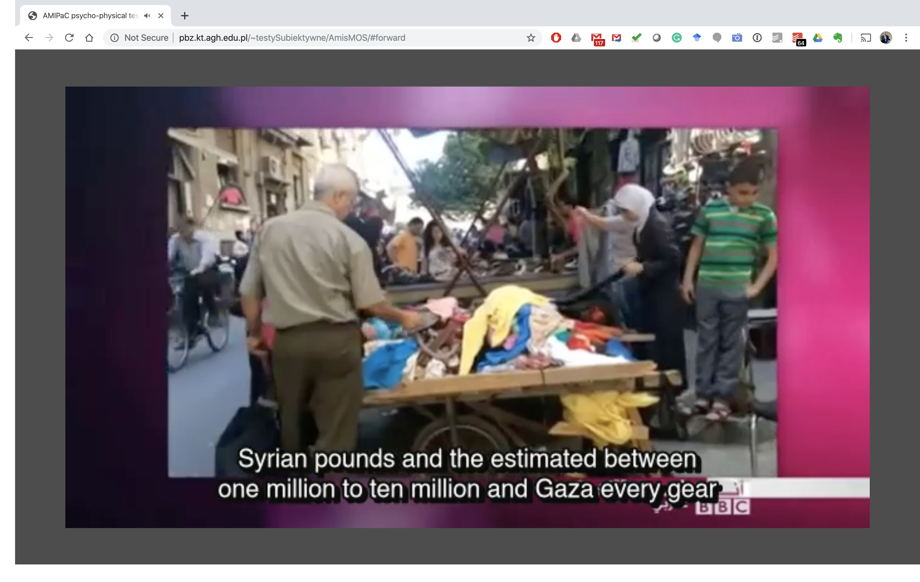
Test Material (Video)
Presentation

Slide 16
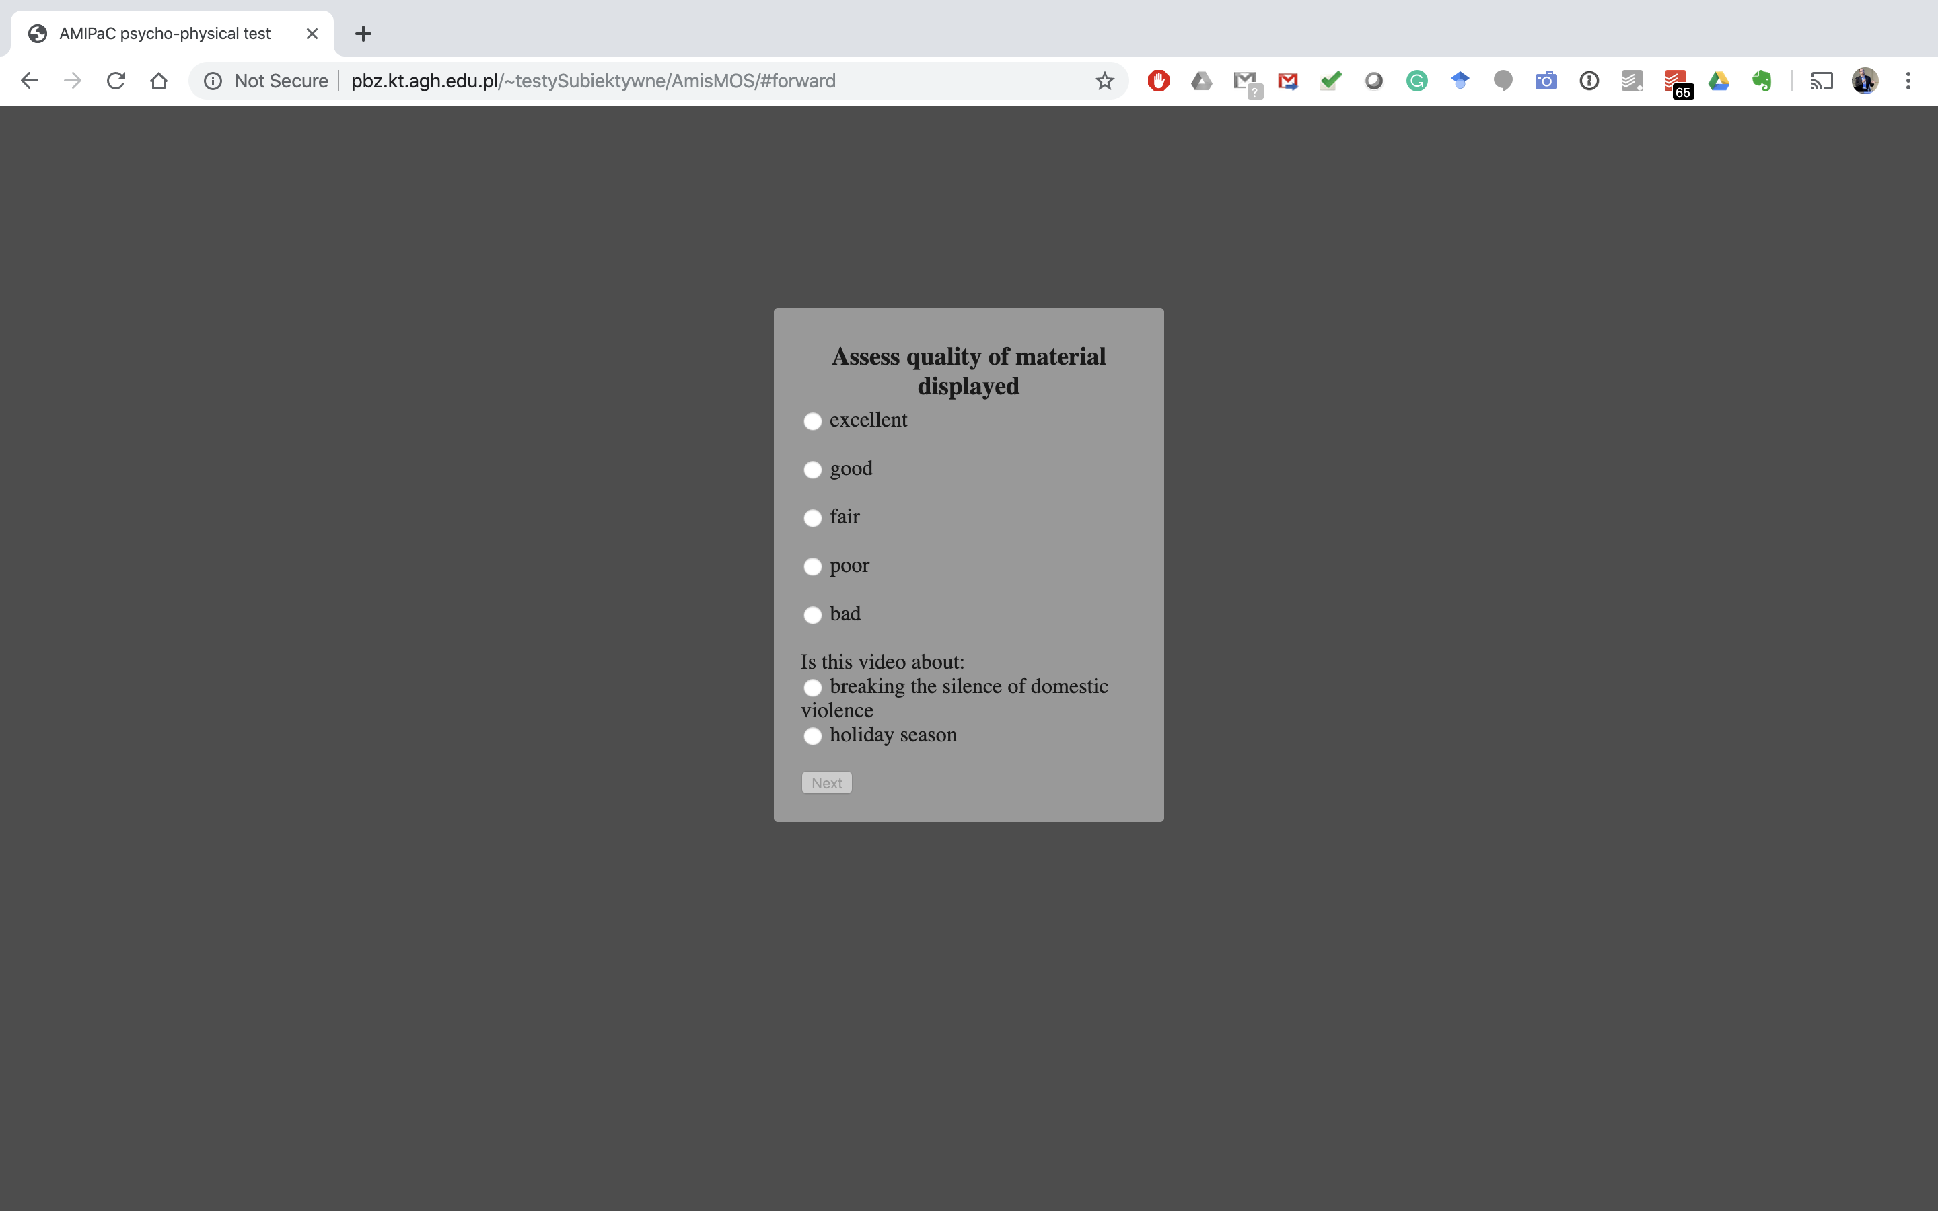
Assessing Quality
(TBD: Crowdsourcing Check)

Slide 17
Request for Participation
Link: http://amis.kt.agh.edu.pl
Please:
  Find 10 min to help us
  Circulate link among colleagues, students, etc.
Deadline: 2 weeks (end of October 2019)

