Slide 1
UPGC content selection and processing criteria for constructing a quality database
Discussion draft
Jing LI, Alibaba Group

Slide 2
UPGC image/video quality assessment
UGC: User Generated Content
PGC: Professionally Generated Content
No ground truth
Quality varies largely
Different resolutions
Different video types

Slide 3
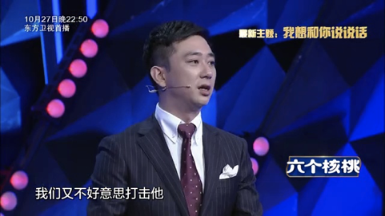
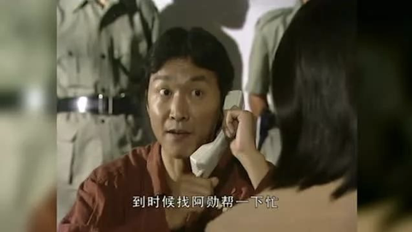
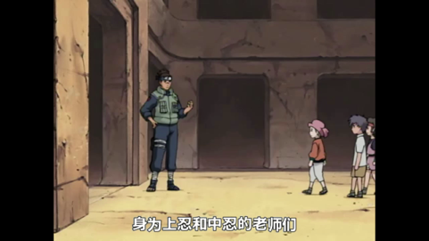
Example
low quality, 4:3 to 16:9
High resolution, 16:9 version
With caption
Low resolution, 4:3 to 16:9

Slide 4


Vertical version
capturing from phone
Different resolution：
Pseudo vertical version
2560x1440
1920x1080
2340x1080
1280x720
Original vertical version
Horizontal version to vertical version

Slide 5
Discussion: How to display the content in subjective test
For a UPGC image/video quality assessment experiment
For horizontal version, should we rescale all the videos to the resolution of the screen (e.g. 1920x1080)?
But how about the vertical version?
Should we include both horizontal and vertical versions playing on PC ?
-Should we only display horizontal version on PC ?
-Should we only display vertical version on phone ?

Slide 6
Discussion: Standards to select the content of the images/videos
Caption
- Caption can be included or not?
Tag-based analysis
- Animation, sports, Vlog, action movie, etc.
Indicator based sampling
Brightness，Contrast， Spatial activity，temporal activity, Blur， Blockiness， Noise， Exposure， colorfulness
Quality based sampling
Using NR metrics
Other suggestions?

Slide 7
Question:
Should we draft a recommendation?

