Slide 1


AVHD-AS/P.NATS Phase 2 Project
Shahid Mahmood Satti (OPTICOM GmbH)
Silvio Borer (Rohde & Schwarz)
Alexander Raake (Deutsche Telekom/TU Ilmenau)
Jörgen Gustafsson (Ericsson)

Slide 2










9 Proponents :

Slide 3
Model Types:
Pixel-based Models:
- FR, NR, RR Models
- Validated using short (8 sec) and long (upto 300 sec) test conditions
Hybrid Models:
- Hybrid NR, Hybrid RR and Hybrid FR Models
- Validated using short (8 sec) and long (upto 300 sec) test conditions
Parametric Models:
- Mode 0, 1, 3 models, Mode 0: header info only, Mode 3: Full bitstream parsing
- Validated using short (8 sec) test conditions
Codecs: H.264, H.265,
VP9
Max FPS: 60
Max Res: UHD1 (2160p)
Bit depth: 8, 10
HDR: No
Display: Mobile,
Tablet, PC Monitor, TV
Services: YT, Vimeo,
Bitmovin
AVHD-AS/PNATS Phase 2

Slide 4
Project Timeline:
Milestone | Date
Call for participation | Feb. 2017
Training Databases Ready | Jun. 2018
Model Training Period | Jul. 2018 – Jan. 2019
Model Submission to ITU | 18 Jan. 2019
Validation Databases Ready | Aug. 2019
Model Validation | 04 Sept. 2019
Model Merging/Optimization | Oct. 2019
ITU Consent | Nov 2019 (ITU-T SG12 Meeting Geneva)
Parametric Models:
- Mode 0 – 3 models, Mode 0: header info only, Mode 3: Full bitstream parsing
- Validated using short (10 sec) test conditions

Slide 5
Subjective Databases: 15 TR, 18 VL
 | Method | Impairments | Display Device | What is rated? | Number of databases
Long-sequence tests | ACR | Compression, initial-buffering, quality switching, Rebuffering/ Stalling | Mobile, TV | Audio-visual quality | 7 (Training: 2, Validation: 5)
Short-sequence tests | ACR | Coding distortions with different codec parameters (bitrate, res, preset, gop-len ) | PC Monitor, TV, Mobile, Tablet | Video quality | 26 (Training : 13, Validation: 13) ~ 190 samples/db

Slide 6
Submitted Models:
Model Category | Model Type | Nr. of Models Submitted
1 | Parametric Mode 0 | 8
2 | Parametric Mode 1 | 4
3 | Parametric Mode 3 | 1
4 | Pixel-based FR | 6
5 | Pixel-based RR | 2
6 | Pixel-based NR | 2
7 | Hybrid-FR | 4
8 | Hybrid-RR | 2
9 | Hybrid-NR | 6
 | Total | 35

Slide 7
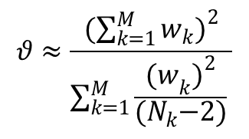
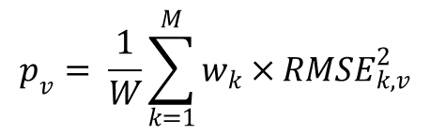
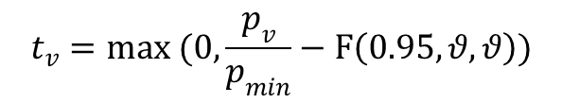
Model Perforamance Evaluation:
M = Total number of databases
w_{k} = Weight of the kth database (0.1 for a training DB, 0.9 for a validation DB)
N_{k} = Number of samples in the kth database
$$p_{v}= \frac{1}{W}\sum_{k=1}^{M}{w_{k}×}{RMSE}_{k,v}^{2}$$
Avg. MSE performance of a model v:
$$θ≈\frac{(\sum_{k=1}^{M}{w_{k}})^{2}}{\sum_{k=1}^{M}{{\frac{{(w}_{k})^{2}}{{(N}_{k}−2)}}_{ }}}$$
Degrees of freedom:
Signficance test w.r.t the best model:
$$t_{v}=max (0,\frac{p_{v}}{p_{min}}−F\left(0.95,θ,θ\right))$$
If t_{v} = 0 the model v is considered as statistically equivalent to the model with p = p_{min}.

Slide 8
Model Performance Requirements:
Parametric Models
Hybrid Models
Pixel-based Models
Parametric Mode 3
Hybrid FR
Pixel-based FR
Parametric Mode 1
Hybrid RR
Pixel-based RR
Prediction Accuracy
Parametric Mode 0
Hybrid NR
Pixel-based NR
Common Baseline = a*log(bitrate+b)+c

Slide 9
Model Performance: RMSE values
Model Type | Minimum Required Performance | Passing Threshold | Best Model RMSE | No. Of Qualifying Models | No. Of Non-qualifiying Models
Parametric Mode 0 | 0.610 | 0.570 | 0.554 | 3 | 5
Parametric Mode 1 | 0.554 | 0.520 | 0.505 | 2 | 2
Parametric Mode 3 | 0.505 | 0.434 | 0.421 | 1 | 0
Pixel-based NR | 0.610 | 0.718 | 0.697 | 0 | 2
Pixel-based RR | 0.610 | 0.458 | 0.444 | 1 | 1
Pixel-based FR | 0.444 | 0.447 | 0.434 | 0 | 5
Hybrid NR | 0.554 | 0.466 | 0.452 | 1 | 5
Hybrid RR | 0.444 | 0.454 | 0.440 | 0 | 2
Hybrid FR | 0.434 | 0.458 | 0.444 | 0 | 4
Models not meeting the min. performance requirement
Models for which a statistically equivelent simpler model is available
§ Pixel-based NR, Pixel-based FR, Hybrid RR and Hybrid FR models will not be standardized

Slide 10
Summary:
35 Models spanning 9 model categories were submitted to ITU
Models were trained on 15 Training Databases
Validation databases (test coding and footage) were completely unknown
at the time of model submission.
17 validation databases with new footage and unknown HRCs were created
Bug-fixes were allowed before sharing the scores of the validation databases
Model verification of the already frozen model was performed and
  winning models were determined
For model categories for which no winning model is found, a computationally simpler
  model will be recommended

Slide 11
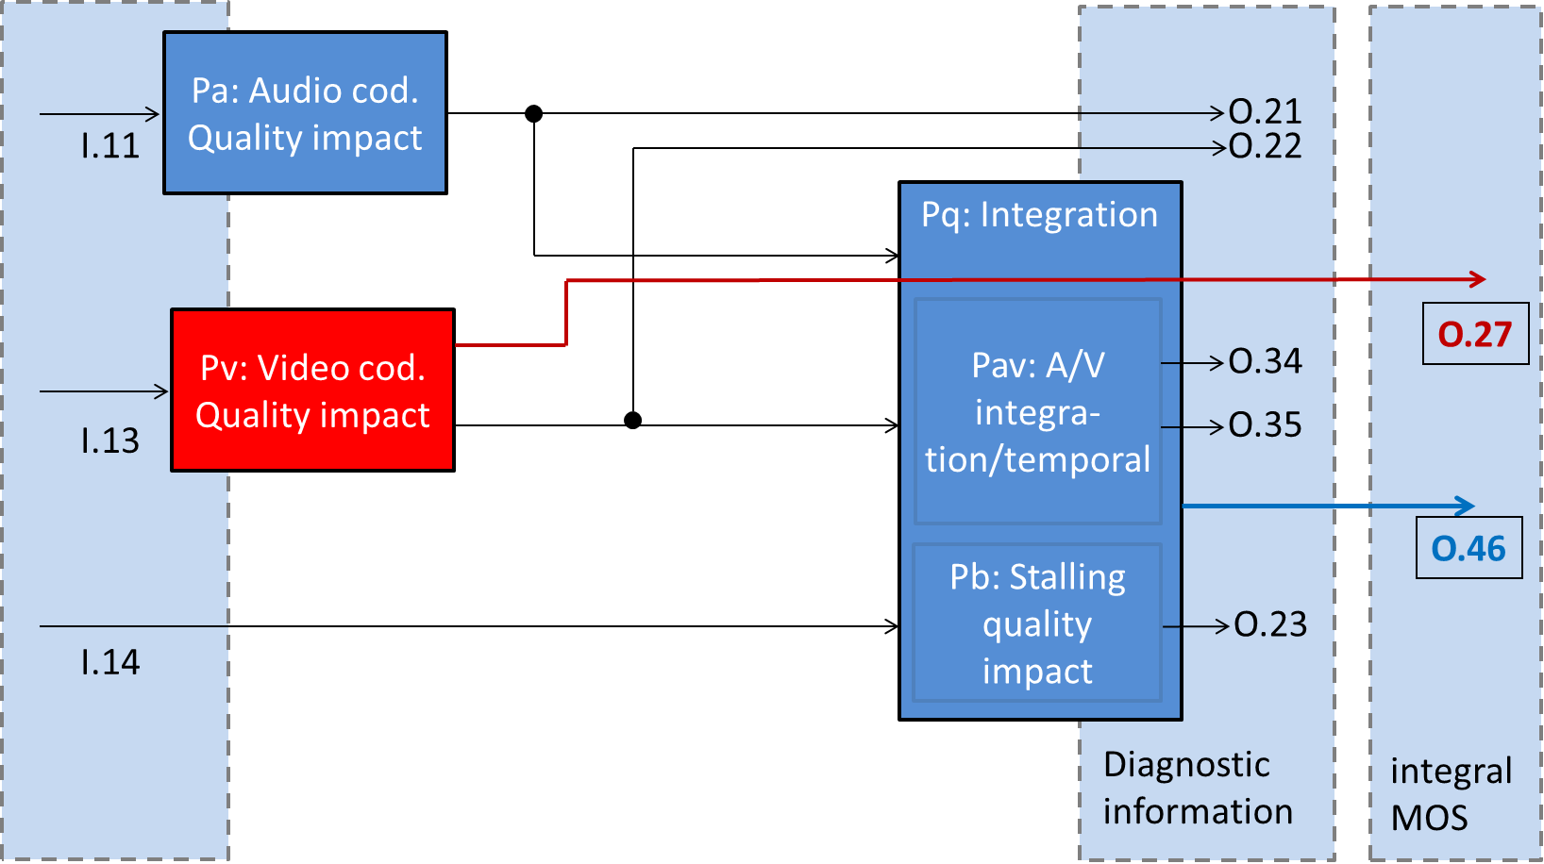
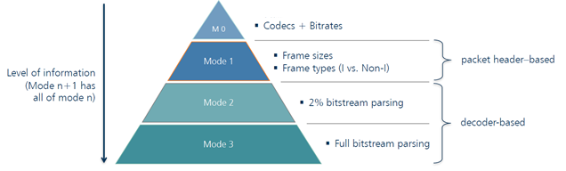
Parametric Models:
Parametric models will be validated for O.27 output only
Parametric audio input
Video Quality Short-term
Parametric video input
Video Quality Long-term
Rebuffering Information
Fig: Block diagram for parametric models
Fig: Modes of operation for parametric models

Slide 12
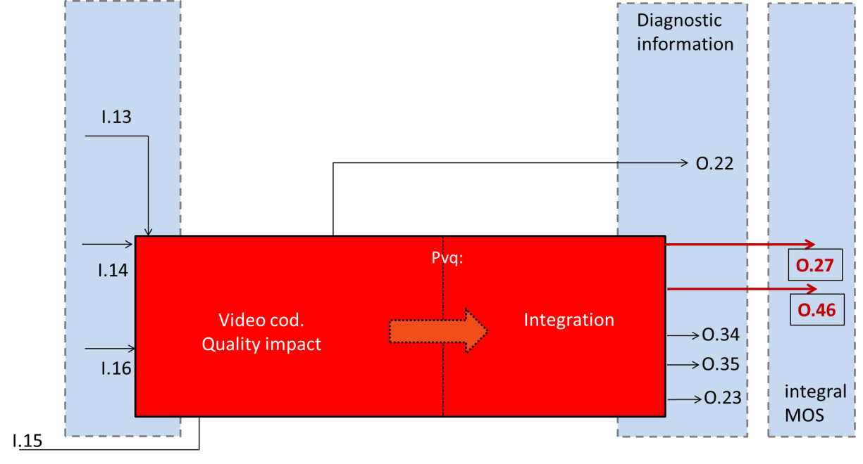
Pixel-based and Hybrid Models:
Pixel-based and hybrid models will be validated for O.27 and O.46 output
Parametric video input
(Hybrid models only)
Rebuffering Information
Video Quality Short-term
Video Quality Long-term
Degraded Video Pixels
Ref Video Pixels
(FR, RR models only)
Fig: Block diagram for Pixel-based and hybrid models

