Slide 1



I n v e s t I g a t I on o f P e r c e p t u a l
V I d e o Q u a l I t y D I m e n s I o n s
Falk Schiffner
Quality & Usability Lab – Technische Universität Berlin

Slide 2

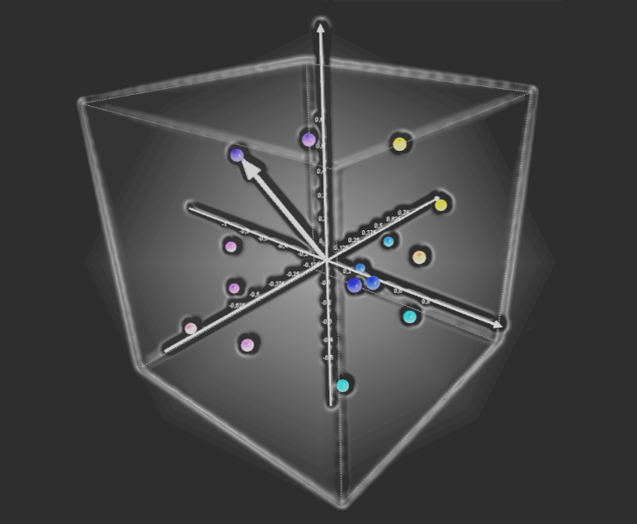
A G E N D A
Introduction
    Quality Rating
    Perceptual Video Quality Dimensions
Experiments – Direct Scaling
    Test method and procedure
    Video degradations
Experiments – Some Results
Quality Prediction
Conclusion and Future Work

Slide 3
I N T R O D U C T I O N - Quality
Quality is a result of an internal comparison between the desired features
and the perceived features
To uncover the nature of the perceptual event
Description in a multidimensional feature space.
Coordinates represents the quantity of the
feature values
If the axes are orthogonal, the features can be
regarded as perceptual dimensions
This approach can help to diagnose the source of
suboptimal QoE
Notes:
definition of quality → desired vs perceived → object under assessement -> Product, Service etc.
physical stimuli produces perceptual event

Slide 4
I N T R O D U C T I O N - Perceptual Video quality Dimensions
Perceptual Video Quality dimensions obtained through subjective tests
  PC experiment with a MDS + SD experiment with a PCA
Resulting in a five dimensional quality space:
Name | Description | Example Impairment
Fragmentation (FRA) | Fallen apart, torn and disjointed | Packet Loss
Unclearness (UCL) | Unclear and smeared image | Low Coding Bitrate
Discontinuity (DIC) | Interruptions in the flow of the Video | Buffer Dealy and Limitations
Noisiness (NOI) | Random change in brightness and color | Quantization, Circuit Noise
Suboptimal Luminosity (LUM) | Too high or low brightness | Under- & Overexposure

Slide 5
E X P E R I M E N T - test Method Direct Scaling
Directly scaling the perceptual dimensions through the participant
Verification in three different experiments
  Two experiments with head+shoulder video material (I + II)
  One experiment diverse video content (III)
Impairments introduced in the video via matlab, ffmpeg, netem and TC
video degradations potentially appearing in video transmission

Slide 6
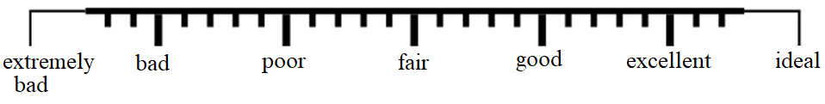
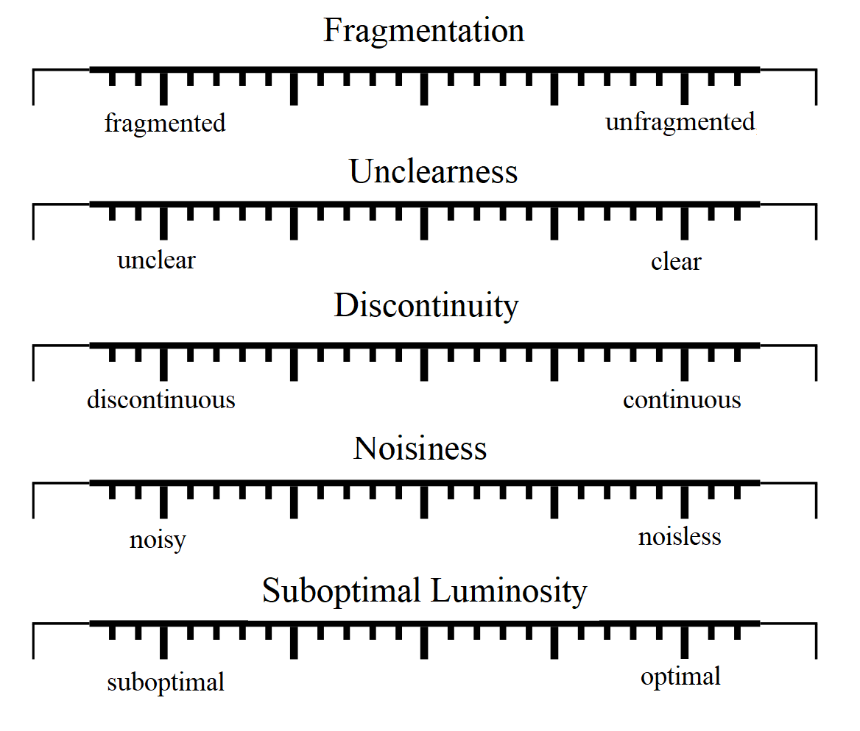
E x p e r i m e n t - Test PRocedure
Quality rating scale
Dimension rating scales
  Based on Likert-scale
  Dimension name as label
  Antonym pairs describes scale range
  Range 10 – 70 (70 = optimum)
  Optimum on the right side (unipolar)

Slide 7
E x p e r i m e n t - Overview Degradations
Name | Description | Experiment
Reference | Unimpaired Material | I + II + III
RISV Artificial Blockiness | All Frames (2x2 - 11x11 - Block Size Setting) | I + II
RISV Artificial Blurring | All Frames (7 Filter Settings) | I + II + III
RISV Artificial Jerkiness | Jerkiness (3 - 18 Frames freeze) | I + II + III
RISV Artificial NoiseQ | Salt & Pepper Noise (1-15% Pixel/Frame) | I + II + III
Bitrate XX kbps | H.264-Codec BR (28-256kbps -> 2-pass Coding) | I + II
Packet Loss (Random) | H.264-Codec, TC, NetEm, PLR (0.25-1.8%) | I + II + III
Luminance Impairment I (darker) | Luminance Value reduced | I + II + III
Luminance Impairment II (lighter) | Luminance Value raised | I + II + III
Additional Combinations for all Types of Degradations |  | II

Slide 8
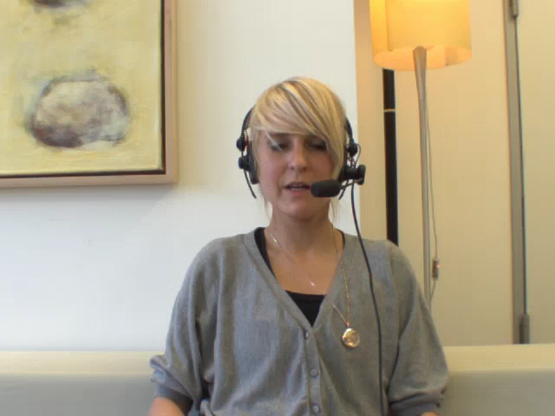
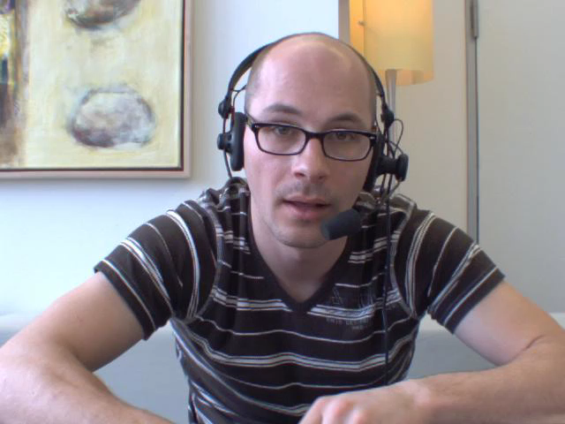
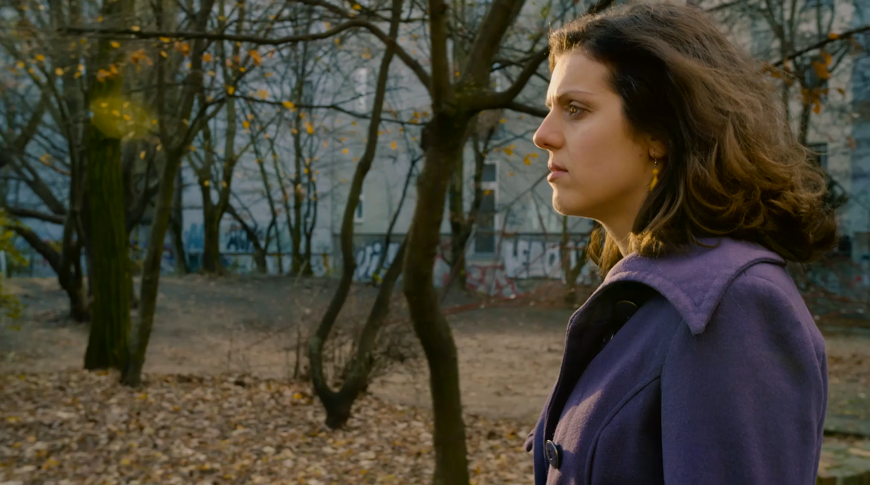

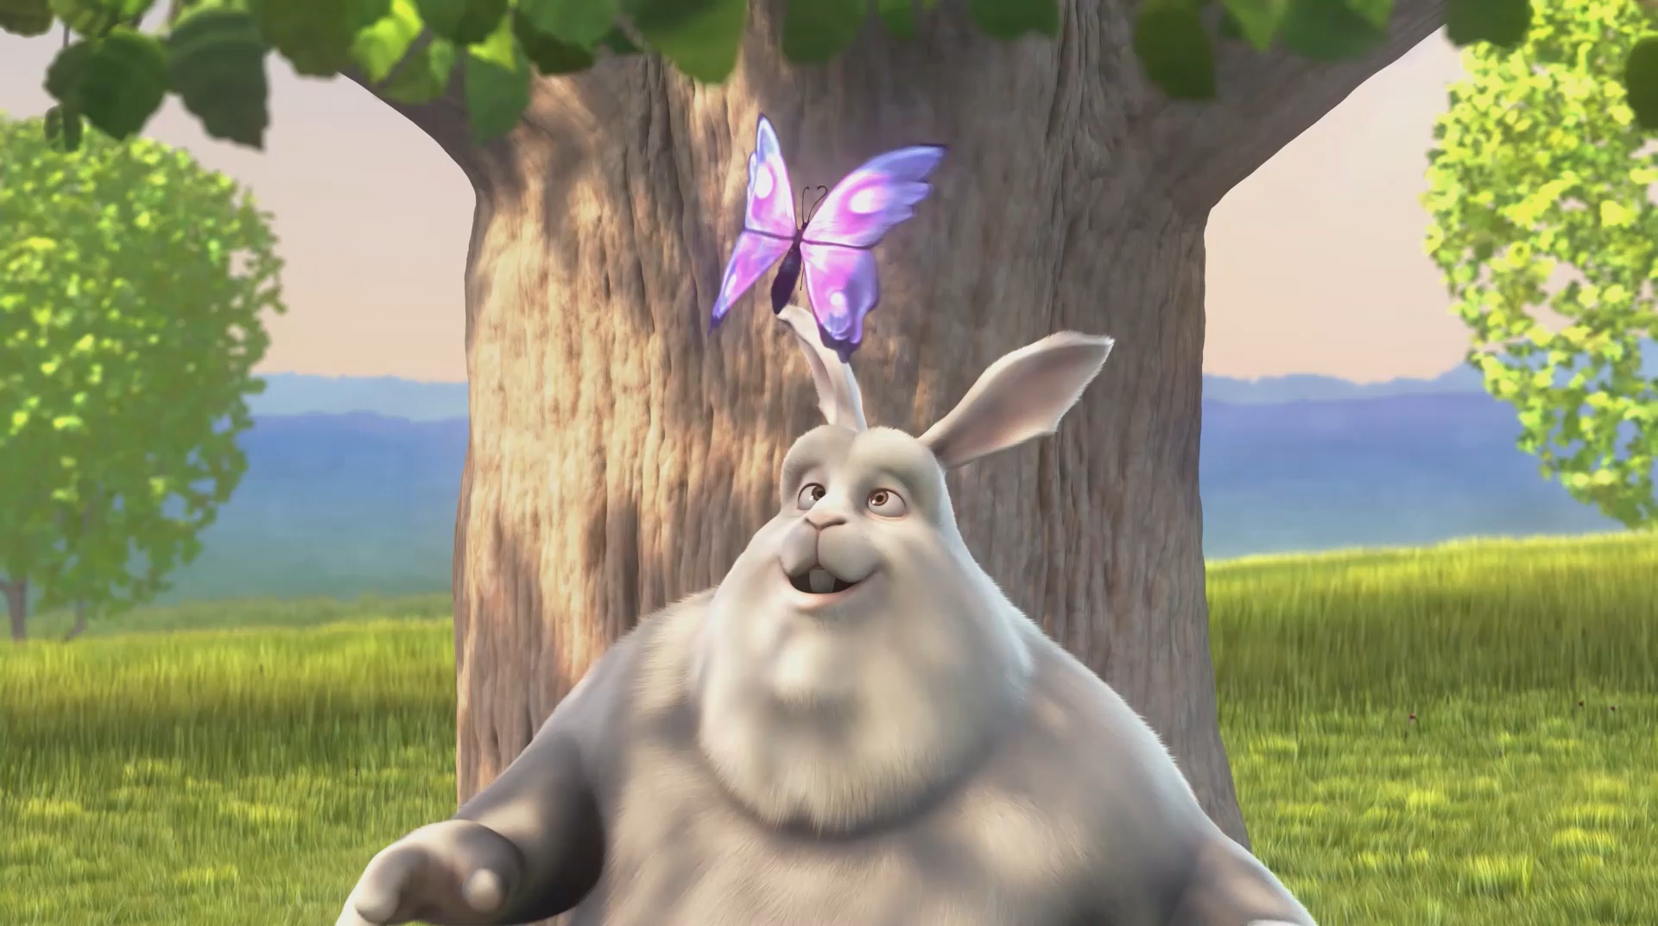


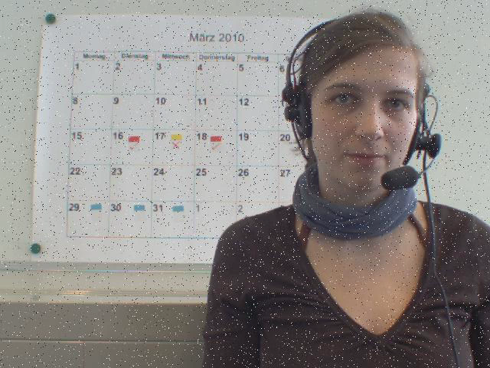
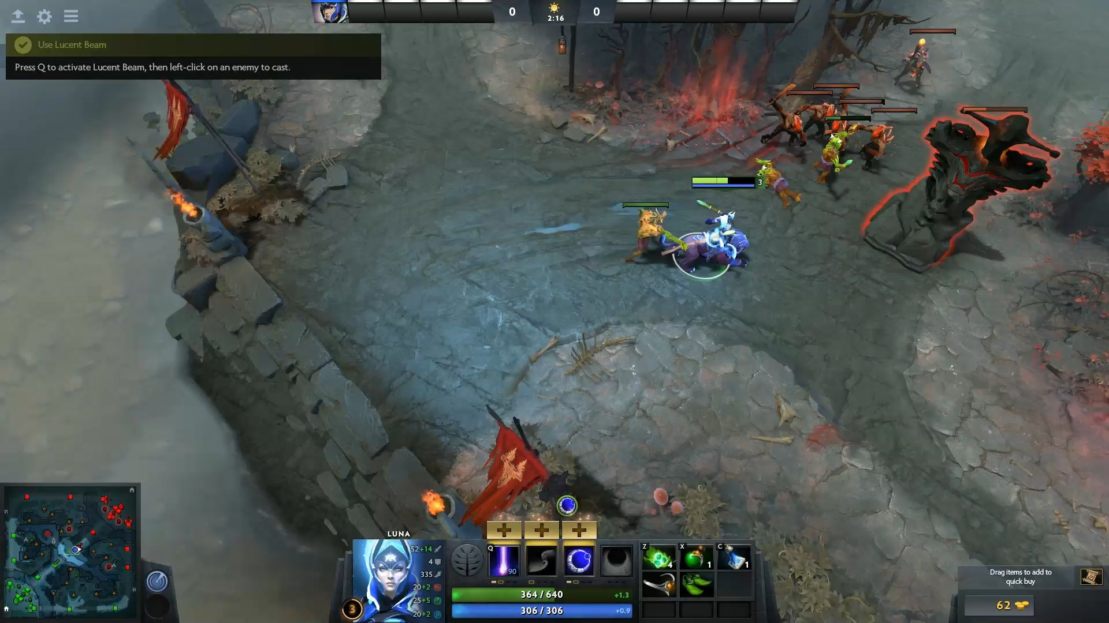
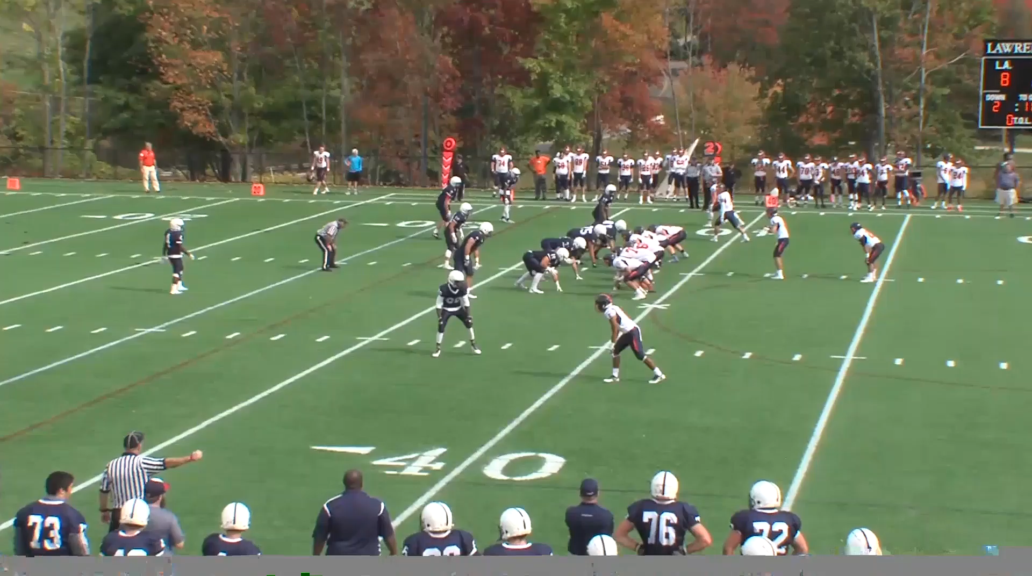
E X p e r i m e n t - Test Material Examples
H+S Video Material Other Material

Slide 9
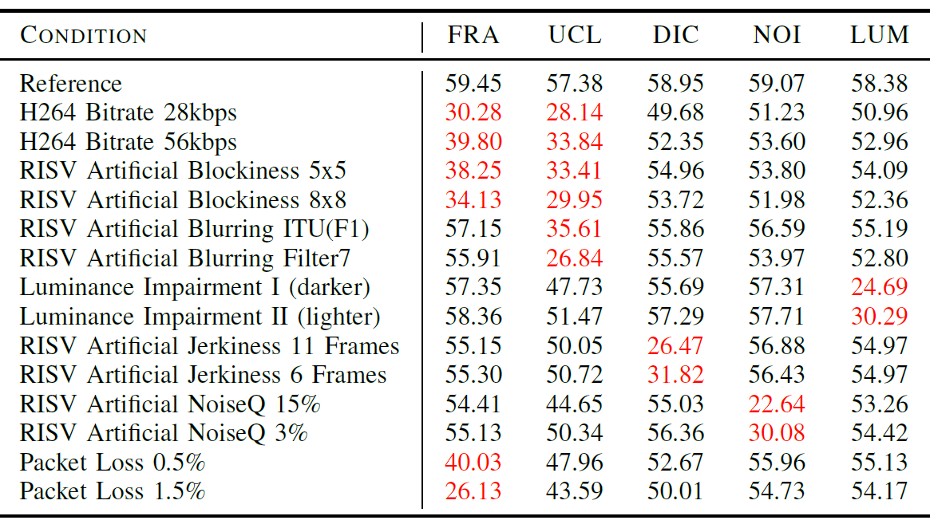
E x p e r i m e n t - Some Results: TEST I H+S

Slide 10
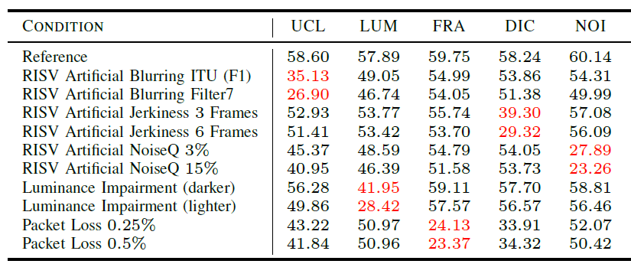
E x p e r i m e n t - Some Results: TEST III other content

Slide 11
E x p e r i m e n t - Some Results: TEST II H+S
Notes:
Q – Rating
DIM Scores
Rating Behavior on all Scales
-> indicated that the percep. video space can be regarded as stable and that it is not independent from the content
BRIDGE to Quality Prediction

Slide 12
E x p e r i m e n t - Some Results: TEST II H+S
Notes:
Q – Rating
DIM Scores
Rating Behavior on all Scales
-> indicated that the percep. video space can be regarded as stable and that it is not independent from the content
BRIDGE to Quality Prediction

Slide 13
E x p e r i m e n t - Some Results: TEST II H+S
Notes:
Q – Rating
DIM Scores
Rating Behavior on all Scales
-> indicated that the percep. video space can be regarded as stable and that it is not independent from the content
BRIDGE to Quality Prediction

Slide 14
E x p e r i m e n t - Some Results: TEST II H+S
Notes:
Q – Rating
DIM Scores
Rating Behavior on all Scales
-> indicated that the percep. video space can be regarded as stable and that it is not independent from the content
BRIDGE to Quality Prediction

Slide 15
E x p e r i m e n t - Some Results: TEST II H+S
Notes:
Q – Rating
DIM Scores
Rating Behavior on all Scales
-> indicated that the percep. video space can be regarded as stable and that it is not independent from the content
BRIDGE to Quality Prediction

Slide 16
Q u a l i t y p r e d i c t i o n - MOS_vQ vs. MOS_VQDIM (HSII)
MOS_VQDIM = -5.94 + (0.21 ∙ FRA) + (0.73 ∙ UCL) + (0.53 ∙ DIC) + (0.47 ∙ NOI) + (0.31 ∙ LUM)
PEARSON = .90
RMSE = .45

Slide 17

C O N C L U S I O N & F U T U R E W O R K
The perceptual video quality space consists of five dimensions.
It can be assessed directly via the corresponding quality dimensions.
It is independent from the video content.
Possible to model overall video quality model from the dimension
scores.
Prediction of the five dimensions using exsiting metrics.
Additional studies are ongoing to confirm the findings.
(Results will be presented next at ITU-T May ’19 )

Slide 18


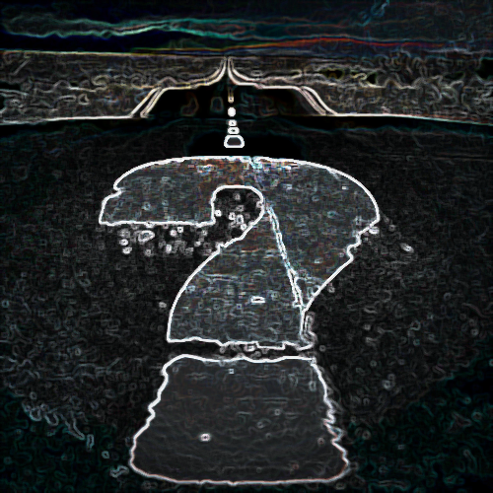

T H A N K Y O U F O R Y O U R A T T E N T I O N
A N Y Q U E S T I O N S

