Slide 1
NR Metrics: Alternate Training Data
Margaret H Pinson
mpinson@its.bldrdoc.gov

Slide 2
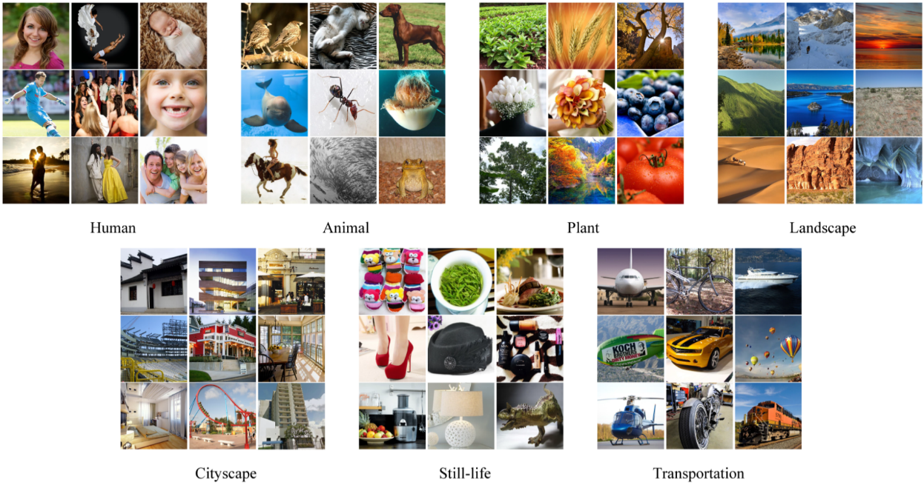
“Waterloo Exploration Database:
New Challenges for Image Quality Assessment Models”
IEEE Transactions on Image Processing, 2017
A posteriori knowledge of image quality → desirable metric behavior
Discriminate between pristine and distorted images
Correctly rank single impairment at multiple levels
Pairwise preference: different photos with known quality differences
Kede Ma, Zhengfang Duanmu, Qingbo Wu,
Zhou Wang, Hongwei Yong, Hongliang Li, Zei Zhang

Slide 3
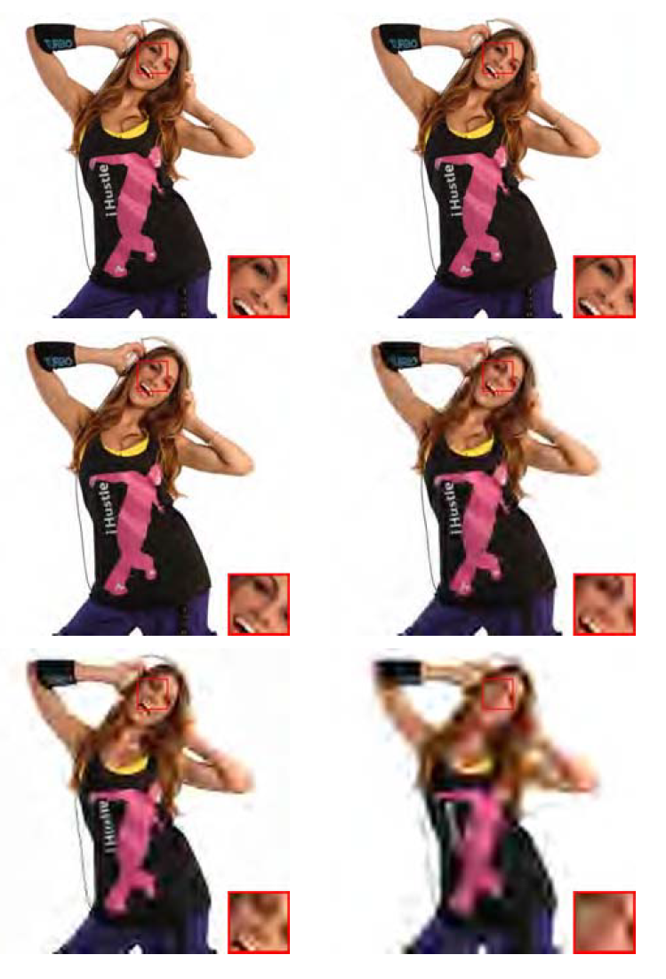
Listwise Ranking Consistency Test (L-Test)
Spearman correlation for each SRC
Average over SRC and distortion types
  JPEG compression levels
  JPEG2000 compression levels
  Gaussian blur levels
  White Gaussian noise levels
4,744 images × 4 distortion types

Slide 4
What Knowledge Can You Contribute?
Request
Impact
Good rules of thumb, not perfect
Illustrates human visual perception
Relative quality
Example: set of codec parameters
  Codec, resolution, frame rate, bit-rate
  Quality(n) > Quality (n+1)
Bound NR metric behavior for known conditions
Extra (cheap) training data
Focus subjective testing on interesting tradeoffs

