Slide 1
On the Use of CNN for Quality Assessment of CGI
Saman Zadtootaghaj, Markus Utke
Quality and Usability Lab (TU Berlin)

Slide 2
Architecture of a Classic CNN
Figure from: https://stanford.edu/~shervine/teaching/cs-229/cheatsheet-deep-learning

Slide 3
Convolutions
24 | 12 | 10 | 10 | 1
32 | 10 | 1 | 23 | 22
32 | 10 | 1 | 34 | 24
26 | 15 | 5 | 42 | 34
13 | 10 | 2 | 34 | 40
22 | 31 | 4 | 31 | 37
76
-35
-35
1 | 0 | -1
1 | 0 | -1
1 | 0 | -1
83
1 | 0 | -1
2 | 0 | -2
1 | 0 | -1
Notes:
Learn low level features
Let NN to learn what kernels we should get, we do not need to design the kernels
Backpropagation leaning which depends on the problem learn what features they need to detect

Slide 4
Pooling (Max)
24 | 12 | 10 | 10 | 1 | 2
32 | 10 | 1 | 23 | 22 | 33
32 | 10 | 1 | 34 | 24 | 44
26 | 15 | 5 | 42 | 34 | 23
13 | 10 | 2 | 34 | 40 | 35
22 | 31 | 4 | 31 | 37 | 12
32
34
34
44
83
Max pool 3x3
1 | 0 | -1
2 | 0 | -2
1 | 0 | -1
Notes:
Learn low level features
Let NN to learn what kernels we should get, we do not need to design the kernels
Backpropagation leaning which depends on the problem learn what features they need to detect

Slide 5
Stride
24 | 12 | 10 | 10 | 1 | 1
32 | 10 | 1 | 23 | 22 | 1
32 | 10 | 1 | 34 | 24 | 5
26 | 15 | 5 | 42 | 34 | 2
13 | 10 | 2 | 34 | 40 | 3
11 | 34 | 9 | 22 | 41 | 5
Stride 3x3
32 | 34
34 | 42

Slide 6
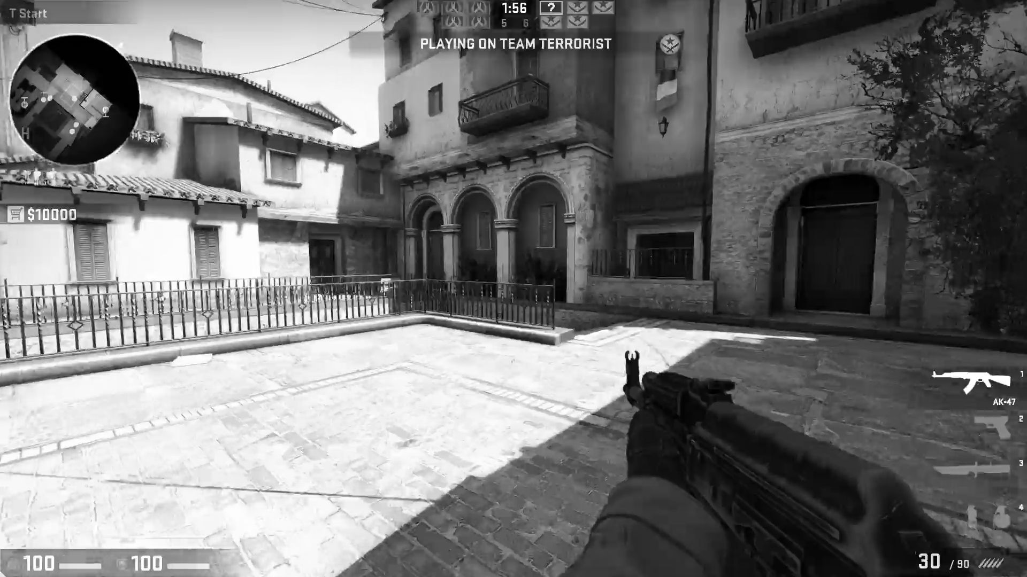

Classic CNN (LeNet-5)
28x28x6
14x14x6
10x10x16
5x5x16
Flatten
FC
FC
$$\hat{y}$$
Conv 5x5
s=1
avg pooling
f=2
s=2
Conv 5x5
s=1
avg pooling
f=2
s=2
32x32x1
400
120
84

Slide 7
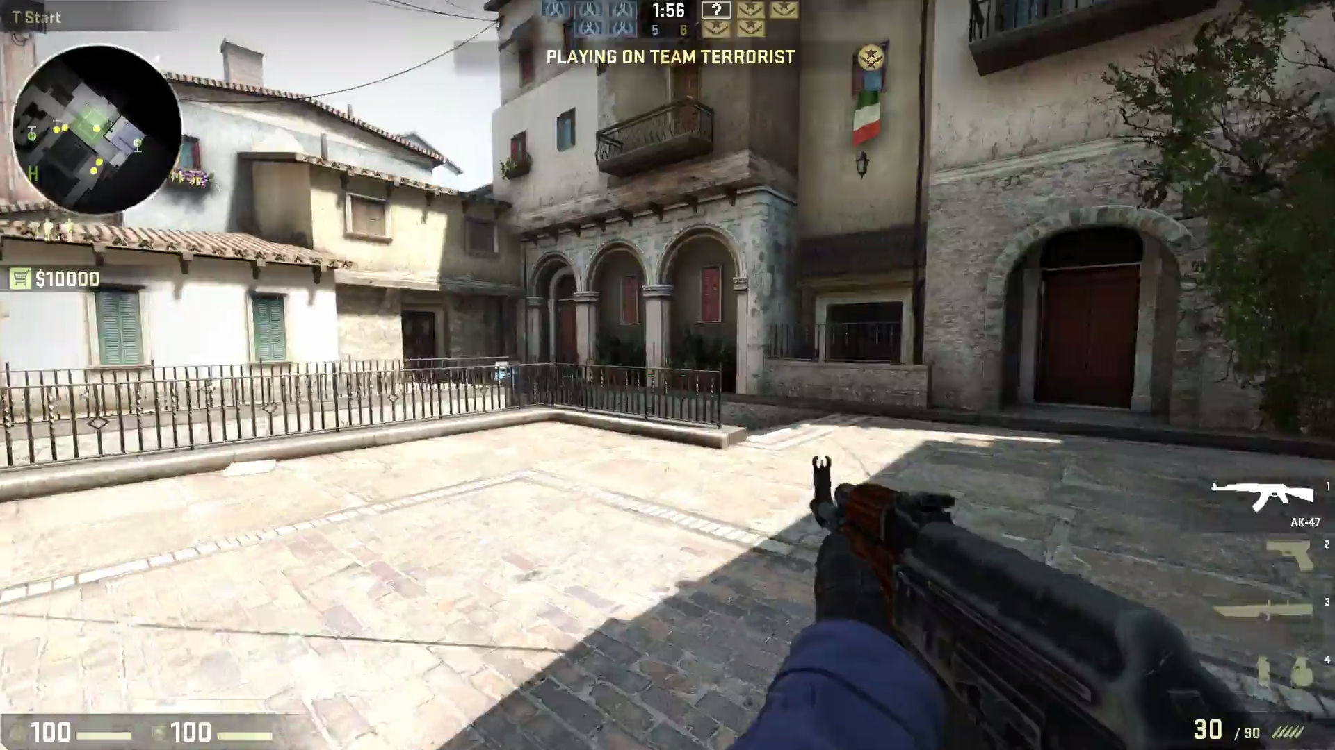

Classic CNN (AlexNet)
55x55x96
27x27x96
27x27x256
13x13x256
13x13x384
max pool
f=3
s=2
max pool
f=3
s=2
Conv
f=3
s=1
Conv 11x11
s=4
Conv 5x5
s=1
Conv
f=3
s=1
227x227x3
13x13x384
13x13x256
6x6x256
Flatten
FC
FC
$$softmax$$
Conv
f=3
s=1
Conv
f=3
s=1
max pool
f=3
s=2
9216
4096
4096

Slide 8
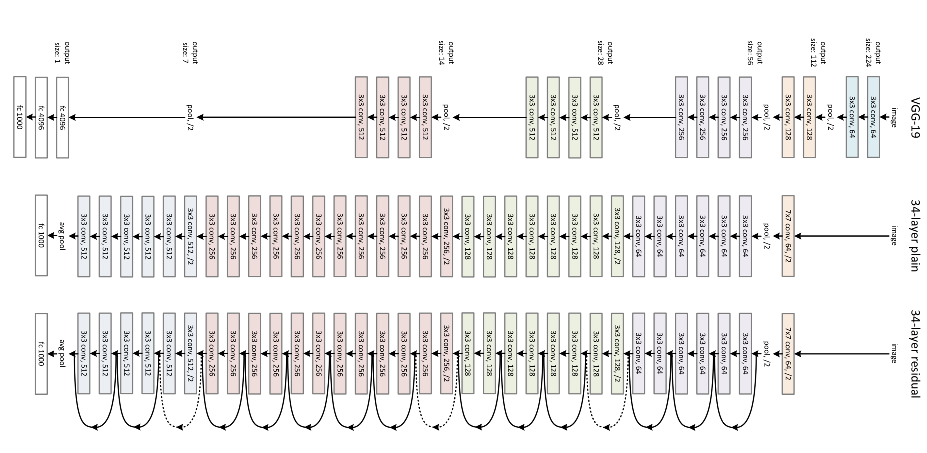
VGG-19
Figure from [3]. Kaiming, et al. Deep residual learning for image recognition

Slide 9
ResNet
Figure from [3]. Kaiming, et al. Deep residual learning for image recognition

Slide 10
Inception
1x1 Conv
Max pool
28x28x192
Max pool
1x1 Conv
1x1 Conv
28x28x sum of filters in each layer
28x28x sum of filters in each layer
Previous Activation
1x1 Conv
3x3 Conv
Channel Concat
3x3 Conv
Channel Concat
1x1 Conv
5x5 Conv
5x5 Conv

Slide 11
Inception
Figure from [5] C. Szegedy, et al. Going deeper with convolutions

Slide 12
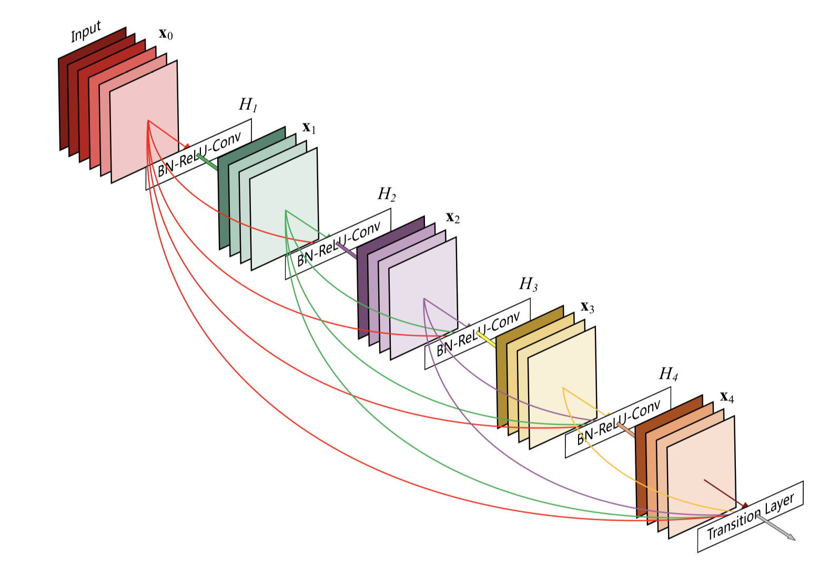
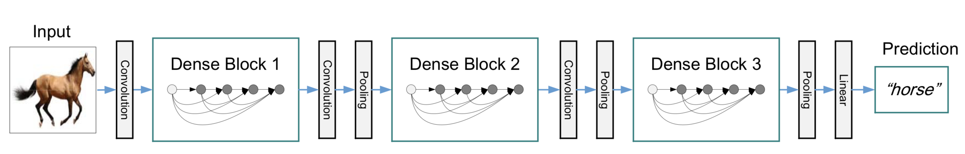
DenseNet
Dense Block
Figure from [5] C. Szegedy, et al. Going deeper with convolutions

Slide 13
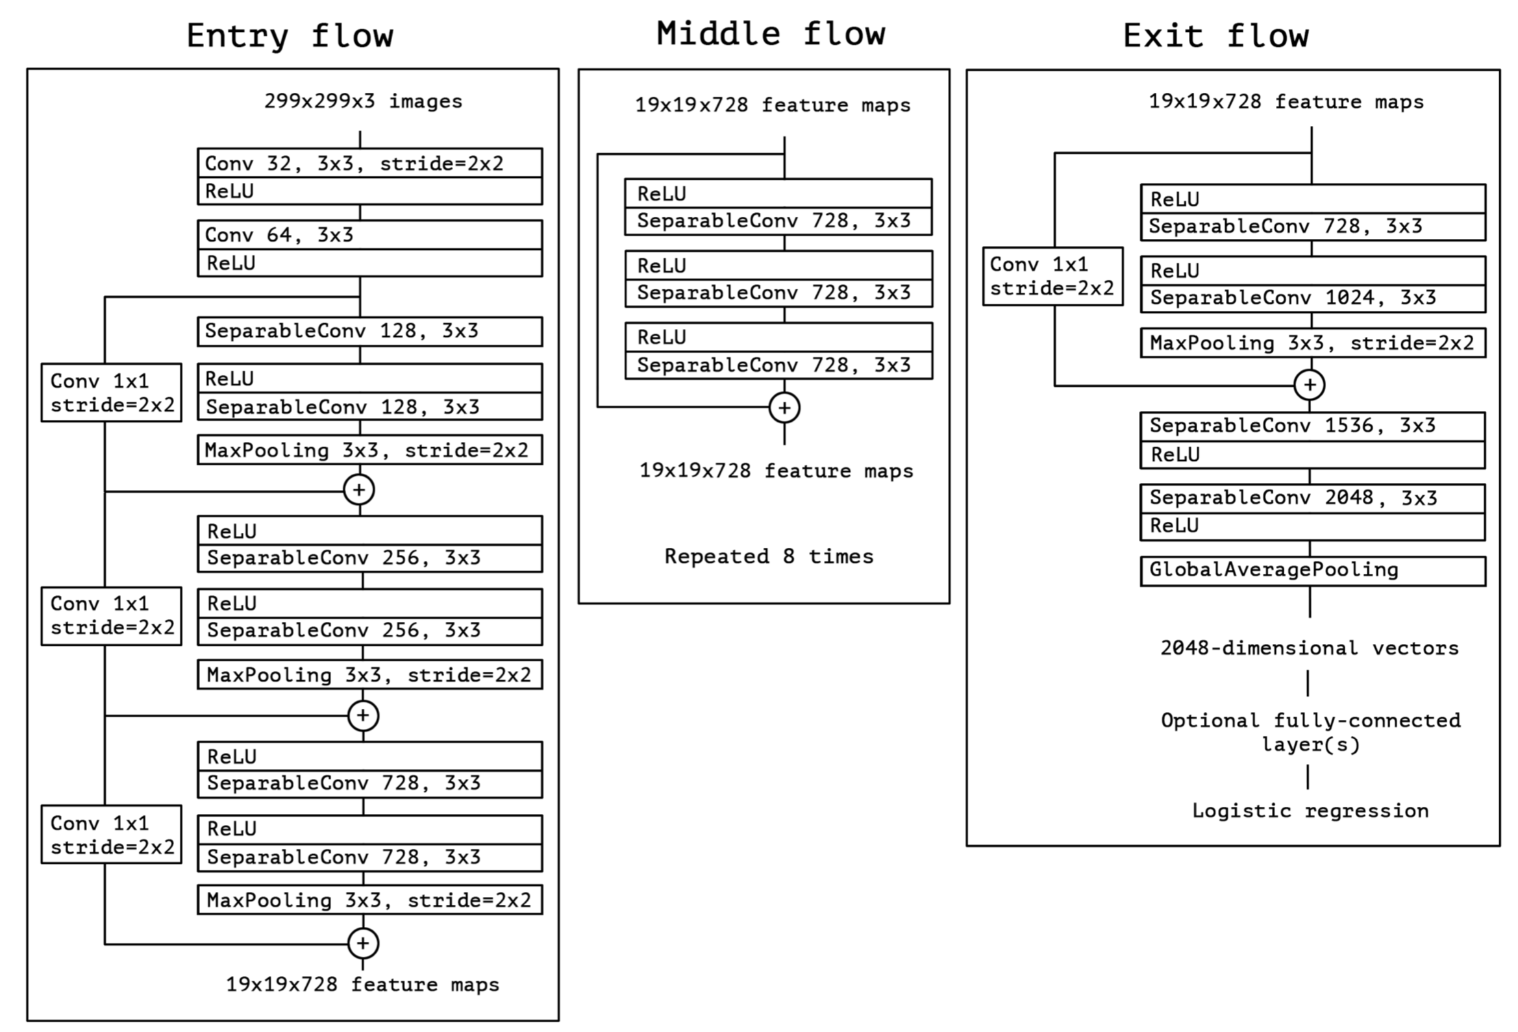
Xception
ensuring high information and gradient flow
using the same number of parameters as Inception
Figure from [6]. F. Chollet Xception: Deep learning with depthwise separable convolutions

Slide 14
Video quality assessment using CNN
On which level should we train the network?
  Video or Frame level?
  How to make it work on the video level?
Video Chunk
3D-Convolution

Slide 15
Video quality assessment using CNN
Using the motion flow together with image data
  Motion flow would be affected significantly by distortion and make the information not so useful
Using image level information
  There exist no quality rating on the frame level for CGI content (specially for gaming content)
  There might be a difference between the perceived quality on the image level and video level

Slide 16
On the frames level quality assessment
No Dataset available for CGI content
  We used VMAF as quality indicator of each frame (similar to DeViQ [7])
  The idea is not to predict the VMAF but to pretrain the network on a reliable metric and retrain some layers based on the subjective results
  How to use the result for the video level?
    Temporal pooling, e.g., average, maximum
    More sophisticated approach, LSTM

Slide 17
Transfer Learning
softmax
Freeze layers
Train the whole network
Figure from [3]. Kaiming, et al. Deep residual learning for image recognition

Slide 18
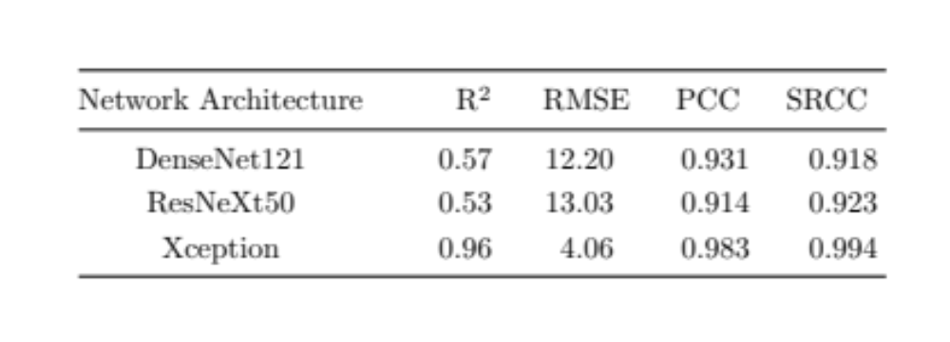
Comparing Existing Architect
We train the last layer of three CNN Architect on a small dataset,
  ResNet, DenseNet, Xception

Slide 19
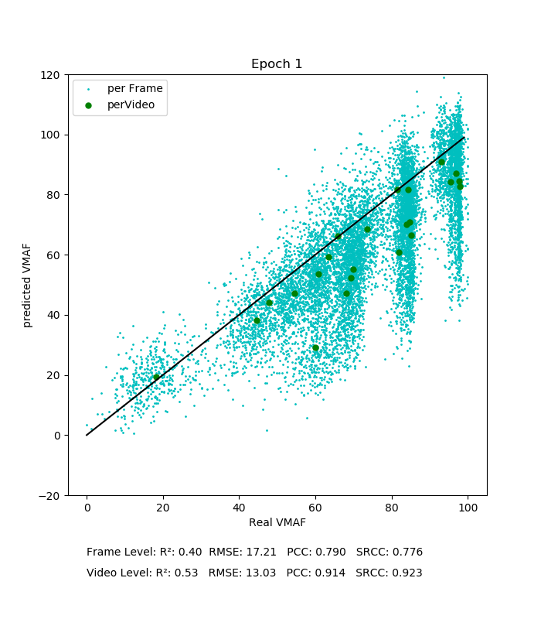
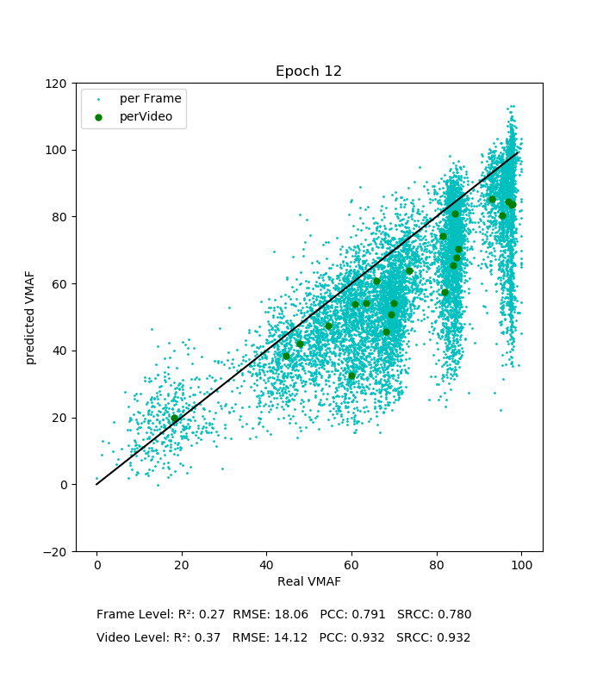
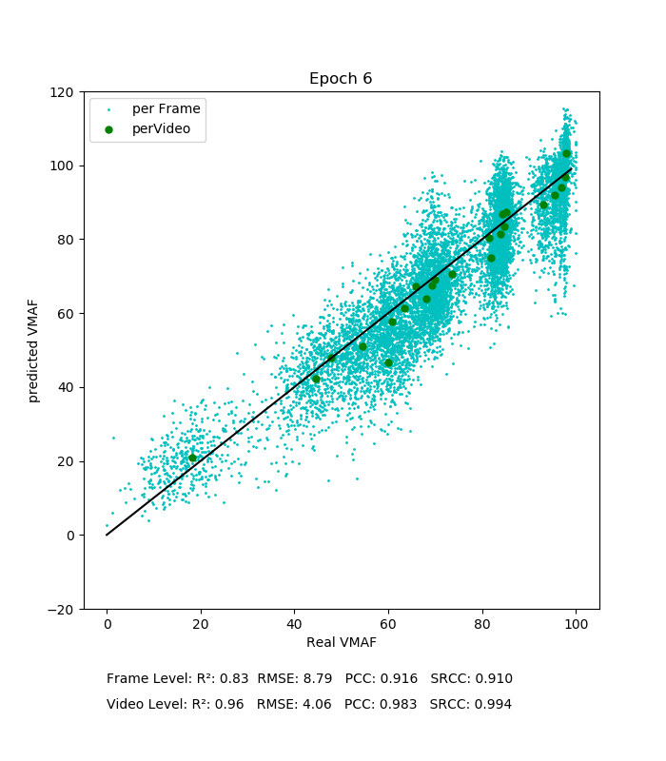
Comparing Existing Architect
We train the last layer of three CNN Architect on a small dataset
ResNet
DenseNet
Xception

Slide 20
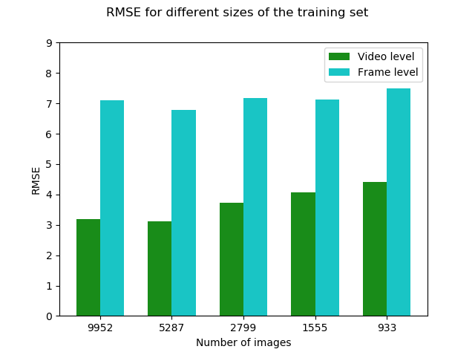
Subset of Frames
Finding a subset of frames that can be used for training of the last few layers of CNN
The result is based on 24 source video sequences encoded under different en-coding parameters (resolution, bit rate) resulting in over 400 (30 seconds) distorted sequences

Slide 21
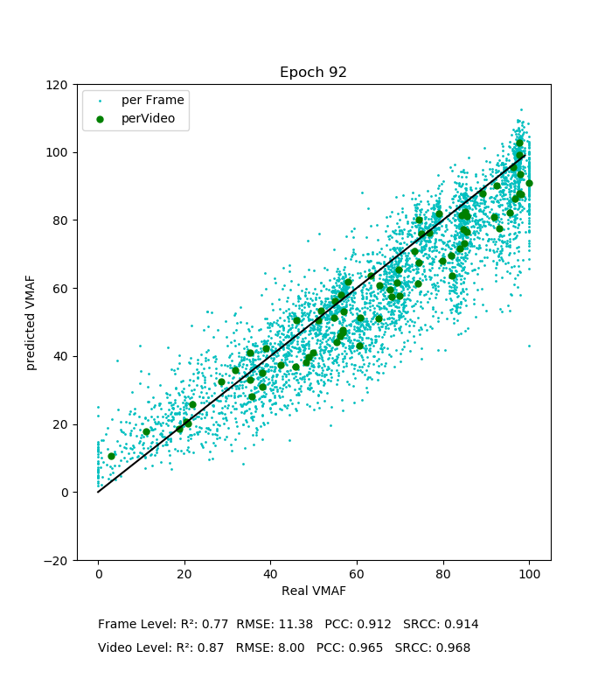
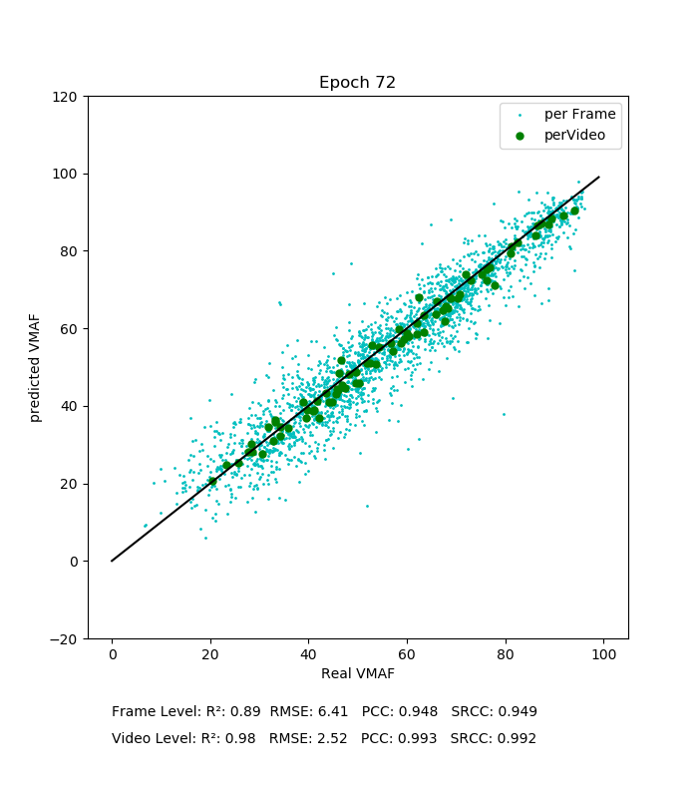
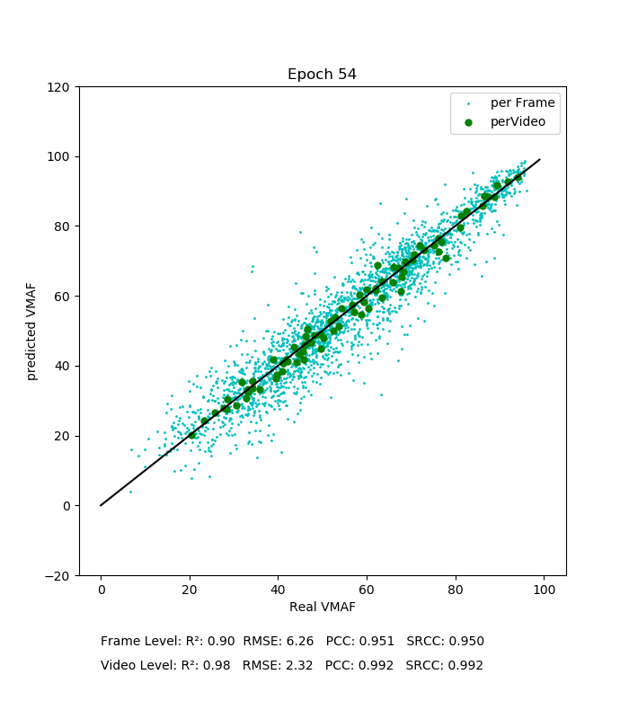
Transfer Learning
Finding a fair number of layers/block that we can use to train Xception with 5k frames

Slide 22
Summary
The plan is to make no-reference quality metric using CNN for gaming content
The main aim is not only to predict quality but also measure the the type of distortion
Gaming content has special characteristic (e.g. similarity of SI and TI within the game) which make it suitable content for machine learning methods
Investigate the reduction of computation cost
  lighter CNN, e.g., MobileNet
  design of new CNN

Slide 23
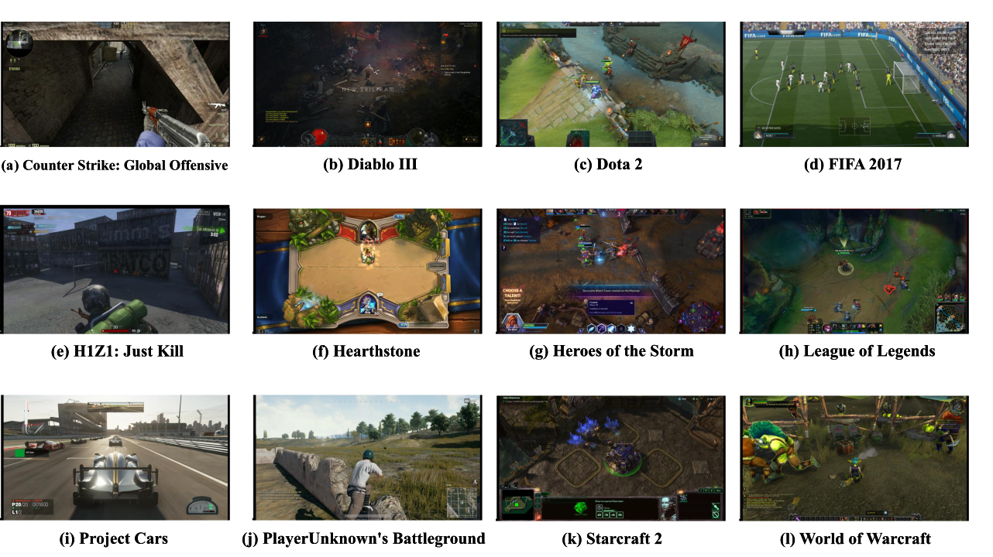
Sample Snapshot of Recorded Sequences
On the use of CNN for quality assessment of Computer Generated Imagery,
VQEG meeting, Deutsche Telekom AG, Berlin, 2019

Slide 24
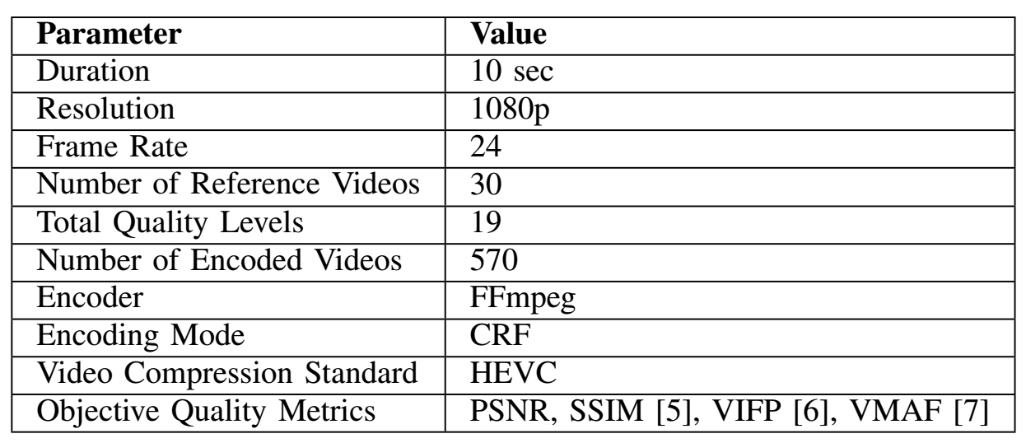
Summary of video encoding parameters
On the use of CNN for quality assessment of Computer Generated Imagery,
VQEG meeting, Deutsche Telekom AG, Berlin, 2019

Slide 25
References
[1]. Krizhevsky, Alex, Ilya Sutskever, and Geoffrey E. Hinton. "Imagenet classification with deep convolutional neural networks." In Advances in neural information processing systems, pp. 1097-1105. 2012.
[2]. Simonyan, Karen, and Andrew Zisserman. "Very deep convolutional networks for large-scale image recognition." arXiv preprint arXiv:1409.1556 (2014).
[3]. He, Kaiming, Xiangyu Zhang, Shaoqing Ren, and Jian Sun. "Deep residual learning for image recognition." In Proceedings of the IEEE conference on computer vision and pattern recognition, pp. 770-778. 2016.
[4]. Huang, Gao, Zhuang Liu, Laurens Van Der Maaten, and Kilian Q. Weinberger. "Densely connected convolutional networks." In Proceedings of the IEEE conference on computer vision and pattern recognition, pp. 4700-4708. 2017.

Slide 26
References
[5]. Szegedy, Christian, Wei Liu, Yangqing Jia, Pierre Sermanet, Scott Reed, Dragomir Anguelov, Dumitru Erhan, Vincent Vanhoucke, and Andrew Rabinovich. "Going deeper with convolutions." In Proceedings of the IEEE conference on computer vision and pattern recognition, pp. 1-9. 2015.
[6].Chollet, François. "Xception: Deep learning with depthwise separable convolutions." In Proceedings of the IEEE conference on computer vision and pattern recognition, pp. 1251-1258. 2017.
[7]. Göring, Steve, Janto Skowronek, and Alexander Raake. "DeViQ–A deep no reference video quality model." Electronic Imaging 2018, no. 14 (2018): 1-6.

Slide 27
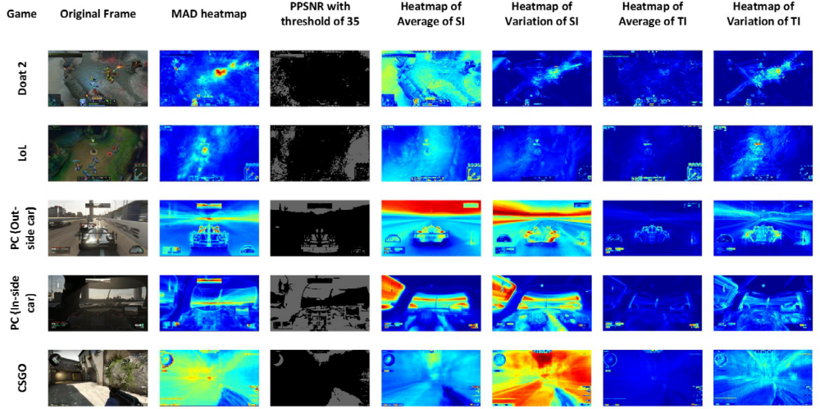
Spatial and temporal features

Slide 28
Thank you for your Attention!!
Any Question?
On the use of CNN for quality assessment of CGI
Saman Zadtootaghaj, Markus Utke
saman.zadtootaghaj@qu.tu-berlin.de
Visit www.qu.tu-berlin.de for more information.
Special thanks to Prof. Andrew NG

