Slide 1
Towards the Impact of Spatial and Temporal Video Quality on Gaming Quality of Experience
Steven Schmidt
Quality and Usability Lab – Berlin Institute of Technology
VQEG Meeting - Berlin, Germany, 2019

Slide 2

MOTIVATION

Slide 3
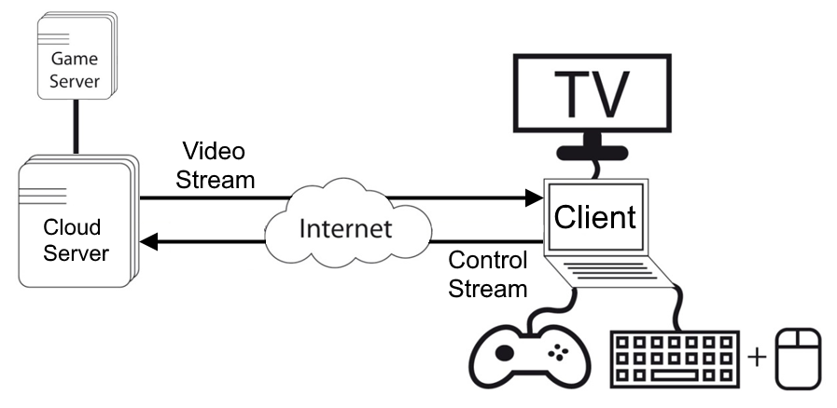
What is Cloud Gaming?
Notes:
- What is Cloud Gaming?
- Optional: Game Server (additonal online gaming component)
- Challenges: Bandwidth limitations and de/encoding delay for video stream, network delay for control stream

Slide 4
What are we working on?
Guidelines on how to ensure acceptance of cloud gaming services
  Network provider: network planning / infrastructure
  Service provider: resource distribution
Understanding how to assess gaming QoE and its underlying multidimensional space
Investigating relevant influencing factors on gaming QoE
Predicting gaming QoE
Notes:
- What is Cloud Gaming?
- Optional: Game Server (additonal online gaming component)
- Challenges: Bandwidth limitations and de/encoding delay for video stream, network delay for control stream

Slide 5
What is Gaming Quality of Experience?
User
System
Context
Influencing
factors
Experience
Playing style
Intrinsic motivat.
Static factors
Dynamic factors
Game genre
Game structure
Game rules
Server
Channel
Player & device
Physic. & social
environment
Extrinsic motivat.
Service factors
Hedonic Pragmatic
Aesthetics
Novelty
Output quality
Interactive
behavior
Input
quality
Learnability
Intuitivity
Appeal
Interaction quality
Playing quality
Quality features
Tension
Challenge
Competence
Quality of Experience (QoE)
Positive
affect
Negative
affect
Immersion
Flow
Player experience
Acceptability
[1]

Slide 6

Standardization Activities
[2]
Creation of 3 work items in ITU-T SG-12
ITU-T Rec. G.1032 (10/2017) – G.QoE-gaming:
  Influence factors on gaming quality of experience
ITU-T Rec. P.809 (05/2018) – P.GAME:
  Subjective evaluation methods for gaming quality
Future ITU-T Rec. G.OMG (studied in Q.13/12):
  Opinion model for gaming applications
[3]
[4]
[5]

Slide 7
Challenges to build G.OMG
Encoding (bitrate, resolution, framerate) and Network parameters (delay, packetloss)
Variety of devices: display sizes, input devices, resolution and refresh rates, etc.
Long stimulus duration for aspects such as immersion (5-10 min)
Many quality aspects to assess (see taxonomy)
User factors: casual and pro gamer – who is the target group
Environment: controlled lab vs. crowdsourcing vs. mobile network
Strong impact of game content on gaming QoE

Slide 8
Study Design without simplification
Intro
Stimulus
Rating
Post
15-20 min
10 min
10 min
10 min
~30 hours
per participant
per game
27000 hours for 30 games and 30 participants
5 bitrates x 3 resolutions x 4 frame rates
3 GoP x 5 frame loss rates
5 delays + 5 input packet losses
85 conditions

Slide 9
Study Design with some simplification
Intro
Stimulus
Rating
Post
1.5 min
15-20 min
10 min
10 min
10 min
Low impact of engagement related concepts on overall gaming QoE in lab
Comparison of passive and interactive tests with different stimulus durations
10 sec too short for representative scene in game and differences between paradigms

Slide 10
Study Design with some simplification
Intro
Stimulus
Rating
Post
15 min
1.5 min
3 min
10 min
In-game Game Experience Questionnaires covers Player Experience with 14 items
Developed a questionnaire to assess Input Quality (Controllability, Responsiveness, Immediate Feedback) with 8 items
Concepts such as learnability and appeal as post-game questionnaire

Slide 11
Study Design with some simplification
Intro
Stimulus
Rating
Post
15 min
1.5 min
3 min
10 min
~5-6 hours
per participant
per game
~1550 hours for 9 games and 30 participants
Do we need to assess them all in interactive tests?
5 bitrates x 3 resolutions x 4 framerates
3 GoP x 5 frame loss rates
5 delays + 5 input packet losses
70 conditions

Slide 12
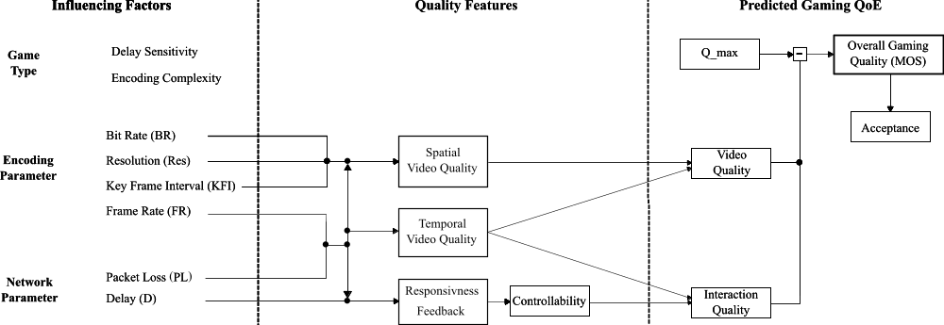
Future ITU-T Rec. G.OMG
?
?
[5]
Input Quality
(8-item Questionnaire)
[5]

Slide 13
METHOD

Slide 14
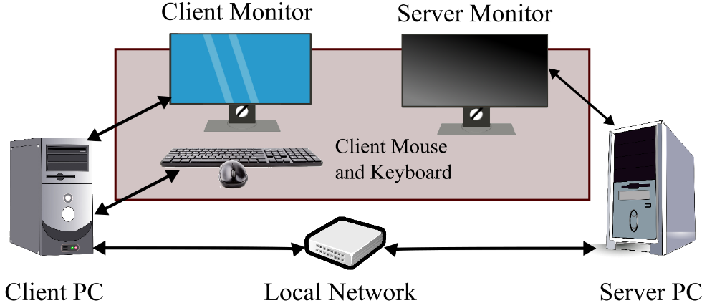
Subjective Test
  Study 1 (N=27)
    Mixture of different bitrate-resolution pairs for one game
  Study 2 (N=12 - ongoing)
    Participants select 1 of 6 games and rate a mixture of previously mentioned parameters
Setup for interactive subjective tests.

Slide 15
Conditions used to model Interaction Quality
  480p: 1, 2, 4 mbps
  720p: 1, 2, 50 mbps
  1080p: 2, 4, 50 mbps
  1080p: 2, 4, 6, 50 mbps
  Frame Rate: 60, 30, 20, 10 fps
  Frame Loss Rate:
  0, 10, 15, 25, 30 %
  Delay: 0, 25, 50, 100, 200, 400 ms
for one game in detail
Spatial Video Quality
(blockiness: fragmentation, unclearness)
for six other games
Temporal Video Quality
(jerkiness: discontinuity)

Slide 16
Assessed Quality Aspects
  Overall Quality
  Video Quality (overall and dimensions by Schiffner)
    Fragmentation, Discontinuity, Noisiness, Unclearness, Suboptimal Luminosity
  Audio Quality
  Input Quality: Responsiveness, Controllability, Immediate Feedback
  Player Experience: iGEQ (Immersion, Flow, Tension, Challenge, Competency, positive and negative Affect)
  Performance and Acceptance
    31 items (~3 minutes)
[7]

Slide 17
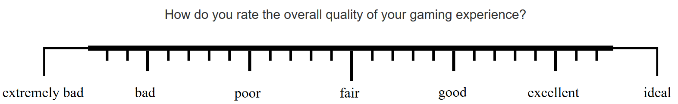
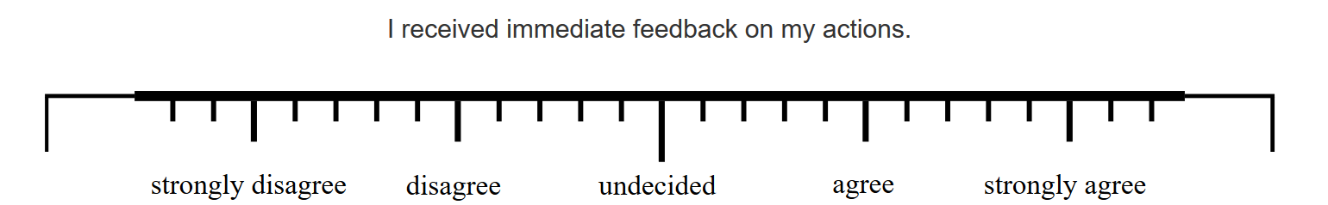
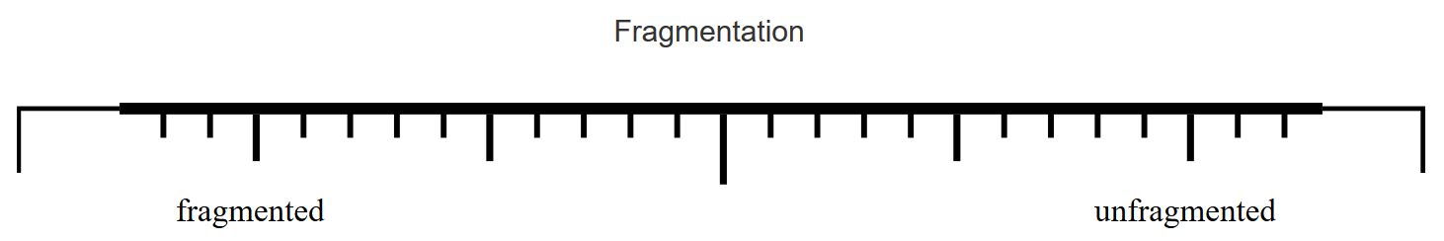
Scale used: 7-point continuous scale
[4]

Slide 18
Results

Slide 19
Study 1
Game: Counter Strike
Aim to trigger spatial video quality aspects
IV: Bitrate and Resolution

Slide 20
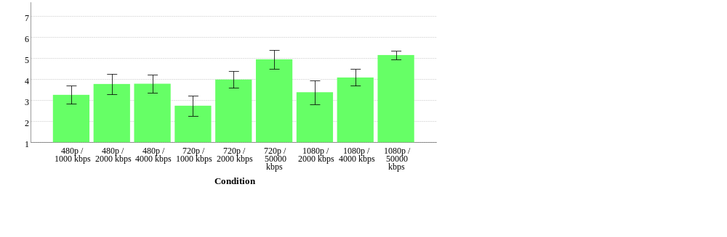
Overall Gaming QoE

Slide 21
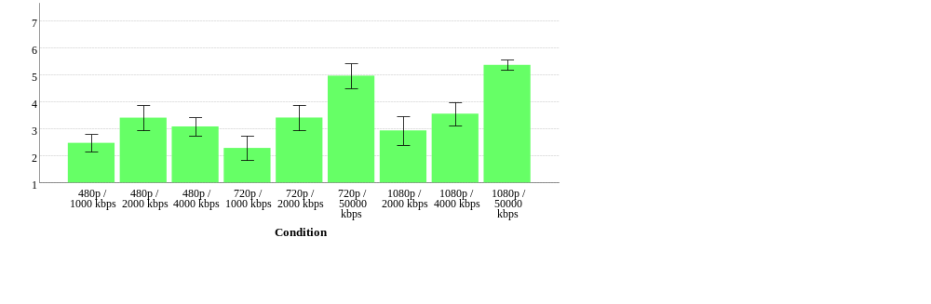
Overall Video Quality

Slide 22
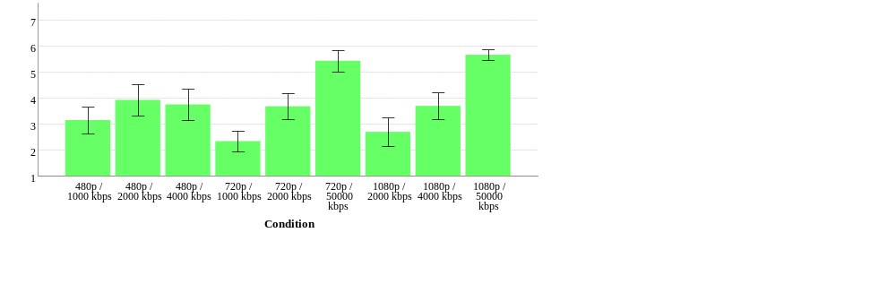
Fragmentation – spatial video quality

Slide 23
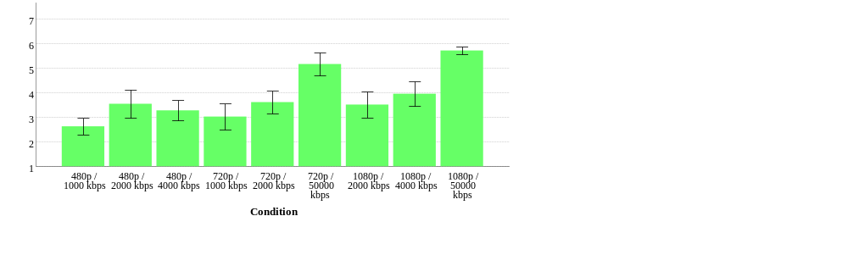
Unclearness – spatial video quality

Slide 24
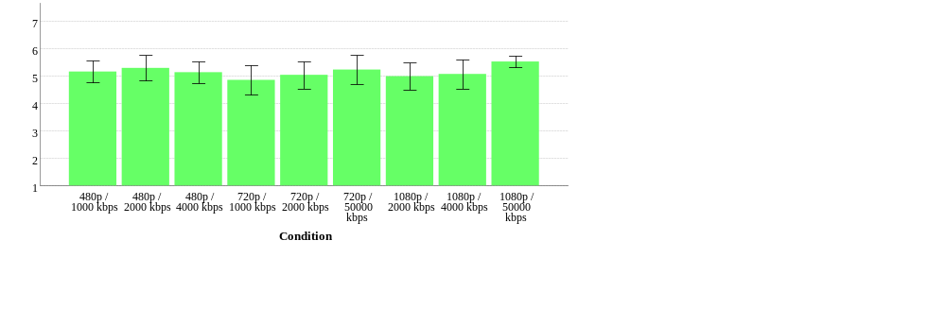
Discontinuity – temporal video quality

Slide 25
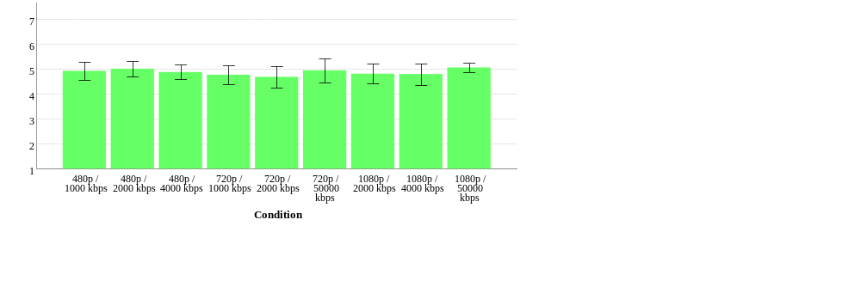
Responsiveness – Input Quality

Slide 26
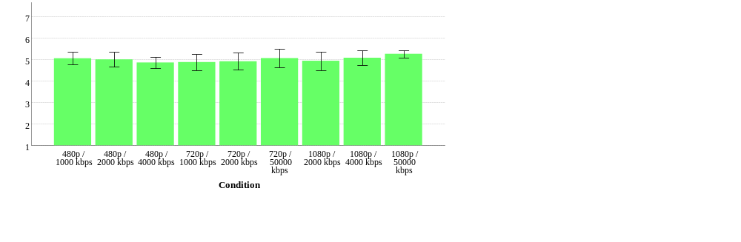
Immediate Feedback – Input Quality

Slide 27
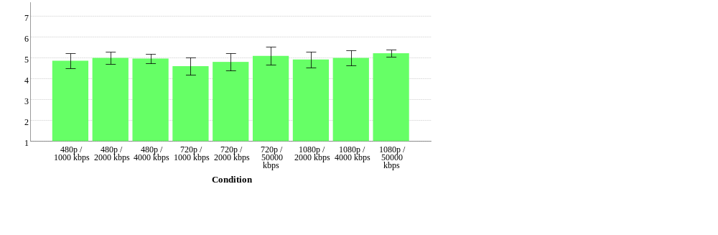
Controllability – Input Quality

Slide 28
Study 2
Six different games
Aim to trigger spatial video quality aspects
IV: Bitrate at 1080p/60fps

Slide 29
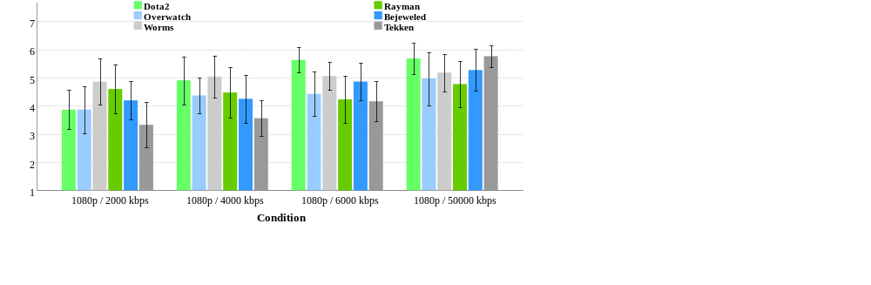
Overall Gaming QoE

Slide 30
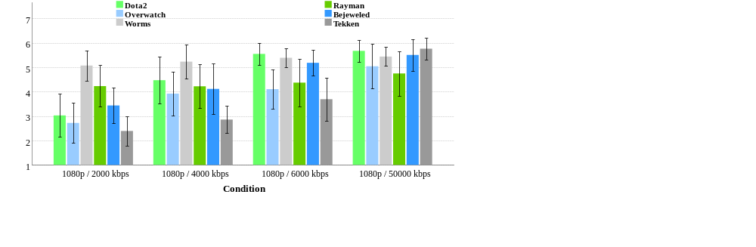
Overall Video Quality

Slide 31
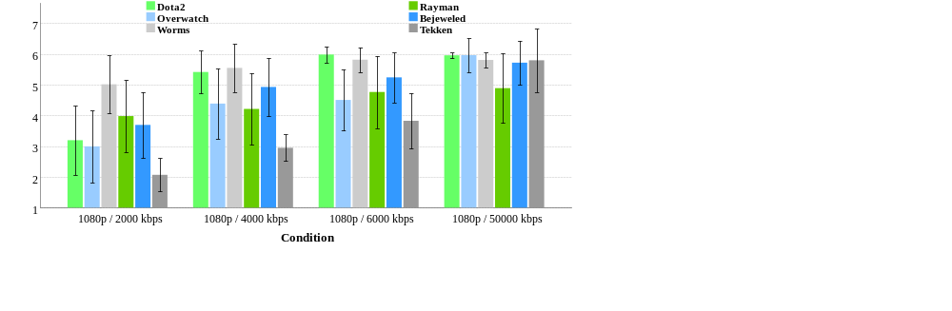
Fragmentation – spatial video quality

Slide 32
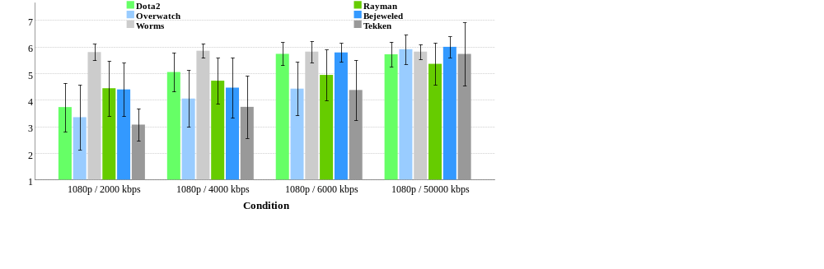
Unclearness – spatial video quality

Slide 33
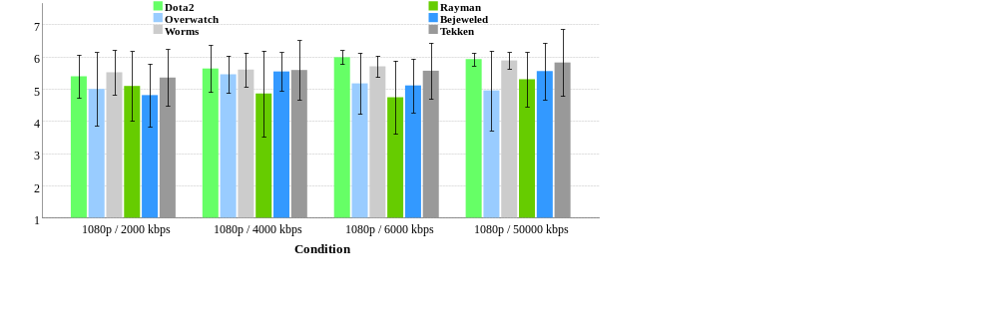
Discontinuity – temporal video quality

Slide 34
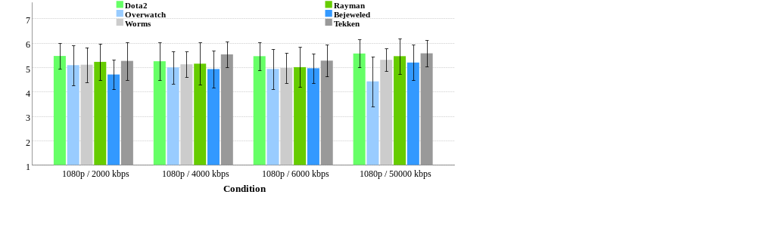
Responsiveness (Input Quality)

Slide 35

Immerdiate Feedback (Input Quality)

Slide 36
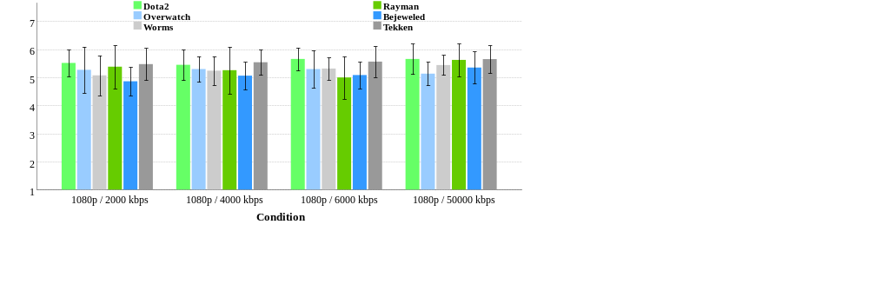
Controllability (Input Quality)

Slide 37
Study 1+2
Nine different games
Aim to trigger temporal video quality aspects
IV: frame rate

Slide 38
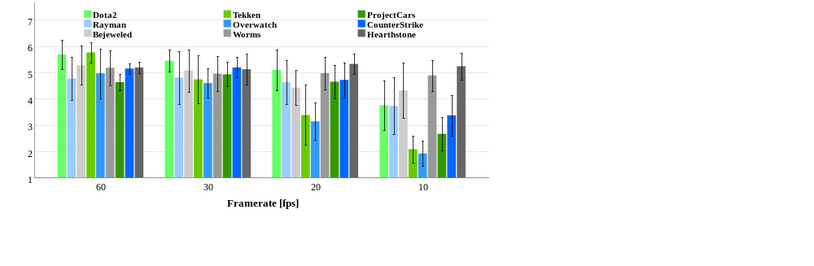
Overall Gaming QoE

Slide 39
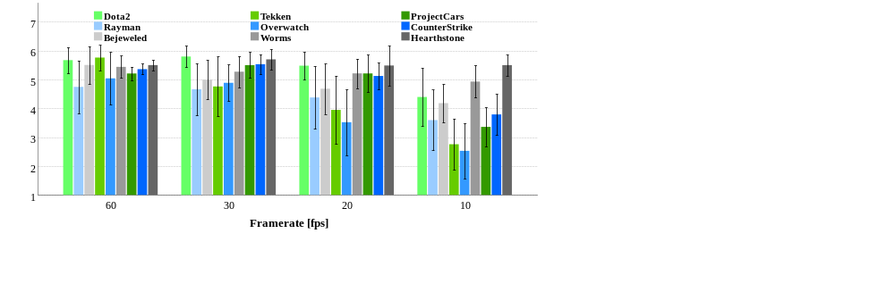
Overall Video Quality

Slide 40
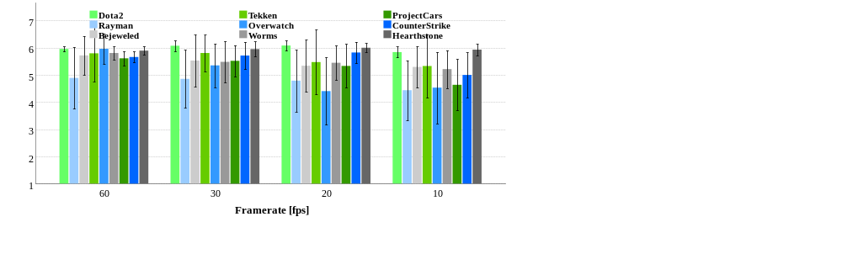
Fragmentation – spatial video quality

Slide 41
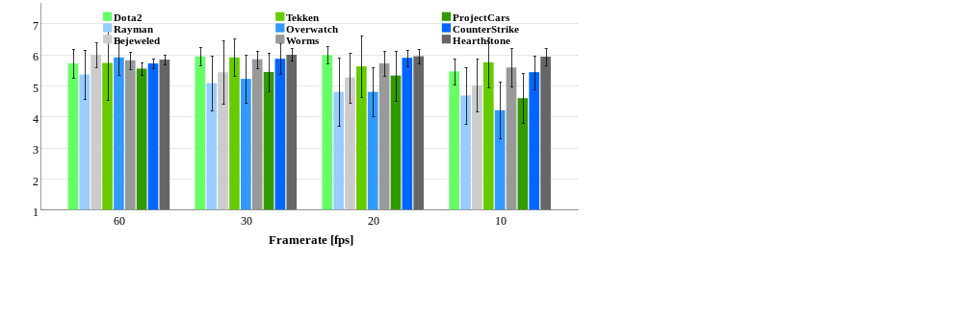
Unclearness – spatial video quality

Slide 42
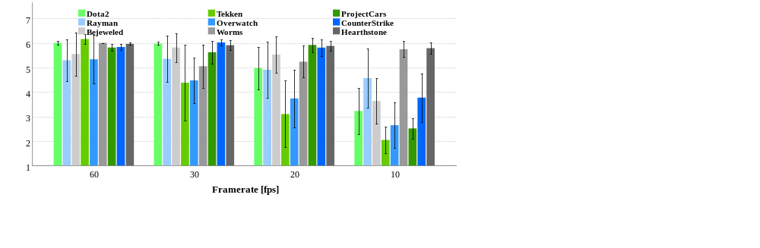
Discontinuity – temporal video quality

Slide 43
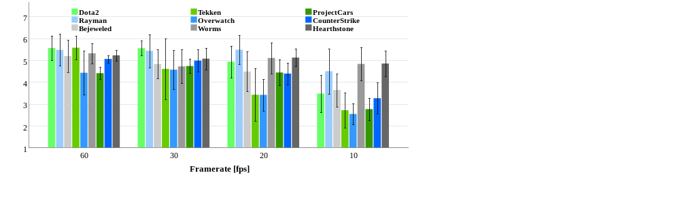
Responsiveness – Input Quality

Slide 44
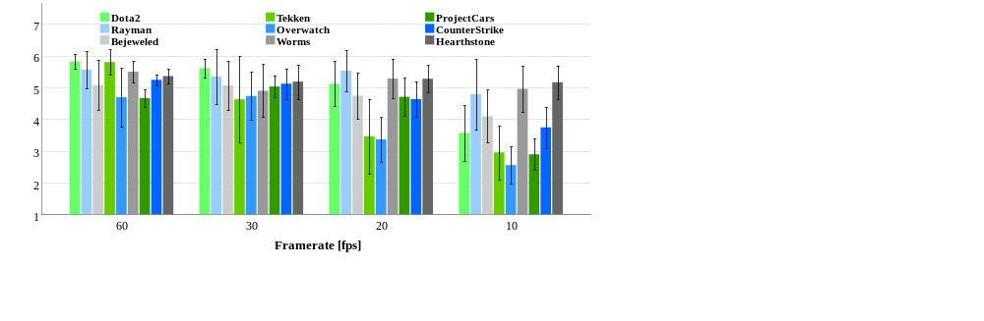
Immediate Feedback – Input Quality

Slide 45
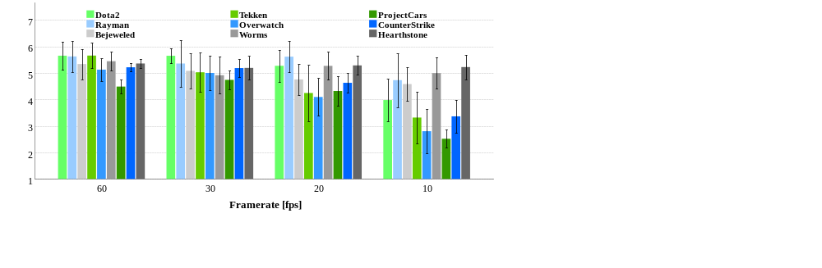
Controllability – Input Quality

Slide 46
Conclusion

Slide 47
Impact of Temporal Video Quality
  Main effect of framerate on overall quality, and temporal video quality (discontinuity)
  Main effect of framerate on Input Quality (responsiveness, controllability, immediate feedback)
Impact of Spatial Video Quality
  Main effect of bitrate and resolution on overall quality, and spatial video quality (fragmentation, unclearness)
  No main effect of bitrate and resolution on Input Quality (responsiveness, controllability, immediate feedback)

Slide 48
Final Study Design
Intro
Stimulus
Rating
Post
15 min
1.5 min
3 min
10 min
1 reference
+ 3 framerates
+ 5 frame loss rates
+ 5 delays
+ 3 bitrates (comparison)
100 minutes
per participant
per game
450 hours for 9 games and 30 participants
17 conditions

Slide 49

Thank you for your Attention!
Towards the Impact of Spatial and Temporal
Video Quality on Gaming Quality of Experience
Steven Schmidt
We are always searching for collaborations ☺
Visit
www.qu.tu-berlin.de
for more information.
Notes:
You may have ask yourself why I even talked about our community and network so much
Quite simply put: It is not large enough … and we would love to connect to other people, researchers or industry

Slide 50
References
[1] S. Möller, S. Schmidt, and J. Beyer, “Gaming taxonomy: An overview of concepts and evaluation methods for computer gaming qoe,” in Quality of Multimedia Experience (QoMEX), 2013 Fifth International Workshop on, 2013.
[2] S. Möller, S. Schmidt, and S. Zadtootaghaj, “New ITU-T Standards for Gaming QoE Evaluation and Management,” in Quality of Multimedia Experience (QoMEX), 2018 Tenth International Workshop on, 2018.
[3] International Telecommunication Union, Study Group 12 (Source: Deutsche Telekom AG), “G.1032: G.1032 : Influence factors on gaming quality of experience” , Geneva, 2017.
[4] International Telecommunication Union, Study Group 12 (Source: Deutsche Telekom AG), “P.809 : Subjective evaluation methods for gaming quality” , Geneva, 2018.
[5] International Telecommunication Union, Study Group 12 (Source: Deutsche Telekom AG), “ITU-T Contribution SG12-C293: Data Assessment for an Opinion Model Predicting Gaming QoE (G.OMG)”, Geneva, 2018.
[6] S. Schmidt, and S. Zadtootaghaj, S. Möller, “A Comparison of Interactive and Passive Quality Assessment for Gaming Research,” in Quality of Multimedia Experience (QoMEX), 2018 Tenth International Workshop on, 2018.
[7] F. Schiffner and S. Möller, “Direct Scaling & Quality Prediction for perceptual Video Quality Dimensions,” in 2018 Tenth International Conference on Quality of Multimedia Experience (QoMEX), 2018, pp. 1–3.

