Slide 1
No-Reference Metrics for Camera Capture: What Should the Scatter Plot Look Like?
Margaret H Pinson
NTIA/ITS
mpinson@ntia.doc.gov

Slide 2
Questions
Do we trust machine learning?
What does a good NR metric look like? How accurate is good enough?
What constraints can we accept?
  Sub-categories of an application
  Extra specifications & data

Slide 3
Application
Goals
Modern cameras
Carrier-grade network performance
  High throughput
  Very low latency
  Low bit-error rate
Understand quality vs bit-rate
Ignore quality changes over time
Performance degrades gracefully
Video quality & image quality
Definition of “quality” = naïve user
Root cause analysis
  Explain why quality dropped
  MOS splits into multiple factors
  Comprehensible

Slide 4
Datasets with Unrepeated Scenes
Its4s
  813 videos, 4 seconds each
  720p 24fps adaptive streaming
  Professional video production
  2.4 to 0.5 Mbps
Its4s2
  1473 images from Flickr
  Some from VQEG VIME
CCRIQ
  392 images
  23 cameras: phone, tablet, compact, DSLR
  16 scene compositions
CCRIQ2 & VIME1
  Thanks to AGH
  92 images extra from CCRIQ
  102 images from VIME in Glasgow
LIVE Public-Domain Subjective in the Wild Image Quality Challenge Database
  1162 images
  500 × 500 pixels
  Phones & tablets

Slide 5
NR Metrics for IQA with Machine Learning
BRISQUE
  Reported performance: 0.94 Pearson correlation
NIQE
  Reported performance: 0.91 Pearson correlation
OG-IQA
  Reported performance: 0.95 Pearson correlation
  Features: gradient magnitude (GM), relative gradient orientation (RO),
  relative gradient magnitude (RM)
  Scales 1 and 2
These metrics were NOT intended for the camera capture application

Slide 6
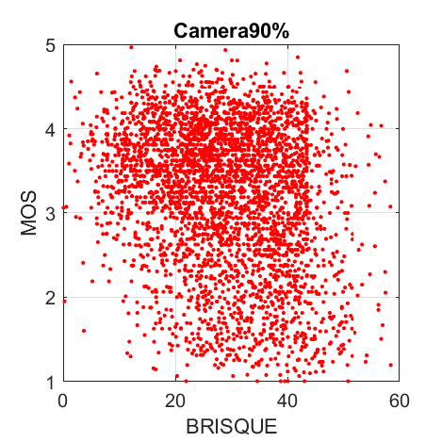
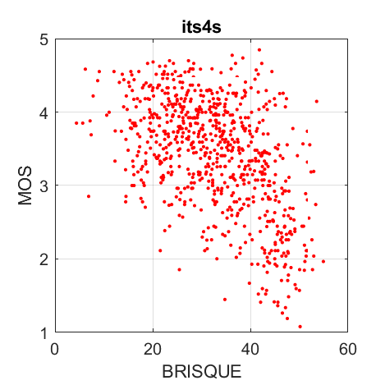
BRISQUE on Unseen Data
-0.23 Pearson Correlation
-0.50 Pearson Correlation

Slide 7
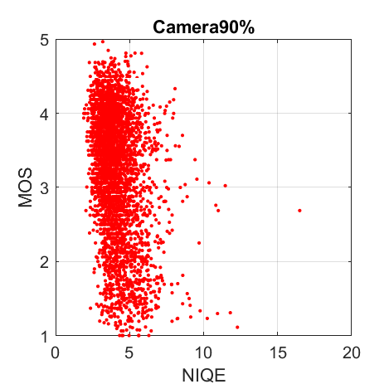
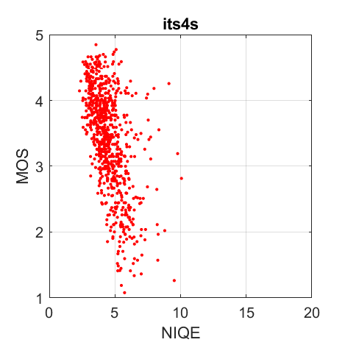
NIQE on Unseen Data
-0.32 Pearson Correlation
-0.54 Pearson Correlation

Slide 8
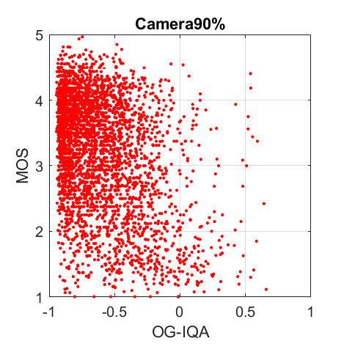
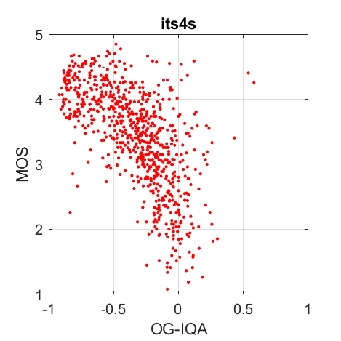
OG-IQA on Unseen Data
-0.39 Pearson Correlation
-0.63 Pearson Correlation

Slide 9
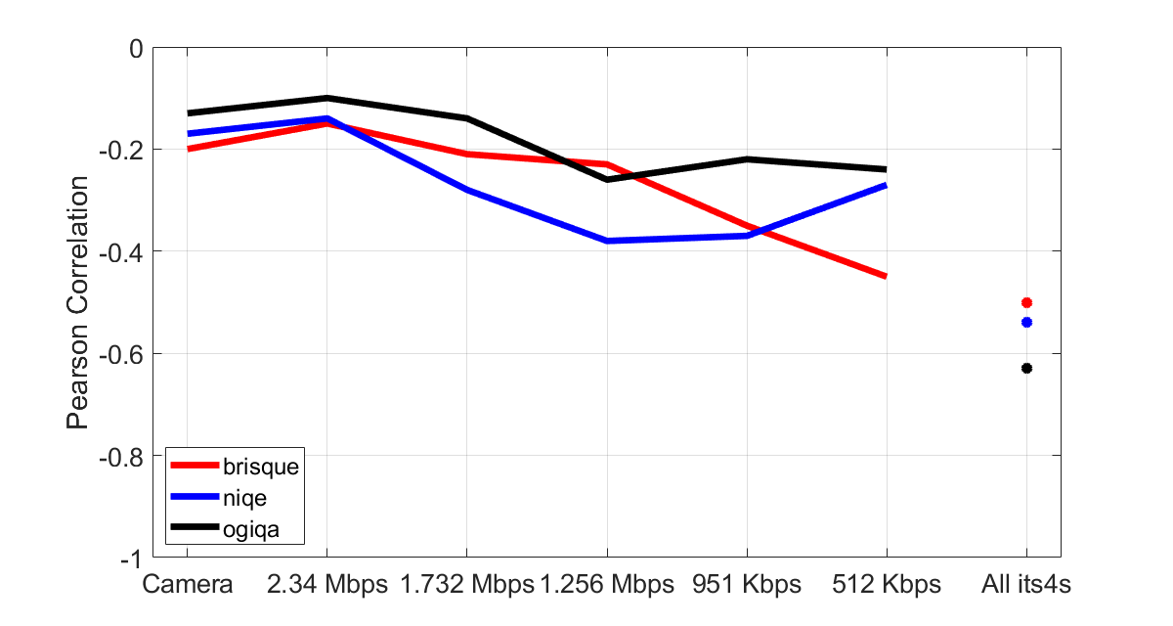
BRISQUE, NIQE, OG-IQA

Slide 10
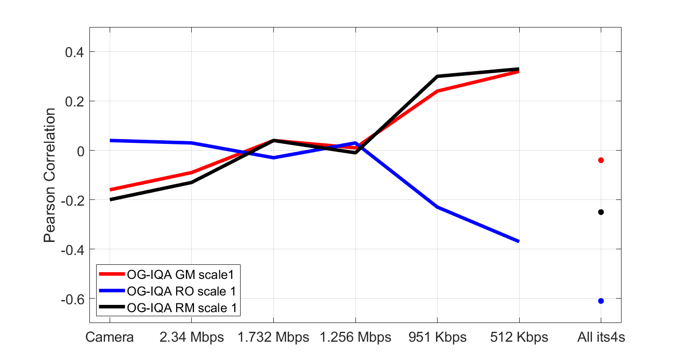
OG-IQA Features

Slide 11
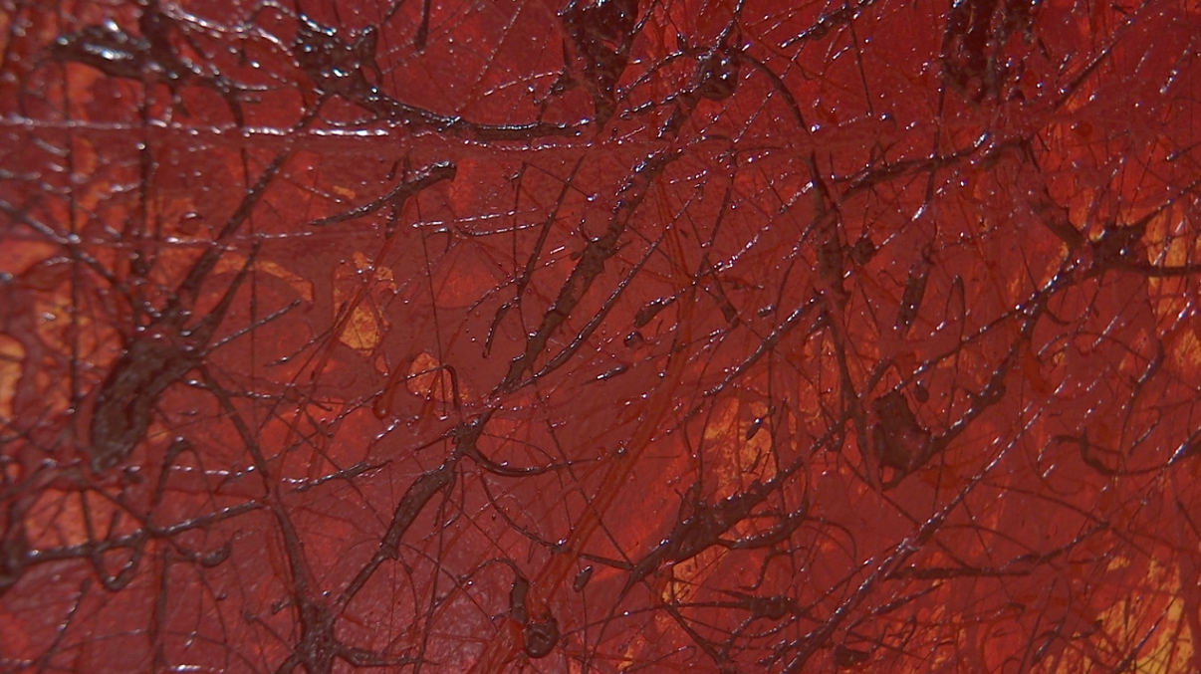
ITS NR Feature for Aesthetic Appeal
Munsell red
  Fraction of “red” pixels
Aesthetics, composition, photography, linguistics, color theory, …

Slide 12
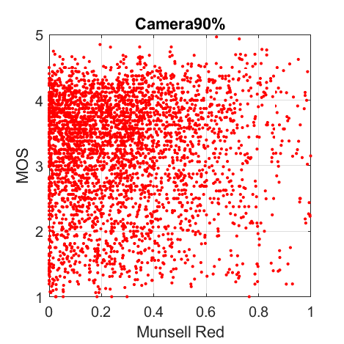
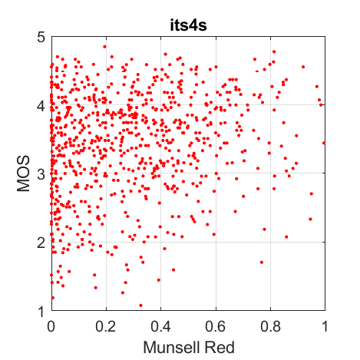
Munsell Red
-0.00 Pearson Correlation
-0.16 Pearson Correlation

Slide 13
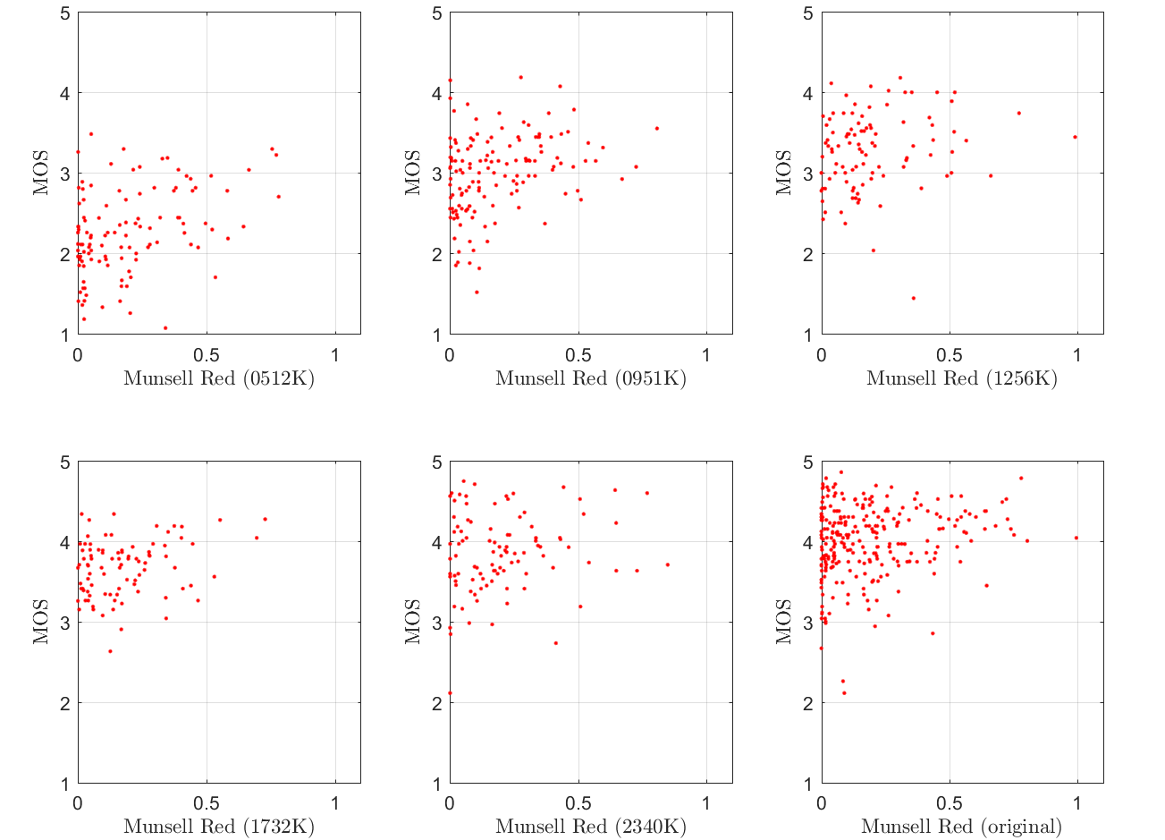
Yes for Professionals — No for Amateurs?
HRC | Correlation
Camera | 0.18
2.34 Mbps | 0.15
1.732 Mbps | 0.28
1.256 Mbps | 0.20
951 Kbps | 0.32
512 Kbps | 0.39

Slide 14
ITS NR Features
Automatic contrast range
  1% to 99% of luma
Spatial Information (SI) of large objects
  Large objects with sharp edges
  2% of image’s vertical size
  SI energy in top 5% of image
Wiener filter 3×3
  Quality improvement from noise
  Energy of difference, Wiener filtered vs not

Slide 15
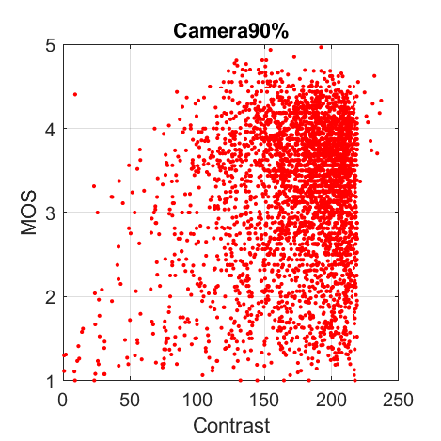
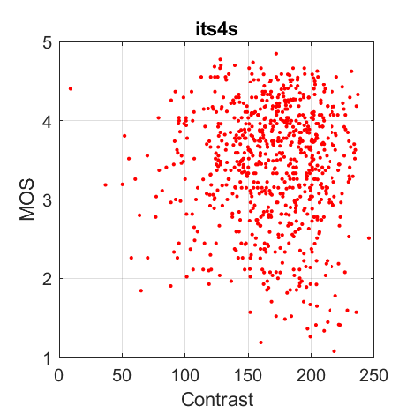
Automatic Contrast Range
No for Professionals — Yes for Amateurs?
0.19 Pearson Correlation
-0.02 Pearson Correlation

Slide 16
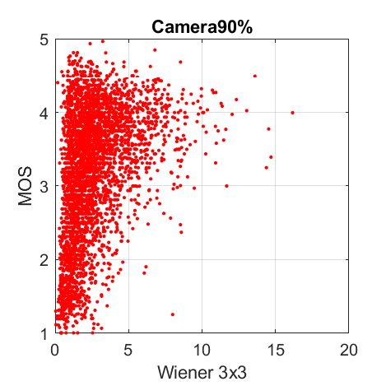
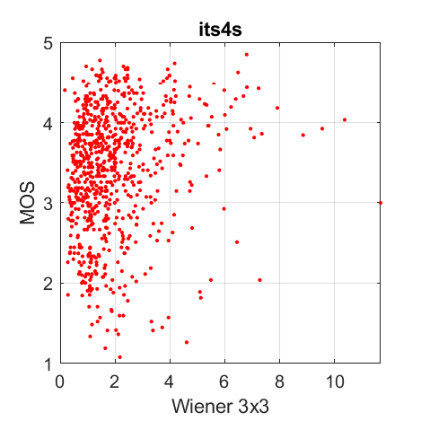
Wiener 3x3
0.38 Pearson Correlation
0.17 Pearson Correlation

Slide 17
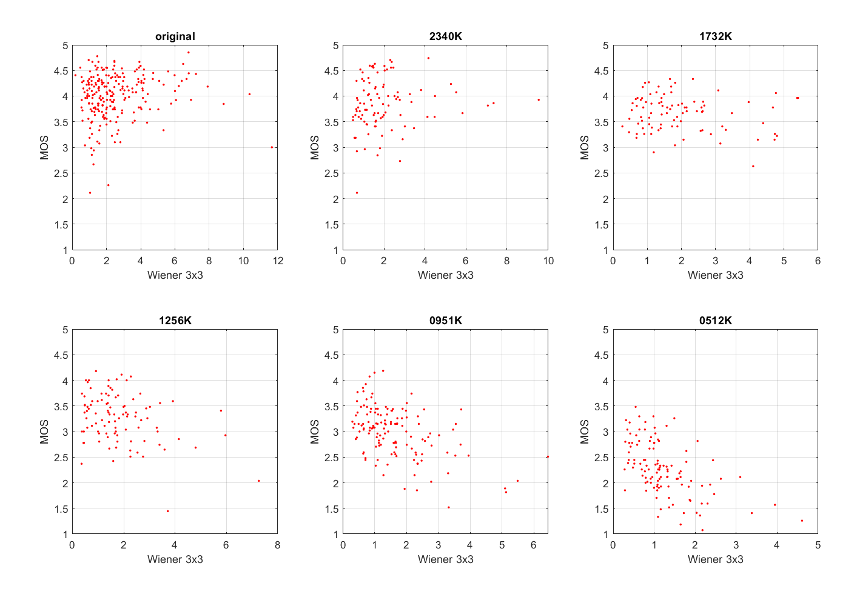
Wiener 3x3 — Meaning Changes Across Bit-rate Range
0.38 Pearson Correlation
0.17 Pearson Correlation

Slide 18
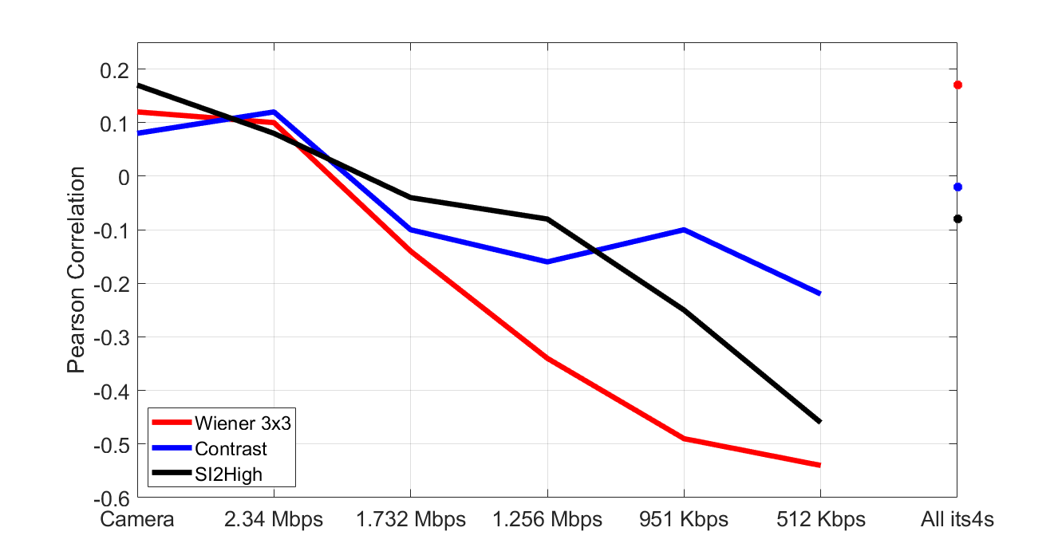
Different Behavior: Camera Capture vs HRC
Requires Relative Bit-rate

Slide 19
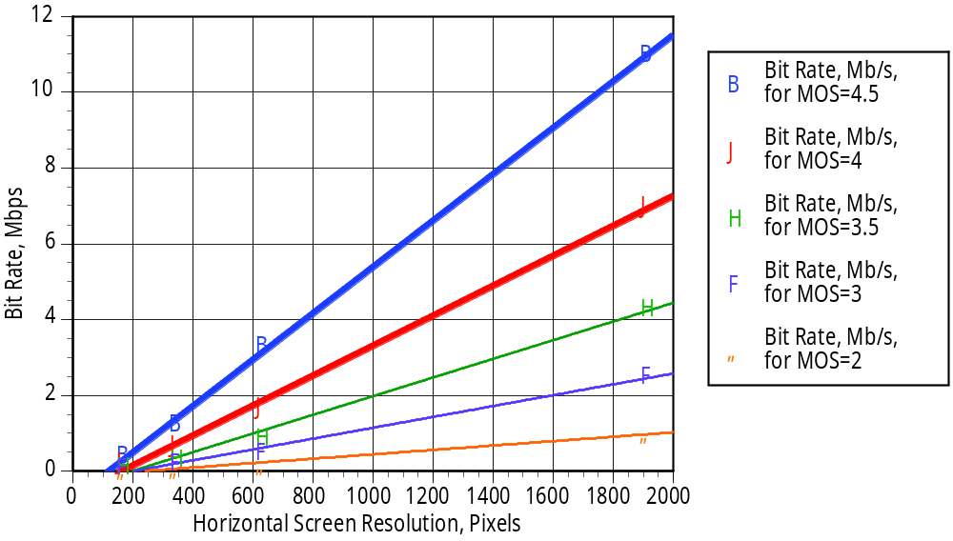
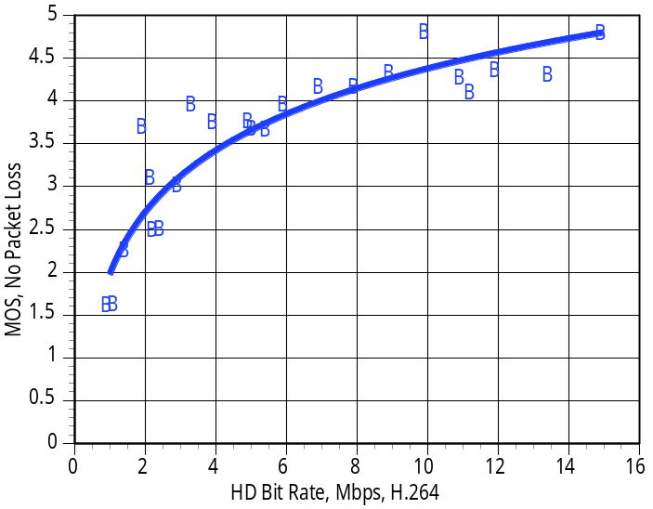
“The fitted curves all have the same general shape that demonstrates diminishing returns from increasing the transmission bit rate to the right of the knee.”
"The Relationship Among Video Quality, Screen Resolution, and Bit Rate"
  Gregory W. Cermak; Margaret H. Pinson; Stephen Wolf

Slide 20
Thank you
Questions
Conclusions
Do we trust machine learning?
What does a good NR metric look like? How accurate is good enough?
What constraints can we accept?
  Sub-categories of an application
  Extra specifications & data
We need more datasets
Flags
  Range of bit-rates for application
  Professional vs amateur
Metadata
  Bit-rate

