Slide 1





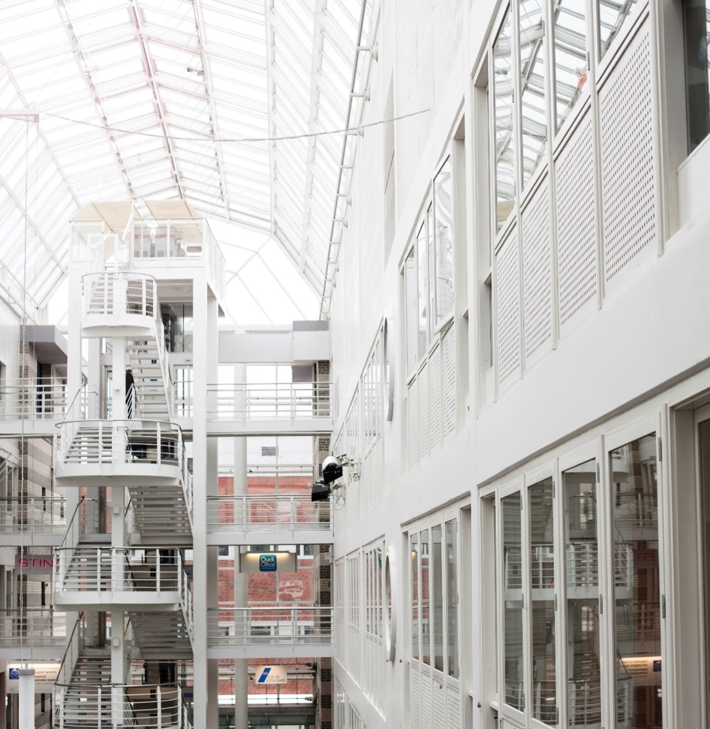
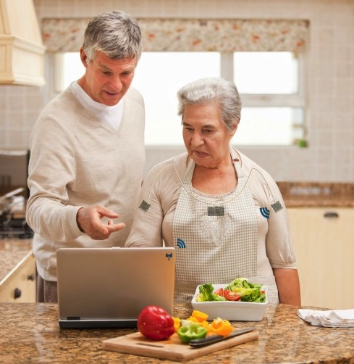
Quality of Experience of visual-haptic interaction in a virtual reality simulator
Kjell Brunnström, Elijs Dima, Mattias Andersson, Mårten Sjöström, Tahir Qureshi, Mathias Johanson
RISE ICT
Acreo

Slide 2
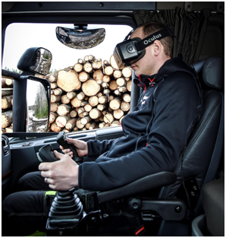

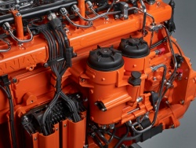
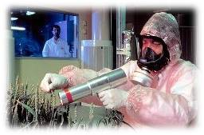
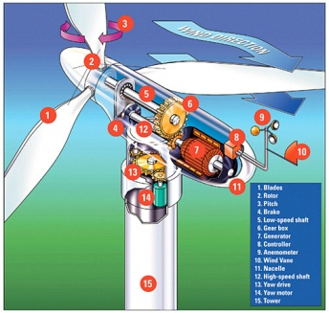
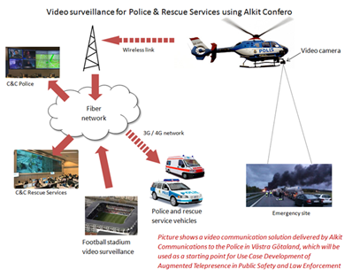
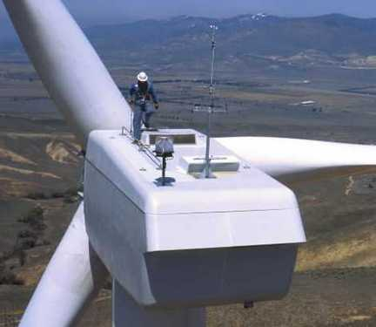
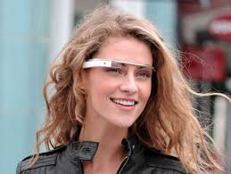

Quality of Experience for Augmented Telepresence
2-year project funded by
Camera
Tracking module
Video Communications
Sensor
Augmented presentation
Partners: RISE Acreo, Mid Sweden University, HIAB and Alkit Communications

Slide 3
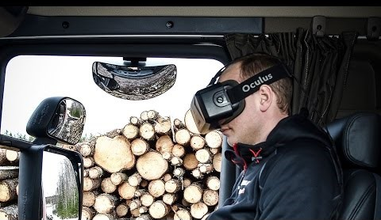
Augmented Telepresence

Slide 4
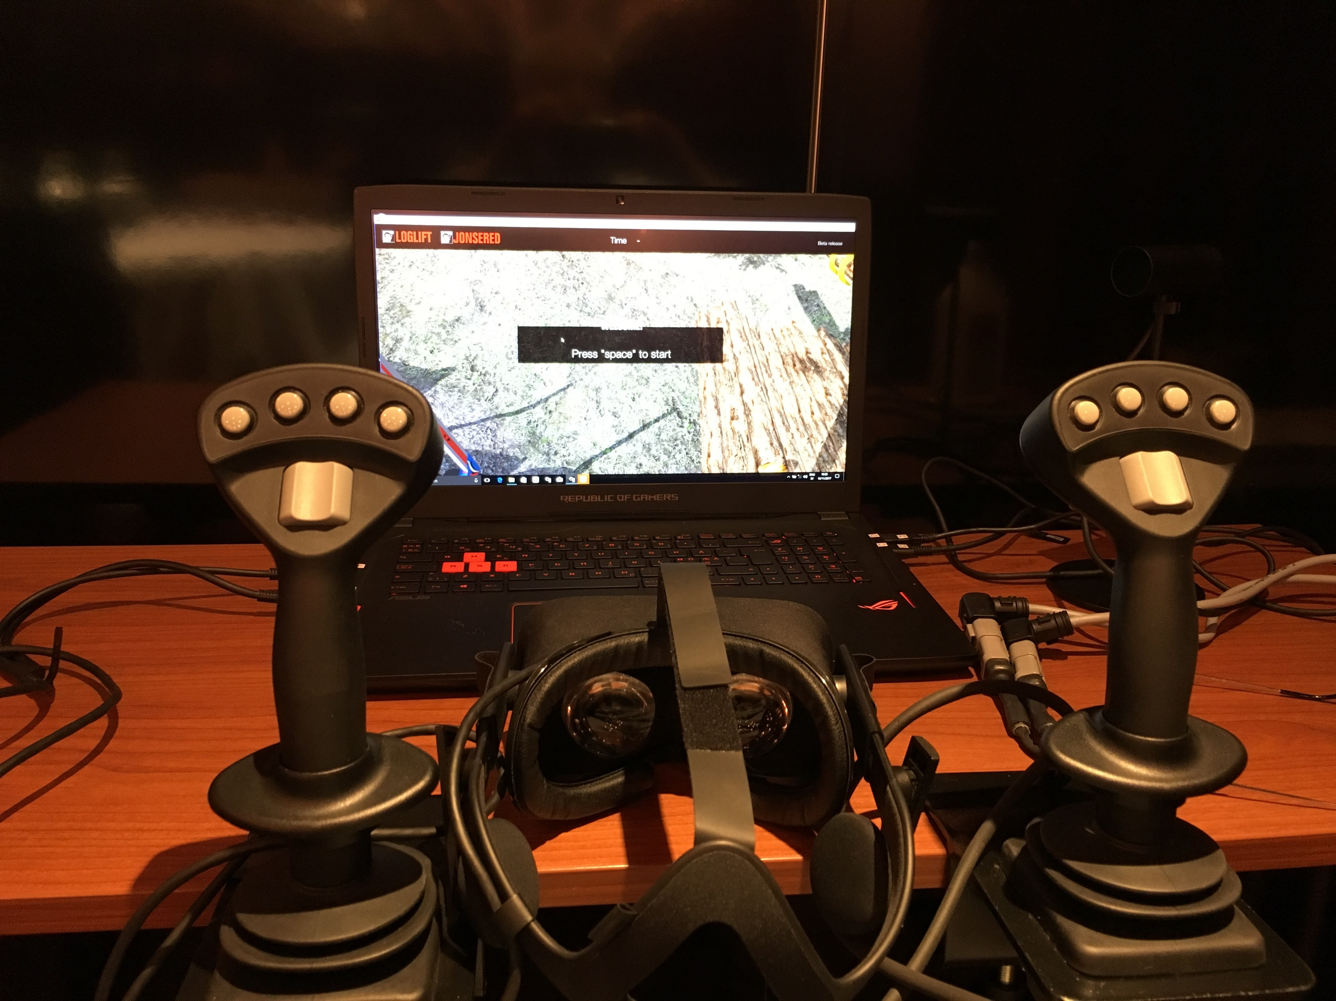
Current study: use of VR-simulator version

Slide 5
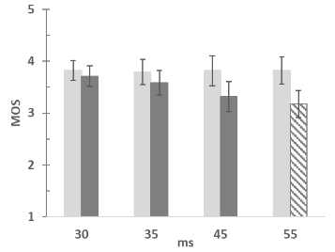
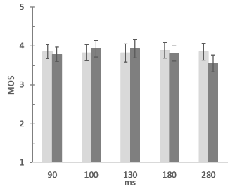
Study overview
Comfort Quality
Responiveness Quality
Baseline study
  Log loading task with VR-system as is
Delay study
  Screen delay and Joystick delay added
Delay study II
  Longer Joystick delay added
Joystick delay
Display delay
Brunnström et al (2018). Quality of Experience of Visual-Haptic interaction in a Virtual Reality simulator. HVEI 2019.
Brunnström et al (2018). Quality of Experience for a Virtual Reality simulator. HVEI 2018.

Slide 6
HVEI 2019 Special session on immersive QoE (joint IQSP)
Brunnstrom et al., Quality of Experience of visual-haptic interaction in a virtual reality simulator (Preview now)
Gutiérrez et al., Complexity measurement and characterisation of 360-degree content (Preview this meeting)
Perez et al., Using 360 VR video to improve the learning experience in veterinary medicine university degree (Preview this meeting)
Hofmeyer et al., Impacts of internal HMD playback processing on subjective quality perception (Preview this meeting)
Are people pixel-peeping 360° videos? (No preview this meeting)

Slide 7
Delay study II - test procedure
The person received written instructions about the procedure
The test persons vision was self-reported by test persons
A pre-questionnaire including an SSQ was filled in by the test person
A short training session was done to familiarize the test person with the task and environment (load twice one or two logs on to the truck). Here also to get to sense the no-delay case
Main session load logs for 6 different 2 min periods with different delay
After 2 min test subjects verbally report their experience.
The simulator was restarted to have the same starting position at each 2 min session
A post-questionnaire including an SSQ was filled in by the test person
Test person was thanked for its participation with a cinema ticket

Slide 8
Delay study II – scales
How many logs did load these two minutes? (performance metric)
How would you rate the responsiveness of the system?
How would you rate your ability to accomplish your task of loading the logs on the truck?
How would you rate your comfort (as in opposite to discomfort)?
How would you rate the immersion of the experience?
How would you rate your overall experience?
Scale was shown in the instructions

Slide 9
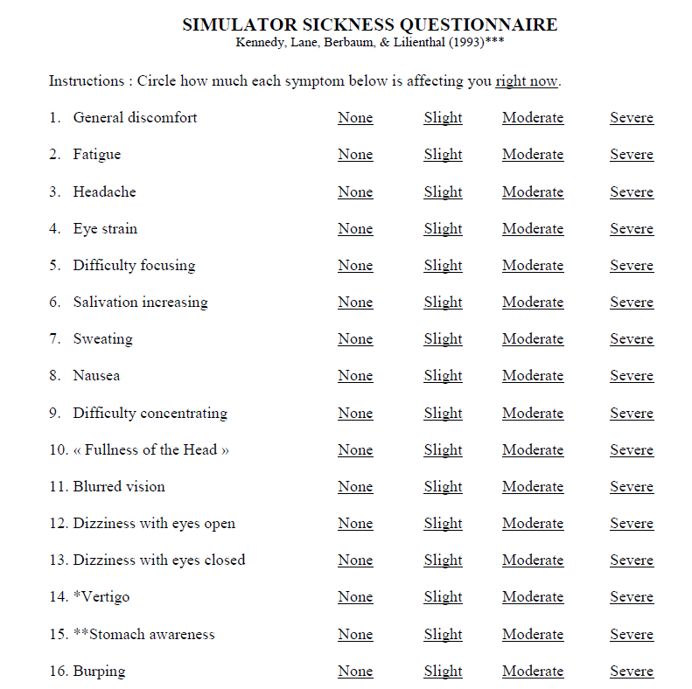
Delay study II

Slide 10
Delay study II – delay values
Six delay conditions (5 delay and one no-delay)
  Reference condition: no-delay
  Joystick delay (ms): 0, 50, 100, 200, 400, 800
  Order randomized per test subject

Slide 11
Delay study – Results
Based on 31 test subjects (22 males and 9 females) recruited at RISE in Kista, Sweden (staff, visiting researchers and students)
Age: 39 (mean), 22-64.
No-one had experience in operating truck cranes
2 test persons did not complete their test due to nausea and discomfort

Slide 12
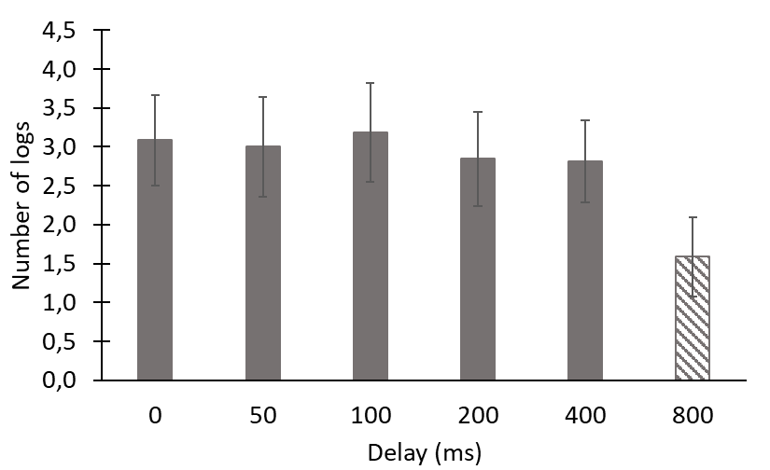
Results – Number of logs

Slide 13
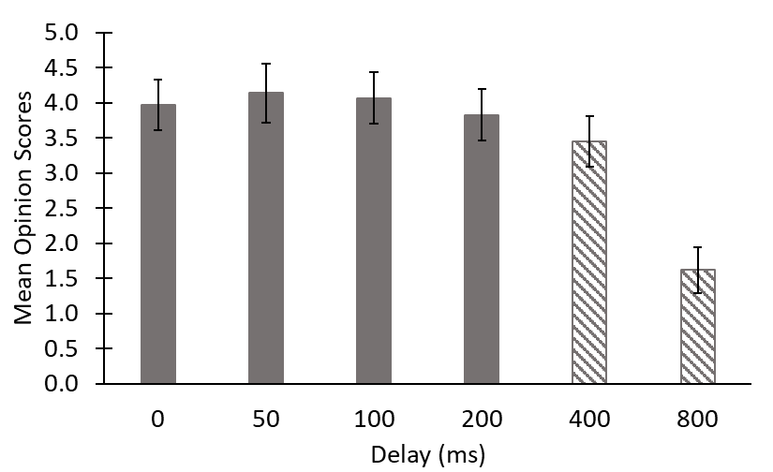
Results – Responsiveness Quality

Slide 14
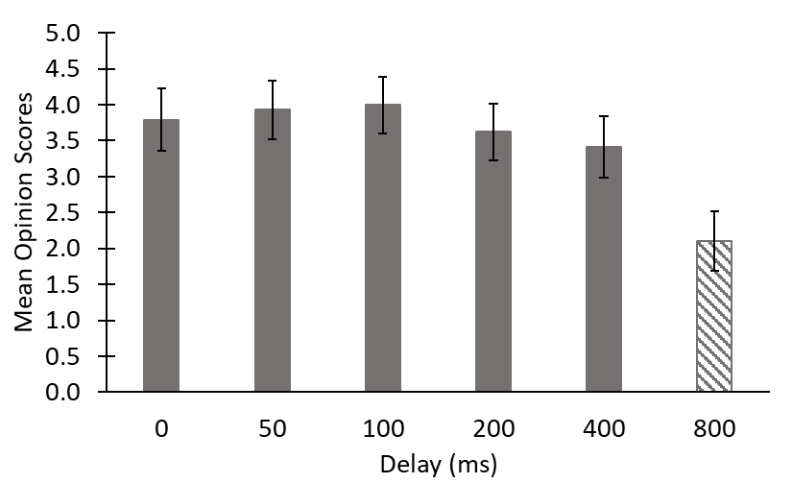
Results – Task accomplishment Quality

Slide 15
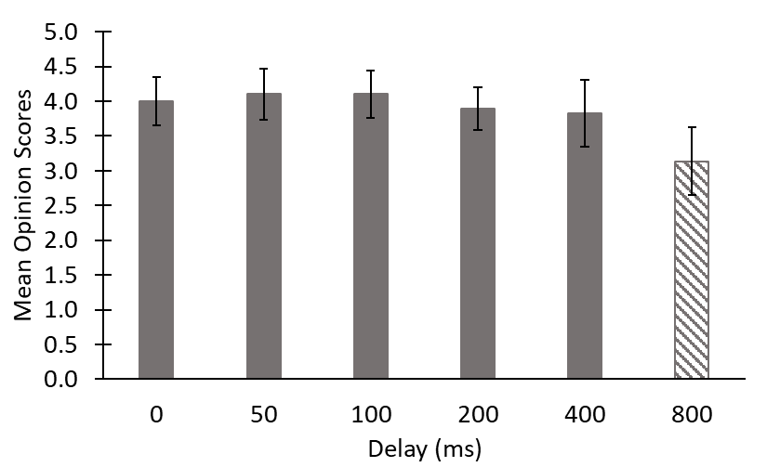
Results – Comfort Quality

Slide 16
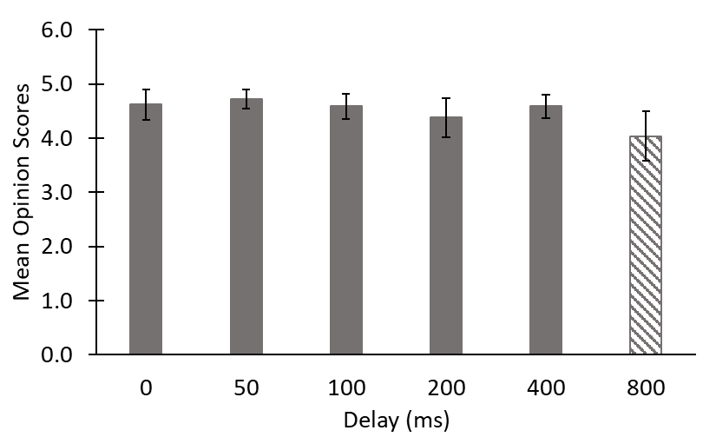
Results – Immersion Quality

Slide 17
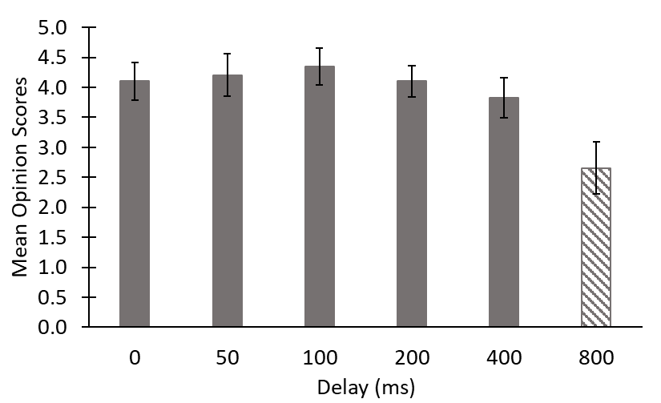
Results – Overall Quality

Slide 18
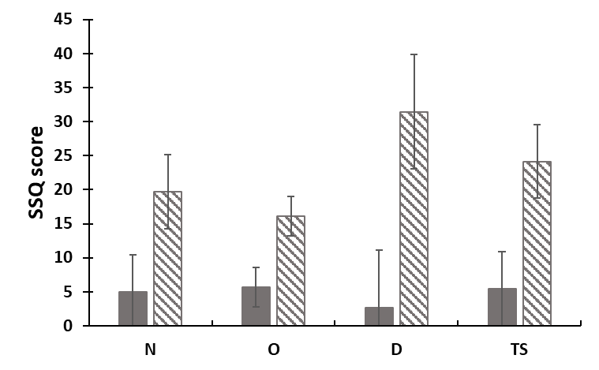
Simulator Sickness Questionnaire - SSQ
Symptoms clustered according to Kennedy et al (1993)
  Nausea (N) – nausea, stomach awereness, increased salivation and burping
  Oculomotor (O) – eyestrain, difficulty focusing, blurred vision and headache
  Disorientation (D) – dizziness and vertigo
  Total Score (TS) – A total severity weighted sum of N,O and D

Slide 19
Summary and discussion – Delay study II
Based on 31 test subjects
Number of logs – Significantly lower for 800 ms, but no clear trend for lower delays
Responsiveness Quality – Significantly lower for both 400 and 800 ms, although 400 ms was borderline
Task accomplishment Quality – 800 ms significantly lower
Comfort Quality – 800 ms significantly lower
Immersive Quality – 800 ms significantly lower
Overall Quality – 800 ms significantly lower
It require clearly very long delays to have a strong effect

Slide 20
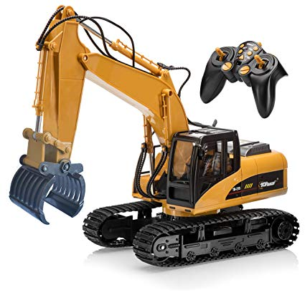
Discussion
Delay study II
  SSQ – Clear increase of symptoms.
  Ongoing to compare results with experienced truck crane operators. Initial results very similar as for unexperienced persons.
Also ongoing
  Remote controlling a miniature vehicle. Vision through VR-goggles and stereo video feed. Adding different AR guidance cues to evaluate where to put what
  Preparation for a user study on a actual crane system also involving AR-placement.

Slide 21
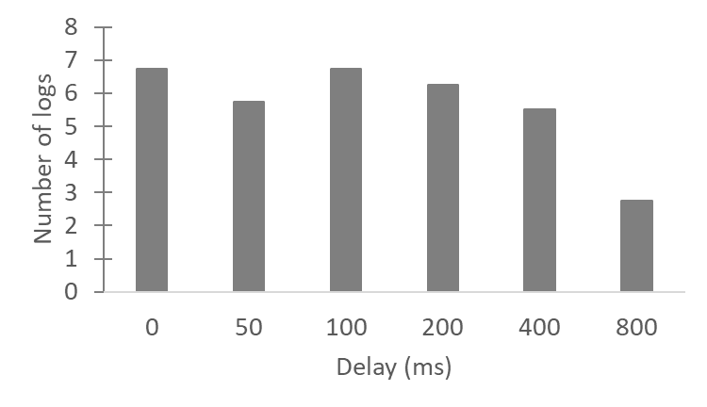
Results – Number of logs naïve vs experts

Slide 22
Thank you!
Kjell Brunnström
kjell.brunnstrom@ri.se
RISE Acreo

