Slide 1
The Many Faces of Video at Facebook
Ioannis Katsavounidis
Research Scientist
Video Infrastructure

Slide 2
Facebook
The world’s largest social network
Over 2.2 Billion users
Multiple products
  Facebook
  Instagram
  Messenger
  WhatsApp
  Oculus
  Portal

Slide 3
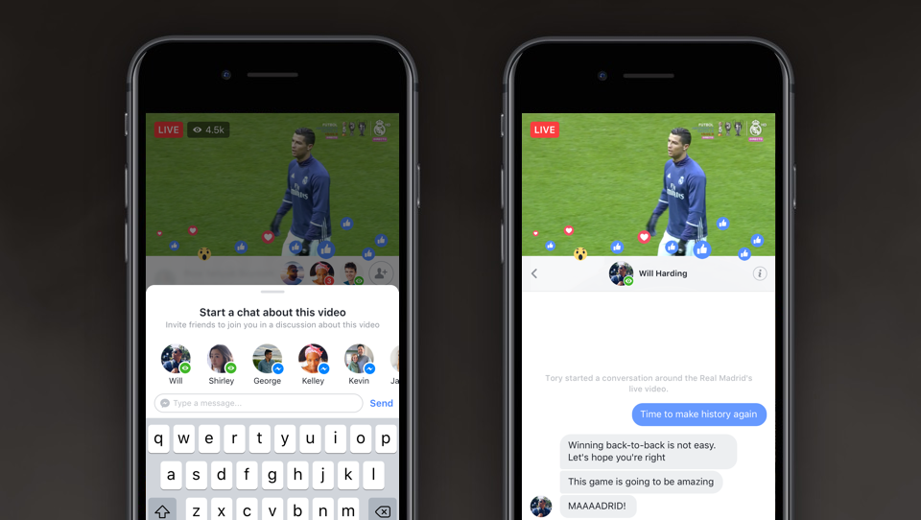
Facebook - LIVE

Slide 4
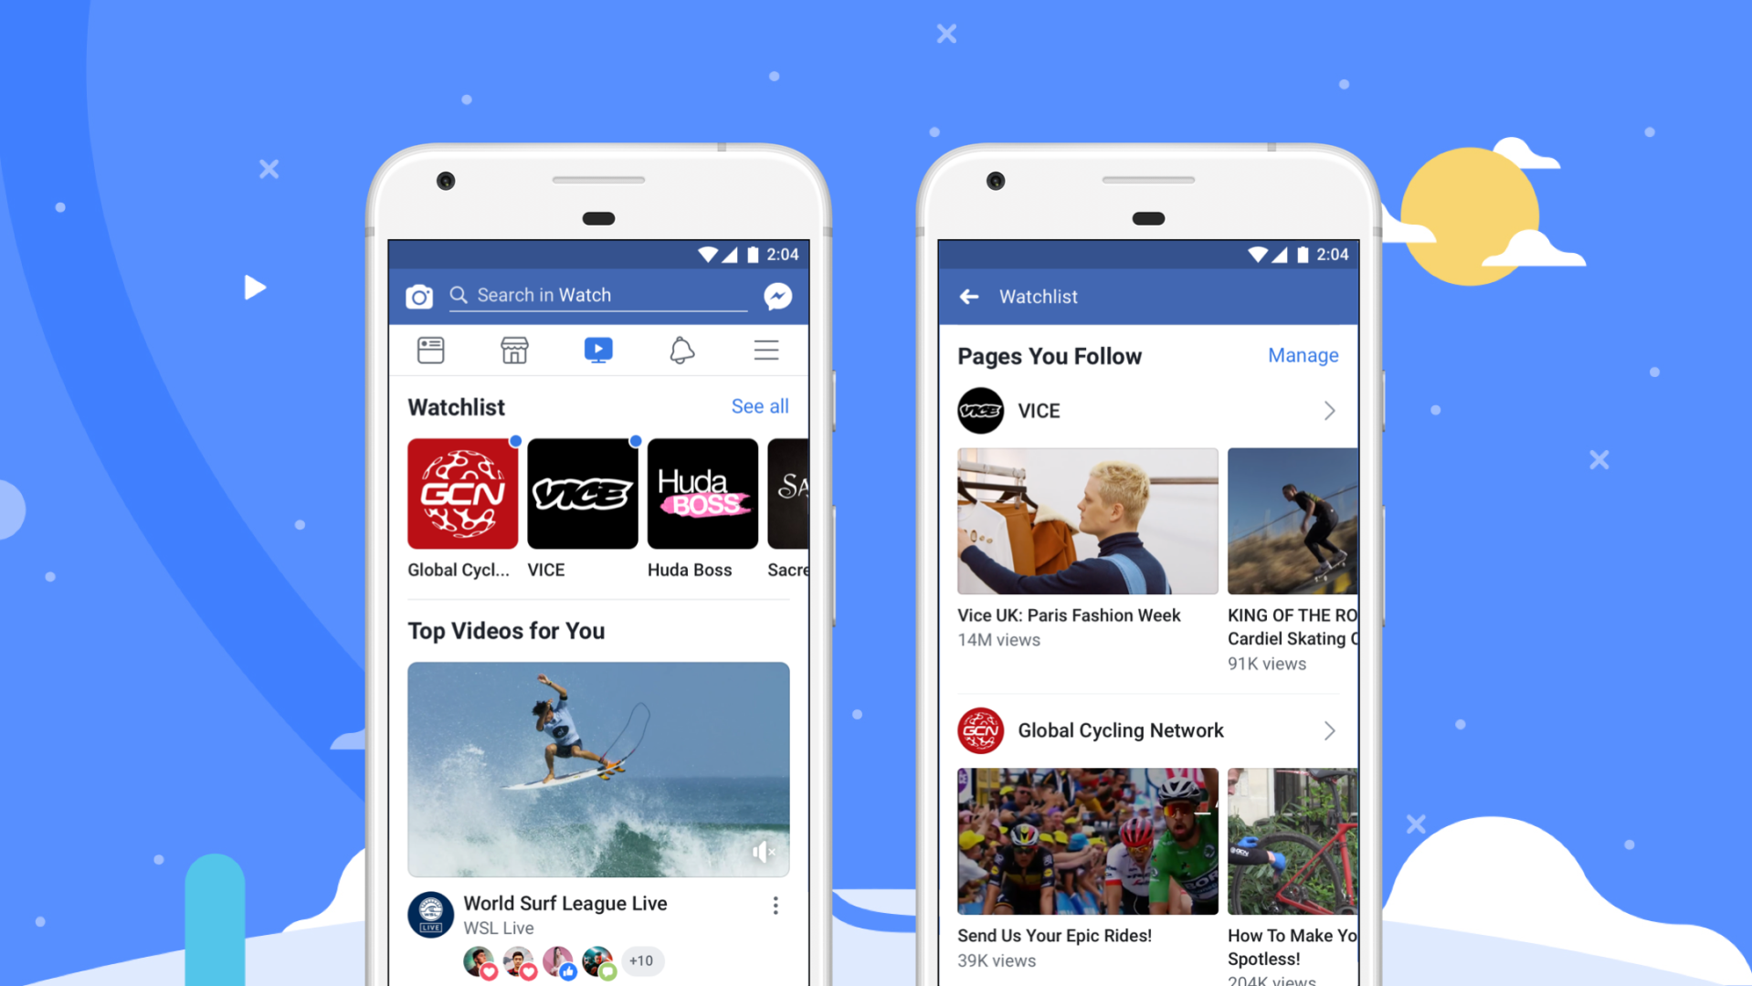
Facebook WATCH

Slide 5
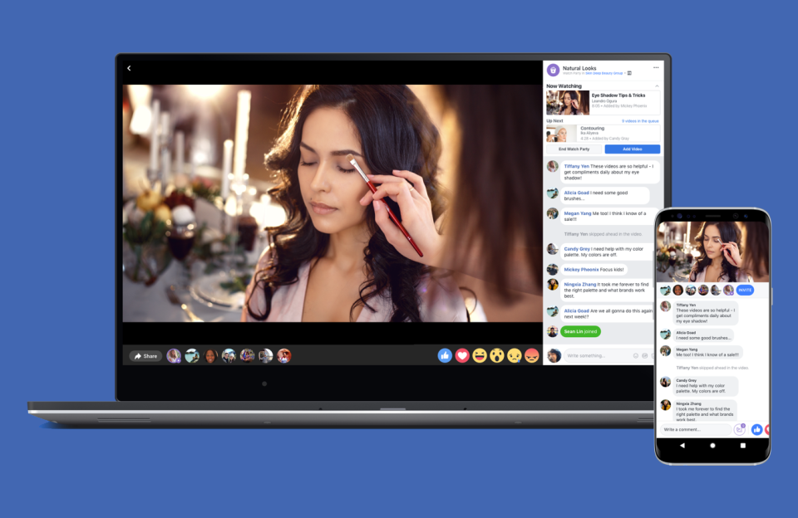
FACEBOOK WATCH Party

Slide 6
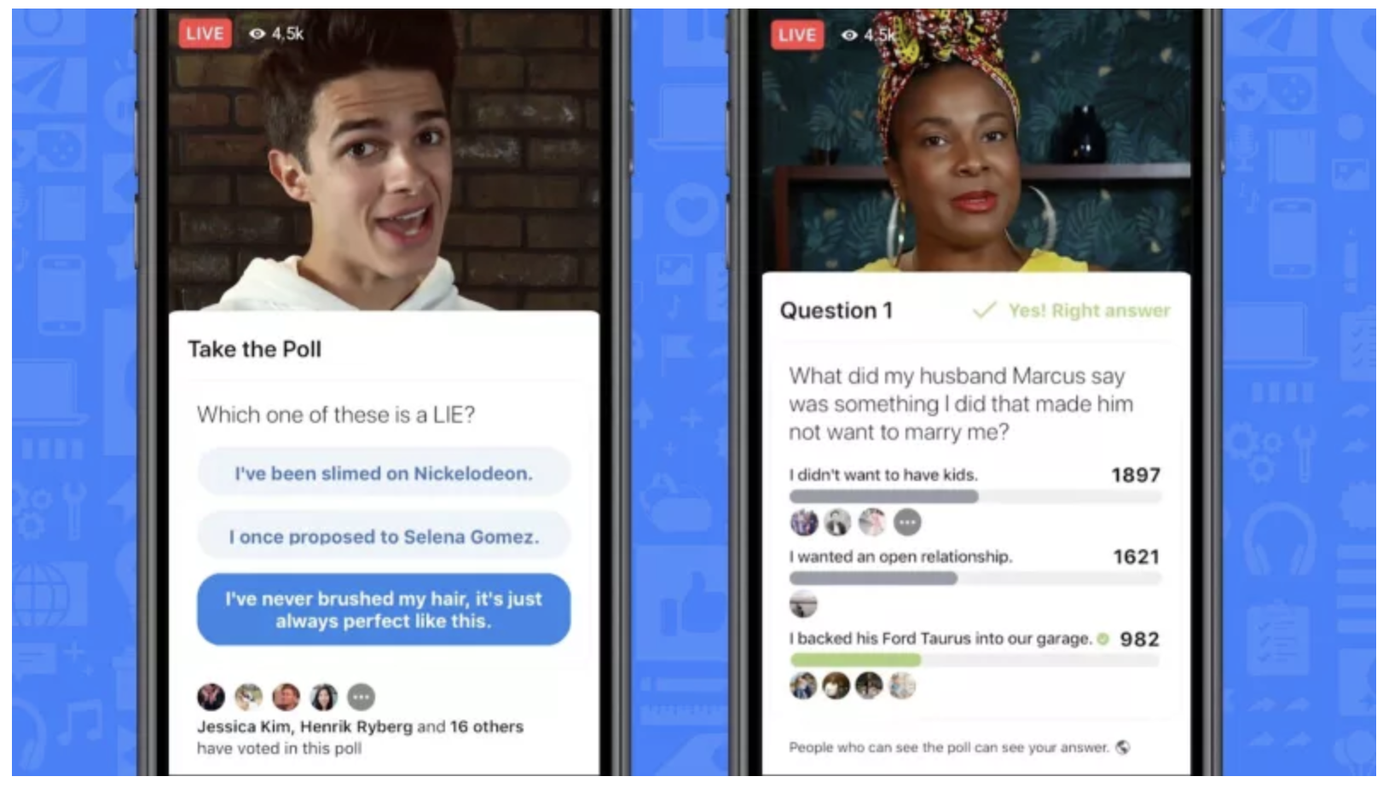
FACEBOOK Live GAME SHOW
Notes:
Interactive Live. Quiz shows. Gamification of live

Slide 7
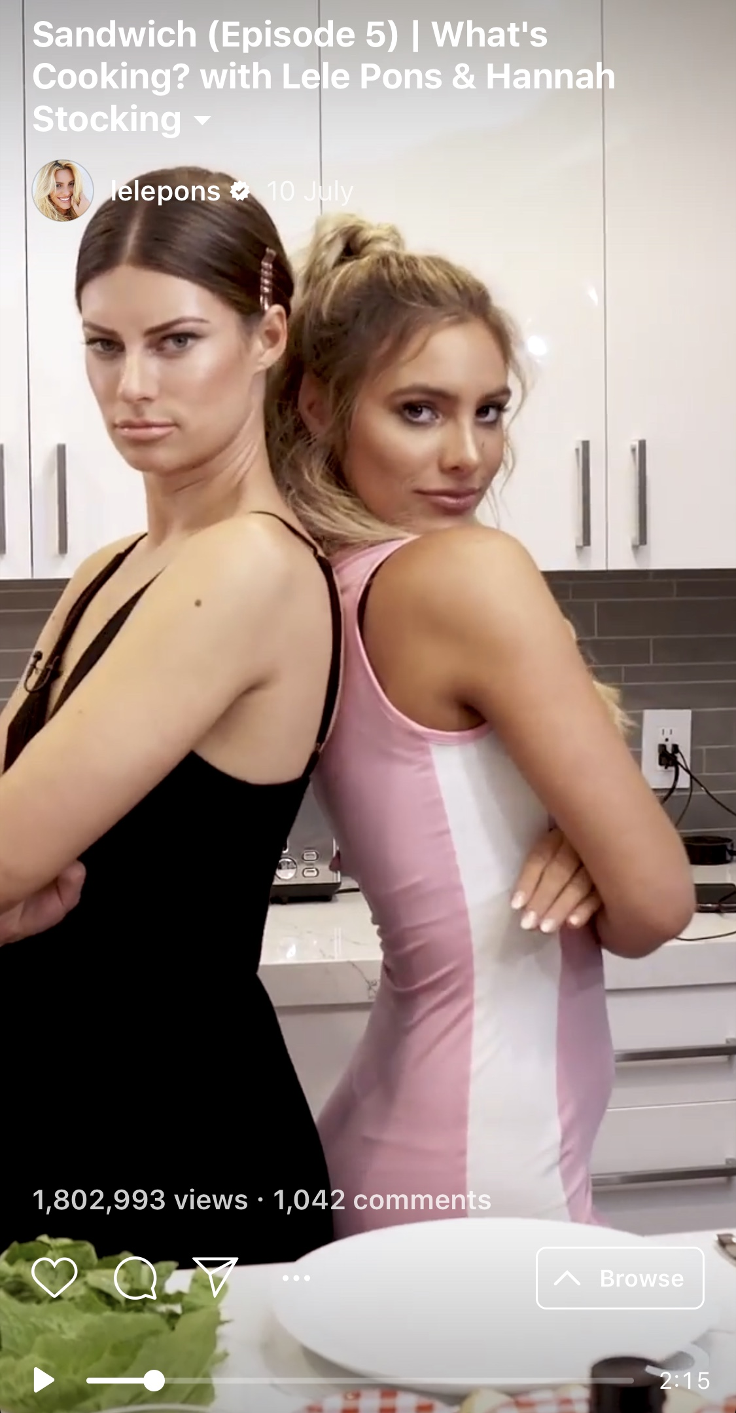
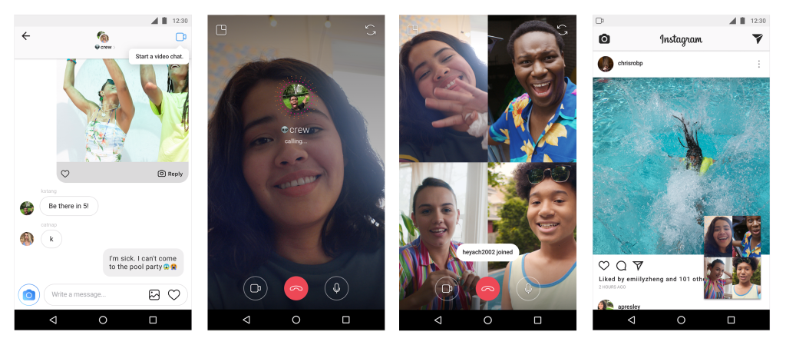
Instagram TV (IGTV) and Instagram video chat

Slide 8
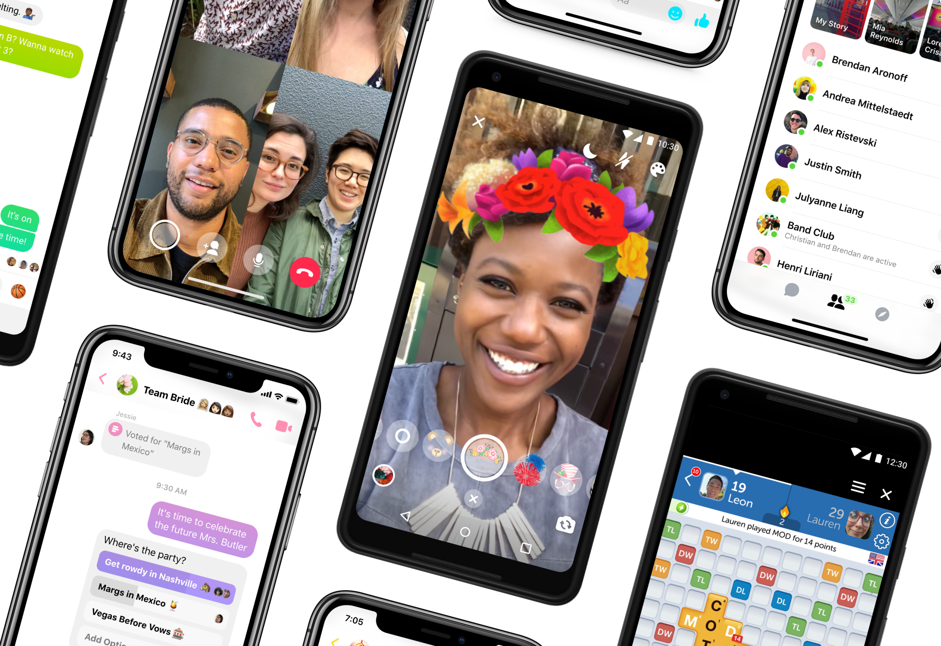
Messenger

Slide 9
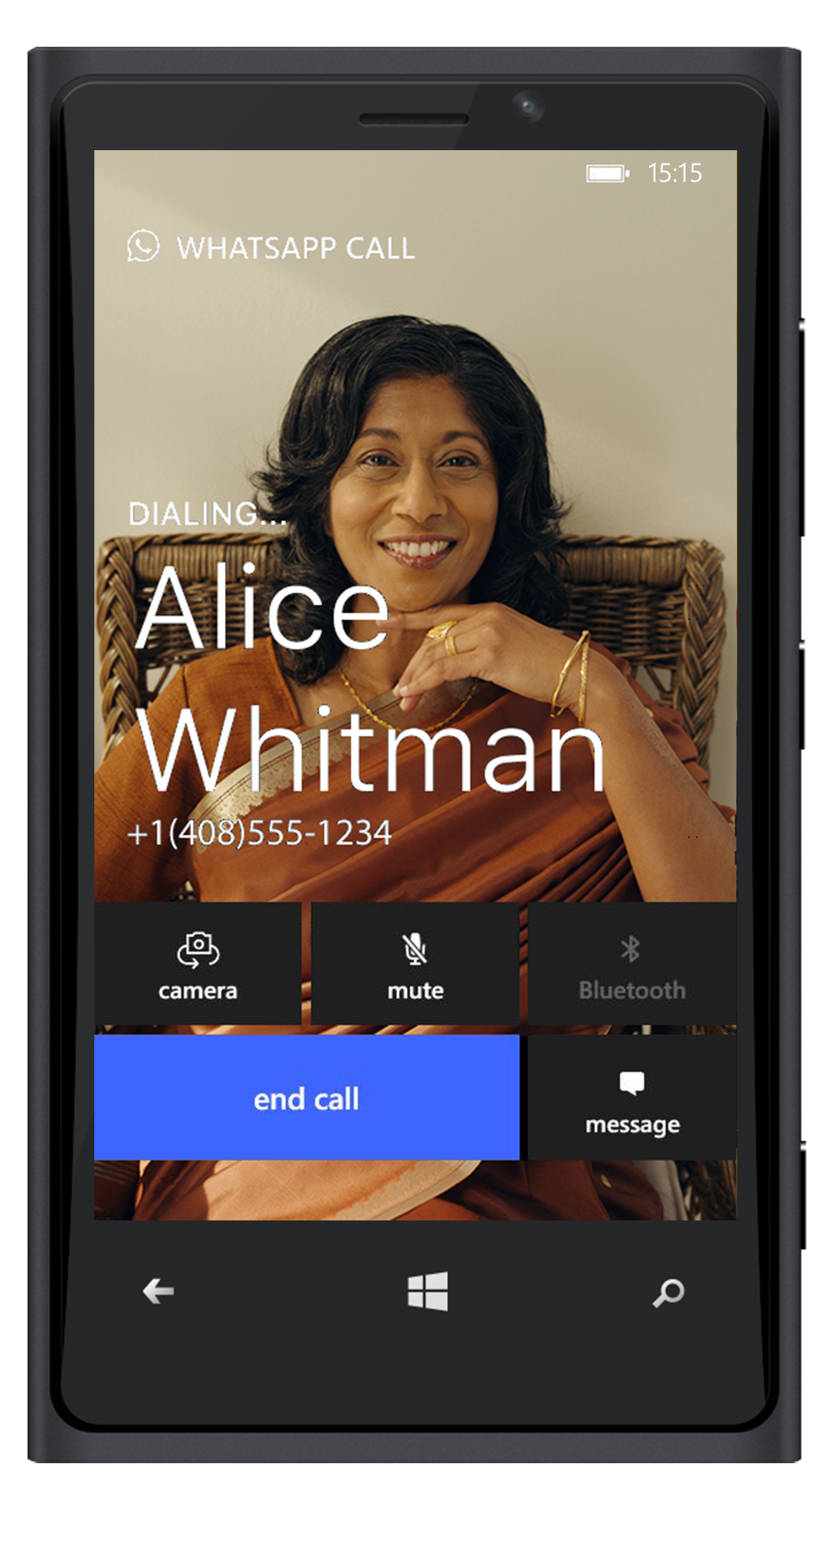
WhatsApp

Slide 10
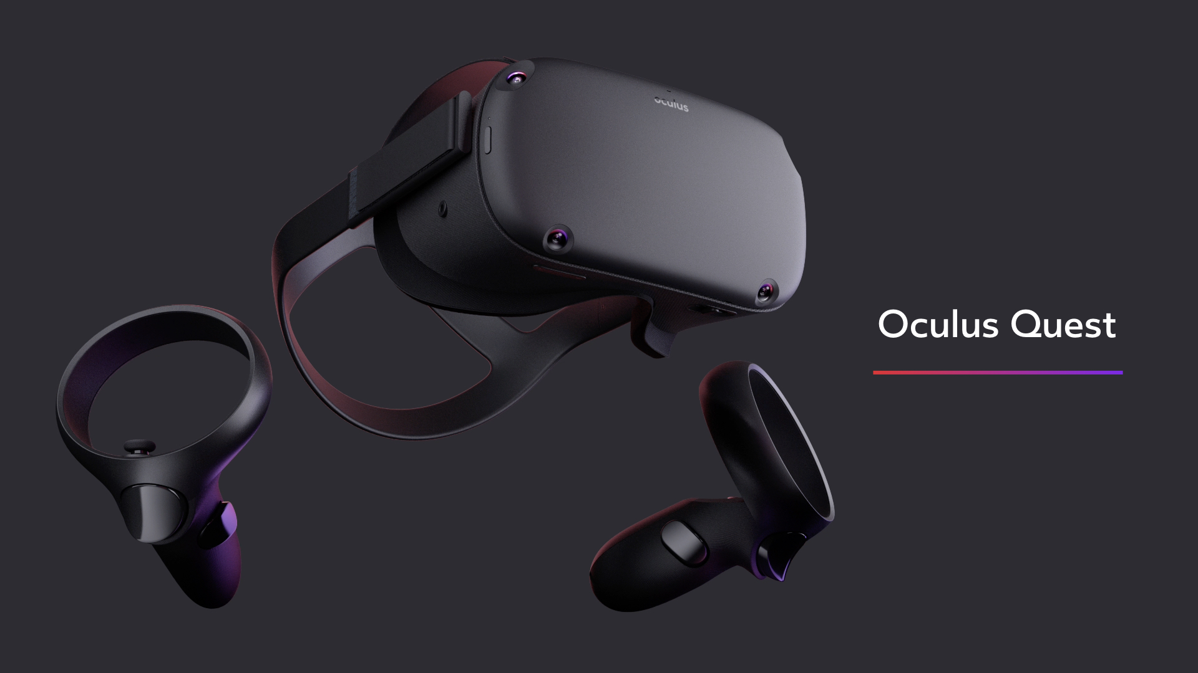
OCULUS

Slide 11
Video Infrastructure @ FB
100-member team
Supports all video processing on the server side at FB
Responsible for the HW configuration and SW stacks that product teams use for their applications
Server-side video processing (encoding, decoding, computer vision algorithms, video understanding, copyright)

Slide 12
Video fundamentals and research @ Video Infrastructure @ FB
New group within Video Infra
Tech lead: Ioannis Katsavounidis
Three main activities
  Video codec research, including standardization
  External academic and industry collaborations
  Joint HW-SW optimization for video processing
Video quality optimization throughout all FB video products

Slide 13
Video challenges at FB
No-reference video quality assessment, mostly for user-generated content
Live encoding quality optimization (end-to-end)
  Low-delay (e.g. Facebook Live)
  Real-time communication (e.g. WhatsApp video call)
Adaptive bitrate streaming for all video content
  Not one-size-fits-all
  Need variety of full-reference and no-reference metrics

Slide 14
Video challenges at FB
Energy efficiency (own data-centers)
Storage considerations
Contribute technologies to new video coding standards that can solve these problems
Offer solutions for billion-scale problems

