Slide 1
Ongoing Standardization Activities of Gaming Quality of Experience
Steven Schmidt
Quality and Usability Lab – Berlin Institute of Technology
VQEG Meeting - Mountain View, California, USA, 2018

Slide 2
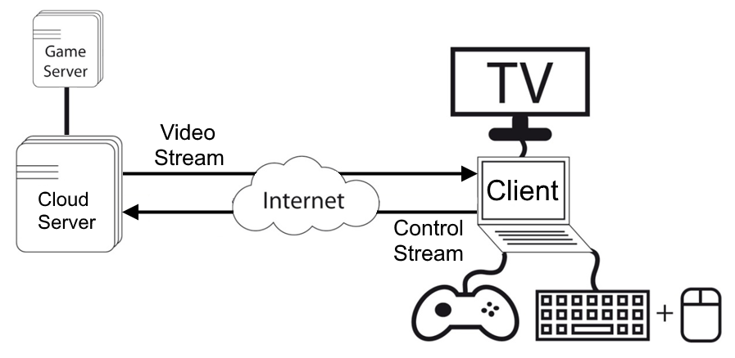
Motivation (I) – What is Cloud Gaming?

Slide 3
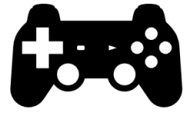
Motivation (II)
2.3 billion gamers will spend $137.9 billion on video games in 2018^{[1]}
Cloud Gaming is one of the most challenging online service
Companies in the past could not provide acceptable QoE
Identification of relevant influencing factors
Investigate methods for gaming QoE assessment
Apply this knowledge to develop a gaming QoE opinion model
[1] Newzoo quarterly update of its Global Games Market Report 2018

Slide 4

Collaboration of Berlin Institute of Technology and T-Labs
Investigation of QoS and QoE of OnLive (D. Pommer)
Dissertation about influencing factors (J. Beyer)
Taxonomy defining gaming QoE (S. Möller, S. Schmidt)
2013 | 2014 | 2015 | 2016 | 2017 | 2018

Slide 5
What is Gaming Quality of Experience?
User
System
Context
Influencing
factors
Experience
Playing style
Intrinsic motivat.
Static factors
Dynamic factors
Game genre
Game structure
Game rules
Server
Channel
Player & device
Physic. & social
environment
Extrinsic motivat.
Service factors
Hedonic Pragmatic
Aesthetics
Novelty
Output quality
Interactive
behavior
Input
quality
Learnability
Intuitivity
Appeal
Interaction quality
Playing quality
Quality features
Tension
Challenge
Competence
Quality of Experience (QoE)
Positive
affect
Negative
affect
Immersion
Flow
Player experience
Acceptability
[2]

Slide 6

Creation of 3 work items in ITU-T SG-12
ITU-T Rec. G.1032 (10/2017) – G.QoE-gaming:
  Influence factors on gaming quality of experience
ITU-T Rec. P.809 (05/2018) – P.GAME:
  Subjective evaluation methods for gaming quality
Future ITU-T Rec. G.OMG (studied in Q.13/12):
  Opinion model for gaming applications
[3]
2013 | 2014 | 2015 | 2016 | 2017 | 2018

Slide 7
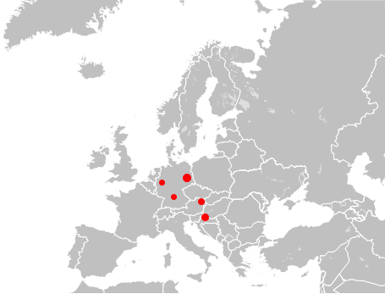

Connection with other researchers from AIT in Vienna, FER in Zagreb, University Würzburg, QoE-Net
Variety of studies
  Feedback delay of mobile devices
  Environment influencing factors
  Physiological measurement for gaming QoE
  Impact of display size, game type, network delay
  Open-Source Mobile Cloud Gaming Platform
[4]
2013 | 2014 | 2015 | 2016 | 2017 | 2018

Slide 8

Approved Recommendation for G.QoE-Gaming (ITU-T Rec. G.1032)
Stronger focus on video encoding parameters
Collaboration with N. Barman and M. G. Martini
  Building gaming video datasets
  Quality assessment metrics
  Content comparison
Evaluation of subjective test paradigms and
questionnaires assessing gaming QoE
2013 | 2014 | 2015 | 2016 | 2017 | 2018

Slide 9
ITU-T Rec. G.1032 - G.QoE-Gaming
[5]
Human influence factors
  Gaming experience, Intrinsic and extrinsic motivation, static and dynamic human factors (age, gender), human vision
System influence factors
  Game genre, mechanics and rules, temporal and spatial features (pace, accuracy), visual perspective, aesthetics and design characteristics, learning difficulty, device portability and size, input and output modalities
  Network and encoding parameters: delay, jitter, bandwidth, framerate, resolution, rate controller, GoP, motion range, audio and video compression
Context influence factors
  Physical environment factors, Social context, Service factors, Novelty

Slide 10

Approved Recommendation for P.GAME (ITU-T Rec. P.809)
Encoding Complexity Classification
Characteristics responsible for delay sensitivity
  Collaboration with S. Sabet and C. Griwodz
Questionnaire assessing input quality
Dimension-based assessment of video quality
Separation of spatial video and interaction quality
Proposal for structure of G.OMG
2013 | 2014 | 2015 | 2016 | 2017 | 2018

Slide 11
ITU-T Rec. P.809 – P.GAME
[6]
QoE aspects of gaming including five engagement concepts
Test paradigms: interactive vs. passive
Passive viewing-and-listening tests with audiovisual stimuli
Interactive tests with game scenes
Experimental set-up: duration, environment, game material
How to ensure similar stimuli for participants
Collection of questionnaires and scales
Player performance measurement
Difference to traditional passive tests:
Instructions of participants
  Make them familiar with games
  Should be interested in gaming
  Video quality vs. graphical quality
Test Material
  Find representative scene
  Stimulus duration longer (~ 30s)

Slide 12
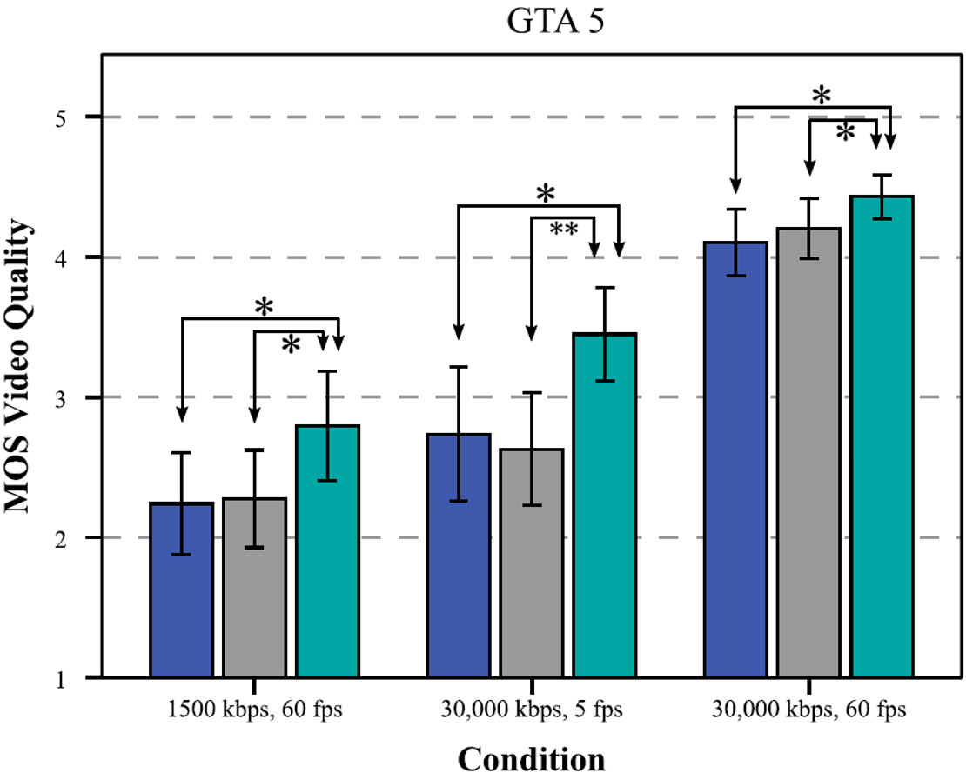
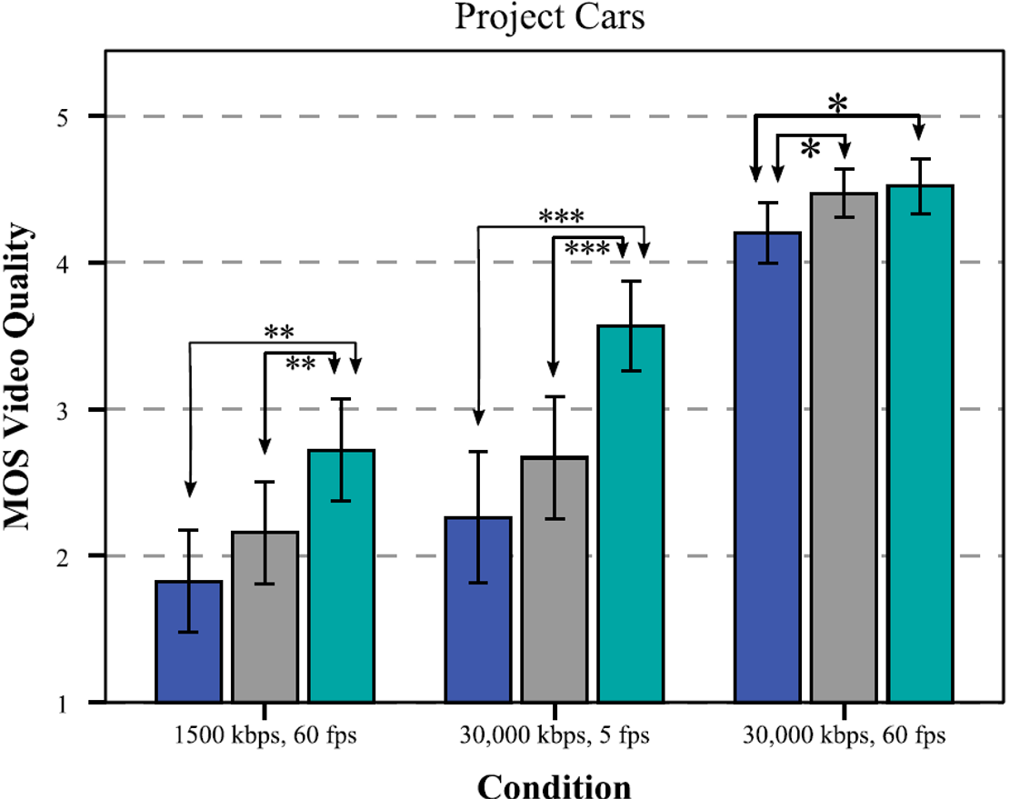
Comparison of interactive and passive tests
[7]
Blocky Jerky Reference Blocky Jerky Reference

Slide 13
Future ITU-T Rec. G.OMG
[8]
Predict overall quality or individual quality aspects based on encoding and network parameters
Two modes depending on available information about game content
Scope:
  Considering relevant factors identified in ITU-T Rec. G.1032
  Network planning tool (infrastructure and resource distribution)
  Target services: cloud gaming
  Target group: non-professional gamer
  Not: VR gaming, mobile devices, social aspects (but might be applicable)
  Not: influence of the design of games or the motivation of users to play

Slide 14
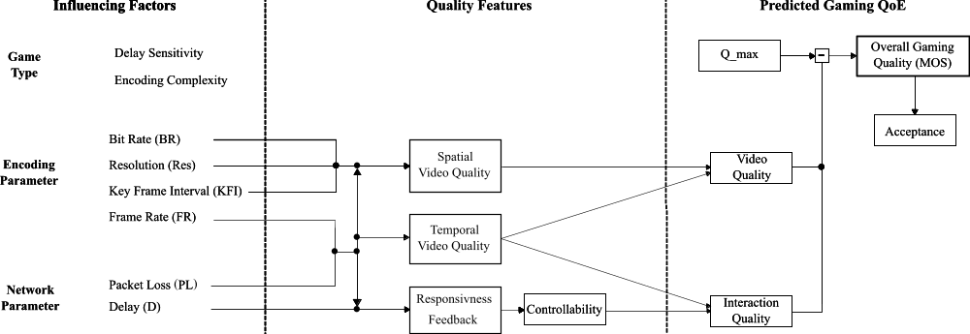
Future ITU-T Rec. G.OMG
[8]

Slide 15
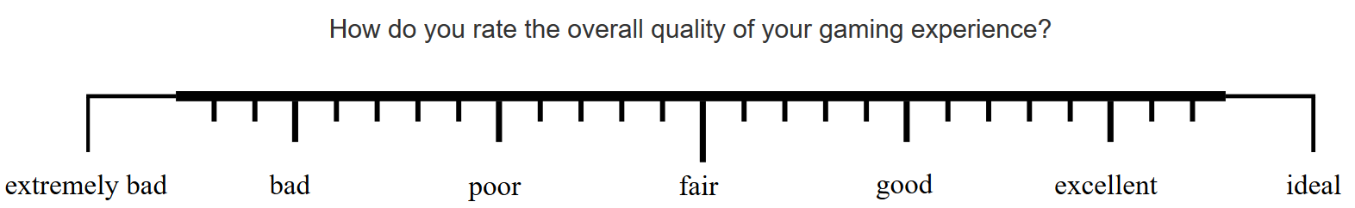
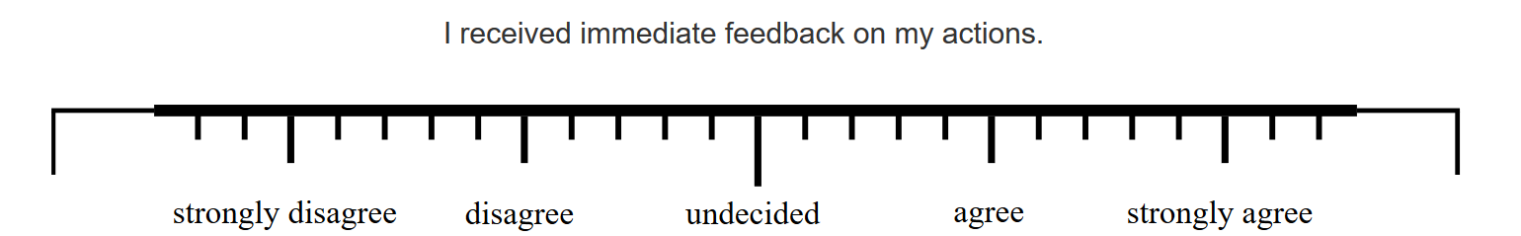
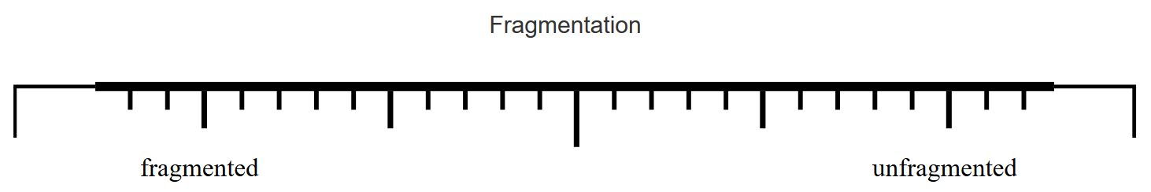
Future ITU-T Rec. G.OMG

Slide 16
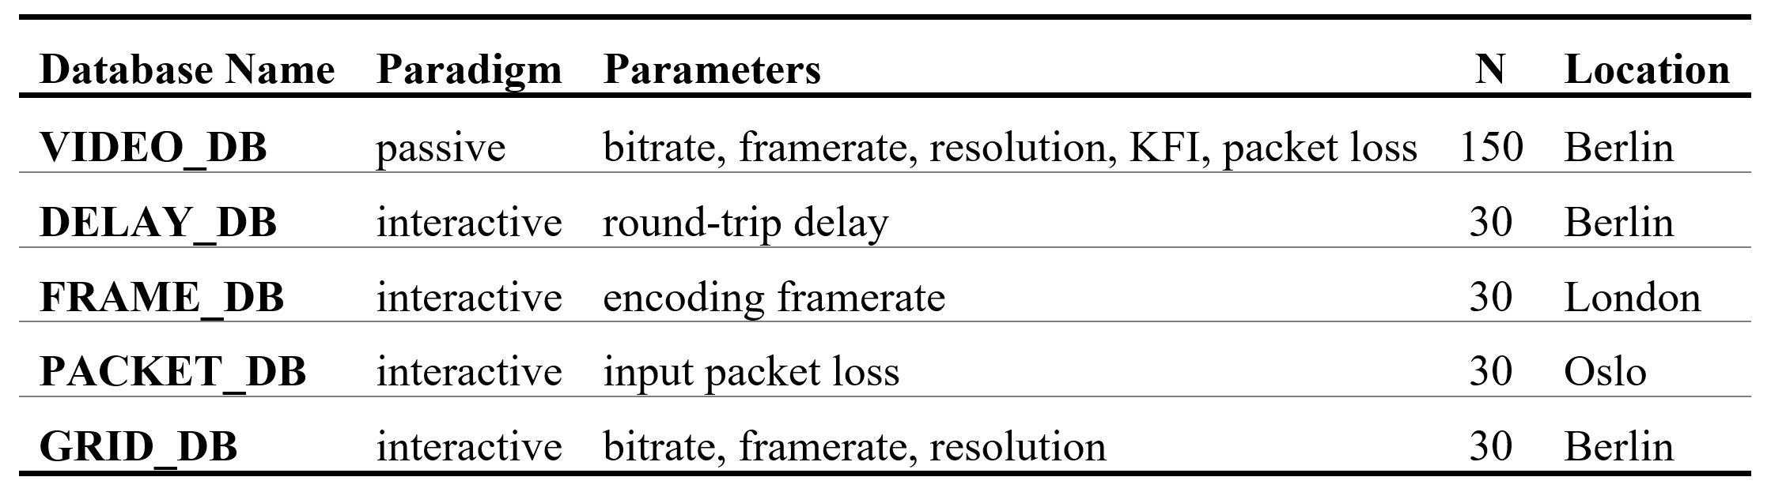
Future ITU-T Rec. G.OMG
Requirement specification submitted in May 2018
Data assessment process will be discussed in Dec 2018
So far six games used to build dataset

Slide 17
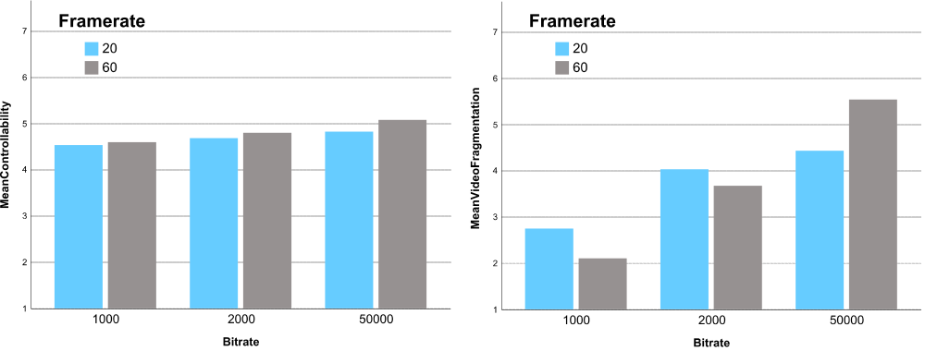
Impact of Spatial Video Quality on Input Quality
Subjective ratings for CSGO at 720p
Interaction Quality Spatial Video Quality

Slide 18
Remaining challenges
Model inputs are system influence factors, but they are potentially augmented by human and context influence factors
Game characteristics largely determine the impact of system influence factors
Parametric description of game characteristics missing
Physiological measurement methods
Performance metrics
Fast development of cloud gaming systems
  Individual network protocols (packet loss influence)
  Current models not accurate for GPU encoding

Slide 19

Thank you for your Attention!
Ongoing Standardization Activities of
Gaming Quality of Experience
Steven Schmidt
We are always searching for collaborations ☺
Visit
www.qu.tu-berlin.de
for more information.

Slide 20
References
[1] H.B. Duran, Newzoo quarterly update of its Global Games Market Report, 2018, URL: http://www.alistdaily.com/entertainment/mobile-games-market-newzoo-april-2018/ (last accessed: 10.11.2018)
[2] S. Möller, S. Schmidt, and J. Beyer, “Gaming taxonomy: An overview of concepts and evaluation methods for computer gaming qoe,” in Quality of Multimedia Experience (QoMEX), 2013 Fifth International Workshop on, 2013.
[3] S. Möller, S. Schmidt, and S. Zadtootaghaj, “New ITU-T Standards for Gaming QoE Evaluation and Management,” in Quality of Multimedia Experience (QoMEX), 2018 Tenth International Workshop on, 2018.
[4] J. Beyer, “Quality-influencing factors in mobile gaming”, http://dx.doi.org/10.14279/depositonce-6406, Dissertation, 2017.
[5] International Telecommunication Union, Study Group 12 (Source: Deutsche Telekom AG), “G.1032: G.1032 : Influence factors on gaming quality of experience” , Geneva, 2017.
[6] International Telecommunication Union, Study Group 12 (Source: Deutsche Telekom AG), “P.809 : Subjective evaluation methods for gaming quality” , Geneva, 2018.
[7] S. Schmidt, and S. Zadtootaghaj, S. Möller, “A Comparison of Interactive and Passive Quality Assessment for Gaming Research,” in Quality of Multimedia Experience (QoMEX), 2018 Tenth International Workshop on, 2018.
[8] International Telecommunication Union, Study Group 12 (Source: Deutsche Telekom AG), “ITU-T Contribution SG12-C200: Requirement Specification and Possible Structure for an Opinion Model Predicting Gaming QoE (G.OMG)”, Geneva, 2018.

