Slide 1
First Responder Use Case
Margaret H. Pinson
mpinson@ntia.doc.gov
Notes:
Margaret H Pinson
mpinson@ntia.doc.gov
(+1) 303-497-3579
ITS Institute for Telecommunication Sciences
ITS is the research & engineering branch of the National Telecommunications and Information Administration (NTIA), a part of the U.S. Department of Commerce (DOC). Located at 325 Broadway St., Boulder, CO, USA, 80305. For more information on the ITS Video Quality Research project, see http://www.its.bldrdoc.gov/resources/video-quality-research/video-home.aspx.
“An open exchange of scientific ideas, information, and research achieves the Department’s vision for an informed society that uses objective and factual information to make the best decisions.”—US Department of Commerce Administrative Order DAO 219-1, Public Communications.

Slide 2
My Research
Audience
  Consumers in general
  Public safety practitioners
Use cases
  Camera capture
  Transmission optimization & storage optimization
  Artificial intelligence systems (future)
Status
  New datasets designed for NR metrics
  Dataset its4s available on CDVL (www.cdvl.org)
  Dataset its4s2 starts this week

Slide 3
Dataset its4s2
Image quality test
Camera capture use case
1,488 photos from Flickr
  Mostly unique
  Sometimes a few variants
  14 sessions, divided by topic
41% public safety
59% entertainment
4 to 5 hours
BeforeAfter
Blur
Bokeh
Color
Edge
Exposure
Fisheye
Lensflare
Lowlight
Macro
Modified
Monochromatic
Night
Obscurants
Panorama
PanoramaError
Perspective
Shadows
Texture
Tilt
Translucent
Unicolor
Washedout

Slide 4
Pilot Data, Correlations
One subject’s ratings vs MOS
Introduction vs conclusion
id001AI 0.82
id001B 0.83
id001C 0.84
id002 0.77
id003 0.81
id004 0.78
id006 0.58
id008 0.74
id001AI 0.82
id001B 0.90
id001C 0.90
id002 0.61
id003 0.75
id004 0.61
id006 0.73
id008 0.80
Overall 0.96

Slide 5
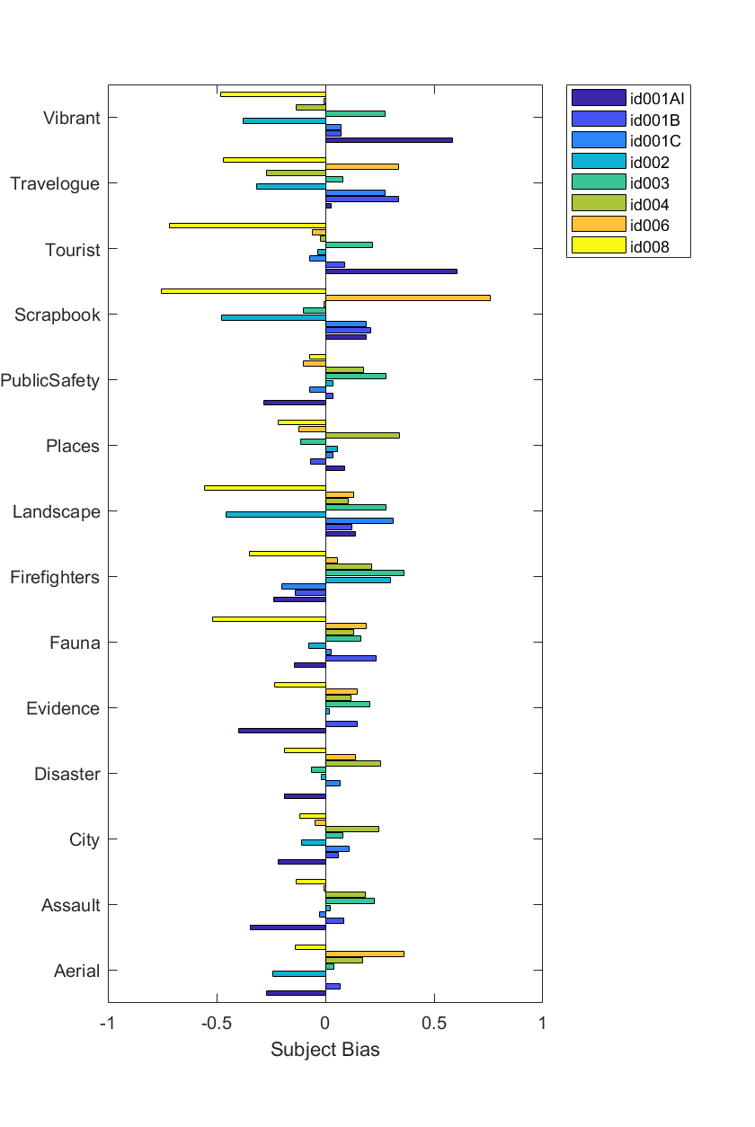

Slide 6
First Responder Use Case
Definitions & Discussions

Slide 7
First Responder, Camera Capture Use Case
Predict the quality of photographs or videos
Consumer grade cameras
Important factor, especially for evidence photographs
Example applications
  Optimize picture quality using a manual feedback loop
  Maximize picture quality for the user's task
  Optimize the recording bandwidth for the user's task
  Enable another NR metric use case

Slide 8
First Responder, Camera Capture
NR Metric Capabilities
Quality impact of the entire camera pipeline
  Sensor, image processing, encode, decode, and display
Human factors
  Aesthetics, composition, how the image or video will be used, …
Limitations of the image or video file format
  Color space, resolution, frame rate, …

Slide 9
First Responder, Network & Storage Optimization
Encoding bandwidth often not the limiting factor
Lower bit-rates = what they want more?
  Better video quality, longer battery life, less data to retain, low system cost, …
NR metric deployed by a system administrator or intelligent network
Decision applied to future videos
Examples
  Optimally apportion bandwidth among live video streams
  Enable priority access
  Understand the quality impact of low bandwidth video recording settings

Slide 10
First Responder, Network & Storage Optimization
NR Metric Capabilities
Understand “camera capture” use case
The extrapolated impact of a wide range of encoding bitrates
Network impairments
  Optionally, depending on the application and network
Tradeoffs between conflicting priorities

Slide 11
First Responder, Artificial Intelligence Systems
Predict the quality of video not intended for human viewing
  Autonomous vehicle systems, video analytics, …
Assesses ability of an artificial intelligence (AI) system to recognize people, objects, or events in the video.
Deployed anywhere
  In the camera, in the cloud, on recorded video, …
Examples
  Detect whether the quality is high enough for the AI algorithm to succeed
  Optimize the camera pipeline in real time, to help an AI algorithm succeed

Slide 12
First Responder, Artificial Intelligence Systems
NR Metric Capabilities
Understand “camera capture”
Understand the AI task to be performed
Accept input from the AI

