Slide 1
Subjective Testing for Encoding Comparisons
Preliminary Results
Shahid Mahmood Satti

Slide 2
Problem Formulation
Whether the subjective quality of two differently encoded videos which should look the same, is the same?
  Coding/scaling distortions
  Frame reduction
  Local distortions
  Different encoders, enocder settings
  Pre-processing, color enhancement, etc.
  …

Slide 3

A/B Test
Two deg videos shown one after the other on the same screen
User can replay video A or B as often as necessary
User is asked to rate:
  „A better than B“
  „B better than A“
  „Same“

Slide 4

Split-screen Test
Split screen video showing same region from two different deg videos
User is asked to rate:
  „Left better than Right“
  „Right better than Left“
  „Same“
User can replay a split screen video as often as necessary

Slide 5
Setup and Methodology
Video duration: 5s
Total number of comparisons: 70
Display Resolution 1920x1080
Videos encoded at lower resolution are scaled to HD resolution before display
Viewing Distance 3H
Total test duration: 35 to 55 mins
Total number of expert subjects: 6

Slide 6
Definitions
Agreement Computation
  Two subjects disagree if one chooses A and the other chooses B
  Absence of a disagreement is an agreement
Preference Computation
  Internally scores are recorded as: A(-1), Same (0), B(1)
  Average Preference = Mean of the scores

Slide 7
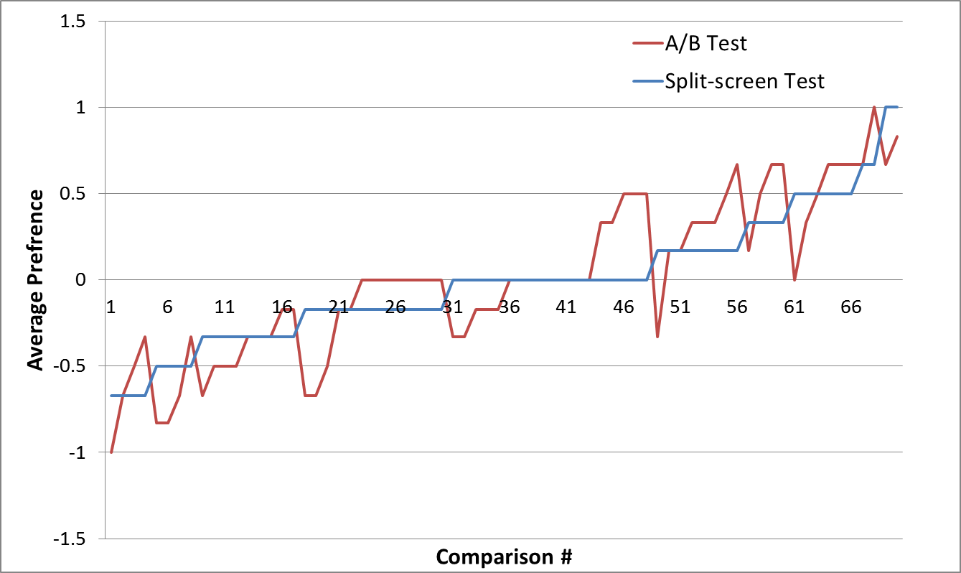
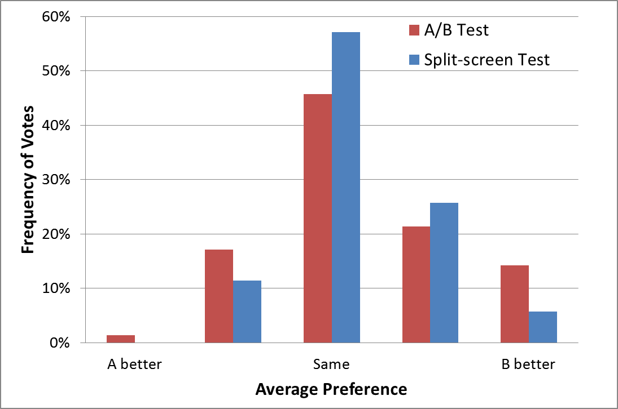
Results, Score Statistics

Slide 8
Results, Score Statistics
Histogram A/B test
Subjects | S1 | S2 | S3 | S4 | S5 | S6
A | 12 | 14 | 9 | 17 | 15 | 11
Same | 40 | 42 | 57 | 35 | 38 | 50
B | 18 | 14 | 4 | 18 | 17 | 9
For each Subject
H: Histograms of scores
P1: p(T_{AB} = A|B/T_{split-screen} = Same)
P2: p(T_{AB} = Same/T_{split-screen} = A|B)
P3: p(T_{AB} = T_{Split})
Histogram Split-screen Test
Subjects | S1 | S2 | S3 | S4 | S5 | S6
Left | 13 | 12 | 10 | 9 | 8 | 10
Same | 43 | 47 | 53 | 51 | 53 | 54
Right | 14 | 11 | 7 | 10 | 9 | 6
Subjects | S1 | S2 | S3 | S4 | S5 | S6
P1 | 0.18 | 0.21 | 0.12 | 0.28 | 0.32 | 0.18
P2 | 0.14 | 0.14 | 0.18 | 0.05 | 0.11 | 0.12
P3 | 0.67 | 0.64 | 0.68 | 0.65 | 0.54 | 0.68

Slide 9
Results, Score Statistics
Agreement Matrix (AB Test / Split-screen Test)
 | S1 | S2 | S3 | S4 | S5 | S6
S1 | 1 / 1 | 0.74 / 0.66 | 0.59 / 0.59 | 0.67 / 0.66 | 0.73 / 0.57 | 0.63 / 0.69
S2 | 0.74 / 0.66 | 1 / 1 | 0.56 / 0.59 | 0.69 / 0.7 | 0.64 / 0.63 | 0.6 / 0.61
S3 | 0.59 / 0.59 | 0.56 / 0.59 | 1 / 1 | 0.54 / 0.63 | 0.53 / 0.69 | 0.7/0.73
S4 | 0.67 / 0.66 | 0.69 / 0.7 | 0.54 / 0.63 | 1 / 1 | 0.71 / 0.64 | 0.5 / 0.64
S5 | 0.73 / 0.57 | 0.64 / 0.63 | 0.53 / 0.69 | 0.71 / 0.64 | 1 / 1 | 0.49 / 0.73
S6 | 0.63 / 0.69 | 0.6 / 0.61 | 0.7/0.73 | 0.5 / 0.64 | 0.49 / 0.73 | 1 / 1
 | All subjects score “same” | 5 out of 6 subjects score “same” | 4 out of 6 subjects score “same”
A/B Test | ~25% | 37% | 55%
Split-screen Test | ~25% | 54% | 71%

Slide 10
Conclusions
People see less differences in the split-screen test compared to the A/B test
  Could be that video viewing is difficult in general
  Since subjects only see one half of the video, differences in the other half are not scored
Subjects tend to agree more in the split-screen test. Score will be more correlated but may not be reflecting the reality
Although the tests are very different, they are consistent, i.e., rank order correlation of preference ~ 85%

