Slide 1

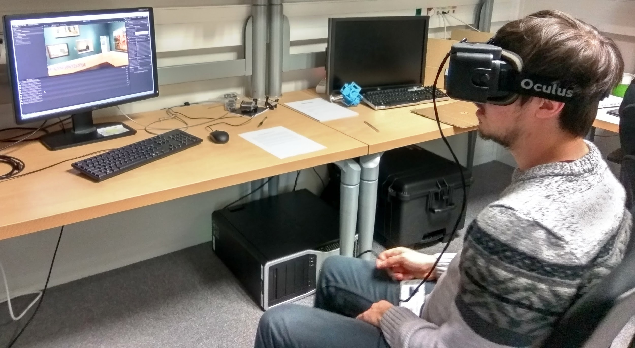


SALIENT360!
GRAND CHALLENGE
ICME 2018 edition

Slide 2
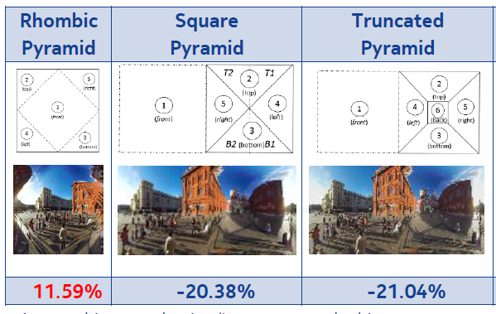
Visual attention (saliency) and 360
Viewport encoding and streaming, non-uniform quality streaming...
Artistic intent, story telling
Evaluation of quality : weighting the metrics
Notes:
Only a small part of the content will be seen!
Weighting the PSNR essential - But what type of saliency weighting???
ansmitting the entire panorama is data intensive/ wasteful
Use eye and head movement analysis to only stream/ render relevant data

Slide 3





SALIENT360!
GRAND CHALLENGE

Slide 4
We record
Raw eye+head tracking data
  Rotational angles, Translational movements.
  [2x2] Eyes-movement within the viewport projection.
  Time stamp of capture and record

Slide 5
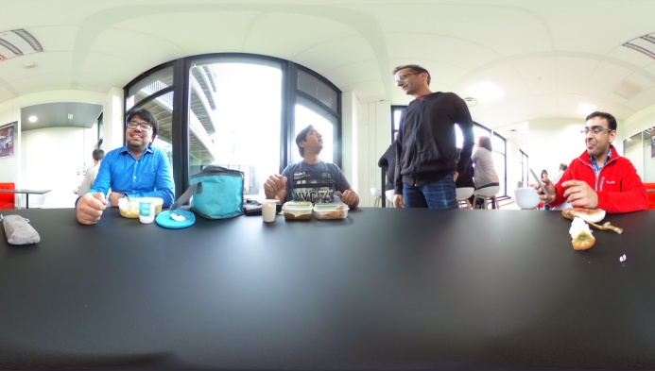
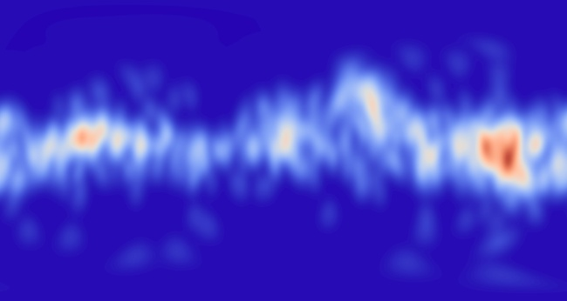
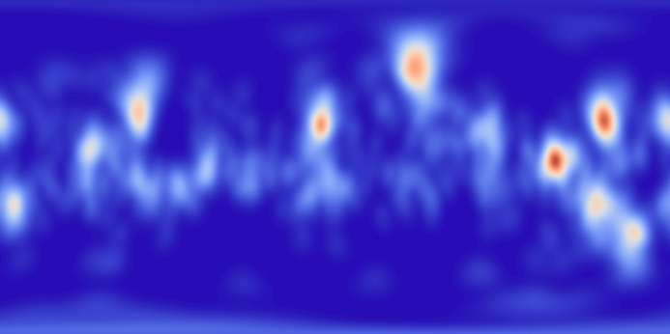
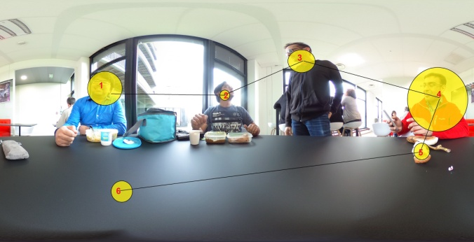
ChallengeS
Given a 360 image
Can you predict the view port location?
(Head gaze)
Can you predict the view port location and the eye gaze location in the view port?
(Eye Gaze location)
Can you predict the order of eye gaze fixation?

Slide 6
ChallengeS
Given a 360 image
Can you predict the view port location?
(Head gaze)
Can you predict the view port location and the eye gaze location in the view port?
(gaze location)
Can you predict the order of eye gaze fixation?
9 Teams
(China, Italy, France, Germany)
11 Teams (China, Italy, France, India, Ireland, South Korea Germany)
3 Teams (China, Ireland)

Slide 7

Many teams …
…and follow-up:
Special issue in Elsevier Signal Processing:Image Communications

Slide 8
2018 edition
Given a 360 image
or video
Can you predict the view port location?
(Head gaze)
Can you predict the order of view port location?
(Head gaze)
Can you predict the view port location and the eye gaze location in the view port?
(gaze location)
Can you predict the order of eye gaze fixation?

Slide 9
Interested to participate?
send an email to salient360@univ-nantes.fr
indicating the type of models that you may submit
For each model type please indicate if you are aiming for image or video
Model Type 1: these models are expected to predict Ground Truth Heat Map (GTHM) derived from the “movement of the head” only
Model Type 2: these models are expected to predict GTHM derived from the “movement of the head” as well as from the “movement of the eye within the viewport”
Model Type 3 : these models are expected to predict the Ground Truth Scan-Path (GTSP) of eye gaze that are obtained from the head and eye-movement data from several observers
Model Type 4: these models are expected to predict the GTSP of head gaze that are obtained from only the head data from several observers

