Slide 1
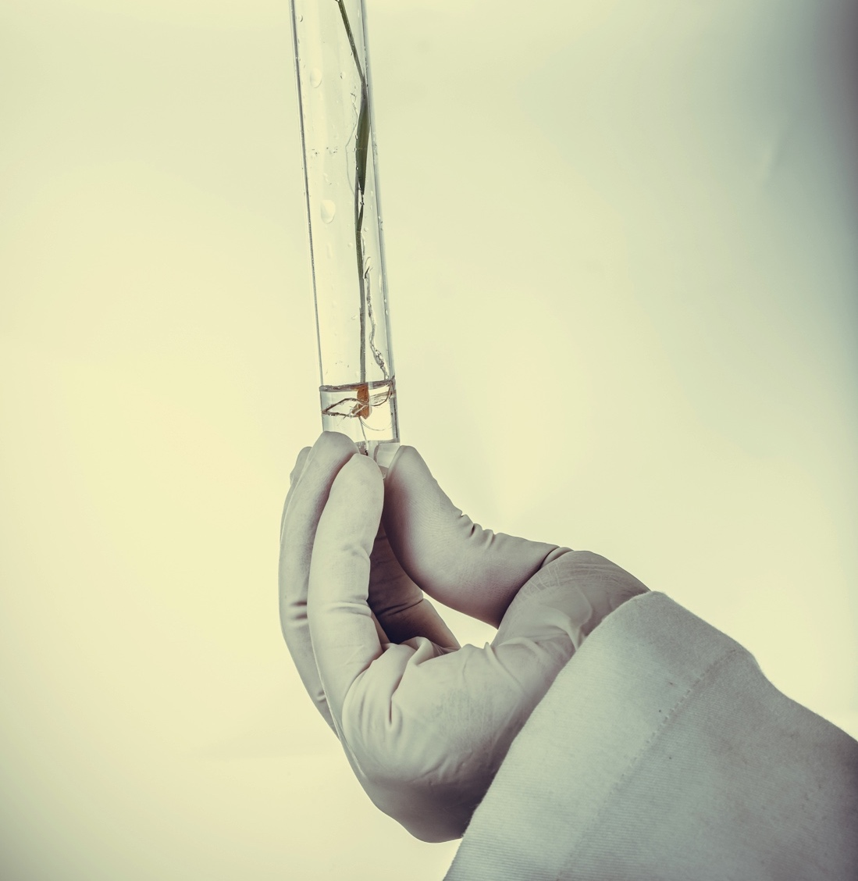

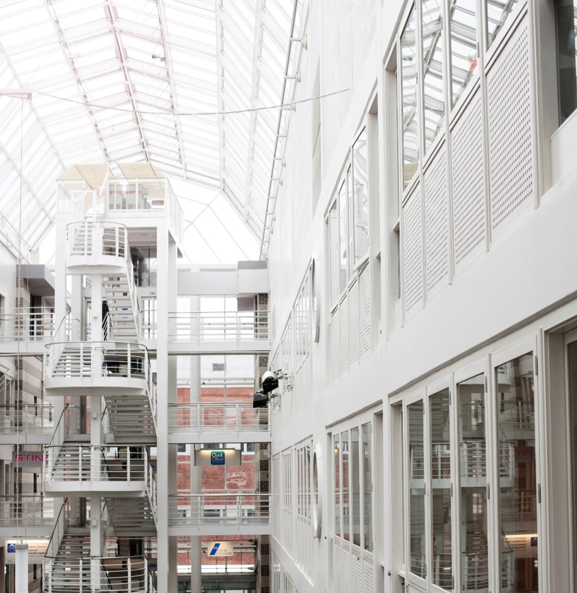
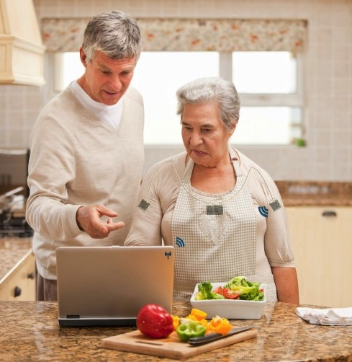
QoE for Augmented Telepresence
Kjell Brunnström
November 2017
RISE ICT
Acreo

Slide 2
Teaser of HVEI special session
Human Vision and Electronic Imaging 2018, 28 January - 1 February, 2018, Burlingame, California USA
  http://www.imaging.org/site/IST/IST/Conferences/EI/Symposium_Overview.aspx
Special session on “Perception and Quality of Experience in Immersive Environments”
Wednesday, 31 Jan 2018
10:50 2832034 Professor Zhenzhong Chen- VR QOE , Wuhan University, China (invited)
11:10 2822000 Christian Timmerer - Universität Klagenfurt, Austria QoE (invited)
11:30 2831058 Ashutosh Singla, Werner Robitza, Alexander Raake (invited)
11:50 2831857 Kjell Brunnström, "Quality of Experience for a Virtual Reality simulator",(invited)
12:10 2830756 JPI-first Jing Li,- "Exploring the effects of subjective methodology on assessing visual discomfort in immersive multimedia" (invited)

Slide 3
Teaser of HVEI special session
10:50 2832034 Professor Zhenzhong Chen- VR QOE , Wuhan University, China (invited) – VQEG meeting Tuesday morning
11:10 2822000 Christian Timmerer - Universität Klagenfurt, Austria QoE (invited) – not presented at the VQEG meeting
11:30 2831058 Ashutosh Singla, Werner Robitza, Alexander Raake (invited) – VQEG meeting Wednesday afternoon
11:50 2831857 Kjell Brunnström, "Quality of Experience for a Virtual Reality simulator",(invited) – VQEG meeting Tuesday morning
12:10 2830756 JPI-first Jing Li,- "Exploring the effects of subjective methodology on assessing visual discomfort in immersive multimedia" (invited) – VQEG meeting Monday afternoon

Slide 4
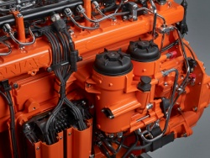
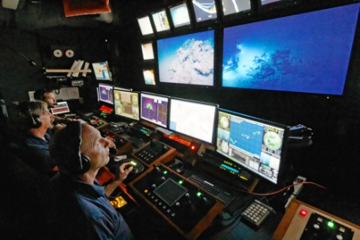
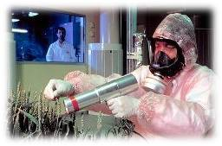
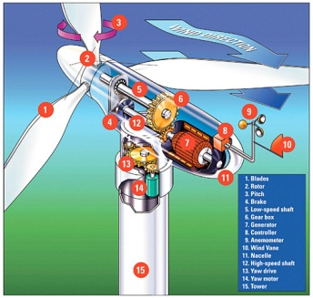
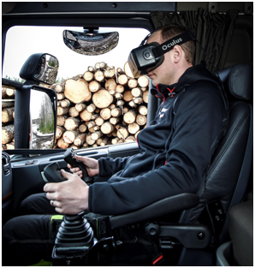
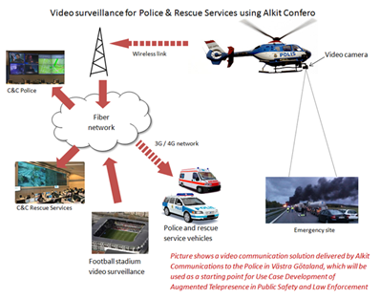
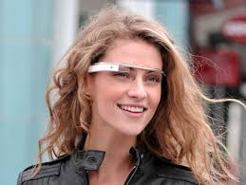
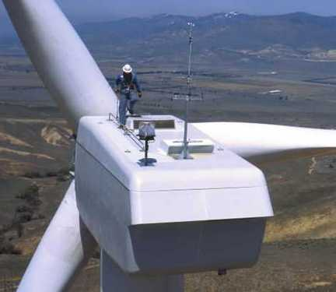

Augmented Telepresence
Remote location
Camera
Tracking module
Video Communications
Sensor
Augmented presentation

Slide 5
Augmented Telepresence
Augmented Reality from a remote location
Can include two way video communication, but could also be remote control of machines

Slide 6
Augmented Telepresence
Camera
Tracking module
Video Communications
Sensor
Augmented presentation

Slide 7
Augmented Telepresence and industrial use-cases
Both HIAB’s and Alkit’s use-case are either an extenstion or a special case of AT
Truck crane operation
Video surveillance for Police and Rescue services

Slide 8
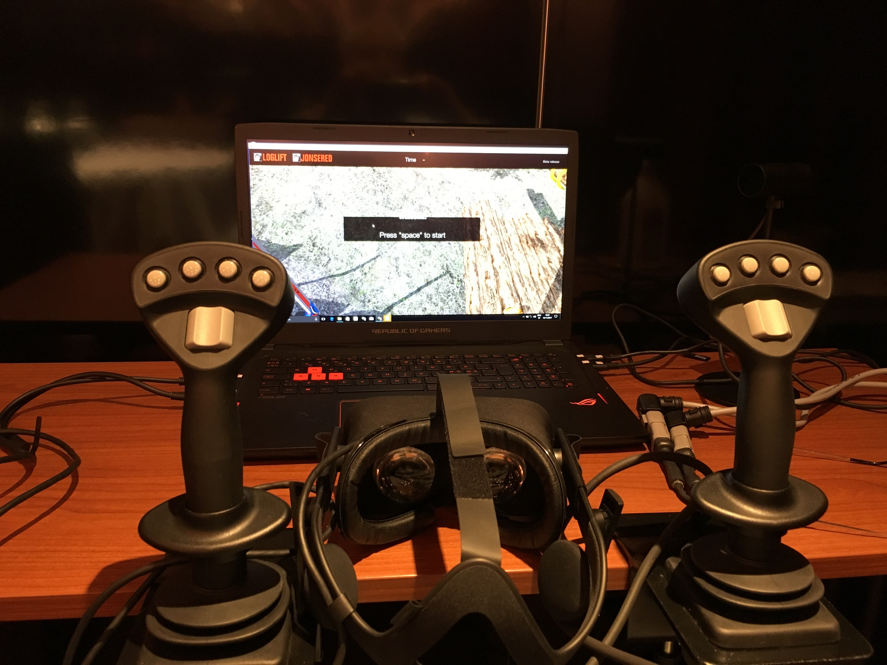
User pre-study – Currently we study the VR-version

Slide 9
User pre-study
A VR-similutor of HiVision Crane Operation has been available at Acreo
A pre-test has been planned, instructions and questionnaires written
The test procedure is as follows
  The test person is welcomed to the test by the test leader
  The person receives written instructions about the procedure
  The test persons vision is tested
  A pre-questionnaire including an SSQ is filled in by the test person
  A short training session is done to familiarize the test person with the task and environment (load two logs)
  Main session (loading a pile of logs). Time elapsed is noted.
  A pre-questionnaire including an SSQ is filled in by the test person
  Test person is thanked for its participation and the test is finished
Four test persons have participated so far

Slide 10
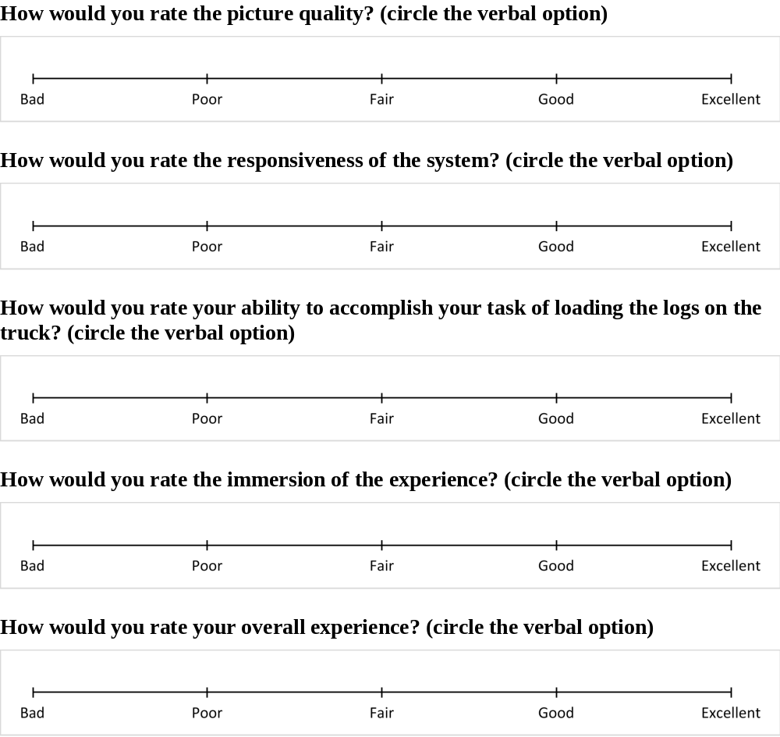
User pre-study
Scales used:

Slide 11
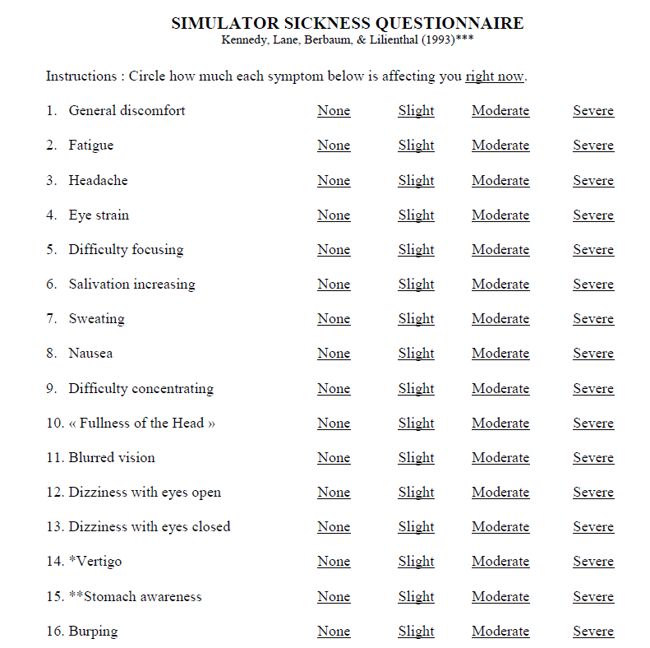
User pre-study
SSQ used:

Slide 12
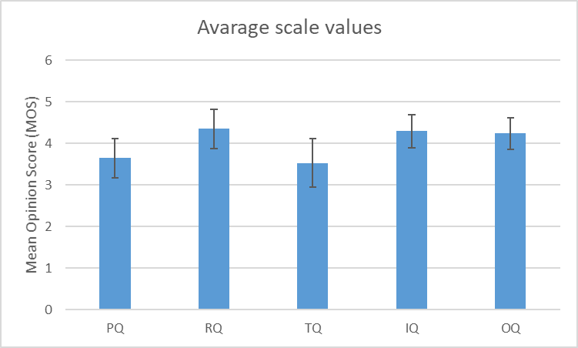
User pre-study – prel results
Based on 17 test subjects (2/3 males and 1/3 females) recruited internally.
Average time: 27 min
SSQ reports at most slight symptoms, so very low influence
Except one person that got very nauseated after just one minute (did not participate in the test)

Slide 13
Upcoming latency study
Simulator software modified to introduce delay/latency
  Screen update
  Haptic control
Plan to vary delay randomly every 2 min
Ask for rating at these time (5 x 5 = 25 different)
Total time about 1 hour
SSQ reports report before and after
Number of test subject about 25 (gender balanced)

Slide 14
Thank you!
Kjell Brunnström
kjell.brunnstrom@acreo.se
+46708419105
RISE Acreo

