Slide 1





Masked Detection of HEVC Compression Artifacts on Professional, Consumer, and Mobile Displays
Yi Zhang, Yus Yaacob, and Damon M. Chandler
Department of Electrical and Electronic Engineering
Shizuoka University
Hamamatsu, Shizuoka, Japan
Shizuoka
University
静岡大学

Slide 2
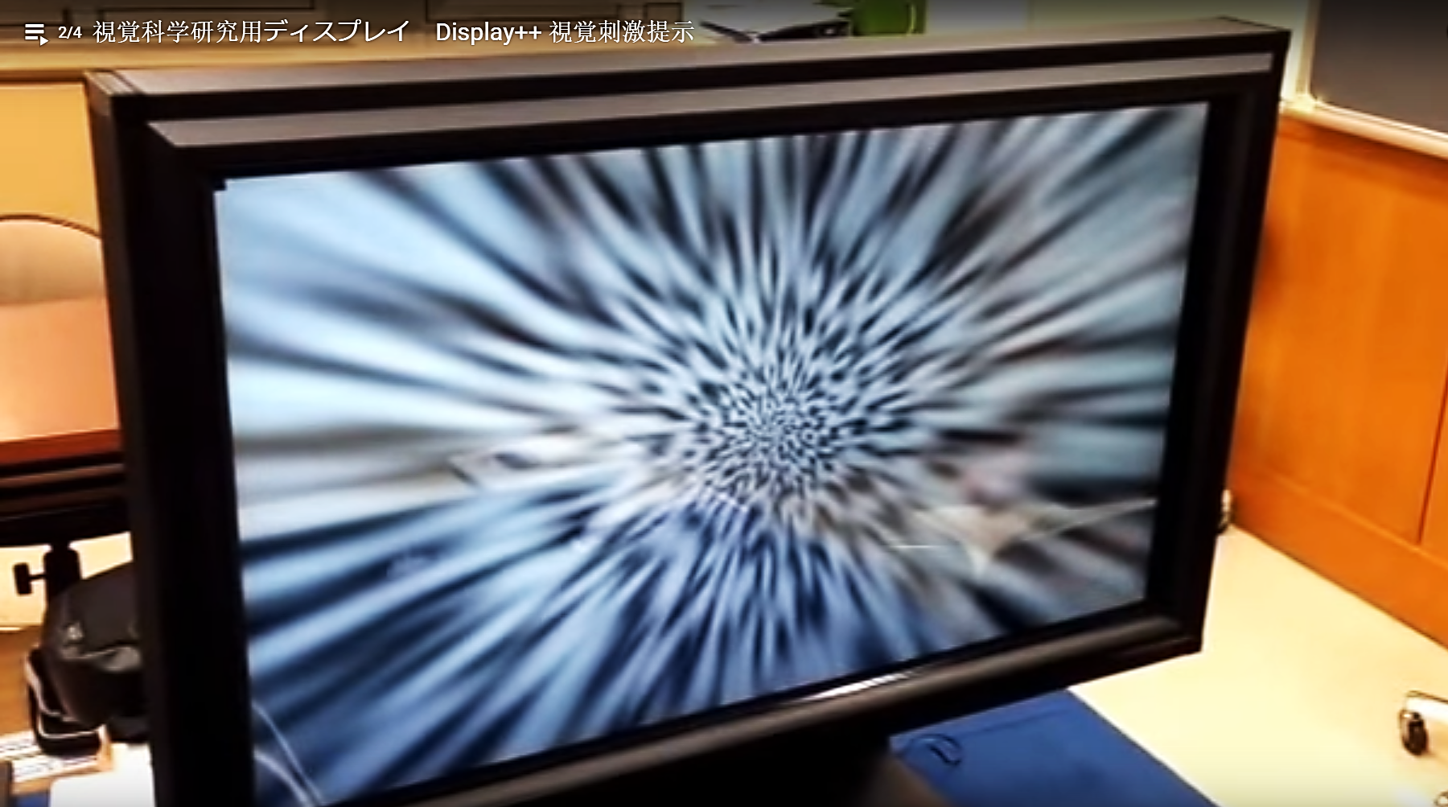

Slide 3
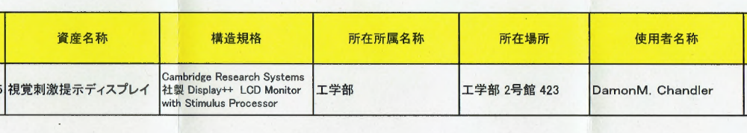
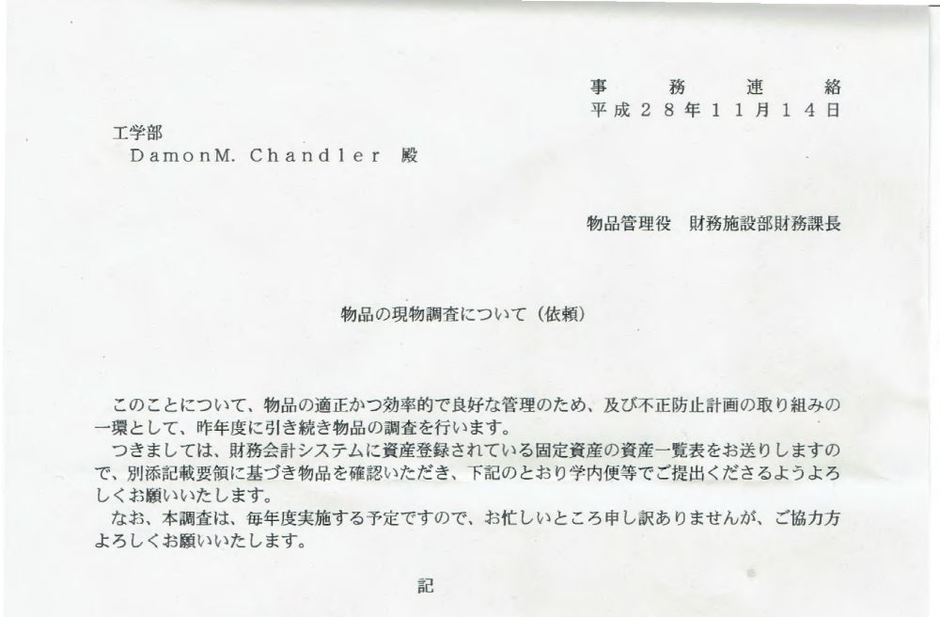

Slide 4
Questions
(1) Can thresholds measured on mobile devices yield the same results as measured on laboratory and desktop displays when viewing conditions and display EOTFs are kept constant?
(2) How are the thresholds affected when EOTFs change on mobile displays, and do such changes agree with model predictions?
(3) How do the variabilities in thresholds due to (1) and (2) compare to the variability across subjects, content, and gaze location?

Slide 5
Outline
Experiment 1: iPad vs. Others
Experiment 2: iPad “Brightness” settings
Summary
1
2
3

Slide 6
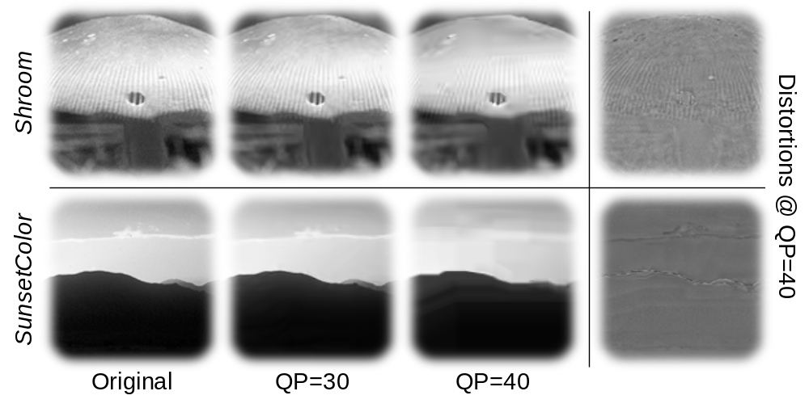
Experiment 1: Stimuli
Reproducing Thresholds on the iPad

Slide 7
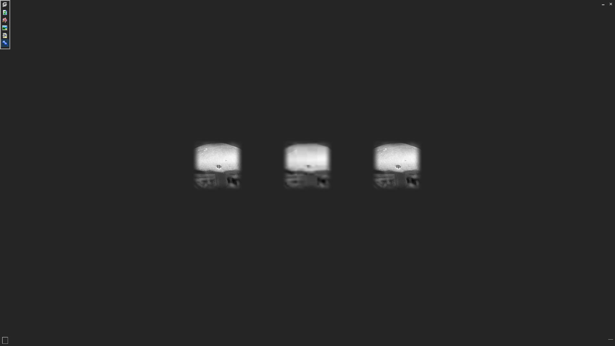
Experiment 1: Methods
Reproducing Thresholds on the iPad
Subjects: Three authors were the subjects
Procedures: Spatial 3AFC, QUEST staircase
7-second time limit, audio feedback
Darkened room (not pitch black, cinema setting)
Displays:
  Cambridge Research Systems Display++ ($10,000)
  I-O Data LCD monitor ($150)
  Apple iPad Air 2 ($650 unit, < $100 LCD+glass alone?)
Viewing distances varied → 3×3-deg stimulus

Slide 8
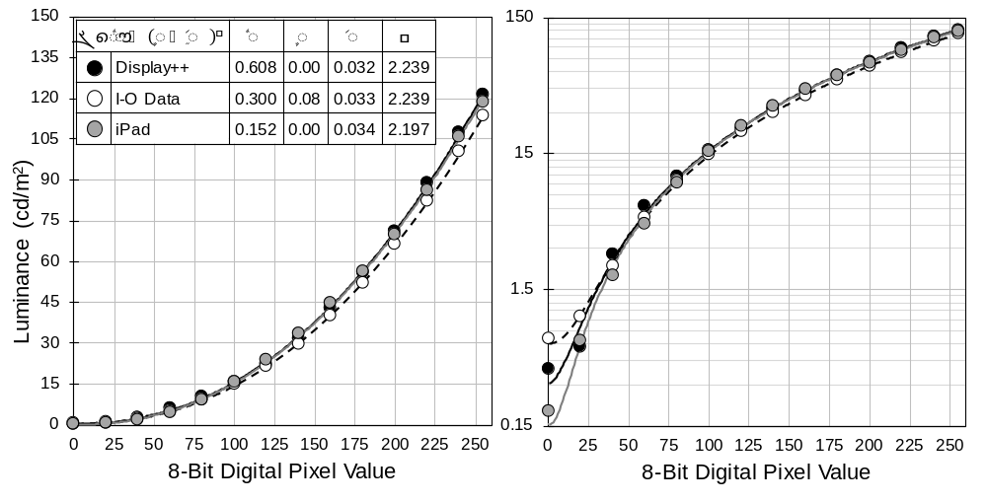
Experiment 1: EOTFs
Reproducing Thresholds on the iPad
DataColor Spyder5 ELITE

Slide 9
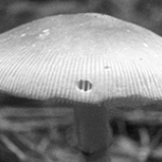
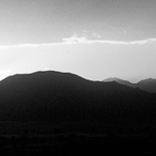
Experiment 1: Results
Reproducing Thresholds on the iPad
Shroom
Shroom
SunsetColor
Easier to Detect
Easier to Detect

Slide 10
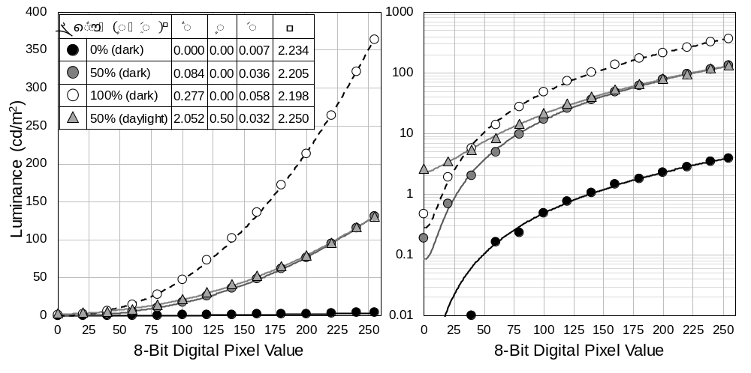
Experiment 2: EOTFs
Thresholds on the iPad for different “Brightness” settings
DataColor Spyder5 ELITE
Luminance (cd/m²)

Slide 11
Experiment 2: EOTFs
Thresholds on the iPad for different “Brightness” settings
DataColor Spyder5 ELITE
Luminance (cd/m²)

Slide 12
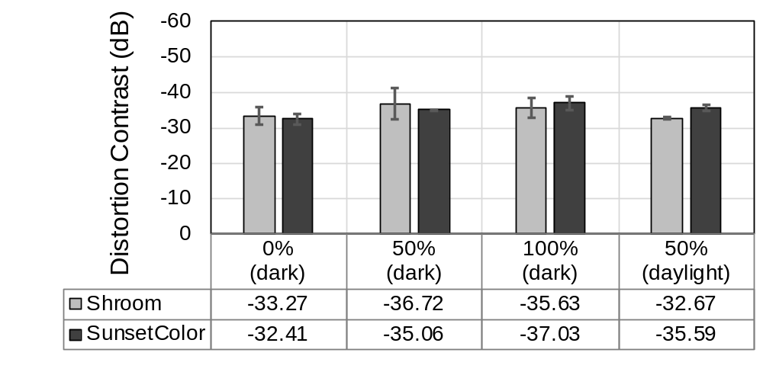
Experiment 2: Results
Thresholds on the iPad for different “Brightness” settings
Easier to Detect

Slide 13
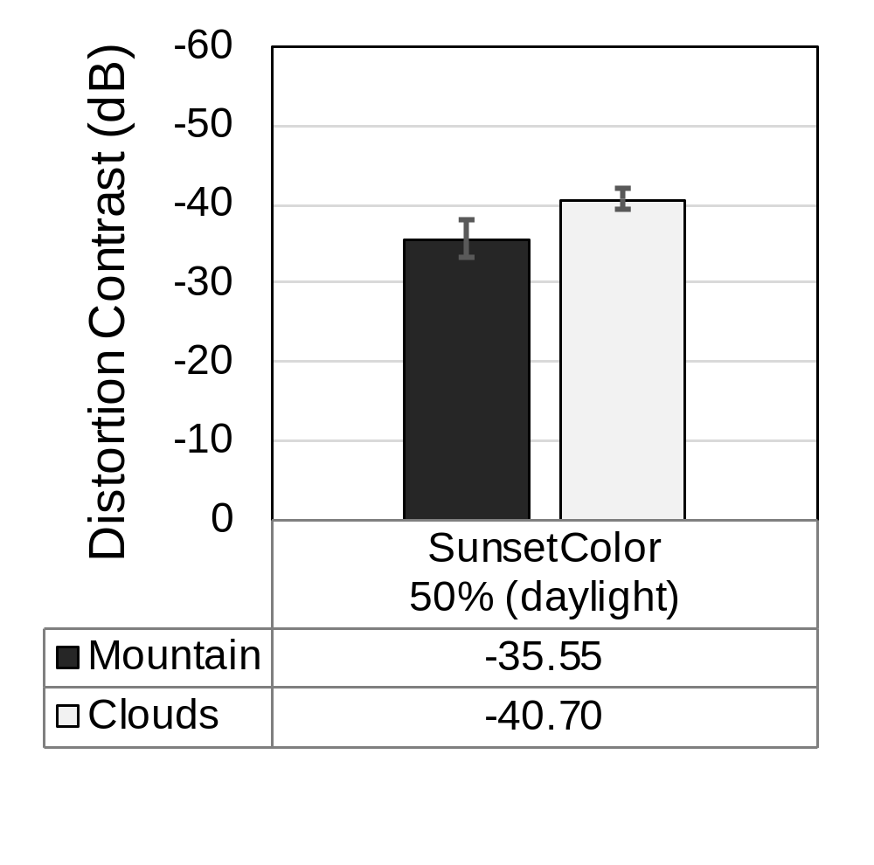
Pilot² Experiment
Effects of gaze location
Easier to Detect
SunsetColor

Slide 14
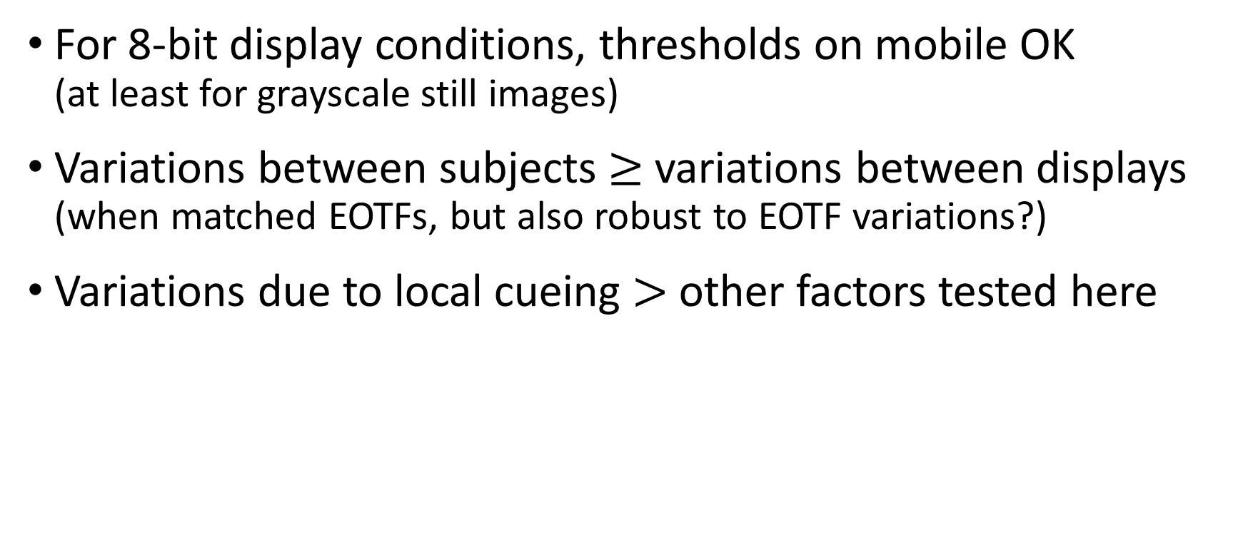
Conclusions
For 8-bit display conditions, thresholds on mobile OK
(at least for grayscale still images)
Variations between subjects $≥$ variations between displays (when matched EOTFs, but also robust to EOTF variations?)
Variations due to local cueing $>$ other factors tested here

Slide 15
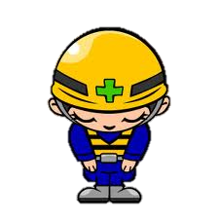
Masked Detection of HEVC Compression Artifacts on Professional, Consumer, and Mobile Displays
Thank you very much!
Yi Zhang, Yus Yaacob, and Damon M. Chandler
Department of Electrical and Electronic Engineering
Shizuoka University
Hamamatsu, Shizuoka, Japan
Shizuoka
University
静岡大学

