Slide 1

From prediction of perceived image quality to online image quality improvement
.
VQEG meeting May 2017
By: Pini Zorea

Slide 2
Short introduction
Lecturer in image processing & electrical engineering courses 2013 - present
ORT Braude Engineering Colleges Israel
Image quality & system engineering lead (2D & 3D digital camera ) 2005 – 2013 Intel – Israel Development Center Israel
Senior video systems architect & video image quality manager 1999 – 2005
OPLUS Technologies (acquired by Intel in 2005) Israel
2

Slide 3
To leverage the VIQET platform capabilities towards development of new applications:
1. Perceived image quality prediction – report here.
2. Online IQ evaluation & IQ improvement in real-time – Will be next.
Objectives
3
Notes:
This should leave of the context of research problem and motivation. But it's not like that...
Because the problem is not good defined.

Slide 4
VIQET introduction
The VQEG Image Quality Evaluation Tool (VIQET) is an objective, no-reference photo quality evaluation tool.
VIQET is a free open source tool designed to evaluate quality of consumer photos.
In this work I used PC version 2.3.117.87
4
Notes:
Is not convincing

Slide 5

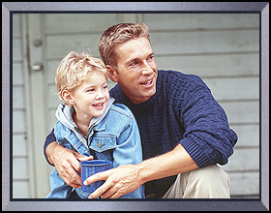
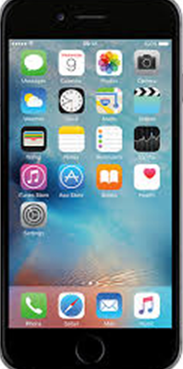







Online IQ assessment & improvement in social networks
On-line IQ monitoring and on-line IQ improvement
Evaluation of
IQ
Improve IQ
5
Notes:
Is not demonstrative!

Slide 6
Perceived IQ prediction with VIQET
6
Notes:
They should start by describing the problem.
But not only...
It was the growth characteristics photo camera, which is limited.
Also, at some level - this growth giving nothing for IQ. But make devices more expensive.
From here you would feel the significance of research for smratpohnes producers and vendors.

Slide 7
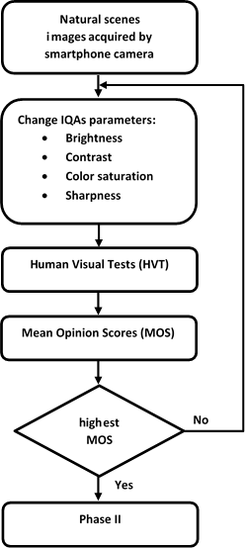
Phase I: Relationship between standard IQAs and perceived IQ
7
Notes:
I do not think that this is a successful parallel. Can be delete.

Slide 8
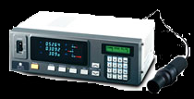
Phase I : Subjective IQ assessment setup
Method | DSIS (Double stimulus impairment scale)
Evaluation scales | 5 Grades (Impairment scales)
Subjects | 98 (Non expert, students), 5 subjects per session
Display | 5.1-inch, LCD Samsung Galaxy S5 All were calibrated with Color analyzer Minolta CA-310
Display resolution | 1920×1080 pixels
Viewing distance | 5H (H = picture height)
Room illumination | ~100lux
8
Notes:
I do not think that this is a successful parallel. Can be delete.

Slide 9
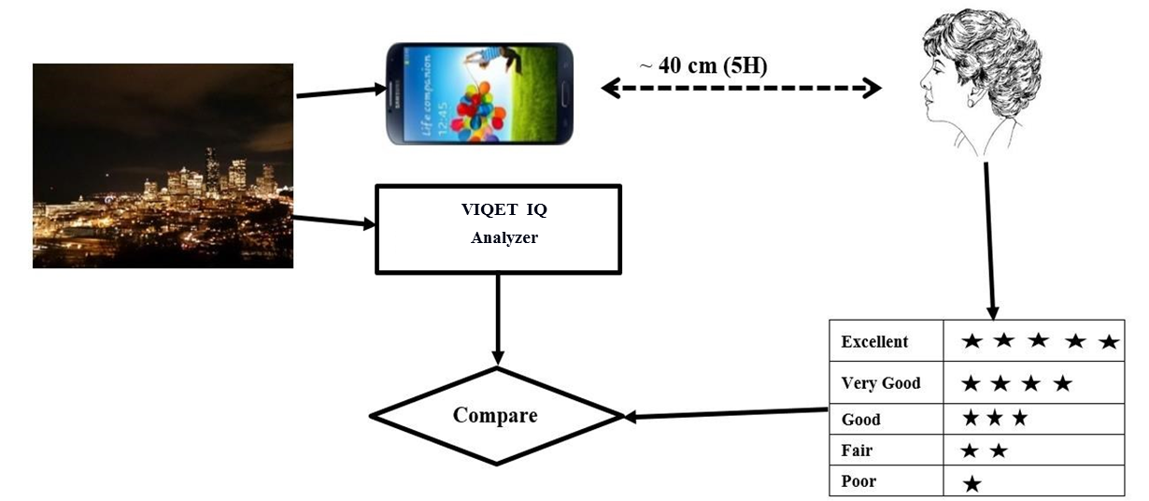
The IQ assessment process
9

Slide 10
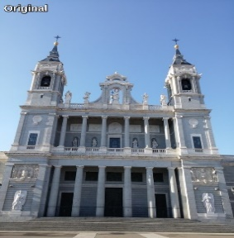


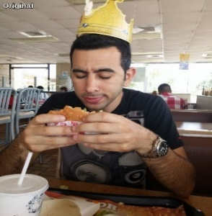
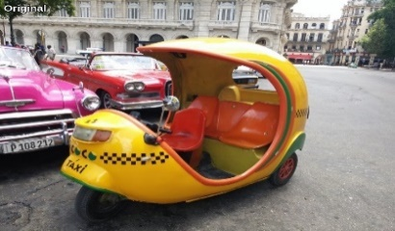
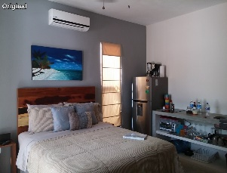
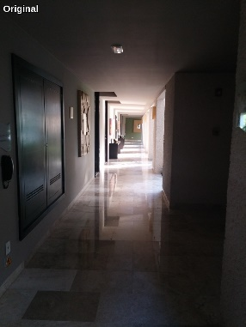

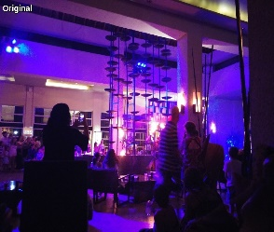
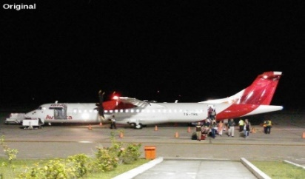
Phase I: Test content
(lake)
(man)
(building)
(taxi)
(king)
(room)
(sunset)
(bar)
(hall)
(airplane)
10
Notes:
I do not think that this is a successful parallel. Can be delete.

Slide 11
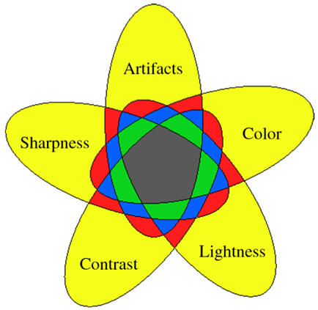
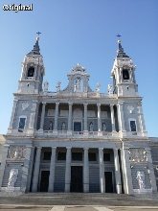
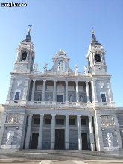
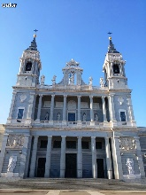
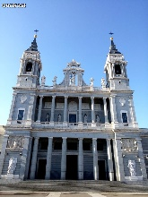
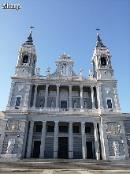
Phase I: Test content with variable image quality attributes
Original
(Brightness)
( Color)
(Contrast)
( Sharpness)
The Venn diagram
HVTs
VIQET
Image Analysis
11

Slide 12
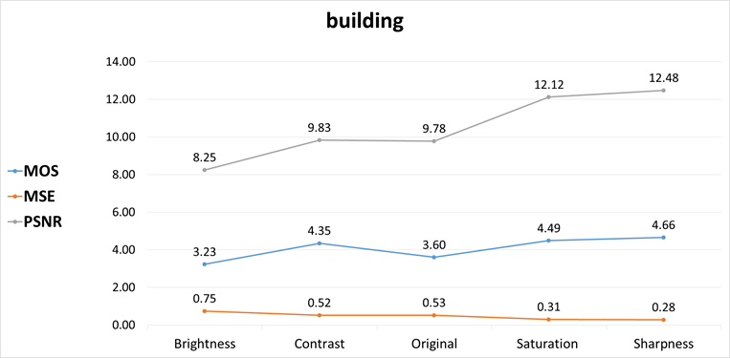
MOS, MSE and PSNR relationship for the “building” image
12

Slide 13
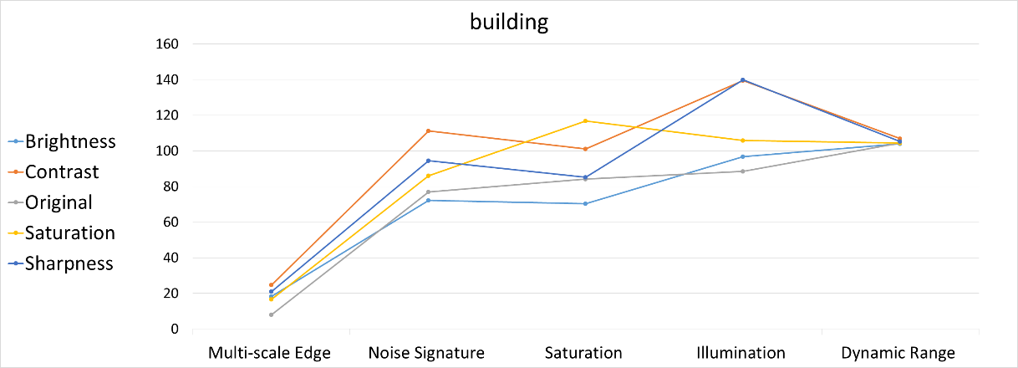
VIQET IQ criteria relationship for the “building” image
13

Slide 14
Classic IQA extraction to VIQET IQ categories
Image quality attributes | VIQET image quality categories
Brightness | Illumination (0-255) % Over‐exposed % Under‐exposed Lux (0-255)
Contrast | Dynamic range (0-255)
Color | Saturation (0-255) Color warmth
Sharpness | Multi-scale edge acutance (0-255) Multi-scale texture acutance (0-255) Noise signature index (0-590)
14

Slide 15
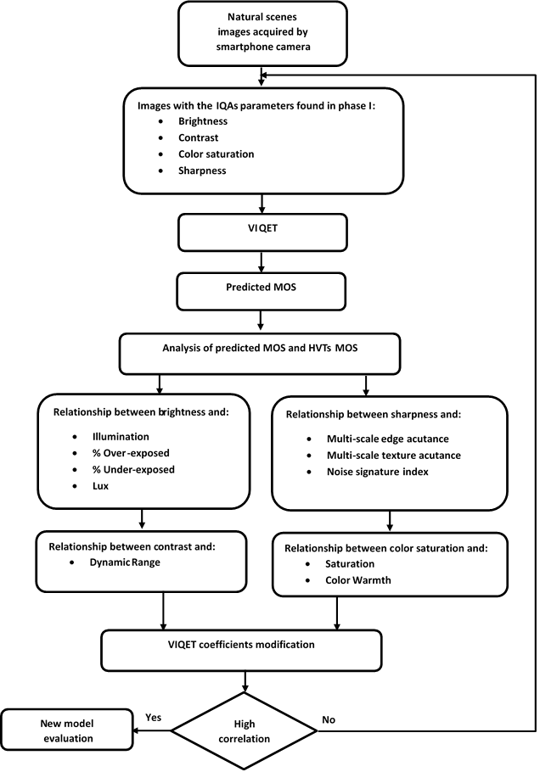
Phase II: Subjective & Objective IQ assessment flow chart
15
Notes:
I do not think that this is a successful parallel. Can be delete.

Slide 16
The new model added value to standard IQ process
16
Notes:
I do not think that this is a successful parallel. Can be delete.

Slide 17
Evaluation of VIQET in perceived IQ prediction
Test content – 40 natural scenes (8MP) by smartphone camera.
Observers – 35 (college students)
Received MOSi (observers) and MOSp by VIQET
Good correlation between MOSp and MOSi.
Results examined according to P.913, ITU-T, 2016 recommendation (5 metrics).
17
Notes:
They should start by describing the problem.
But not only...
It was the growth characteristics photo camera, which is limited.
Also, at some level - this growth giving nothing for IQ. But make devices more expensive.
From here you would feel the significance of research for smratpohnes producers and vendors.

Slide 18
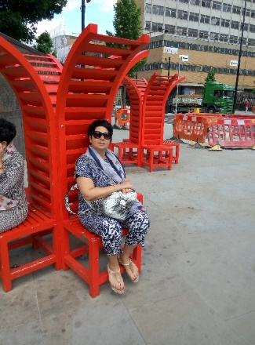
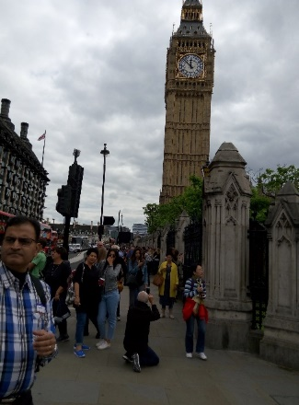
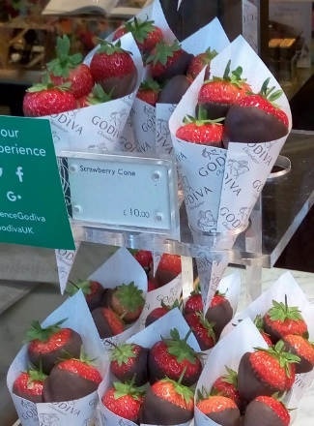
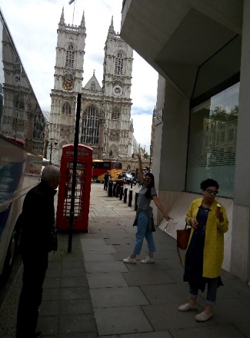
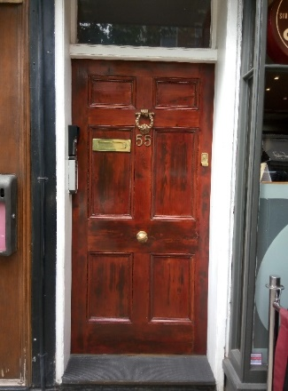
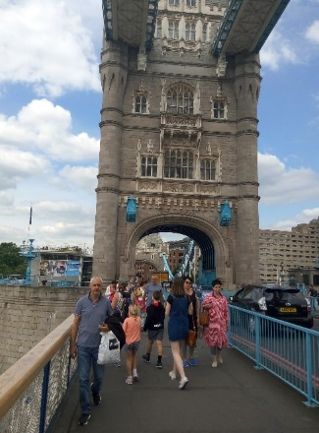
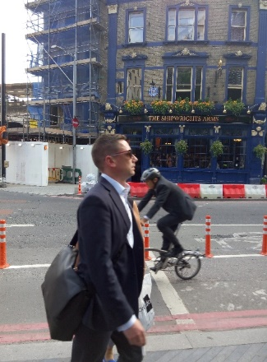
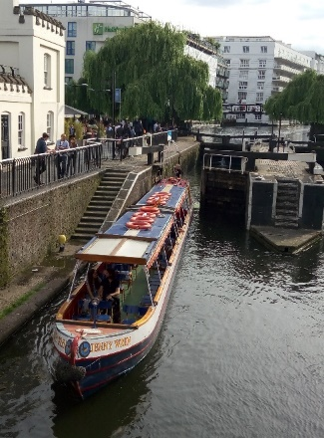
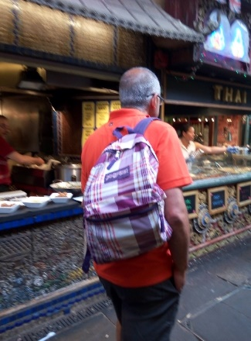
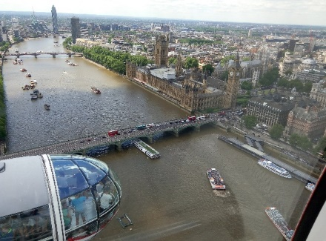
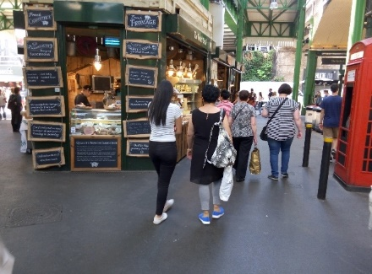
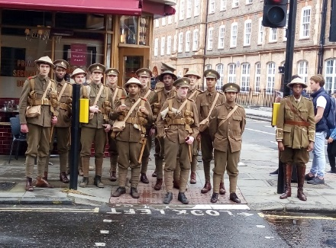
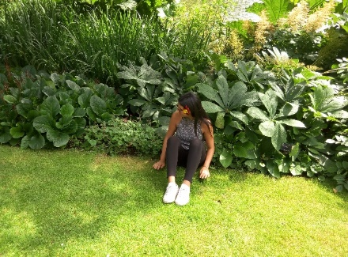
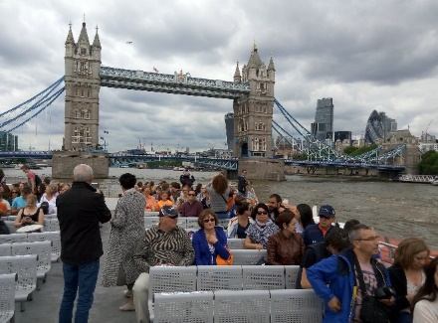
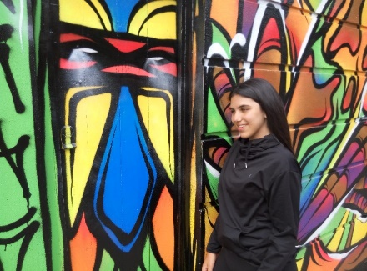
Outdoor Day light
18
18
Notes:
Is not convincing

Slide 19
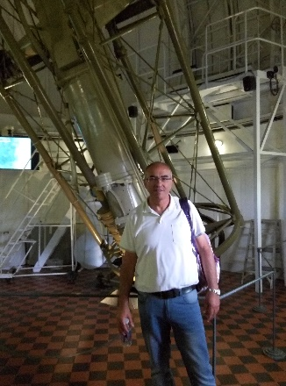
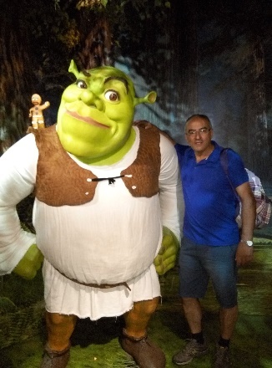
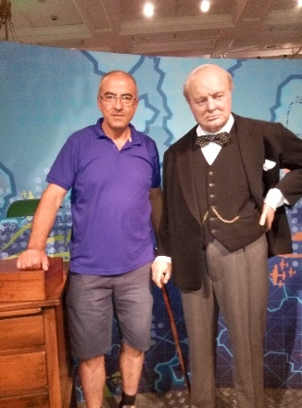
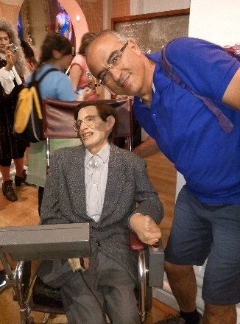
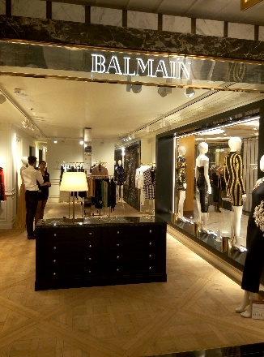
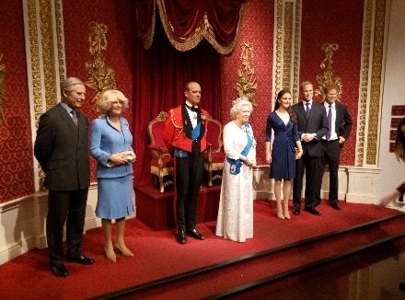
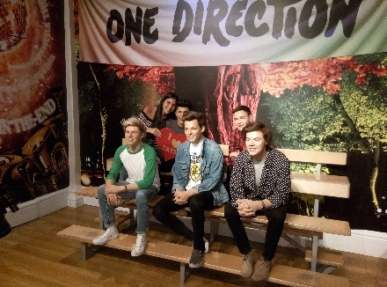
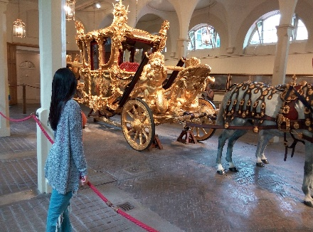
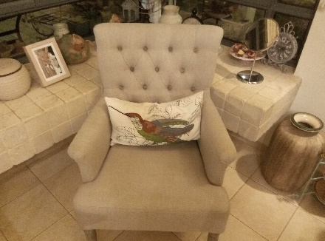
Indoor Arrangements
19
19
Notes:
Is not convincing

Slide 20
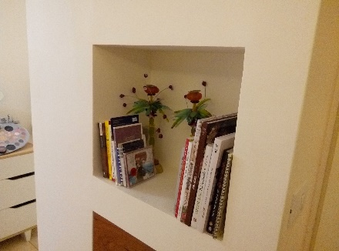
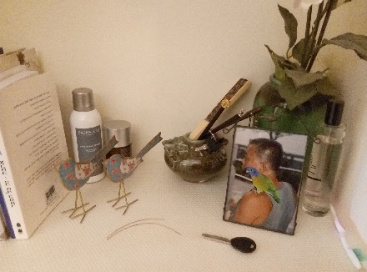
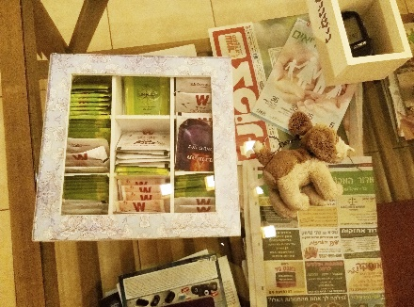
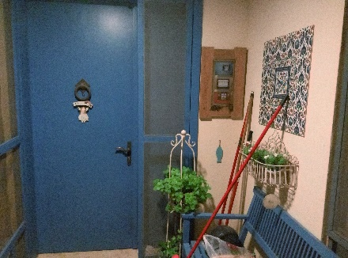
Indoor Wall hangs
20
20
Notes:
Is not convincing

Slide 21
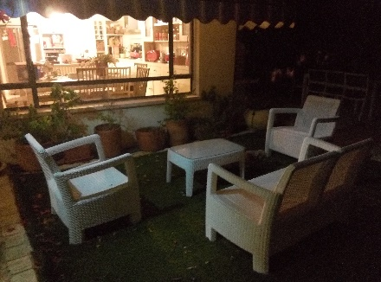









Outdoor Night
21
21
Notes:
Is not convincing

Slide 22

MOSp relation to MOSi
22
Notes:
I do not think that this is a successful parallel. Can be delete.

Slide 23

The new model evaluation
Metric 1: Pearson correlation coefficient (CC) between objective MOSp and subjective MOS scores. It is evaluation of prediction accuracy
Where MOS(i) denotes the subjective score and MOSp(i) the objective score.
N represents the total number of images considered in the analysis.
This measures the strength of a linear association between two variables.
value r = 1 means a perfect positive correlation.
value r = -1 means a perfect negative correlation.
23

Slide 24

New model evaluation…cont.
Metric 2: Spearman rank order correlation coefficient (SROCC) between objective MOSp and subjective MOS. It measures the prediction monotonicity
Where MOS(i) denotes the subjective score and MOSp(i) the objective score.
N represents the total number of images considered in the analysis.
The significant Spearman correlation coefficient value of 1.00 confirms a strong positive correlation between the two variables MOSp and MOS.
24

Slide 25

New model evaluation…cont.
Metric 3: Outlier ratio (OR) evaluates an objective model's ability to provide consistently accurate prediction
Where Outlier Ratio = Outliers / N.
N represents the total number of images considered in the analysis.
Outlier is a point for: |MOS(i) − MOSp(i)| > 2×σ(MOS(i)), where σ(MOS(i)) is the standard deviation of the individual scores.
The smallest Outlier Ratio is better.
25

Slide 26

New model evaluation…cont.
Metric 4: Average absolute prediction error (AAE)
Where MOS(i) denotes the subjective score and MOSp(i) the objective score.
N represents the total number of images considered in the analysis.
The AAE measures the average magnitude of the errors in a set of forecasts.
It measures accuracy for continuous variables.
The AAE is a linear score which means that all the individual differences are weighted equally in the average
26

Slide 27

New model evaluation…cont.
Metric 5: Root mean square error (RMSE)
Where MOS(i) denotes the subjective score and MOSp(i) the objective score.
N represents the total number of images considered in the analysis.
The accuracy of the objective metric is evaluated by RMSE
The RMSE is a quadratic scoring rule which measures the average magnitude of the error.
Lower value of RMSE is better
27

Slide 28
Thank You !
Notes:
They should start by describing the problem.
But not only...
It was the growth characteristics photo camera, which is limited.
Also, at some level - this growth giving nothing for IQ. But make devices more expensive.
From here you would feel the significance of research for smratpohnes producers and vendors.

