Slide 1
QAPI: a QoE control technology for online video streaming services
VQEG Meeting
2017.5.11
Arifumi Matsumoto
NTT Network Technology Laboratories

Slide 2
Who we are
NTT Network Technology Laboratories is in NTT R&D division.
Our team’s research theme: QoE-centric operation
  QoE quantification (standardization)
  QoE measurement/collection
  QoE analysis/visualization
  QoE control
QAPI(Quality API)
is an instance of
QoE-centric
operation

Slide 3
Even the latest video streaming technology needs improvement
Even with the latest streaming technology, such as ExoPlayer provided by google, video viewing experience is degraded largely due to user mobility and network congestions.
*Rebuffering ratio: the ratio of viewing that includes one or more rebuffering events

Slide 4
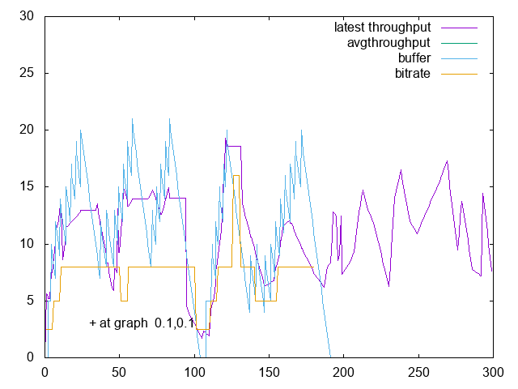
A case with rebuffering
When network quality(throughput) fluctuates, higher bitrates are likely to be chosen mistakenly, which results in rebuffering events at video player.

Slide 5




QAPI feature#1: Network Quality Prediction
Streaming server
QAPI
server
Network quality
prediction
Network quality
feedback for
future prediction
Bitrate selection
based on the prediction
Non-congested
area
Congested
area
QAPI server predicts and notifies network quality for each viewing.
The user device selects bitrate using the predicted quality.

Slide 6
Rapid Increase of Video Traffic
Video traffic is becoming headaches for carriers/contents providers.
Provisioning/Delivery cost increase, and traffic congestion results in video QoE degradation.

Slide 7
QAPI feature#2: control balance of QoE and Traffic
Poor Cost Performance
High volume of traffic consumption, but in QoE it makes little difference
QoE
Target QoE
QoE rapidly increases as the cost increases
Cost-Effective
Unacceptable QoE
Cost(Traffic=bitrate)
QAPI enables the control of QoE and Traffic balance.
With the target QoE fixed, QAPI achieves lowest cost delivery, that is, bitrate selection.
QoE model is used for the QoE calculation.

Slide 8
QAPI core technologies
QoE Model
Network Quality Prediction
P.NATS model proposed by NTT. This is pluggable.
Based on historical network quality data gathered from user devices.
Bitrate Selection Strategy
A series of bitrates is worked out with the QoE targeted, traffic cost lowest.

Slide 9
QAPI effect: QoE = 4.0 (avg)
With the loss of QoE by 0.3 points, the traffic cost(bitrate) was reduced by 70%.
The strategy with lower stop rate and lower bitrate was chosen to achieve QoE 4.0
This is a simulation result based on real-world data, such as
throughput fluctuation and mobile hand-over occurrences.

Slide 10
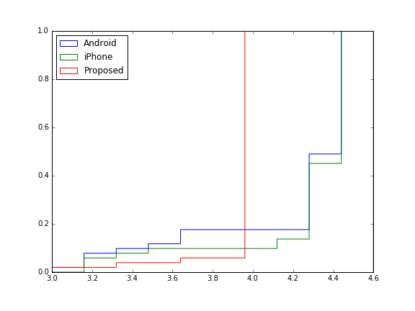
QAPI effect: QoE = 4.0 (CDF)
Target QoE: 4.0
Viewings with QoE > 4.0 are almost zero, viewings with QoE < 4.0 are reduced.
Overall, QoEs are converged to the targeted QoE: 4.0.

Slide 11
QAPI effect: QoE = 5.0 (avg)
QAPI works for boosting QoE by setting the target QoE 5.0 (maximum).
if the traffic cost(bitrate) increase of 30% is acceptable, QoE can be increased by 0.1, 0.2 points,
This is a simulation result based on real-world data, such as
throughput fluctuation and mobile hand-over occurrences.

Slide 12
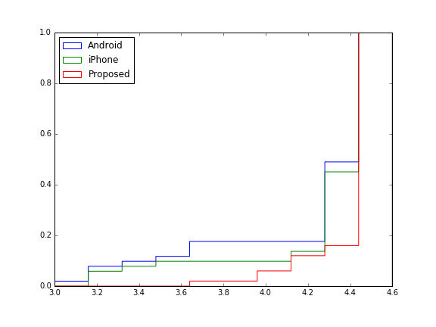
QAPI effect: QoE = 5.0 (CDF)
Target QoE: 5.0
Viewings with QoE < 5.0 are reduced.
The QoE model has the upper limit around 4.5.

Slide 13
Easy to integrate QAPI into player app.
Streaming server
QAPI
server
Playlist
Media data
Quality Prediction
Player GUI
QAPI
module
Quality Feedback
QAPI module chooses a bitrate and retrieves corresponding media data as guided by the QAPI server.
Inside a viewer application
QAPI module is loosely coupled with the player part. The module needs to be called only once for viewing setup.

Slide 14
Try QAPI !!
QAPI is just baked.
  QAPI is a technology to balance the traffic cost and QoE, and based on network quality prediction.
We are looking for a partner to demonstrate QAPI in the field as a joint effort.
QAPI

