Slide 1
Status update on ITU-T
Crowdsourcing Standardization
Hanan Alnizami, Philip J Corriveau, Patrick E. McKnight
Jake Quartuccio, David Nicholas, Michele Saad
Tobias Hossfeld, Samira Tavakoli

Slide 2
Scope
Standardization of a general crowdsourcing guidance for different media subjective assessment testing
For each media type : an Annex to the standard

Slide 3



Why crowdsourcing?
Flexibility in experimental design
Realistic settings

Slide 4
Content
Experimental design
    Evaluation methodology
      Pair Comparison
    Stimuli
      Source stimuli
      Anchor

Slide 5
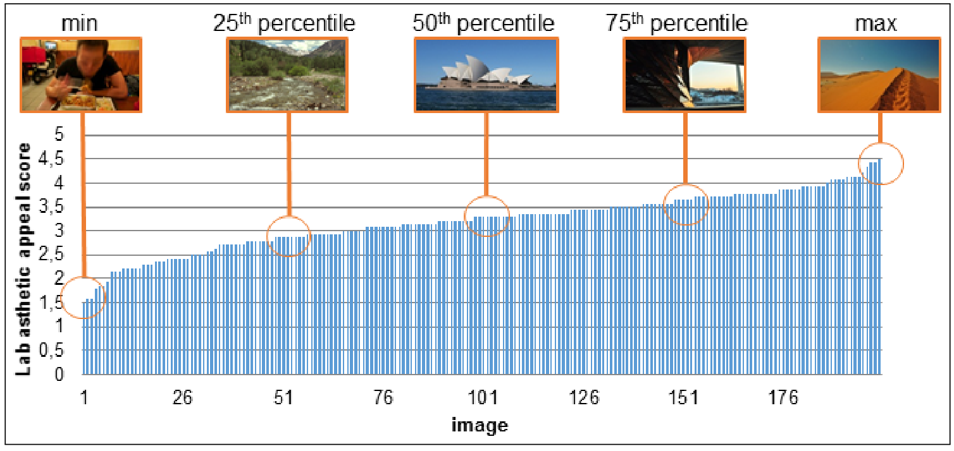


Content
Experimental design
    Evaluation methodology
      Pair Comparison
    Stimuli
      Source stimuli
      Anchor

Slide 6
Content
Experimental design (cont.)
    Validity check

Slide 7
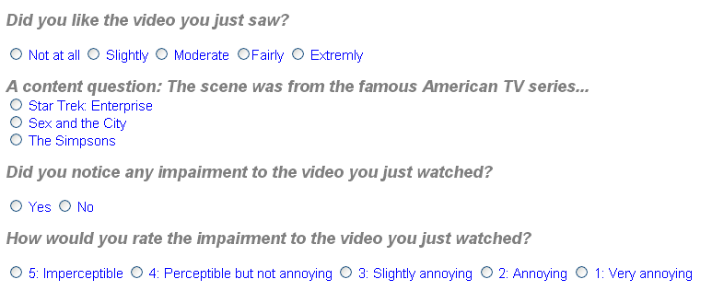
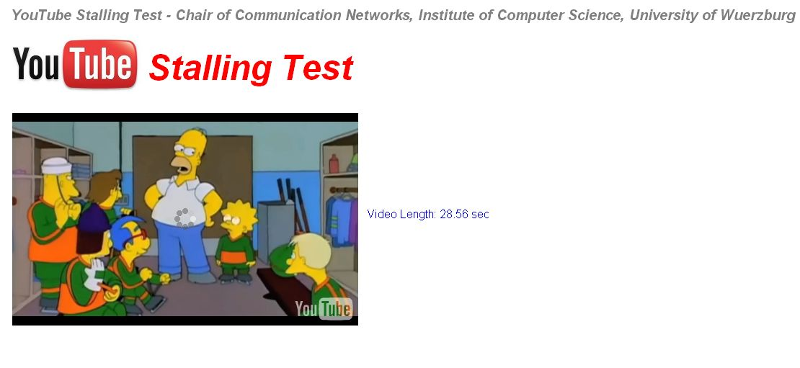
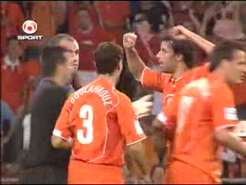


Validity check: User ratings for consistency questions
stops
Content Question
Simple questions!
Which sport was shown in the clip?
Tennis
Soccer
Sking
Application usage monitoring
  E.g. measuring the focus time= time interval during which browser focus is on the test website

Slide 8


Content
Experimental design (cont.)
    Test length
      overall enjoyability of the whole experiment
      complexity of the task
      amount of reward
      user’s ability to understand the task
      Pilot testing
    Number of test participants

Slide 9

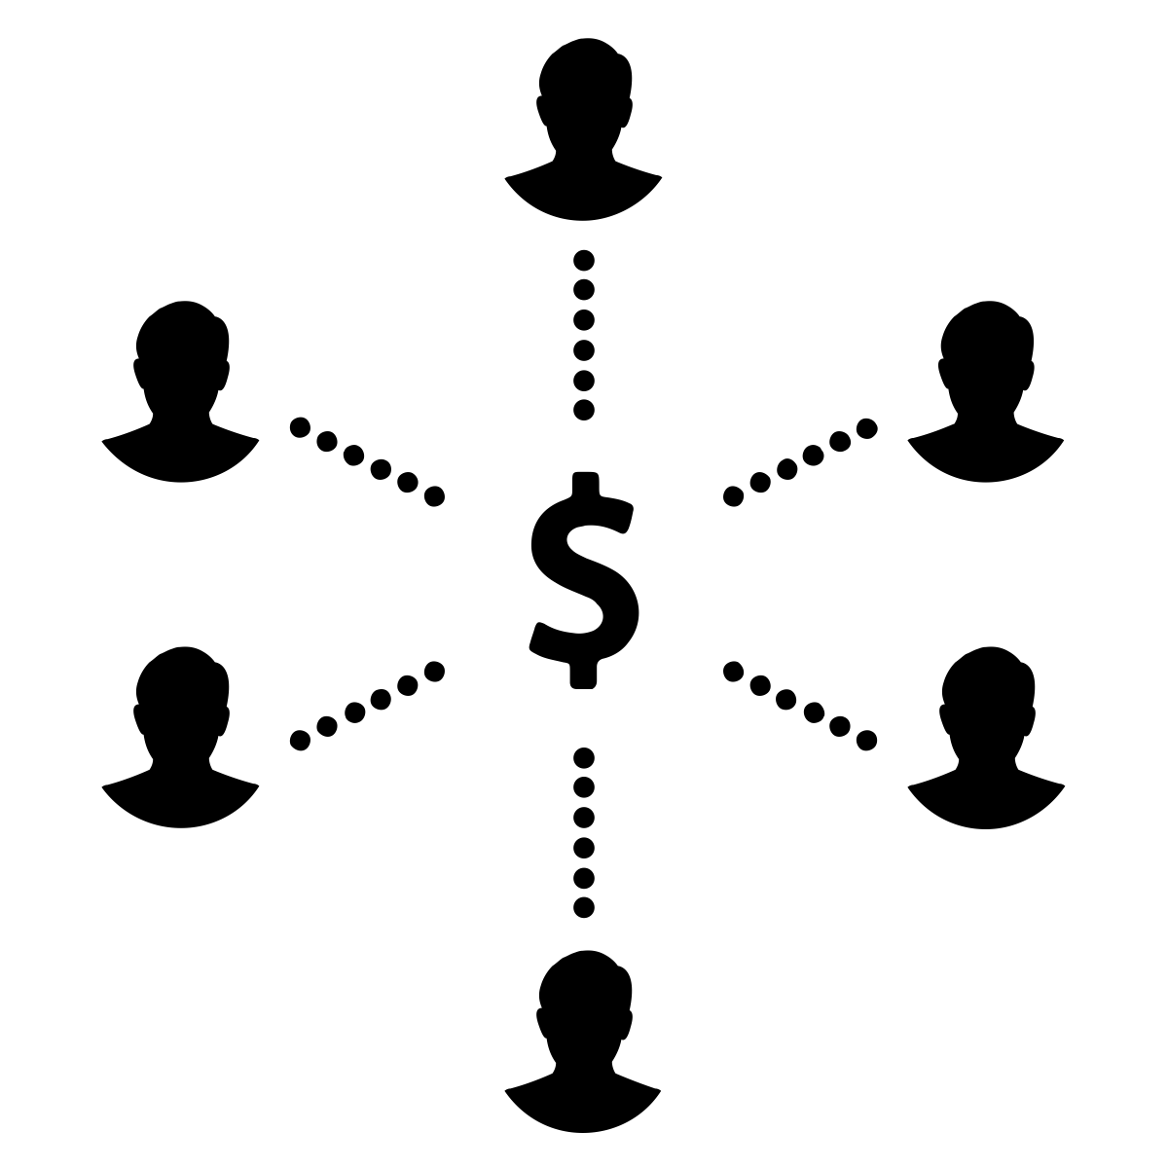
Content
  Study design
  Within subject design
    smaller stimuli sets
  Participants can participate in as many tests as they desire
  Using clear, specific, and unambiguous instructions
  Compensation and Incentives
    relevant to the amount of time it takes to complete a test
    Not too high to cause bias

Slide 10





Content
Handling human subjects
  Human subjects regulations in different countries
    Obtaining informed consent from participants
  Screening
Screening participants before a test (age, gender, etc.)
Screening participants when signing up for a test or during data analysis
1.
2.

Slide 11

Content
Data Analysis
  Correlate the data with lab “ground truth” data and visualize the bivariate relationship

Slide 12
Appendix: Monitoring and copping with hidden influence factors
Monitoring of the Workers’ Environmental Conditions and Context
  Simple test pattern for device calibration or quantification of deviation
Expectation of Users
          (-2) Much worse than I expected
          (-1) Worse than I expected
          (0) Just as I expected
          (1) Better than I expected
          (2) Much better than I expected
    “Please indicate to which degree the overall quality of this video was in line or not in line with your expectations? The overall video quality was...”.

Slide 13
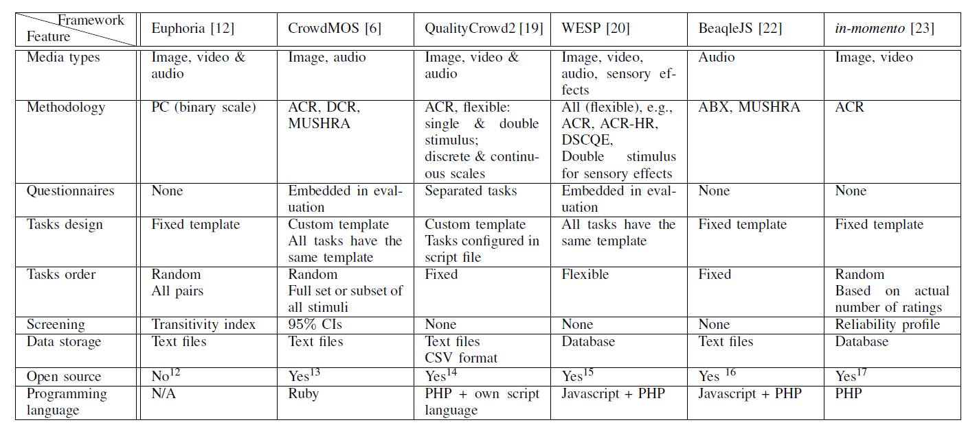
Appendix: Current crowdsourcing frameworks
Hoßfeld, T.; Hirth, M.; Korshunov, P.; Hanhart, P.; Gardlo, B.; Keimel, C.; Timmerer, C., "Survey of web-based crowdsourcing frameworks for subjective quality assessment," Multimedia Signal Processing (MMSP), 2014 IEEE 16th International Workshop on , vol., no., pp.1,6, 22-24 Sept. 2014

Slide 14
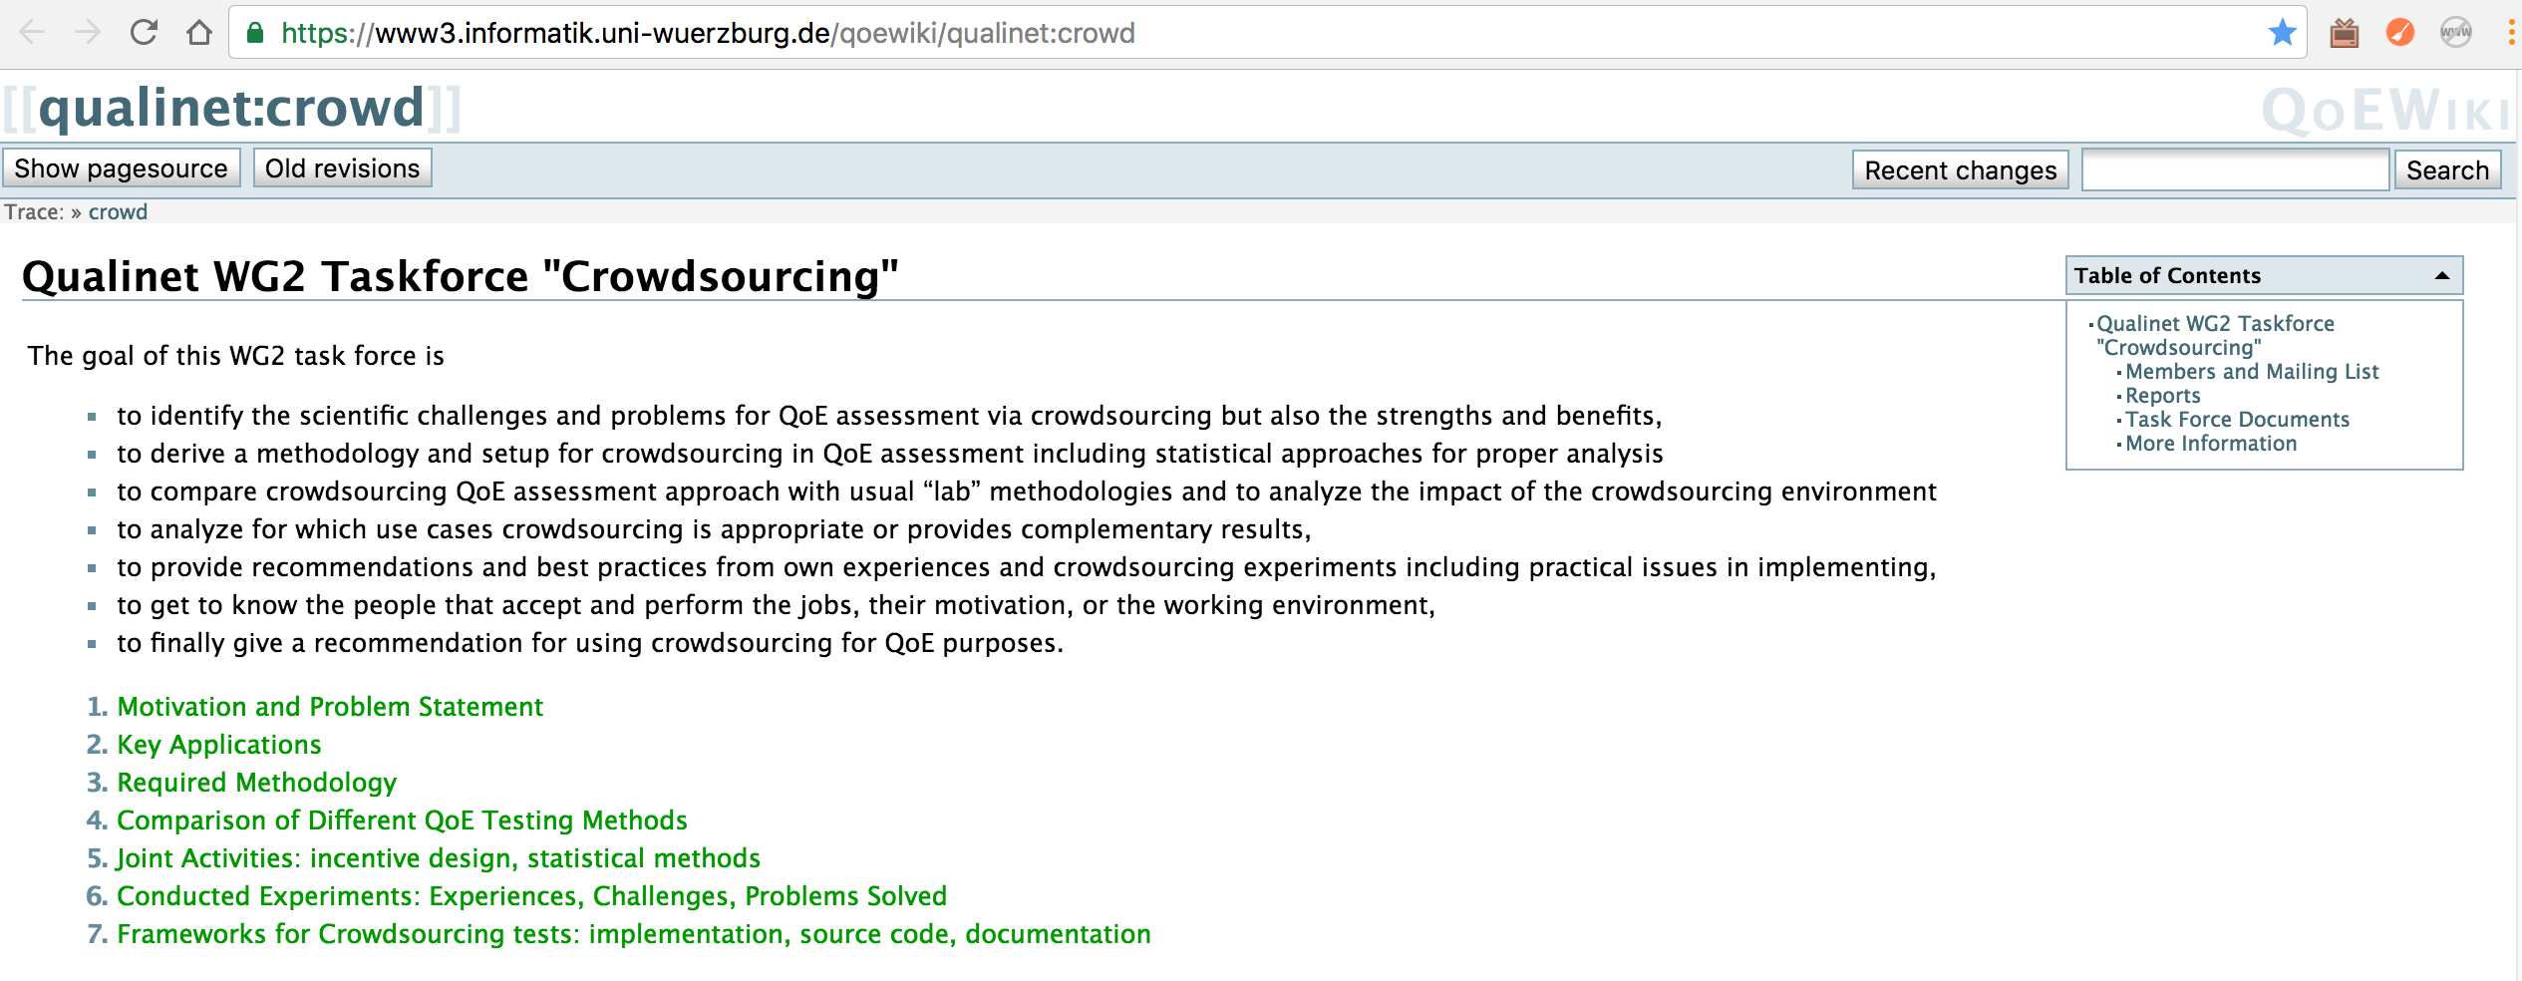
Qualinet Task Force on crowdsourcing
ITU-T Standardization efforts in P.CROWD
  Comparison lab (P.800) & Crowdsourcing
    Dataset: used for P.863
    Analysis of CS platforms: Crowdee, Microworkers, Mturk, CrowdFlower
https://www3.informatik.uni-wuerzburg.de/qoewiki/qualinet:crowd

