Slide 1
Designing Subjective Tests for NR Metrics
Margaret H Pinson
mpinson@ntia.doc.gov

Slide 2
Original
Video
Processed Video
Encode
Transmit
Decode
MOS_{in}
MOS_{out}
≈MOS_{out}

Slide 3
Original
Video
Processed Video
Encode
Transmit
Decode
bit-rate
&
codec
MOS_{in}
MOS_{out}
≈MOS_{in}
≈MOS_{out}

Slide 4
Original
Video
Processed Video
Encode
Transmit
Decode
MOS_{in}
MOS_{out}
How do people judge video quality?
Do people judge original and processed videos differently?
Can we divide MOS_{in} and MOS_{out} into factors?
How much are MOS_{in} and MOS_{out} influenced by the subject matter?

Slide 5
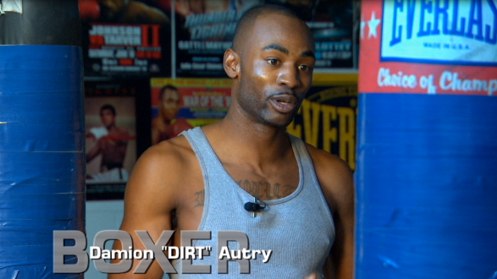
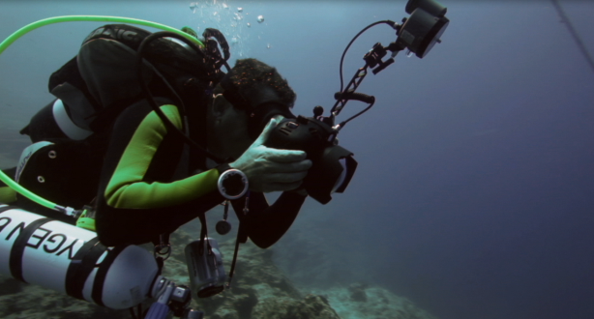
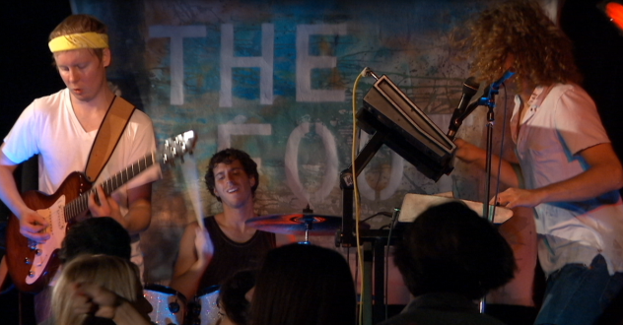
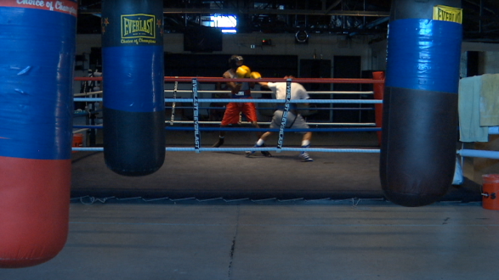
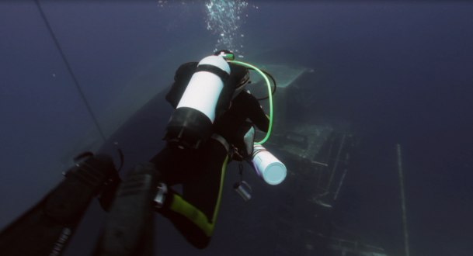
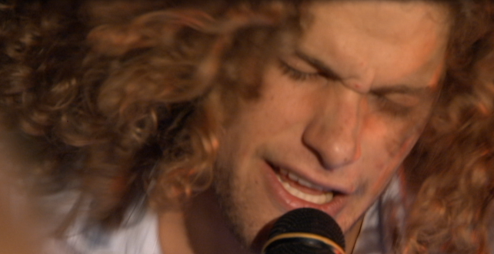
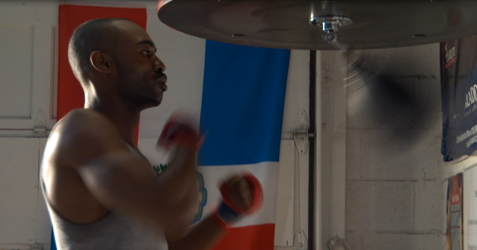
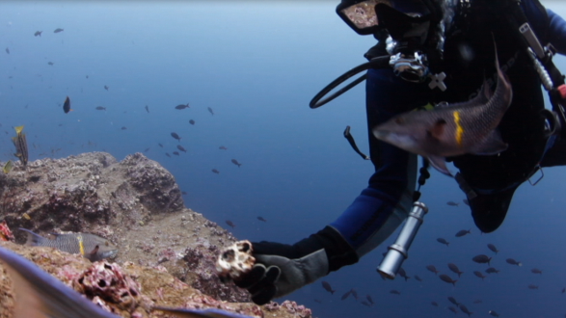
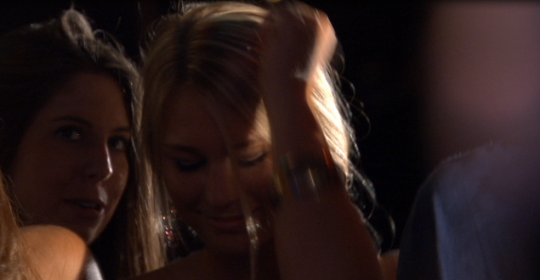
Novel Scene Experiment Design
Systems
Scenes

Slide 6
Experiment Design
8 sessions of 100 clips
  Same experiment design
  Different video topics
4sec
“Source video” includes:
  Conversion to 720p 24fps
  No minimum quality threshold
As bit-rate drops, encoded resolution drops
Broadcast
Chance
Everglades
Music & Mexico
Nature
Ocean
Public Safety
Sports
SRC | SRCpls | 2.34 M | 1.732 M | 1.256 M | 0.951 M | 0.512 M
257 | 23 | 97 | 89 | 99 | 136 | 112
2 ½ / 8 | − | 1 / 8 | 1 / 8 | 1 / 8 | 1½ / 8 | 1 / 8

Slide 7
ACR Plus
Typical ACR scale—excellent, good, fair, poor, bad
Computer error
  Select “Computer error” if our playback system has a problem.
  Never used
Human Error
  Select “human error” if you cannot rate the clip. For example, you were distracted and did not pay attention to the video. This may happen.
  Concern: 4sec too short, rating task too difficult
Times Used | 0 | 1 | 2 | 3 to 5 | 6 to 10 | 19
# Subjects | 9 | 4 | 3 | 6 | 4 | 1

Slide 8
Subject Demographics
NTIA
AGH
27 subjects
12 male, 15 female
20 to 29 12
30 to 39 5
40 to 49 4
50 to 59 5
6 engineers
21 temps
24 subjects,
80% male, 20% female
20 to 25 24
24 university students, engineering

Slide 9
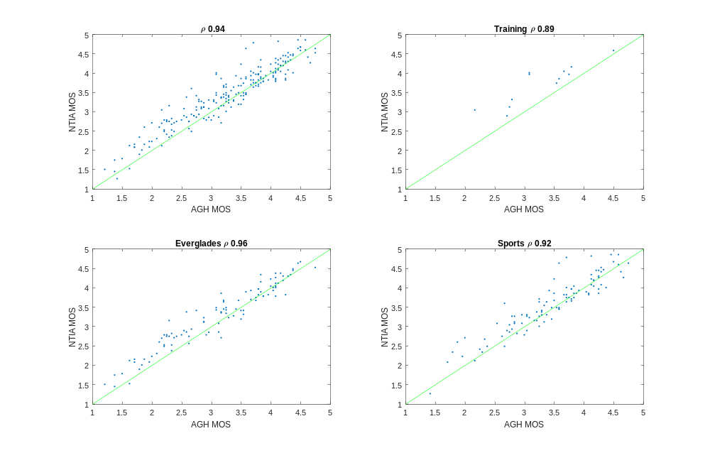
AGH vs. NTIA

Slide 10
NTIA Subject Feedback
Interest in the content itself
  Is Naomi a real person?
  I pieced together the plot for Tears of Steel
  They did a good job on the simulated wounds
  Where did you get the telemedicine footage…thought real
Positive feedback on:
  4 sec videos
  Test duration, 2 to 2.5 hours
  Topic change between sessions
  Public safety content
Rare dislike of a particular content type
  Canadian geese (44 clips)
  Bees (17 clips)

Slide 11
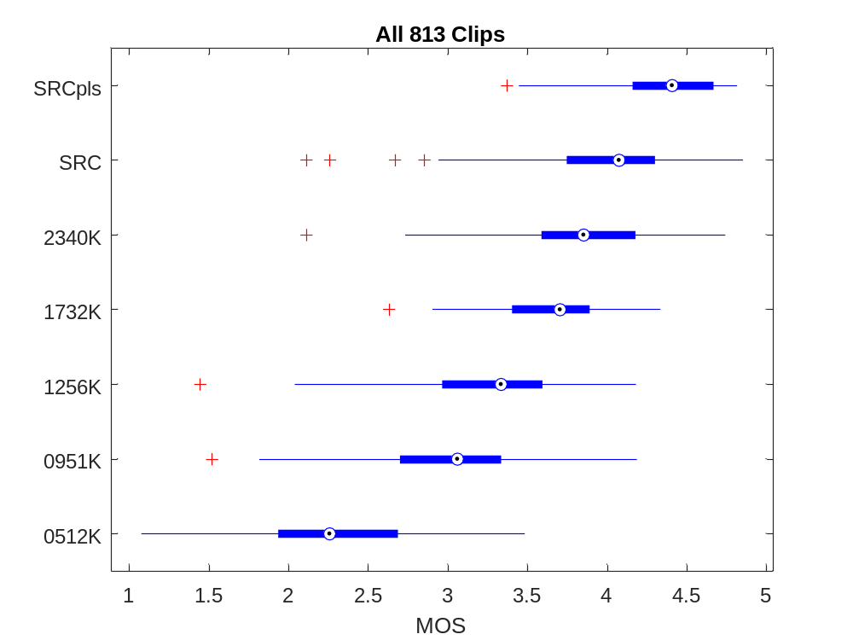
Distribution of Mean Opinion Scores (MOS)
ANOVA
  Session ≈2%
  Bitrate ≈ 56%
  Scene 16% to 40%

Slide 12
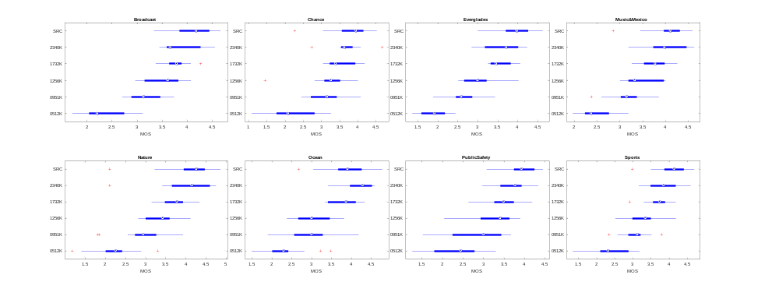
Session Comparison

Slide 13
AGH Infrastructure for High-Attendance,
Simple Psychophysical Experiments
“Multimedia Information Processing and Communications” Course:
Value:
Several multimedia topics, including subjective quality evaluation
Two classes (lessons) on this topic, each lasting 90 min
AGH fully controlling teaching syllabus
Twice a year, next classes October 2017
Less control than typical VQEG Test Plan
More control than crowd-sourcing
Can generate up to 10,000 scores, twice a year
Can (should) do extra data processing
0 cost
Already successfully used for 2 VQEG experiments
Contact: http://vq.kt.agh.edu.pl/

