Slide 1
Why Is No-Reference Model Development Failing?
Margaret H. Pinson

Slide 2
“Globally, IP video traffic will be 82 percent of all consumer Internet traffic by 2020, up from 70 percent in 2015.”
Cisco Visual Networking Index: Forecast and Methodology, 2015-2020 White Paper.

Slide 3
Impairment Perspective

Slide 4
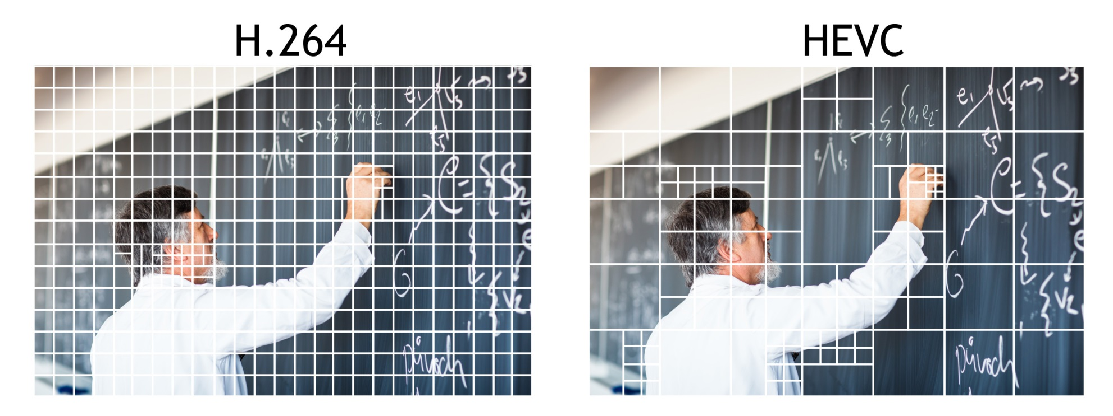
Codecs Are Homogenous
HEVC- What's Next in Video Compression, © Z3 Technology, http://z3technology.com/

Slide 5
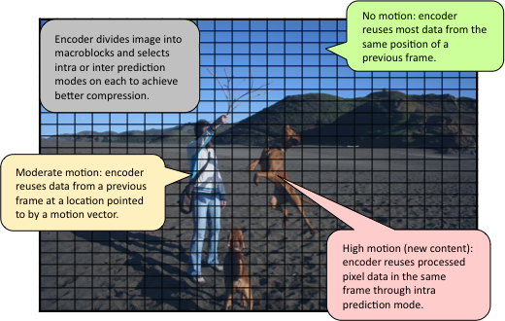
Codecs Divide Video into Homogenous Pieces
Inside WebM Technology: VP8 Intra and Inter Prediction, Open Media Project, © 2010-2012, http://blog.webmproject.org/

Slide 6
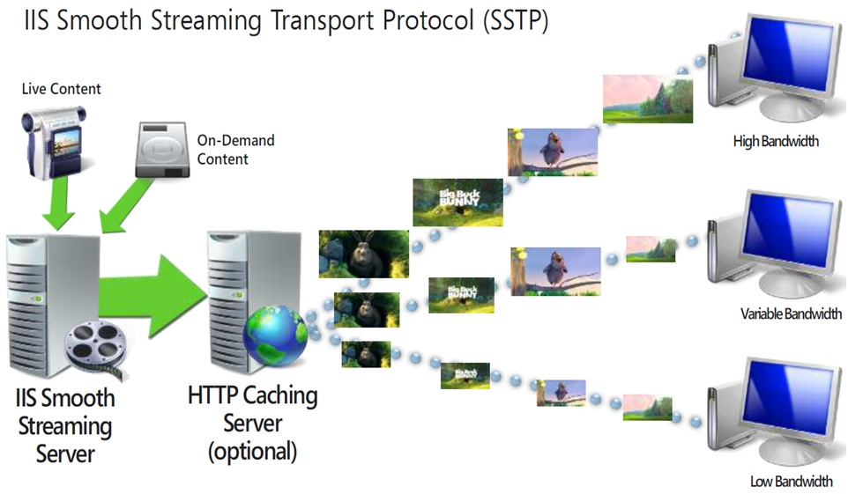
Adaptive Streaming Changes Everything
Телевидение в кармане»: как работает мобильное вещание, © tvkinoradio.ru, 2010–2016. https://tvkinoradio.ru/

Slide 7
Per-Title Encode Optimization, December 14, 2015, Netflix Tech Blog, http://techblog.netflix.com/

Slide 8

Packet Loss Unimportant

Slide 9
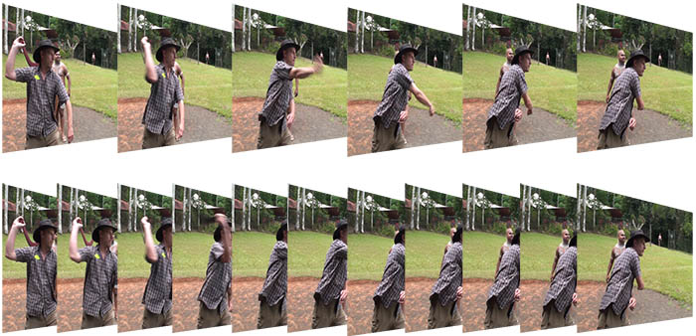
Frame Rate Higher (24 fps and up)
Sigle nei video -risoluzione e frame rate, Copyright © 2014 - Daniele Armillotta. http://www.danielearmillotta.eu/

Slide 10
Metric Perspective

Slide 11

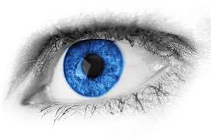
Traditional Work Flow
MOS
Impairments
Original video
noise
blocking
Focus
blurring
jerky motion
edge angle

Slide 12

Traditional Experiment Design
Impairment Focus
System 1
MOS 1
System 2
MOS 2
System 3
MOS 3
compare codecs & bitrates
…
System N
MOS N

Slide 13
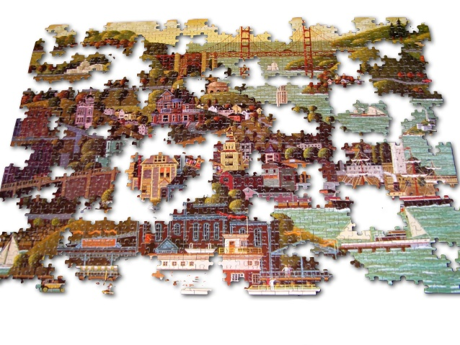
Merge Multiple Tests with Impairments
Genome Assembly, Keith Bradnam, @kbradnam, http://www.slideshare.net/kbradnam/

Slide 14
My Work Flow
MOS
Impairments
Original video
coding complexity
Focus
bitrate
resolution
aesthetics

Slide 15
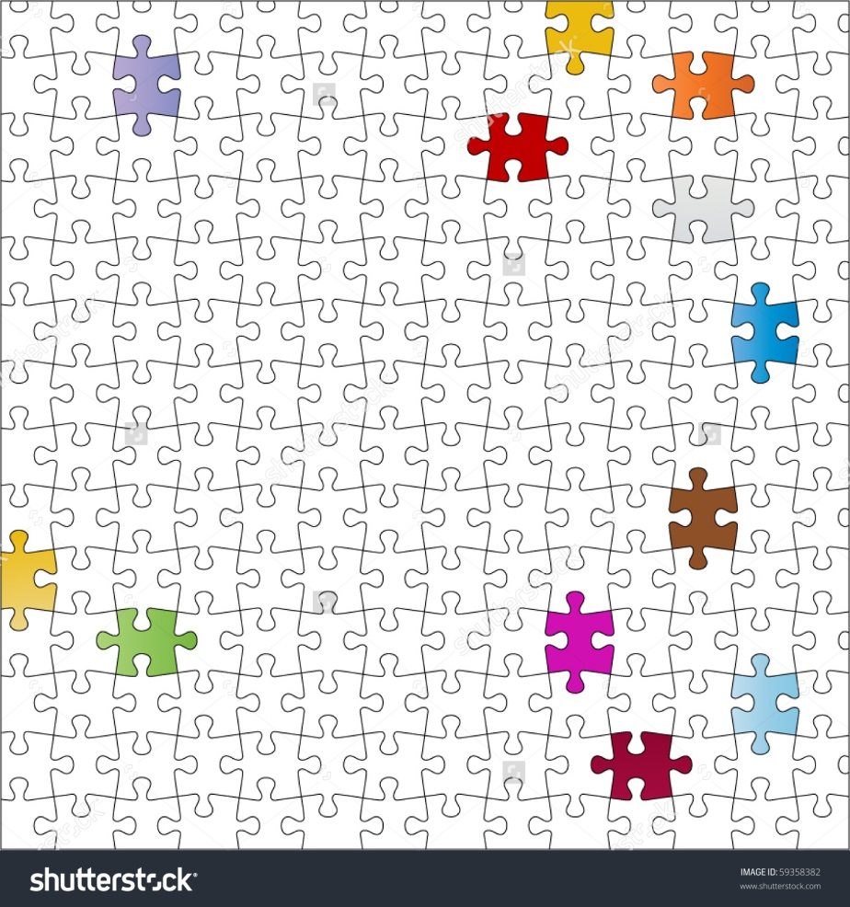
Merge Multiple Tests with Scenes
Puzzle – separate pieces – color to your liking, © Debra Hughes, http://www.shutterstock.com/

Slide 16

Video Content is Heterogeneous
51 ways to use web video to help your business grow, © Jomm Fox, OMM, https://onemarketmedia.com/

Slide 17
Changing Quality is Tricky
Temporal quality changes
  Scene cuts
  Fixed camera then pan or zoom
  Sudden motion
Perceptual impact is a higher order problem
  Best understood with subjective testing
NR metric useful without solution

Slide 18
My Conclusions

Slide 19
Discrepancy
Training Data
> 5 years old
8 to 15 sec video sequences
Scene cuts, temporal changes
Accurately codec, bitrate
Minimal video content

Slide 20
Discrepancy
Training Data
Video Coding
> 5 years old
8 to 15 sec video sequences
Scene cuts, temporal changes
Accurately codec, bitrate
Minimal video content
Video delivery has changed
¼ to 3 sec video segments
No scene cuts, temporal consistent
Codecs homogeneous
Video content heterogeneous

Slide 21
Need New Training Data
Huge variety of videos
  Very short duration
  Internally consistent (like MPEG)
Modern codec behavior
  Adaptive coding
  Bitrate → resolution
No network errors

Slide 22




New Experiment Design
Video Content Focus, Adaptive Streaming
System 1
MOS 1
System 2
MOS 2
System 3
MOS 3
…
System N
MOS N

Slide 23
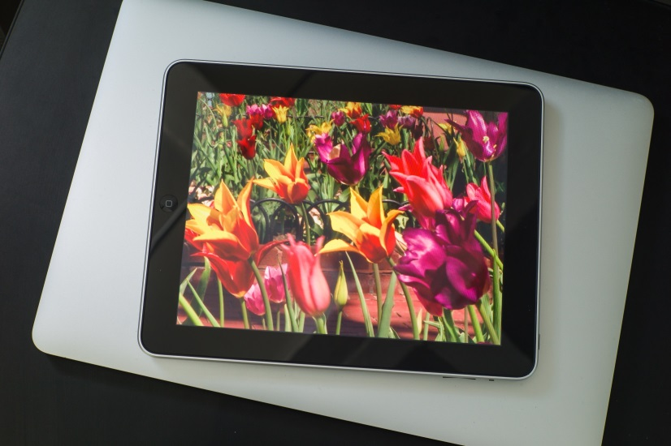
New Training Data
Scenes
Impairments
Many scenes: 800+
4 sec
Each used once
Related segments from longer videos
8 viewing sessions, each with theme
720p HDTV, 24fps
Few impairments (5)
Adaptive streaming
Connect bit-rate & resolution
2.34 Mbps to 512 Kbps
Tablet

Slide 24
…in progress…

Slide 25
Thoughts?

