Slide 1
“Summarizing Work on Monitoring of Audio Visual Quality by Key Indicators”
Mikołaj Leszczuk, Lucjan Janowski,
Jakub Nawała
24.10.2016

Slide 2
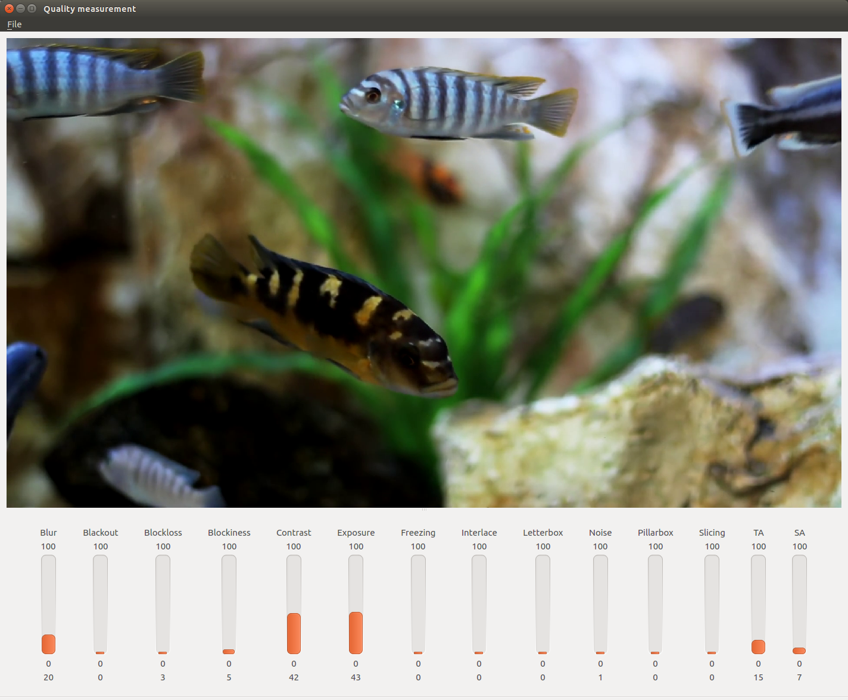
QoE Measurement Software Package Working in No-Reference Model

Slide 3
Details (1/2)
Consists of 15 independent indicators
Doesn’t need access to source sequence
Transparent to video codec (operates on decompressed content)
Utilizes modern multi-threaded architecture of processing units

Slide 4
Details (2/2)
Metrics don’t use closed libraries (source code is easily portable)
Available on all 3 popular platforms (our target = easy availability of our work)
Designed modularly (modularity = easier testing and integration)
Based on our and others’ scientific work

Slide 5
No Uniform MOS Scale
Mapping
Unknown specific user
Different needs for different scenarios
Difficult to compare our work with others’
Necessity of such mapping definition in future
Partial solution is SVM model mapping on VQM

Slide 6
VQM Mapping
All 1080p CDVL sequences
SRC split to chunks two seconds long
Total number of chunks: 361
10 different HRCs, compression only
8 HRCs taken into the model
VQM calculated for 2 seconds sequences

Slide 7
Predictors
Blockiness
Spatial Activity (SA)
Blur
Noise
SVM (R-Squared form 0.6 to 0.76)
Linear model (Adjusted R-Squared 0.689)

Slide 8
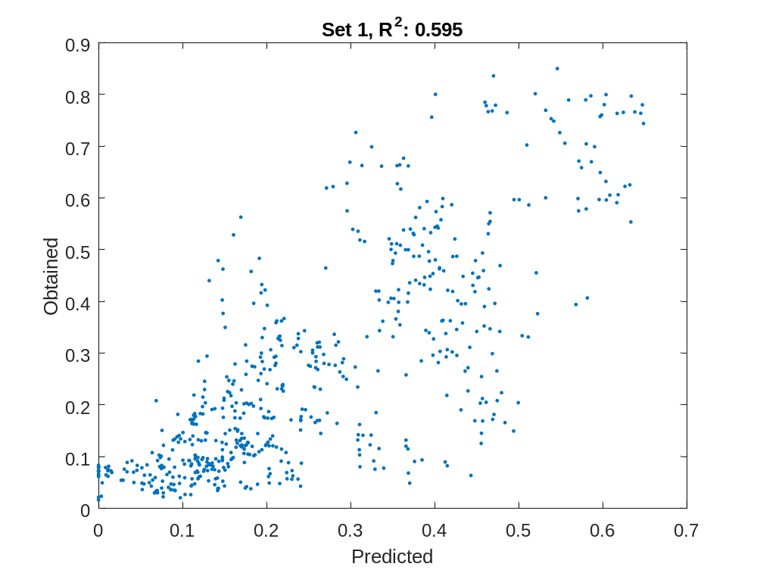
Set 1, R^2:0.595

Slide 9
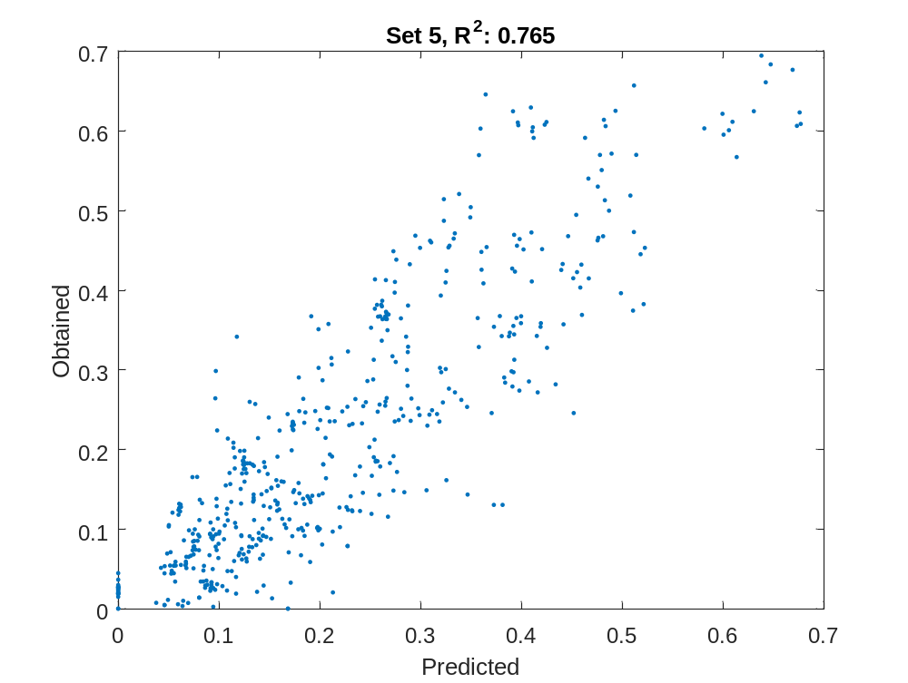
Set 5, R^2:0.765

Slide 10

Status
Public funding only until end Oct 2016
Ongoing cooperation with business partner
Known partner = known needs = better addressing them
Known target group = more precise tests
Somewhat limiting, but allows to keep project going
Independently research with students

Slide 11
Contact
http://vq.kt.agh.edu.pl

