Slide 1
Test Plan for Subjective Assessment of VR Video Quality
11/10/2016

Slide 2
1 Subjective Test Environment
The subjective rating environment will follow the parameters:
Voting methodology: ACR-HR, Single Stimulus
Voting interface: Screen
Stimulus in between presentations: Grey scene or equivalent
Stimulus type: panoramic videos (with or without depth information)
Display devices: Gear VR, HTC Vive, Oculus Rift or other qualified VR HMDs
Notes:
拍照

Slide 3
2 Display Control
No matter standing or sitting, we suppose two kinds of head state while viewing to guarantee the consistency of the evaluation contents of all the subjects :
Head free and viewport fixed: No matter where the head moves or turns, the content keeps the same in front of the eyes.
Head fixed and video moving: The head should not move greatly, with the video moving in a certain trajectory.

Slide 4

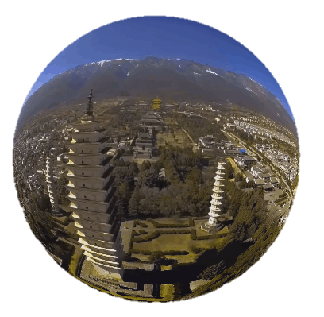
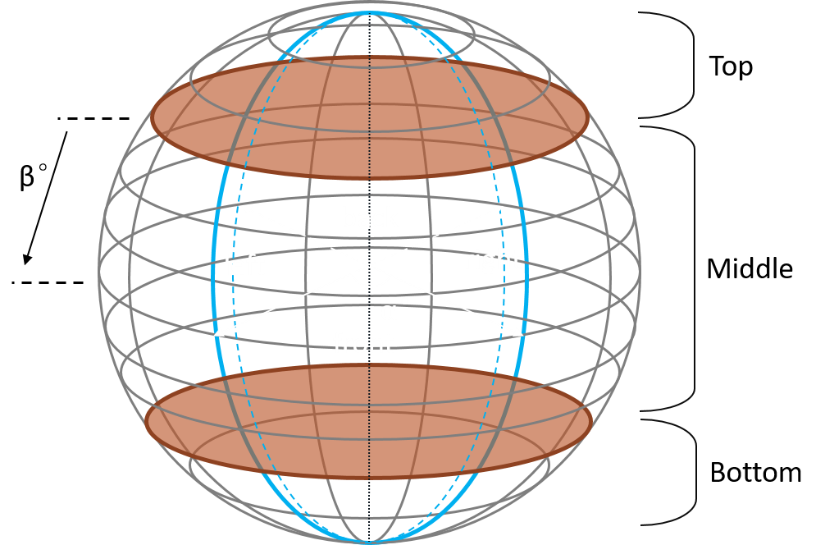
2 Display Control
Through our experiment, we found that the state “Head fixed and video moving” would easily make the subjects feel sick, even though the rotating speed was very slow. So we suggest the “ Head free and viewport fixed” method.
We divide the video into six tiles and fix viewport on each tile for several seconds and quickly switch to the next till all the tiles have been shown to the subjects.
α = 90°,β = 45°
Notes:
前后左右各2s，上下1s

Slide 5
3 Subject Screening
Number of subjects: 24 (at least 15)
1 Only non-expert subjects will participate ^{[1, 2]} :
The subjects do not work on video quality or related areas.
The subjects have not participated in any subjective video quality assessment within at least six months^{[2]}.
2 Vision acuity:
Normal far vision and near vision (Snellen Chart or E Chart)
Normal color vision (Ishihara Plates)
Normal Stereopsis (Randot Stereo test) (for 3D videos)
No severe sickness with VR HMDs
[1] ITU-R BT.500-13, Methodology for the subjective assessment of the quality of television pictures, 2012.
[2] VQEG, Test plan for evaluation of video quality models for use with stereoscopic three-dimensional television content, 2012.
Notes:
Less than 15 will be considered as informal(BT500,BT915)

Slide 6
4 Subjective Test Method
ACR-HR: the Absolute Category Rating Hidden Reference method^{[3]}
A category judgment where the test sequences are presented one at a time and are rated independently on a category scale.
The reference sequences must be presented and voted by the subjects without any special identification.
The differential quality score (DMOS) will be computed between each test sequence and its corresponding (hidden) reference.
Five-grade scale
Grade | Quality
5 | Excellent
4 | Good
3 | Fair
2 | Poor
1 | Bad
[3] ITU-T P.910, Subjective video quality assessment methods for multimedia applications, 2008.
Notes:
P910提出，VQEG for 3DTV使用（适用2D3D）

Slide 7
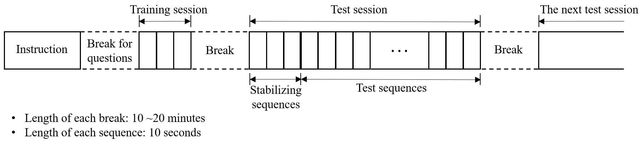
5 Subjective Assessment Procedure
Notes:
the subjective assessment procedure mainly consists of three phases: The instruction session, training session and test session(s). Due to the influence of viewing fatigue or sickness, breaks should be properly arranged throughout the entire procedure.

Slide 8
5.1 Instruction for Subjects
The aim of the test
The task in each session
The method of assessment
The grading scale to be used
What to evaluate
How and when to vote
Number and type of test sequences
Total duration of the test
What to do with sickness during the test
Other information needed
To make the subjects know clearly what to do in different stages during the test and thus ensure a valid process.
NOTE: The instruction must not include any indication of correct or wrong rating. The subjects should vote according to their own judgement. ^{[4]}
Notes:
A written instruction is needed
After instruction, questions should be answered
A sample instruction is given in Appendix 1.

Slide 9
5.2 Training session
A set of representative VR videos should be displayed to the subjects for voting.
The length of each sequence should be the same as the test sequences but the content must be different.
The quality of training sequences should cover the entire range of test sequence quality.
The rating data in training session must not be taken into account in the final test results.
Notes:
to make the subjects acquainted with the assessment process and quality range of the test. And check whether the subjects have misunderstandings on the process

Slide 10
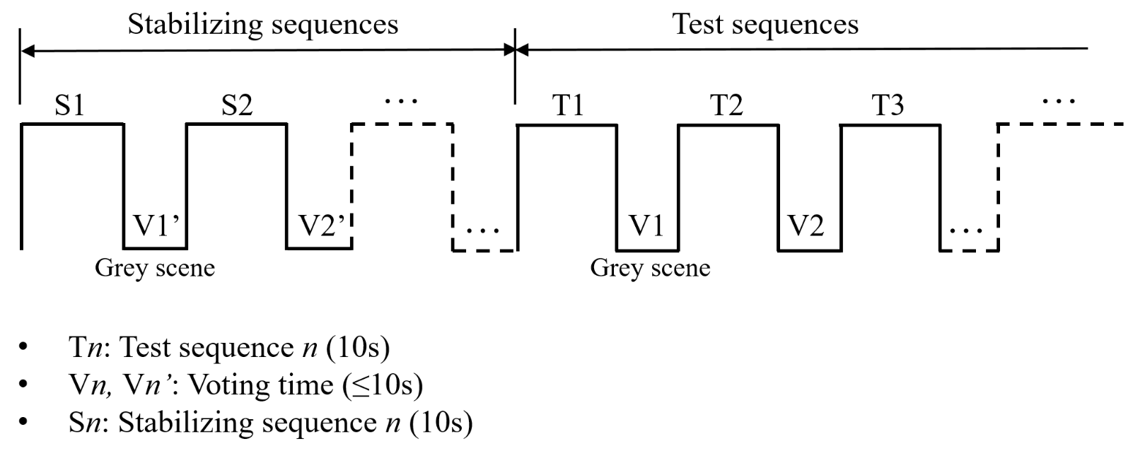
5.3 Test Session
Notes:
Test session is divided into two parts
three to five stabilizing sequences ($S_{i}$) should be presented to stablize the sujects’ rating
the entire test session, including the stabilizing period, should be limited to 20 minutes.
all the test and reference sequences will be presented randomly to avoid order effects. Usually the test sequences originating from the same reference should not be presented continuously as well. A pseudo-random order is suggested to be used to meet this condition.(同一个参考序列生成的两段测试序列能否连续播放，质量相差较小的两段序列能否连续播放
A minimum of two randomized session orders must be used to different subjects.

Slide 11
6 Data Presentation
All the rating data will be arranged into one summary file, which will be the basis of data screening and statistical analysis.
Experiment ID： 20160817
 |  | Subject ID | Subject ID | Subject ID | … | Subject ID
Reference sequence ID | Test sequence ID | 1 | 2 | 3 | … | 24
1 | 1 | 4 | 3 | 3 | … | 4
3 | 5 | 2 | 3 | 2 | … | 3
2 | 0 | 5 | 4 | 5 | … | 5
1 | 3 | 1 | 1 | 2 | … | 2
… | … | … | … | … | … | …

Slide 12
6 Data Presentation
Additionally, to ensure a complete data record, the following information must be presented ^{[1]}:
Details of the test setup
Details of the test sequences
Information of the VR player and display device
Number and description of subjects
To acquire more information, an additional questionnaire on the prior and post-test health condition of the subjects and the subjects’ VR viewing experience may be applied.

Slide 13
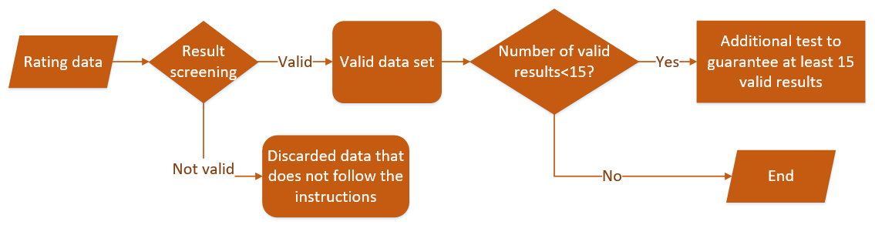
7 Result Analysis
7.1 Subject Reliability
[1] ITU-R BT.500-13, Methodology for the subjective assessment of the quality of television pictures, 2012.
[4] ITU-T P. 915, Subjective assessment methods for 3D video quality, 2016.
Notes:
1 can be checked by using procedures that are close to those described in [ITU-R BT.500-13] for the SSCQE method.
2 the rating to references

Slide 14
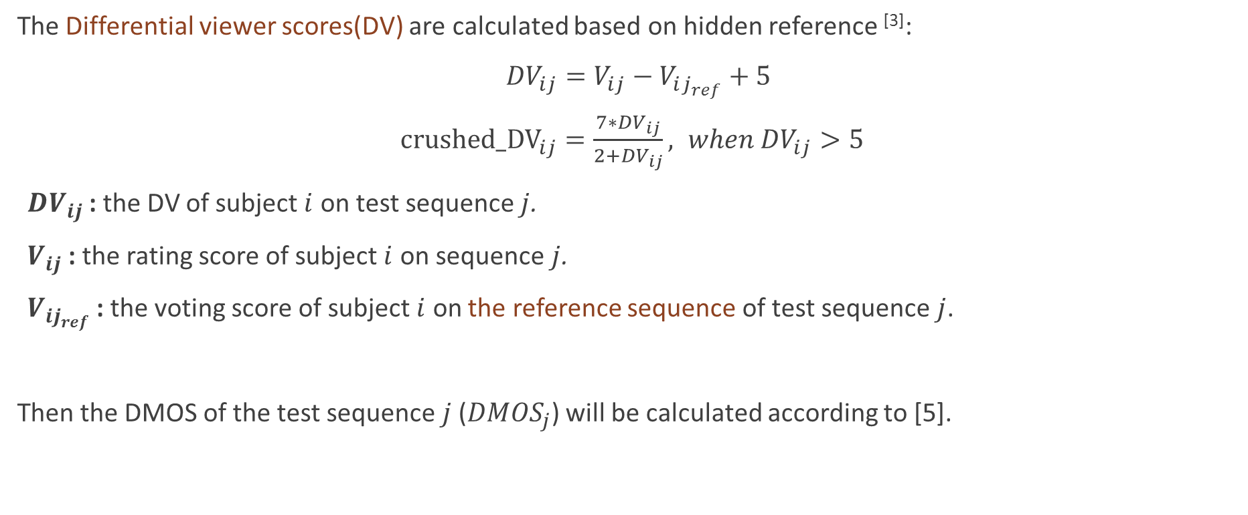
7 Result Analysis
7.2 Calculation of DMOS
The Differential viewer scores(DV) are calculated based on hidden reference ^{[3]}:
${DV}_{ij}=V_{ij}−V_{ij_{ref}}+5$
${crushed_DV}_{ij}=\frac{7∗{DV}_{ij}}{2+{DV}_{ij}}, when {DV}_{ij}>5$
${DV}_{ij}$ : the DV of subject $i$ on test sequence $j$.
$V_{ij}$ : the rating score of subject $i$ on sequence$j$.
$V_{ij_{ref}}$ : the voting score of subject $i$ on the reference sequence of test sequence$j$.
Then the DMOS of the test sequence$j$(${DMOS}_{j}$) will be calculated according to [5].
[3] ITU-T P.910, Subjective video quality assessment methods for multimedia applications, 2008.
[5] K. Seshadrinathan, et al. “Study of subjective and objective quality assessment of video”, IEEE TIP, pp. 1427-1441, 2010.
Notes:
This calculation of DV to guarantee that a higher score corresponds a higher quality.

Slide 15
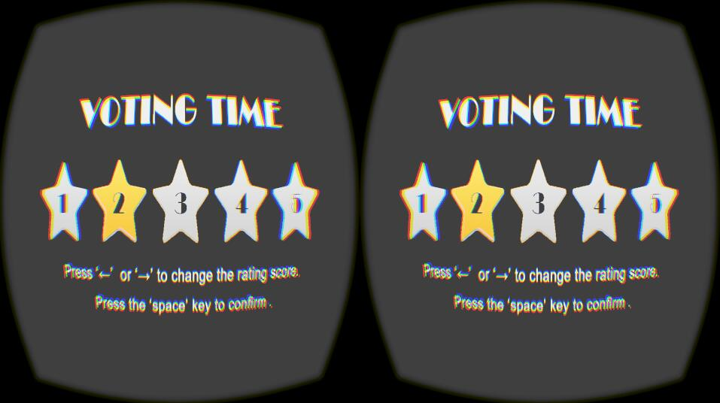
Software for the Assessment Process
Based on the test plan, we developed a software to help conducting the test. It can display VR videos, help rating, record data and calculate DMOS. After inputting necessary parameters, the test process can be controlled by the software.
Panoramic video
Display in six viewing angles
Rating interface

Slide 16
Problems to be settled
Display control: 2-second viewing time may be too short for each video tile
Subject screening: The quantitive standard of vision acuity and the term “Non-expert”
Rating score: Five-grade or one-hundred-grade, continuous or discrete
Test session: the most appropriate duration (50min? 30min? 20min?)
Sequence order: How to arrange the pseudo-random order of the test sequences (can reference sequence and corresponding test sequences, sequences with similar quality, test sequences from the same reference be displayed successively?)

Slide 17
Thanks for your attention!
Test Plan for Subjective Assessment of VR Video Quality
11/10/2016

Slide 18
Top
β°
back
left
right
Middle
α°
front
Bottom

