Slide 1


UHD Television
VQEG Meeting
Friday 28th October 2016
Katy C. Noland

Slide 2
Pixel Formats
SD 704 x 576 pixels (or similar) | Full HD 1920 x 1080 pixels
UHD-1 3840 x 2160 pixels Often called “4K” | UHD-2 7680 x 4320 pixels Often called “8K”
[ITU-R. Parameter values for ultra-high definition television systems for production and international programme exchange. Recommendation ITU-R BT.2020-1, June 2014]

Slide 3
How Many Pixels Are Enough?
It depends how big the screen is, and how far away the viewer is sitting!

Slide 4
Design Viewing Distances
SD 704 x 576 pixels (or similar) viewed from 6 H | Full HD 1920 x 1080 pixels viewed from 3 H
UHD-1 3840 x 2160 pixels Often called “4K” viewed from 1.5 H | UHD-2 7680 x 4320 pixels Often called “8K” viewed from 0.75 H
3 H = 3 times the screen height
[ITU-R. General viewing conditions for subjective assessment of quality of SDTV and HDTV television pictures on flat panel displays. Recommendation ITU-R BT.2022, August 2012]

Slide 5
Survey Conducted in Summer 2014
Asked about:
  Current screen size
  Current viewing distance
  Ideal screen size
  …and much more
Online questionnaire (SurveyMonkey)
Majority of responses from 2 promotions on the BBC homepage.
Respondents:
  2633 complete responses
  2416 used
  2185 of these have a TV
K. C. Noland and L. H. Truong, A Survey of UK Television Viewing Conditions, BBC R&D White Paper 287, January 2015.

Slide 6
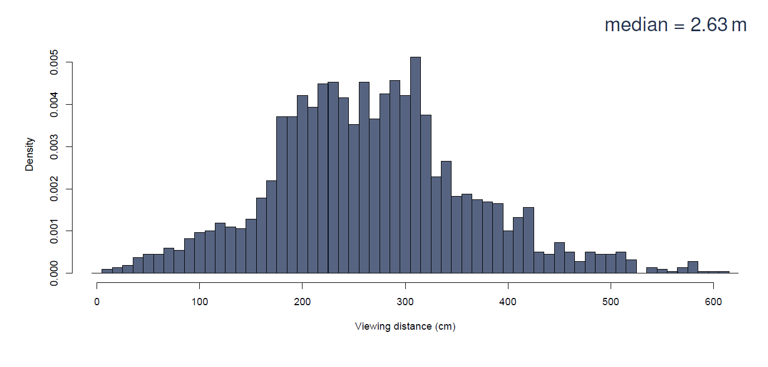
Viewing Distances

Slide 7
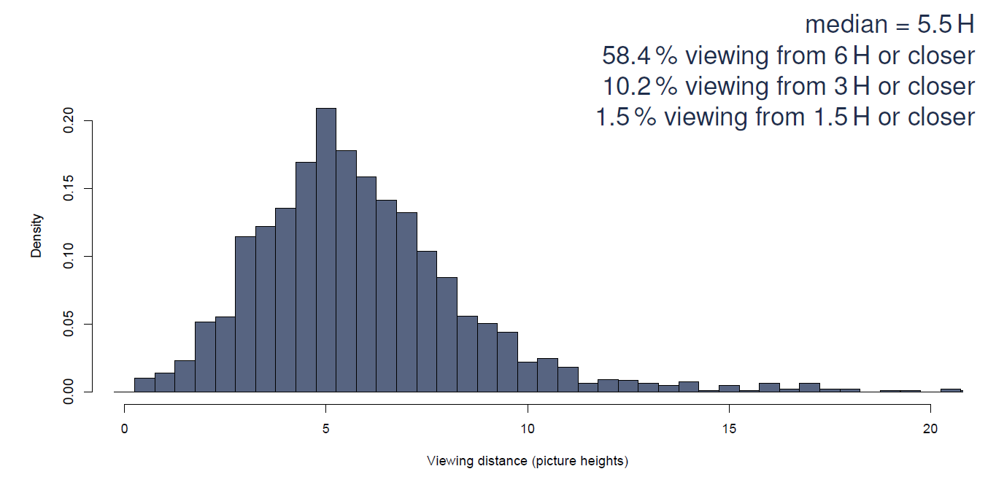
Relative Viewing Distances

Slide 8
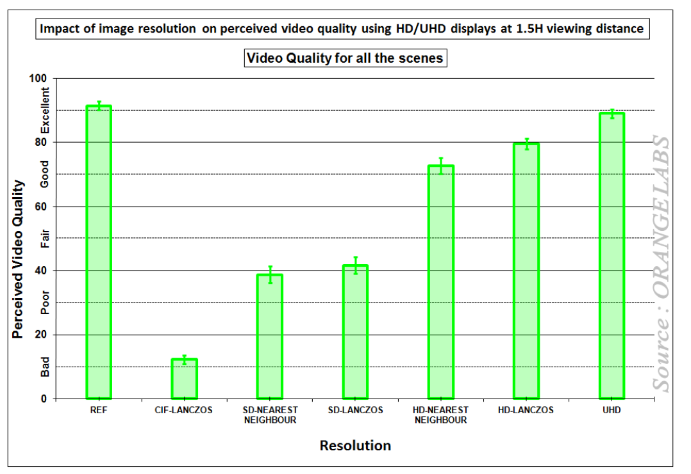
Perceived Benefit of Increasing the Pixel Count
[Orange Labs. Impact of Image Resolution on Perceived Video Quality Using HD/UHD Displays at 1.5H Viewing
Distance. ITU Document 6C/246-E, November 2013.]

Slide 9
For a real wow factor, use better pixels!

Slide 10
Other Factors to Consider
High frame rate (HFR)
High dynamic range (HDR)
Wide colour gamut (WCG, “deep colour”, or “BT.2020 colour”)
Immersive audio
We see all of these as part of the UHD package

Slide 11
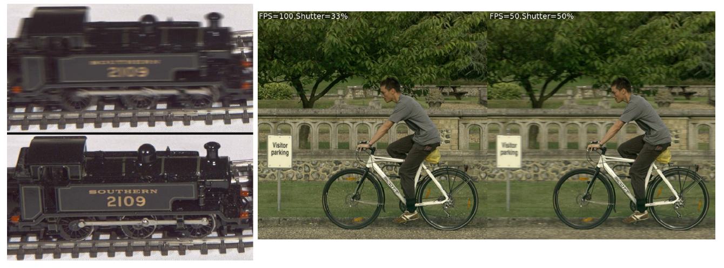
High Frame Rate
Any increase in spatial resolution is lost to motion blur when objects move

Slide 12
High Frame Rate
Fundamental trade-off between blur and strobing
  Varies according to camera shutter, display processing, and eye movements
  Blur visible in tracked motion
  Strobing visible in untracked motion

Slide 13
High Frame Rate
Motion blur and strobing artefacts are visible at much higher frame rates than the rate needed to eliminate flicker (about 80 Hz [1]).
Theoretical analysis and experiments in critical conditions suggest that artefacts may only become completely imperceptible at 600 [2] or 700 fps [3].
Subjective tests show an effect of diminishing returns: there is a big quality boost from conventional rates to around 100 or 120 fps, and a much smaller further boost at 240 or 250 fps [4, 5].
Experimental work at BBC R&D shows that as luminance increases, motion artefacts become more visible [awaiting publication].
[1] M. Emoto and M. Sugawara. “Critical Fusion Frequency for Bright and Wide Field-of-View Image Display.” Journal of Display Technology 8(7):424-429, July 2012.
[2] A. Mackin, K. C. Noland and D. R. Bull. “The Visibility of Motion Artifacts and their Effect on Motion Quality”. IEEE International Conference on Image Processing (ICIP), Phoenix, September 2016 (to appear).
[3] K. C. Noland. “High Frame rate Television: Sampling Theory, the Human Visual System, and why the Nyquist-Shannon Theorem Doesn’t Apply.” IBC Conference, Amsterdam, September 2014.
[4] D. Driesnack. “Another Important “H”.” EBU Tech-I Magazine, 18:16, December 2013.
[5] Y. Kuroki, T. Nishi, S. Kobayashi, H. Oyaizu and S. Yoshimura. “A Psychophysical Study of Improvements in Motion-Image Quality by using High Frame Rates. “ Journal of the society for Information Display 15(1):61-68, January 2007.

Slide 14
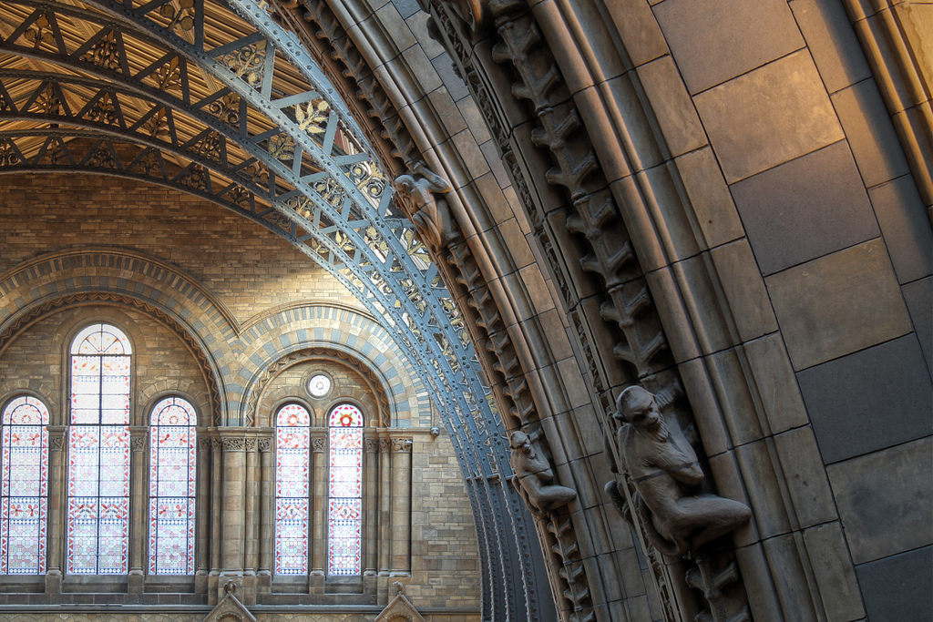
High Dynamic Range (simulated)
Detail maintained in highlights
Detail maintained in shadows
Beyond contrast range of current TV system
Requires screen with greater range and higher bit depth

Slide 15


Banding
Original
Extreme Banding

Slide 16
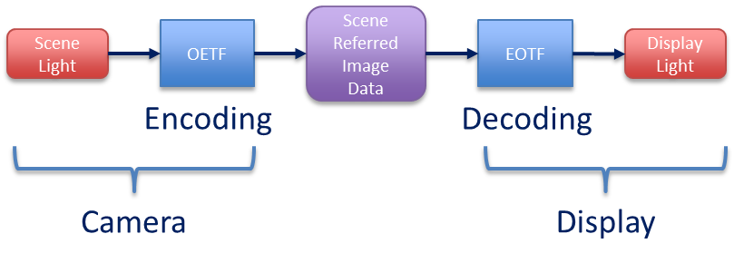
End-to-End Television Signal Chain

Slide 17
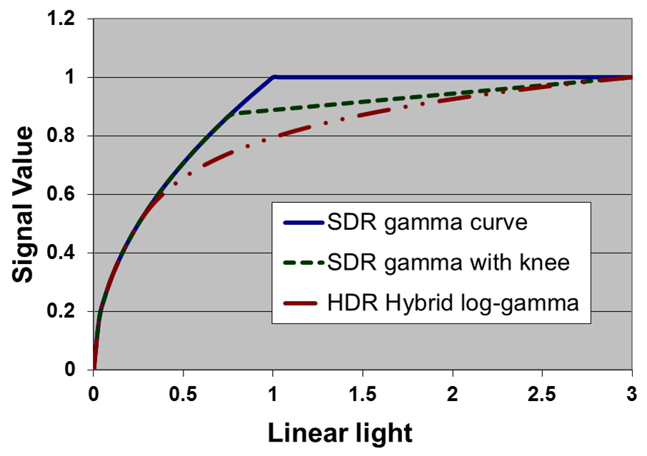
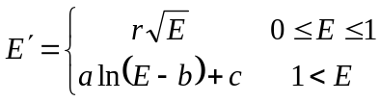
Hybrid Log-Gamma OETF Similar to SDR OETF with Knee
Where:
E is proportional to light intensity
E’ is the non-linear signal
r is the reference level, 0.5
a= 0.17883277,
b= 0.28466892,
c= 0.55991073.
Linear light
(scaled)

Slide 18
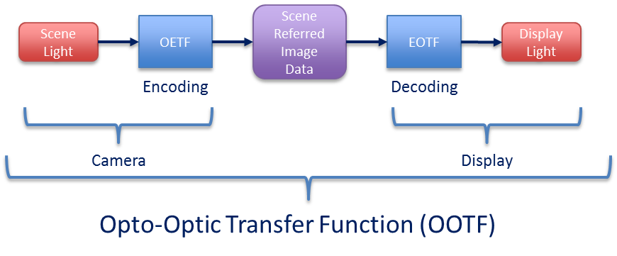
Overall Transfer Function (OOTF) Non-Linear
OOTF varies according to viewing environment and brightness of the display

Slide 19
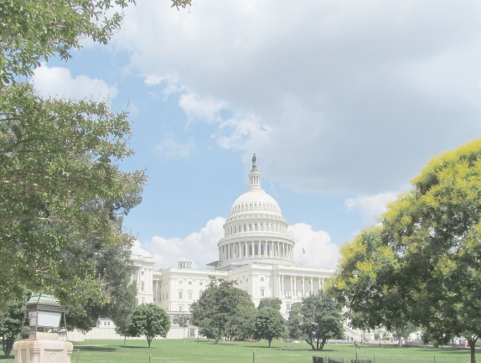
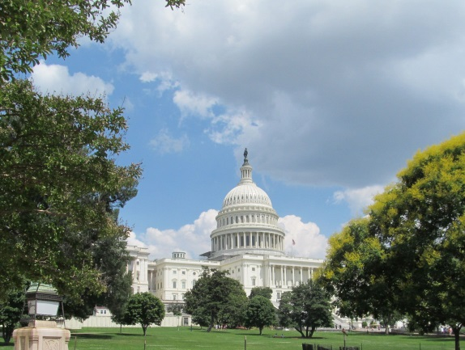
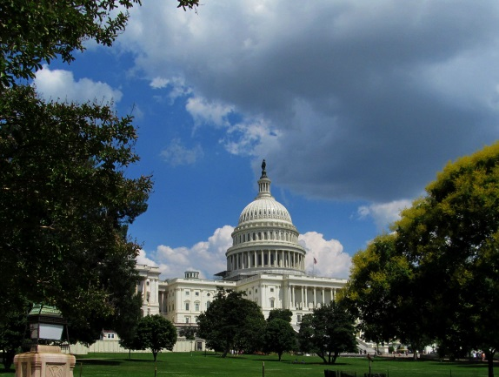
The OOTF or “Rendering Intent”
Gamma too low
Gamma correct
Gamma too high

Slide 20
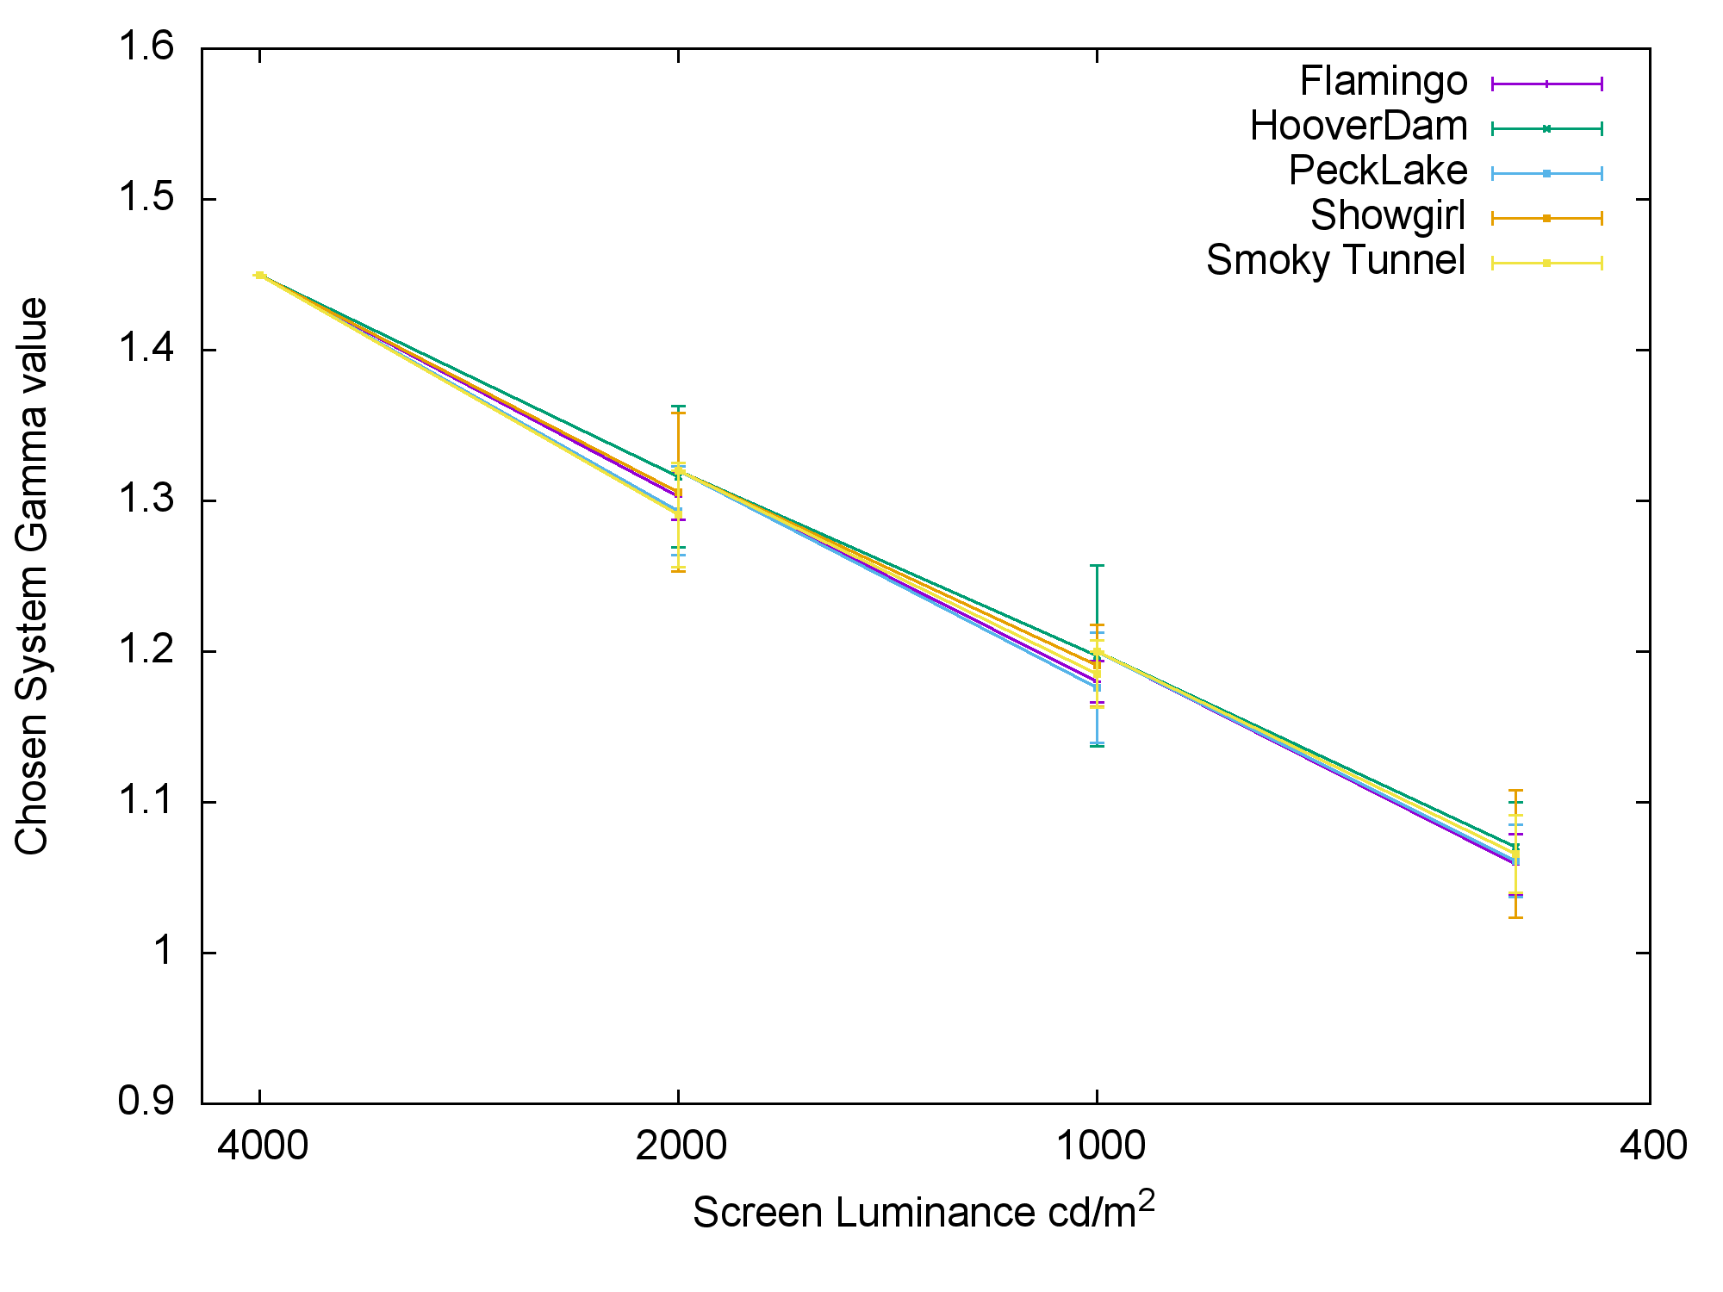

Variation of Gamma for Perceptual Match
L_{w} = peak luminance of screen in cd/m²
[M. Pindoria and S. Thompson, Image Adaptation Requirements for High Dynamic Range Video under Reference and Non-Reference Viewing Conditions, IBC conference, Amsterdam, September 2016.]

Slide 21
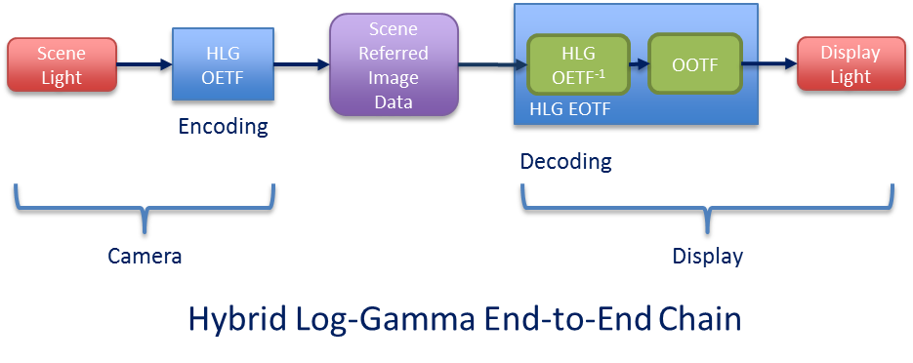
For Scene-Referred Systems OOTF is Part of EOTF
One signal serves displays of different brightness
No metadata required

Slide 22
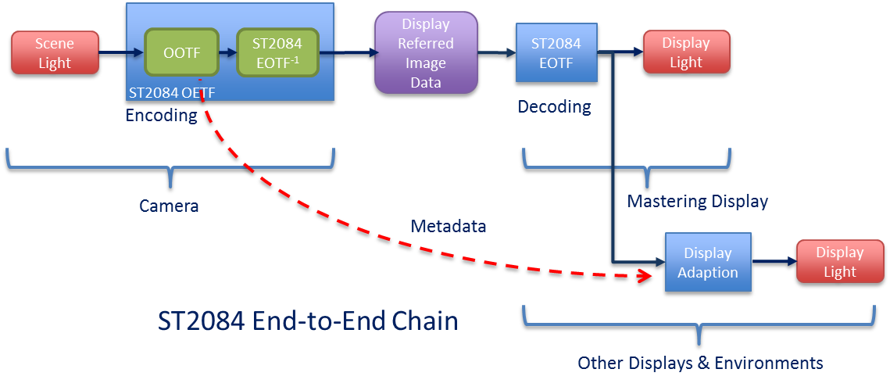
For Display-Referred Systems OOTF is Part of the OETF
A fundamentally different approach

Slide 23
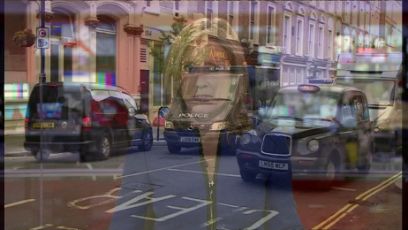
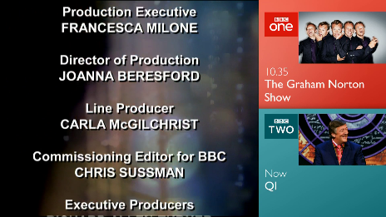
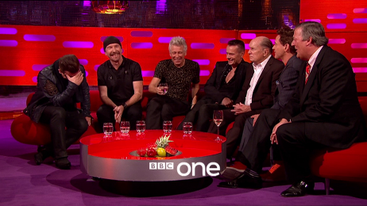
No Metadata: A Key Requirement for Broadcasters
With dynamic metadata we cannot:
mix sources
use a DVE
(Digital Video Effects)
add graphics

Slide 24
Test Shoots and Field Trials
Many BBC R&D trials, including a live studio shoot and grading of existing natural history content
Many industry field trials, including Sky Deutschland, Vatican Television Center, Roland-Garros…
Insights from our experience:
Straightforward to add HLG to user gamma of a professional camera
Existing SDR equipment worked fine
HDR monitoring strongly preferred for key positions, but SDR monitoring produced good pictures
Colorist needed some encouragement to make use of the extra dynamic range, but then loved the creative possibilities it opened up
Need to be careful of camera noise
SDR compatible image is more accurate using BT.2020 colour (wider colour gamut)
For UHD in general, camera focussing is hard, and focus assist is unreliable

Slide 25
Things that have caught us out in the past:
RGB to YUV conversions are different for different colour primaries (BT.2020 or BT.709).
Applying display gamma to RGB rather than luminance increases colour saturation.
Checking HDR and colour mode on monitor.
If testing on consumer screens, it’s important to measure their performance.

Slide 26
Potentially of Interest:
We intend to release LUTs for an HDR ecosystem – we foresee fully automatic conversions.
We have some HLG demo content available for research and development use (e-mail katy.noland@bbc.co.uk).
We will be gradually adding information to our HDR webpage http://www.bbc.co.uk/rd/projects/high-dynamic-range

Slide 27
Ongoing Work
Gamma adjustment for different ambient lighting conditions
HDR and SDR compatibility
  How to embed SDR into an HDR signal chain
Reference levels
  Essential to avoid abrupt changes in brightness between programmes, adverts and trails
  Similar to audio loudness problem

Slide 28
Brightness Perception
In order to provide guidelines for brightness levels, need to be able to measure brightness
Subjects were asked to adjust a grey slate until it matched the “overall brightness” of a set of images, at 4 peak display luminance levels

Slide 29
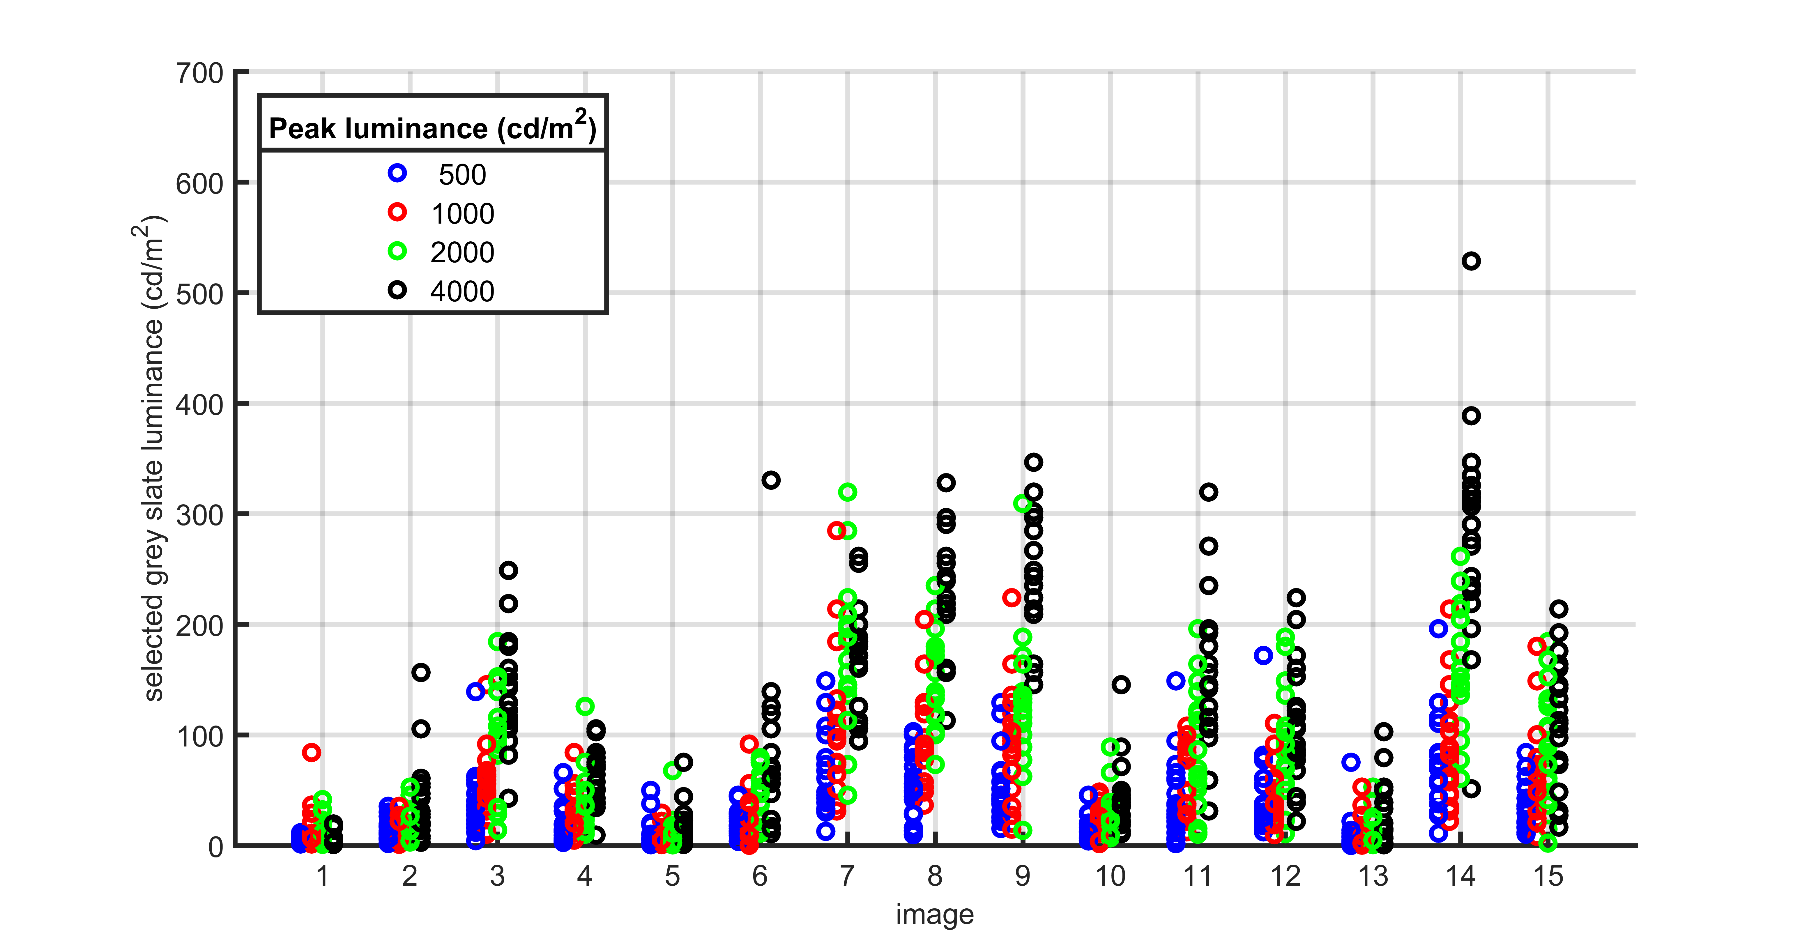
Perception of Brightness: Individual Responses

Slide 30
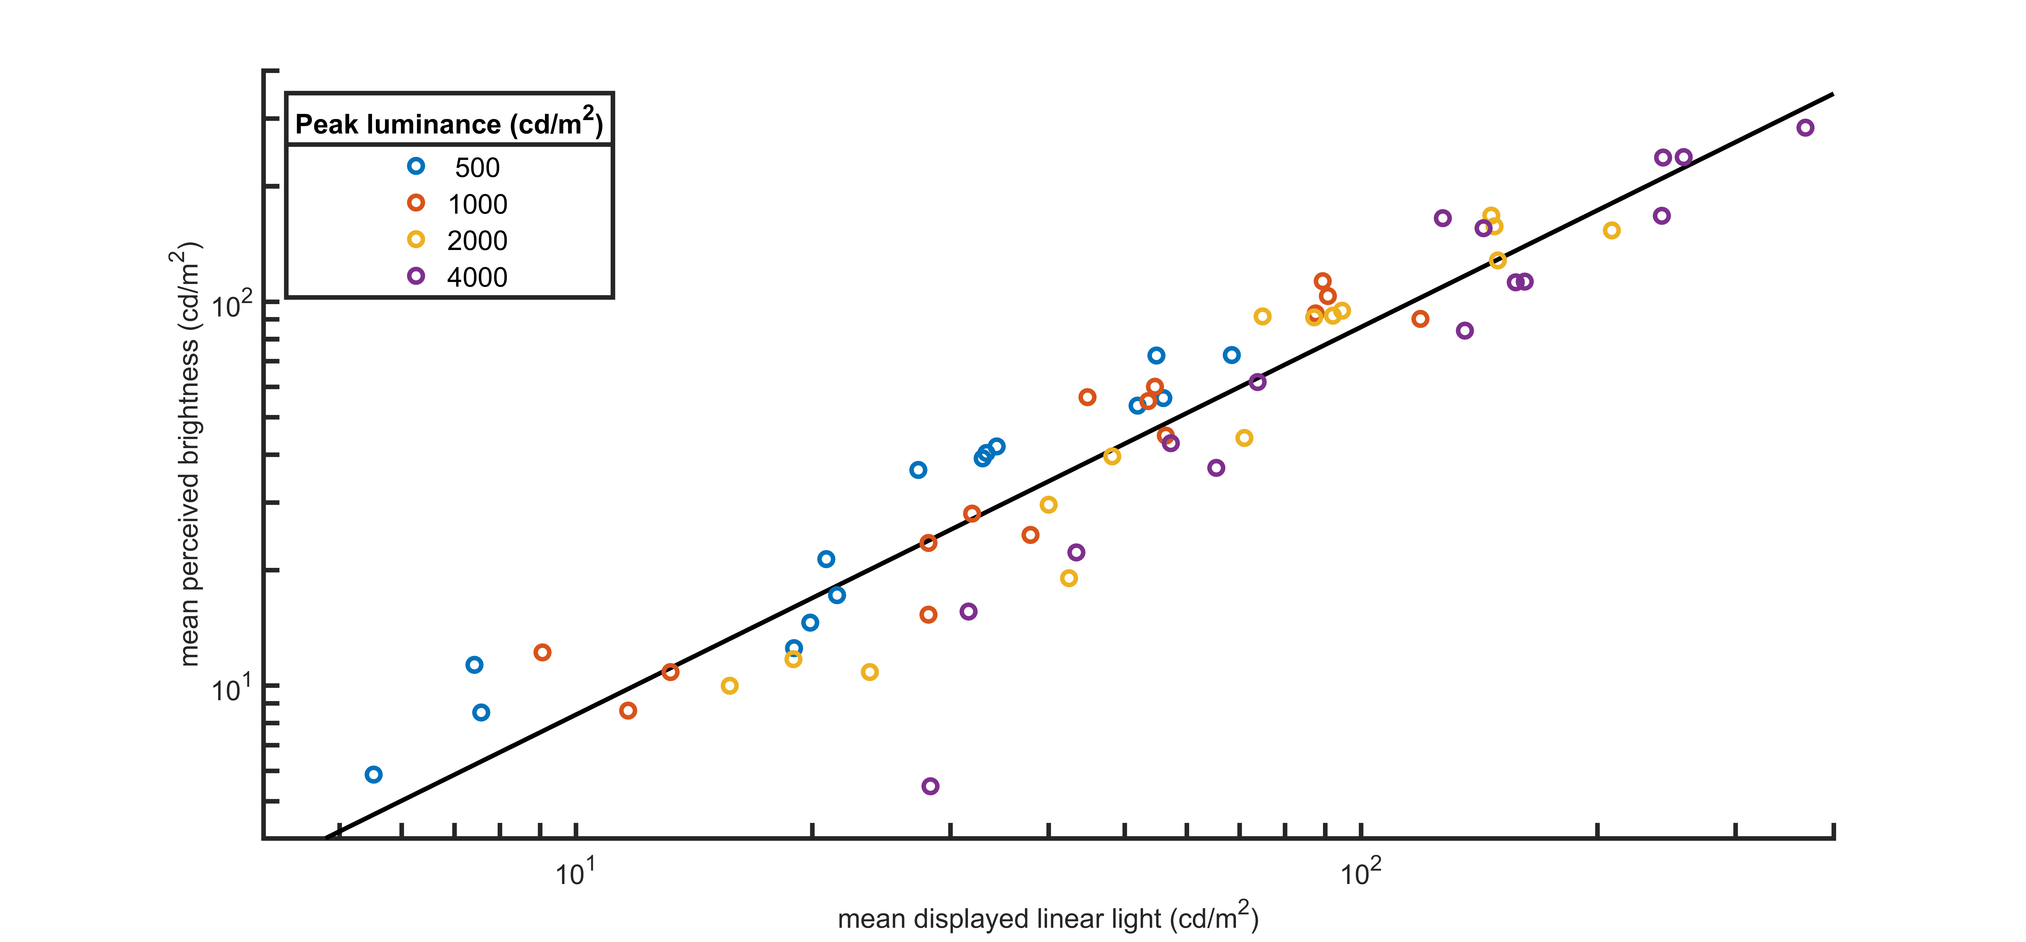
Perception of Brightness: Mean Responses vs. Mean Displayed Luminance

Slide 31
Next Steps
Development of objective brightness measure
How to measure brightness change tolerance?
  Between programmes/channels
  Within a programme

Slide 32
Thank you
bbc.co.uk/rd
Email:
Twitter:
katy.noland@bbc.co.uk
@bbcrd

