Slide 1

Measuring Perceptual Video Quality at Scale
Ioannis Katsavounidis
Video Algorithms Team

Slide 2
The best video quality possible.
Build cloud-based encoding pipeline with automated quality monitoring
Evaluate state-of-the-art video compression formats
Optimize encoding recipes and algorithms
  Experiment and test on subset of titles
  Deploy and run A/B tests
Participate in next-generation codec development
Measure perceptual video quality at scale

Slide 3
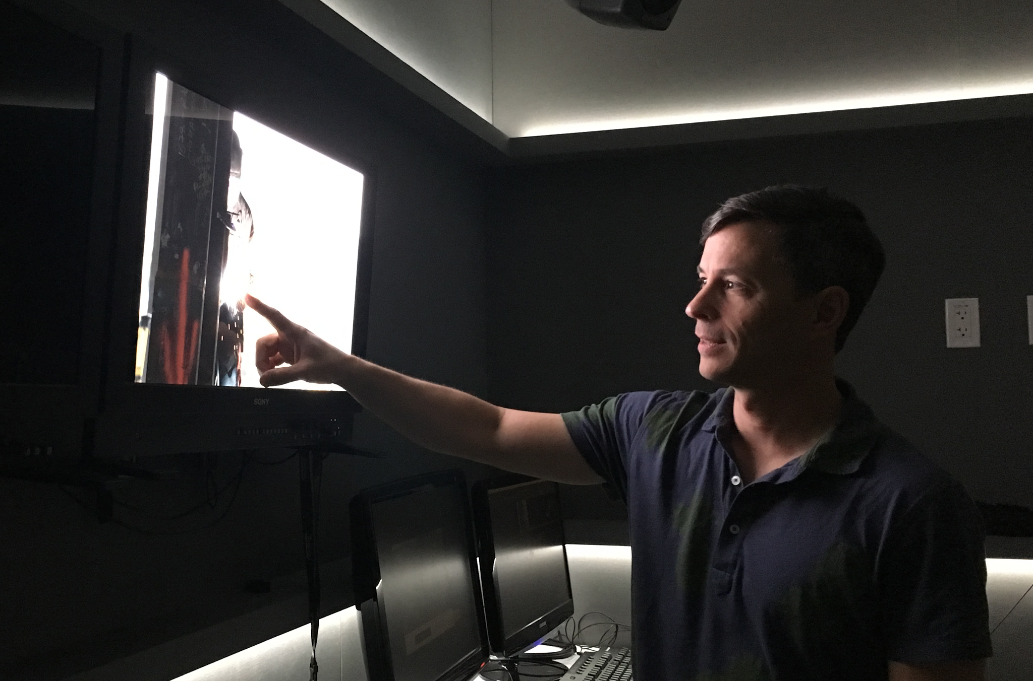
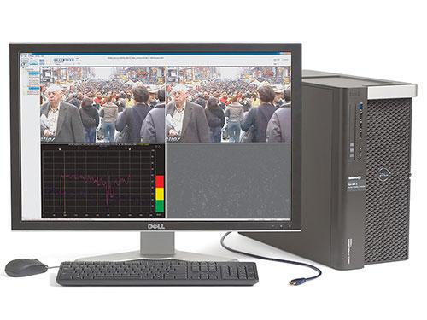
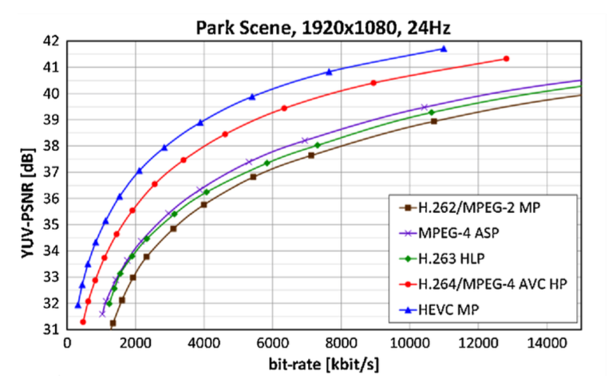
Ways to measure quality
[Ohm, et al., 2012]
Visual Testing
Video Analyzers
PSNR, SSIM, etc.

Slide 4
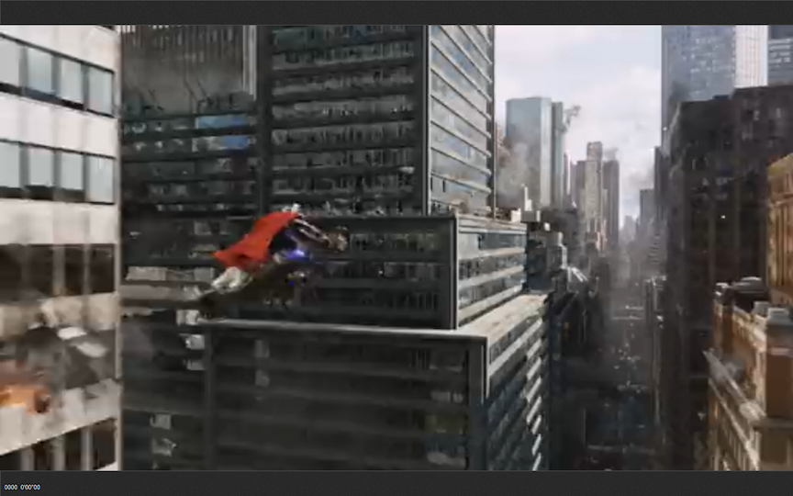
PSNR 29.1 dB

Slide 5
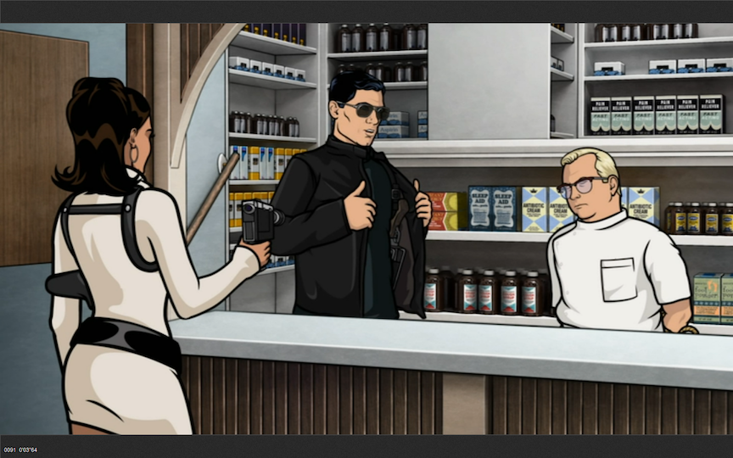
PSNR 29.3 dB

Slide 6
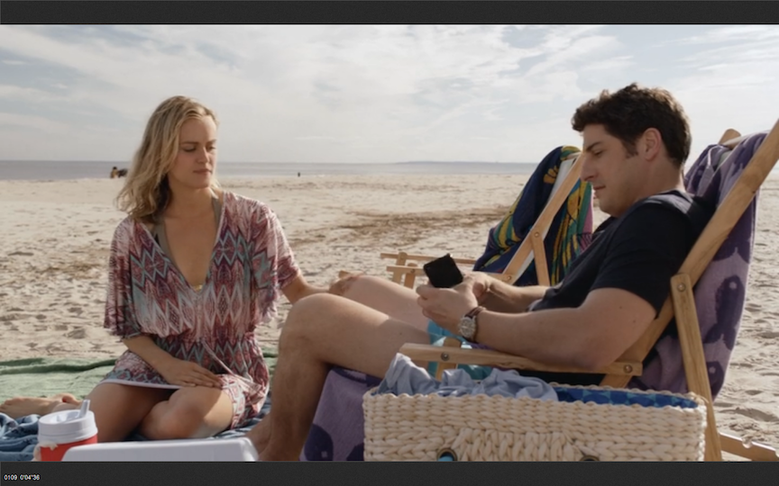
PSNR 37.3 dB

Slide 7
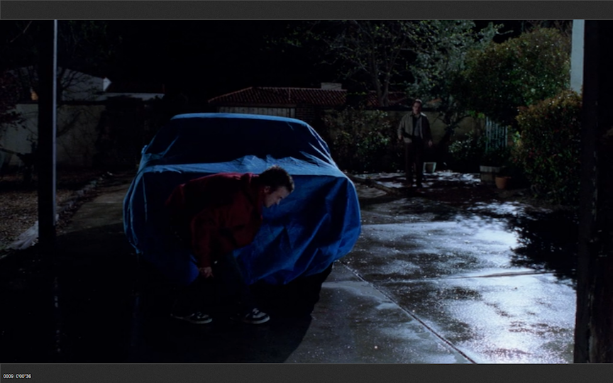
PSNR 32.9 dB

Slide 8
Design a video quality metric
Accurately captures human perception of quality
Consistent across titles
Can be run at scale
For our use case
  Compression artifacts
  Scaling artifacts

Slide 9
What is VMAF?

Slide 10
Video Multimethod Assessment Fusion
Full reference video quality metric
Combines multiple elementary quality metrics
Machine-learning regression to predict a final “fused” score

Slide 11
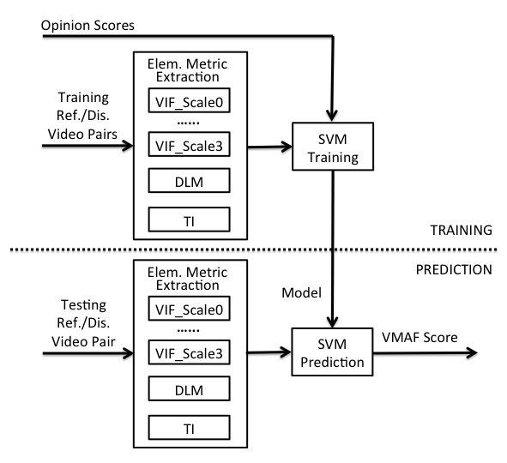
Visual Information Fidelity
H. Sheikh and A. Bovik, “Image Information and Visual Quality,” IEEE Transactions on Image Processing, vol. 15, no. 2, pp. 430–444, Feb. 2006.
Detail Loss Measure
S. Li, F. Zhang, L. Ma, and K. Ngan, “Image Quality Assessment by Separately Evaluating Detail Losses and Additive Impairments,” IEEE Transactions on Multimedia, vol. 13, no. 5, pp. 935–949, Oct. 2011.

Slide 12
Results
NETFLIX-TEST Dataset
LIVE Dataset (compression only impairments)
Metric | SRCC | PCC | RMSE
PSNR | 0.746 | 0.725 | 24.577
SSIM | 0.603 | 0.417 | 40.686
FastSSIM | 0.685 | 0.605 | 31.233
PSNR-HVS | 0.845 | 0.839 | 18.537
VQM-VFD | 0.949 | 0.934 | 11.967
VMAF 0.3.1 | 0.953 | 0.963 | 9.277
Metric | SRCC | PCC | RMSE
PSNR | 0.416 | 0.394 | 16.934
SSIM | 0.658 | 0.618 | 12.340
FastSSIM | 0.566 | 0.561 | 13.691
PSNR-HVS | 0.589 | 0.595 | 13.213
VQM-VFD | 0.763 | 0.767 | 9.897
VMAF 0.3.1 | 0.690 | 0.655 | 12.180

Slide 13
Results
VQEGHD3 Dataset (streaming impairments)
LIVE Mobile Dataset
Metric | SRCC | PCC | RMSE
PSNR | 0.772 | 0.759 | 0.738
SSIM | 0.856 | 0.834 | 0.621
FastSSIM | 0.910 | 0.922 | 0.415
PSNR-HVS | 0.858 | 0.850 | 0.580
VQM-VFD | 0.925 | 0.924 | 0.420
VMAF 0.3.1 | 0.929 | 0.939 | 0.372
Metric | SRCC | PCC | RMSE
PSNR | 0.632 | 0.643 | 0.850
SSIM | 0.664 | 0.682 | 0.831
FastSSIM | 0.747 | 0.745 | 0.718
PSNR-HVS | 0.703 | 0.726 | 0.722
VQM-VFD | 0.770 | 0.795 | 0.639
VMAF 0.3.1 | 0.872 | 0.905 | 0.401

Slide 14
Sample Clips
Clip #1
Clip #2

Slide 15
Sample Clips
Clip #1 : PSNR 37.3 dB, VMAF 78.4
Clip #2 : PSNR 32.3 dB, VMAF 81.5

Slide 16
Mitigates (some) issues of other metrics
Problematic or corner-case content
  Black frames
  Low contrast regions
  Frames with film grain noise
Image-only - no temporal information
Computationally intensive

Slide 17
Known limitations/questions
Metric is as good as the training data
Source Videos
  1080p
  Pristine sources
  How about 4K?
Distorted videos
  Living room viewing conditions
  Range of quality
  How about viewing on cellphones or tablets?
Does it reflect visual improvements from AQ?
Motion model is very simple

Slide 18
A metric and a framework. VMAF Development Kit (VDK)
https://github.com/Netflix/vmaf
Software package includes
  The VMAF implementation (including trained model)
  Framework to train and test a custom VMAF model
  Additional metrics including PSNR, SSIM and multiscale SSIM
Written in C and Python
  Elementary metric extraction in C
  Control code and model training/testing in Python
Brand new release 1.1.6
  C++ stand-alone executable (Python-independent)
  Docker and Xcode support
  VMAF algorithm update to 0.3.2 (numerical fixes)

Slide 19
Do we trust VMAF?
Do we use VMAF?

Slide 20
Build cloud-based encoding pipeline with automated quality monitoring ✓
Evaluate state-of-the-art video compression formats
Optimize encoding recipes and algorithms
  Experiment and test on subset of titles
  Deploy and run A/B tests
Participate in next-generation codec development

Slide 21
Build cloud-based encoding pipeline with automated quality monitoring
Evaluate state-of-the-art video compression formats ✓
Optimize encoding recipes and algorithms
  Experiment and test on subset of titles
  Deploy and run A/B tests.
Participate in next-generation codec development

Slide 22
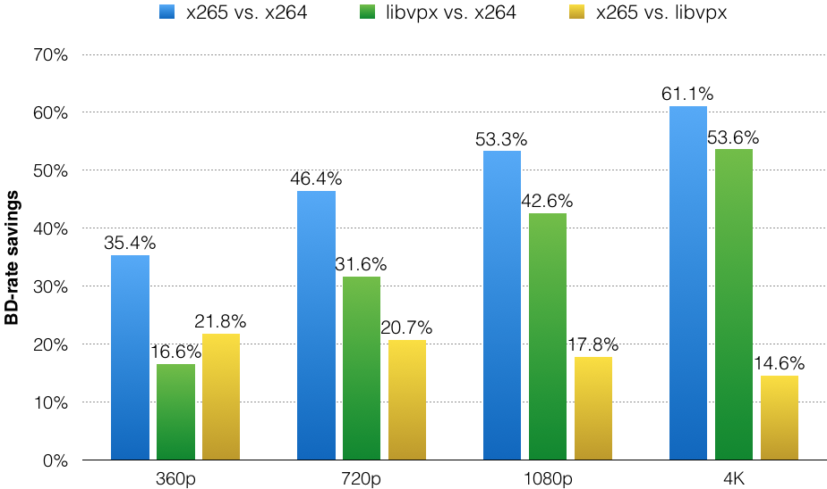
Results: Visual Quality tuned configuration
BD-rate savings based on VMAF
overall quality range

Slide 23
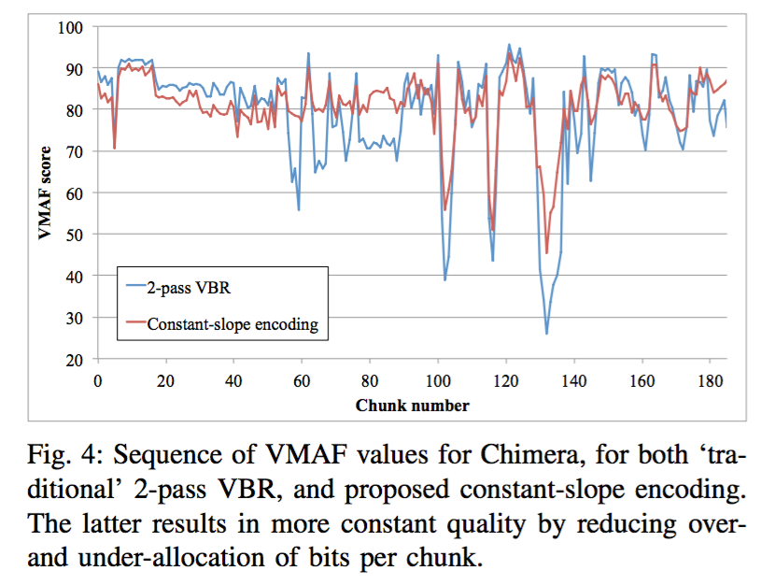
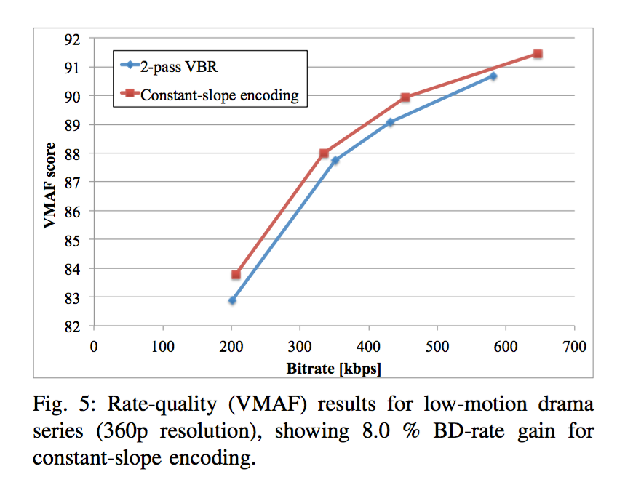
Build cloud-based encoding pipeline with automated quality monitoring
Evaluate state-of-the-art video compression formats
Optimize encoding recipes and algorithms
  Experiment and test on subset of titles ✓
  Deploy and run A/B tests ✓
Participate in next-generation codec development
J. De Cock and A. Aaron, “Constant-Slope Rate Allocation for Distributed Real-World Encoding,” to appear in PCS 2016.

Slide 24
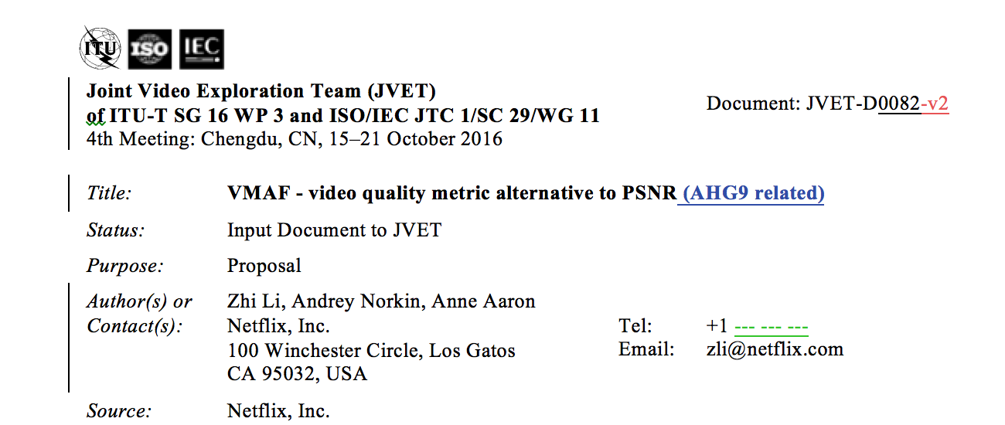

Build cloud-based encoding pipeline with automated quality monitoring
Evaluate state-of-the-art video compression formats.
Optimize encoding recipes and algorithms
  Experiment and test on subset of titles
  Deploy and run A/B tests.
Participate in next-generation codec development ✓

Slide 25
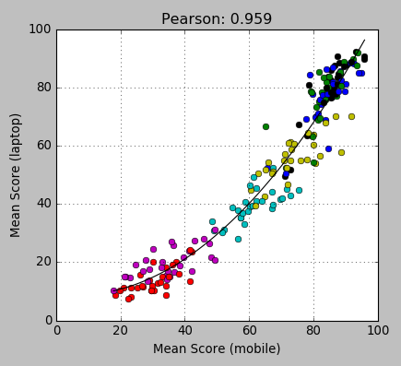
Ongoing Improvements: VMAF+
Low resolution sources
Other viewing scenarios
  TV
  Laptop
  Cellphone

Slide 26
The Team
Netflix Video Algorithms
Anne Aaron
Jan De Cock
Rich Gerber
Zhi Li
Megha Manohara
Aditya Mavlankar
Anush Moorthy
Andrey Norkin
University of Southern California
Prof. C.-C. Jay Kuo
Joe Yuchieh Lin
University of Texas Austin
Prof. Al Bovik
Todd Goodall
Christos Bampis
Université de Nantes
Prof. Patrick Le Callet

Slide 27
Thank you.

Slide 28
Extra Slides

Slide 29
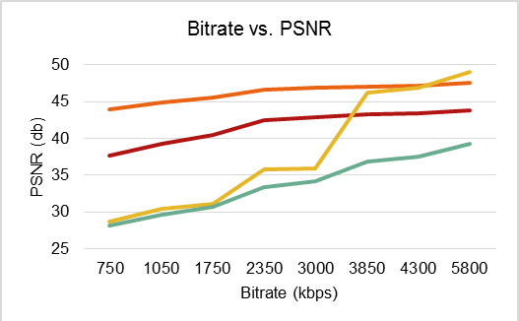

Slide 30



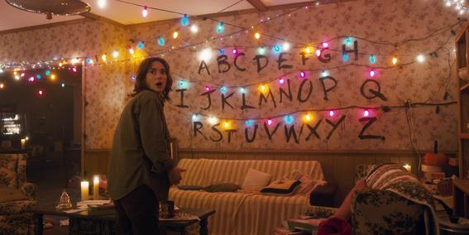
The best video quality possible
190 countries.
83 million members.
125 million hours of TV shows and movies per day
35% peak downstream traffic in North America

