Slide 1
Best Practices for Crowdsourced QoE Studies: QoE Crowdtesting
Tobias Hoßfeld, Samira Tavakoli

Slide 2
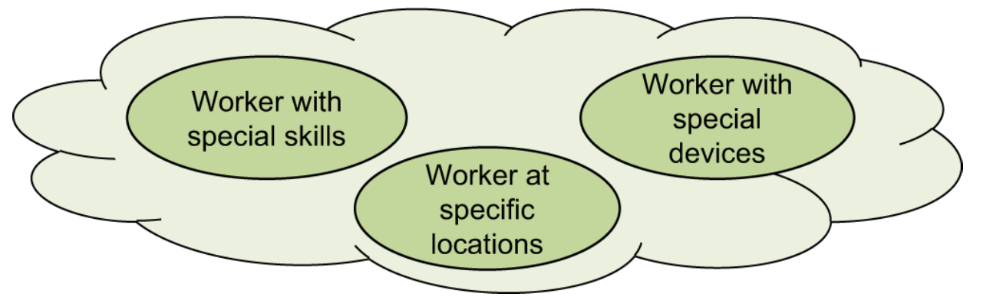
Background
Crowdsourcing is a neologism composed of “crowd“ and “outsourcing“
All tasks are web-based micro jobs, little effort to fulfill
Interesting for QoE user studies:
  low costs compared to laboratory studies
  large user panel
  user studies can be executed in short time
  QoE tests for Internet applications with realistic settings

Slide 3
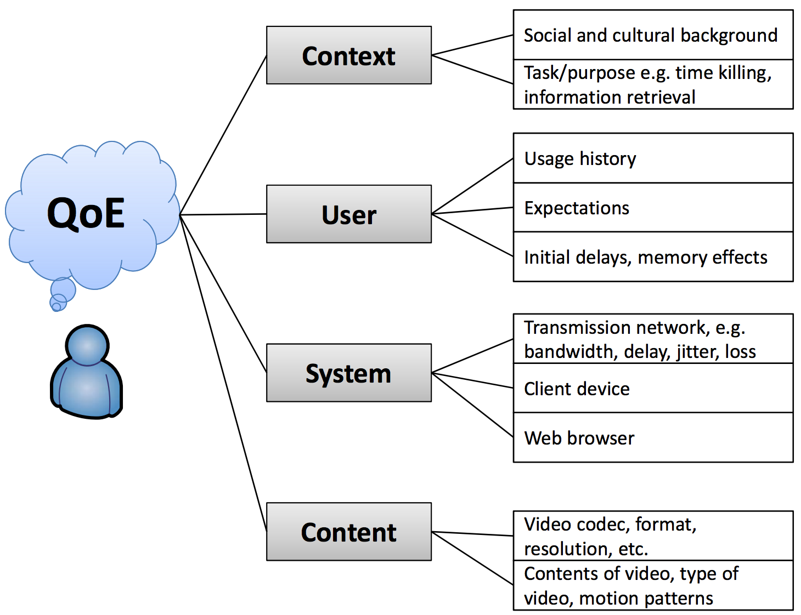






Potential of Crowdsourced QoE
realistic settings & physical context
social context
cultural context
user diversity
demographic background
usage history
impact of incentives
heterogeneous client devices & software
various access technologies
world-wide user locations
New possibilities
collection of sensor data from smartphones
additional monitoring data enabled like eye-tracking
interaction possibilities during subjective test, e.g. online chats
Beyond QoE
field trials with crowd
user experience and user behavior

Slide 4









Challenges of Crowdsourced QoE
task design
crowdsourcing setting
short task duration
instructions & training
feedback & questions
hidden influence factors
reliability of users
…
QoE study
testing methodology
QoE influence factors under investigation
additional QoE factors
proper subset of items
…
test items
incentives
crowd
implementation
Statistical analysis & Evaluation
Analyzing hidden factors
Outlier detection & score normalization
Acceptable level of difference between lab and CS studies
…
Internet
Technical aspects
server implementation
client application & compatibility
desired test conditions
context monitoring
…
delivery of test data
heterogeneous devices & Internet access
Hossfeld, T., Keime, C., Hirth, M., et al., “Best Practices for QoE Crowdtesting: QoE Assessment With Crowdsourcing”, IEEE Transactions on Multimedia, 2014

Slide 5
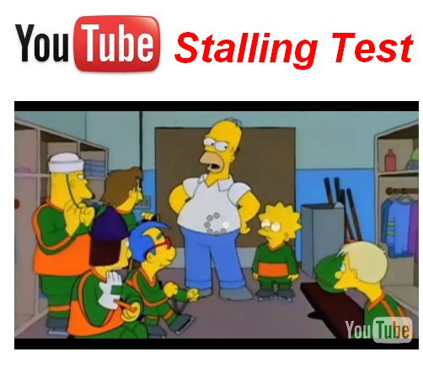
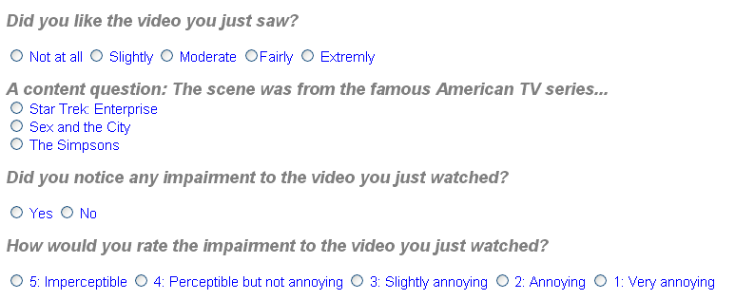
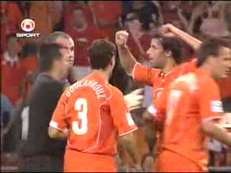

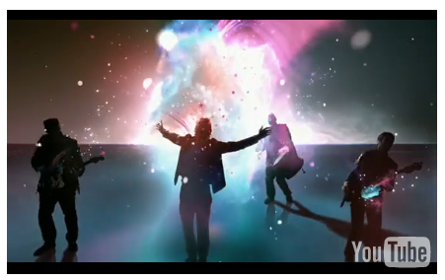

User Ratings and Consistency Questions
Golden Standard Data
Use easy question!
stops
Content Question
Simple questions!
Which sport was shown in the clip?
Tennis
Soccer
Sking
Monitor user activity, e.g. browser focus

Slide 6
Monitoring to Identify Unreliable Users
Lack of control → Application Usage Monitoring
  Relies on objective measures on application-level
  Example: measuring the time the worker spends on the task
    Task completed very quickly → sloppy work?
    Problem: Reaction times of subjects may differ significantly.
  Example: monitor browser events
    to measure focus time = time interval during which browser focus is on the website belonging to user test.
    → Warning message!
User monitoring and environment monitoring
  Tired/bored users
  Difficult to implement → using webcams?
  Excluding the user entirely, NOT only the unreliable tasks

Slide 7
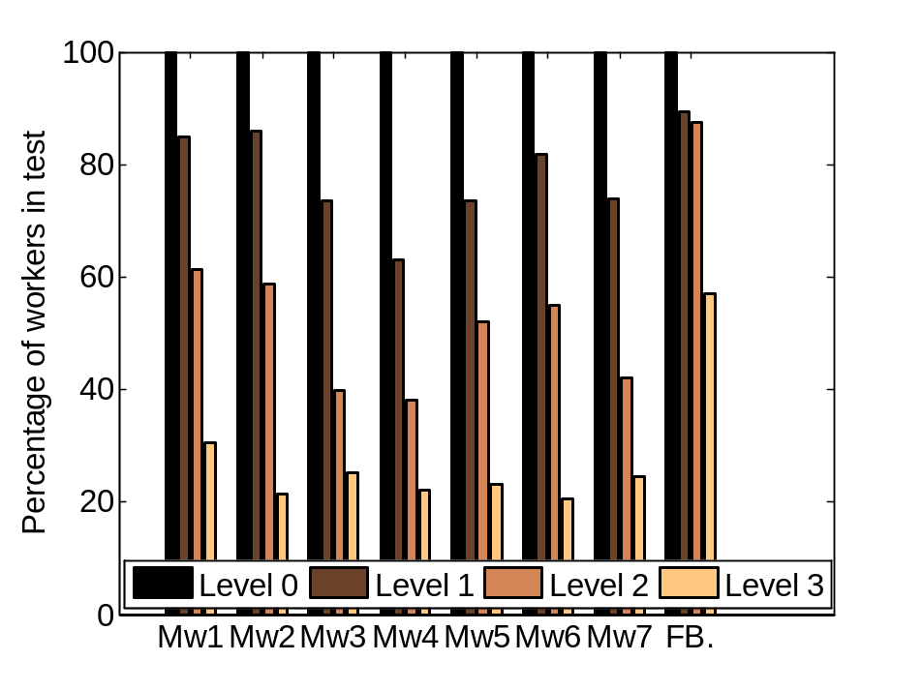
Example: Detecting unreliable workers
LEVEL 1:
- wrong answers to content questions
different answers to the same questions
always selected same option
consistency questions:
  specified the wrong country/continent
LEVEL 2:
- did not notice stalling
- perceived non-existent stalling
LEVEL 3:
- did not watch all videos completely
Many user ratings rejected
→ improvements?
User warnings („Test not done carefully“) → rejection rate decreased about 50%
Filtering may be too strict → application layer monitoring (LEVEL 3) not reliable?
C1 C2 C3 C4 C5 C6 C7 Facebook
Hoßfeld, T., Seufert, M., Hirth, M., Zinner, T., Tran-Gia, P., Schatz, R., “Quantification of YouTube QoE via crowdsourcing”, IEEE International Symposium on Multimedia (ISM), 2011

Slide 8
Best Practices and Lessons Learned
Best Practices and Recommendations for Crowdsourced QoE - Lessons learned from the Qualinet Task Force Crowdsourcing.
Qualinet Whitepaper, 2014.
https://hal.archives-ouvertes.fr/hal-01078761

Slide 9
Pitfalls and Lessons Learned
Use common software without requiring admin installations!
Simplify your questions!
Take the right duration for your experiment!
Include proper training sessions!
Integrate a feedback channel!
Use event logging!
Include reliability checks! In the test design. . .
Include reliability checks! . . . during the test . . . !
Include reliability checks! . . . after the test!
The crowd consists of human beings!
Lessons learned from lab test → Use them in Crowdsourcing too!
Use the appropriate scale for your problem!
Motivate your users!
Crowdsourced lessons learned:

Slide 10
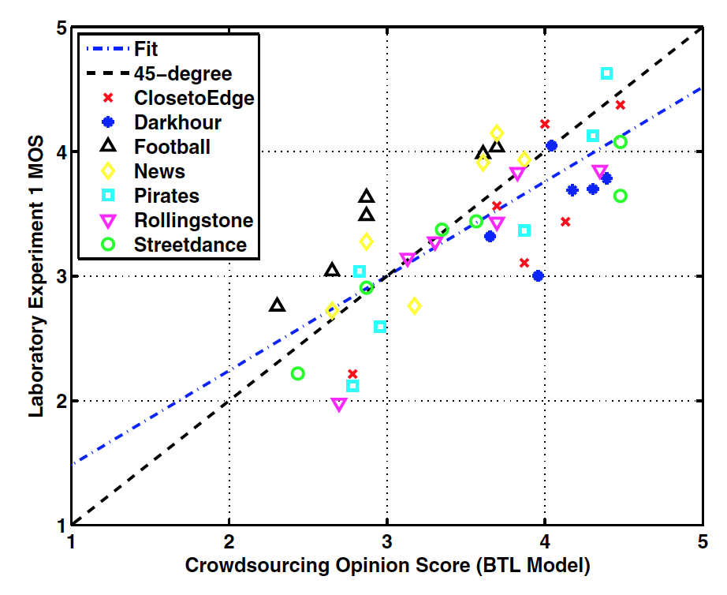
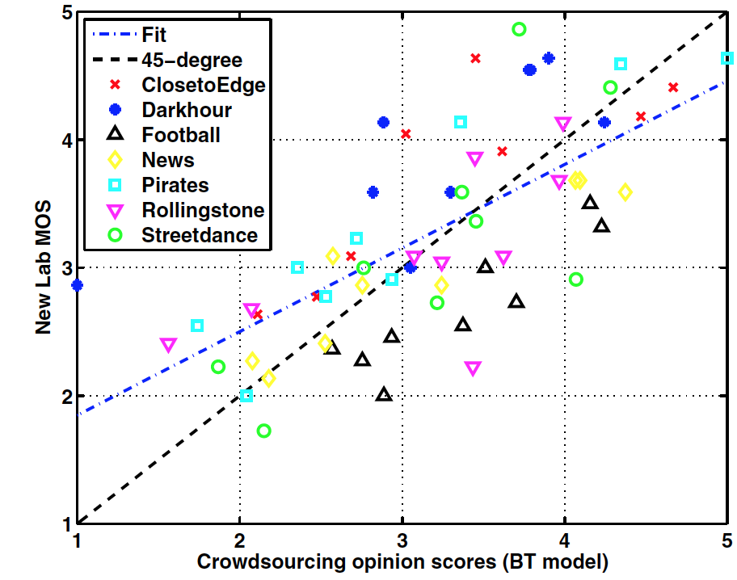


Lab vs. CS: Choice of evaluation methodology matters!
Test platform | Test Methodology
Laboratory 1 | Single Stimulus
CS | Pair Comparison
Laboratory 2 | Pair Comparison
Laboratory 1 MOS
Laboratory 2 MOS
Laboratory 2 MOS
$$R^{2}=0.77$$
$$R^{2}=0.70$$
Crowdsourcing Opinion Score
Crowdsourcing Opinion Score
Sogaard, J.; Shahid, M.; Pokhrel, J., Brunnstrom, K., " On subjective quality assessment of adaptive video streaming via crowdsourcing and laboratory based experiments," Multimedia Tools and Applications 2016, vol.75, pp.1-22492

Slide 11
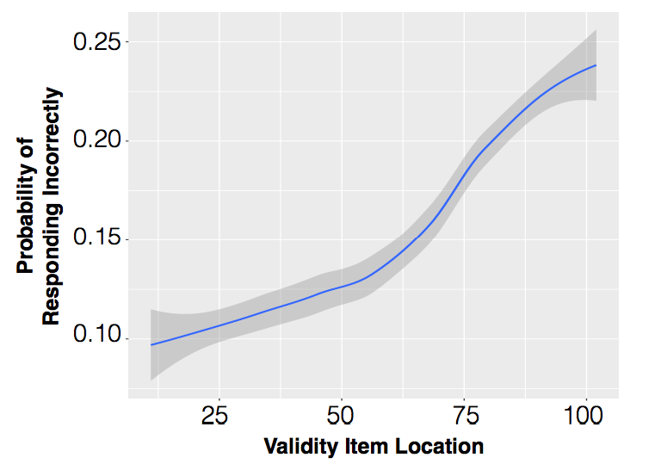
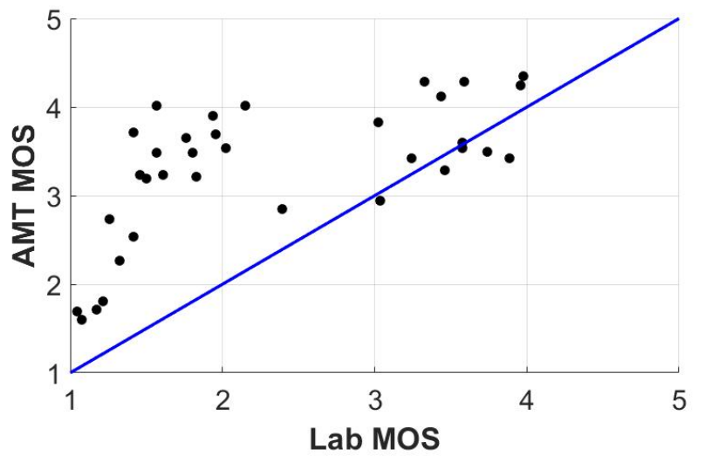
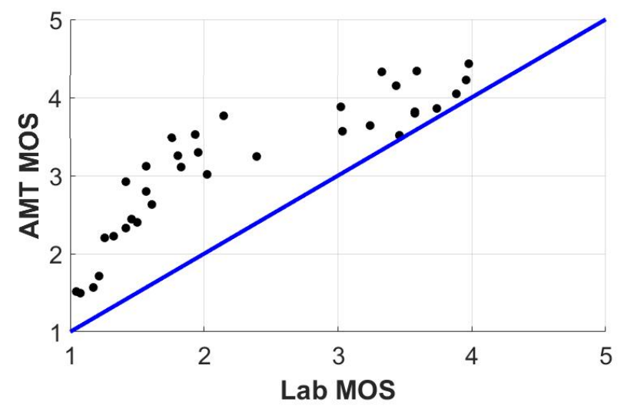


Impact of test design choice
Probability of responding incorrectly
Increasing correlation when stimulus shown in full-screen mode
Item Location
Crowdsourcing
Crowdsourcing
$$R^{2}=0.62$$
$$R^{2}=0.87$$
Saad, M.A.; McKnight, P.;Quartuccio, J.; Nicholas, D.; Jaladi, R.; Corriveau, P., " Consumer-Photo Quality Assessment: Challenges and Pitfalls in Crowdsourcing,"
IEEE Quality of Multimedia Experience, QoMEX 2016

Slide 12
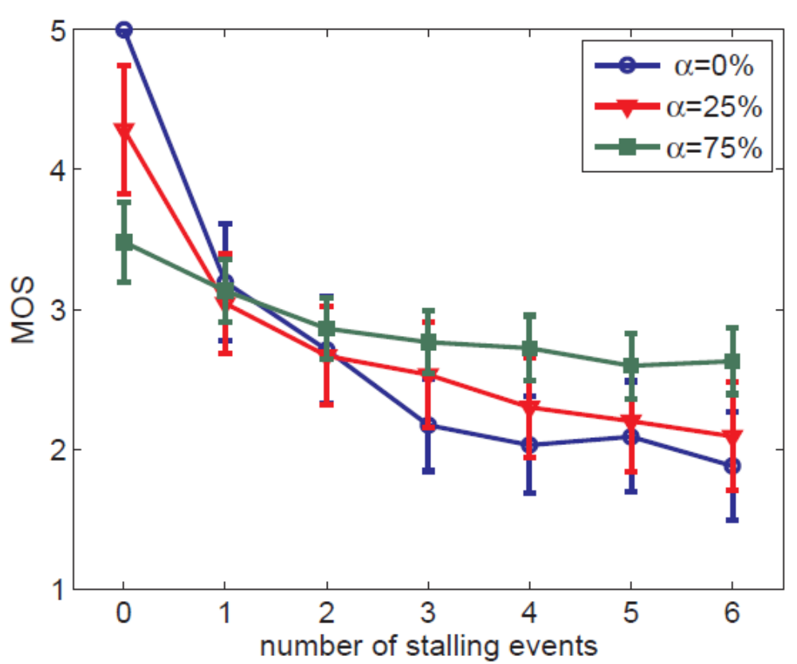
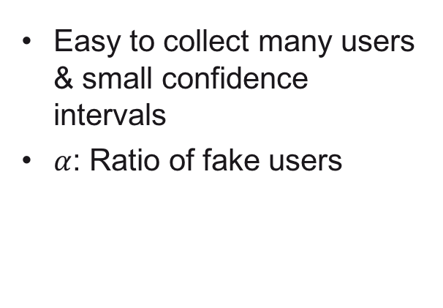
Data Quality & Reliability
Easy to collect many users
& small confidence intervals
$α$: Ratio of fake users
Small CI is not sufficient!
Crowdsourcing test design is different
    proper training
    reliability checks
    Statistical analysis
Hossfeld, T., Keime, C., Hirth, M., et al., “Best Practices for QoE Crowdtesting: QoE Assessment With Crowdsourcing”, IEEE Transactions on Multimedia, 2014, vol.16, No. 2

Slide 13
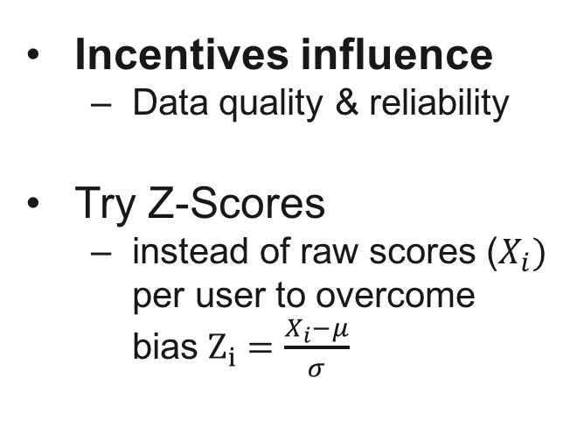
Motivation & Incentives
Measure | Facebook – volunteers | Microworkers – paid workers
#Registered users | 414 | 258
Did not complete training | 63% | 31%
Finished scoring first set of images | 32% | 67%
#Users in analysis | 133 | 172
#Users after filtering | 99 (74%) | 113 (65%)
Incentives influence
  Data quality & reliability
Try Z-Scores
  instead of raw scores ($X_{i})$ per user to overcome bias$Z_{i}=\frac{X_{i}−μ}{σ}$
3
0
Facebook
2
5
Microworkers
2
0
Percentage
1
5
1
0
5
0
1
2
3
4
5
Score

Slide 14
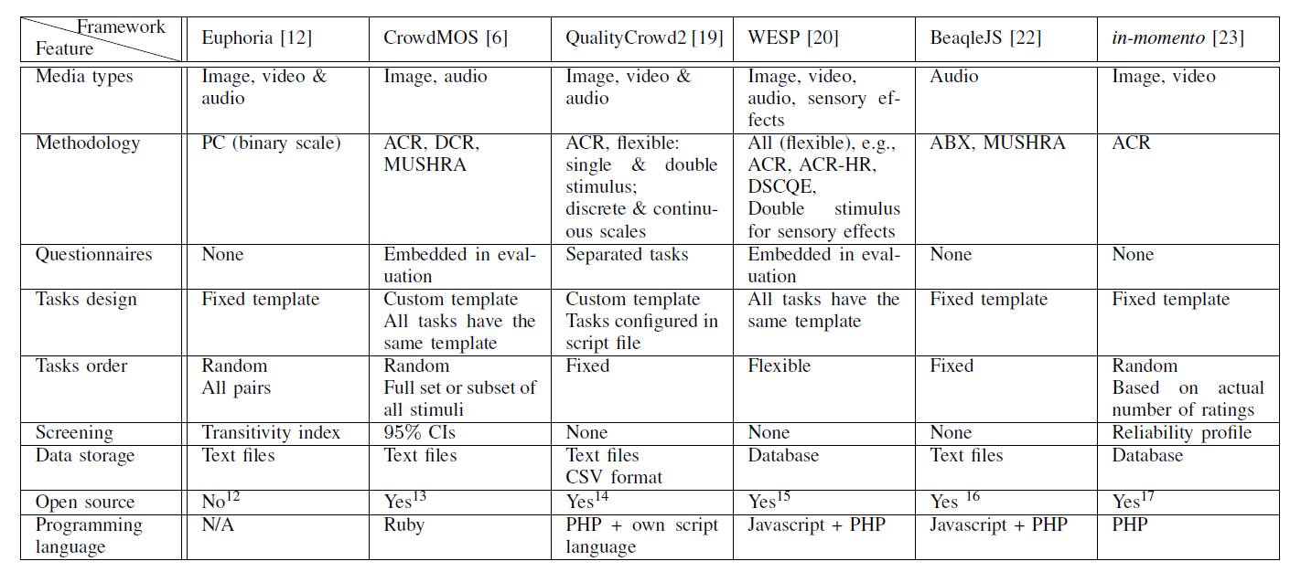
Crowdsourcing Frameworks
Hoßfeld, T.; Hirth, M.; Korshunov, P.; Hanhart, P.; Gardlo, B.; Keimel, C.; Timmerer, C., "Survey of web-based crowdsourcing frameworks for subjective quality assessment," Multimedia Signal Processing (MMSP), 2014 IEEE 16th International Workshop on , vol., no., pp.1,6, 22-24 Sept. 2014

Slide 15
Ongoing works

Slide 16
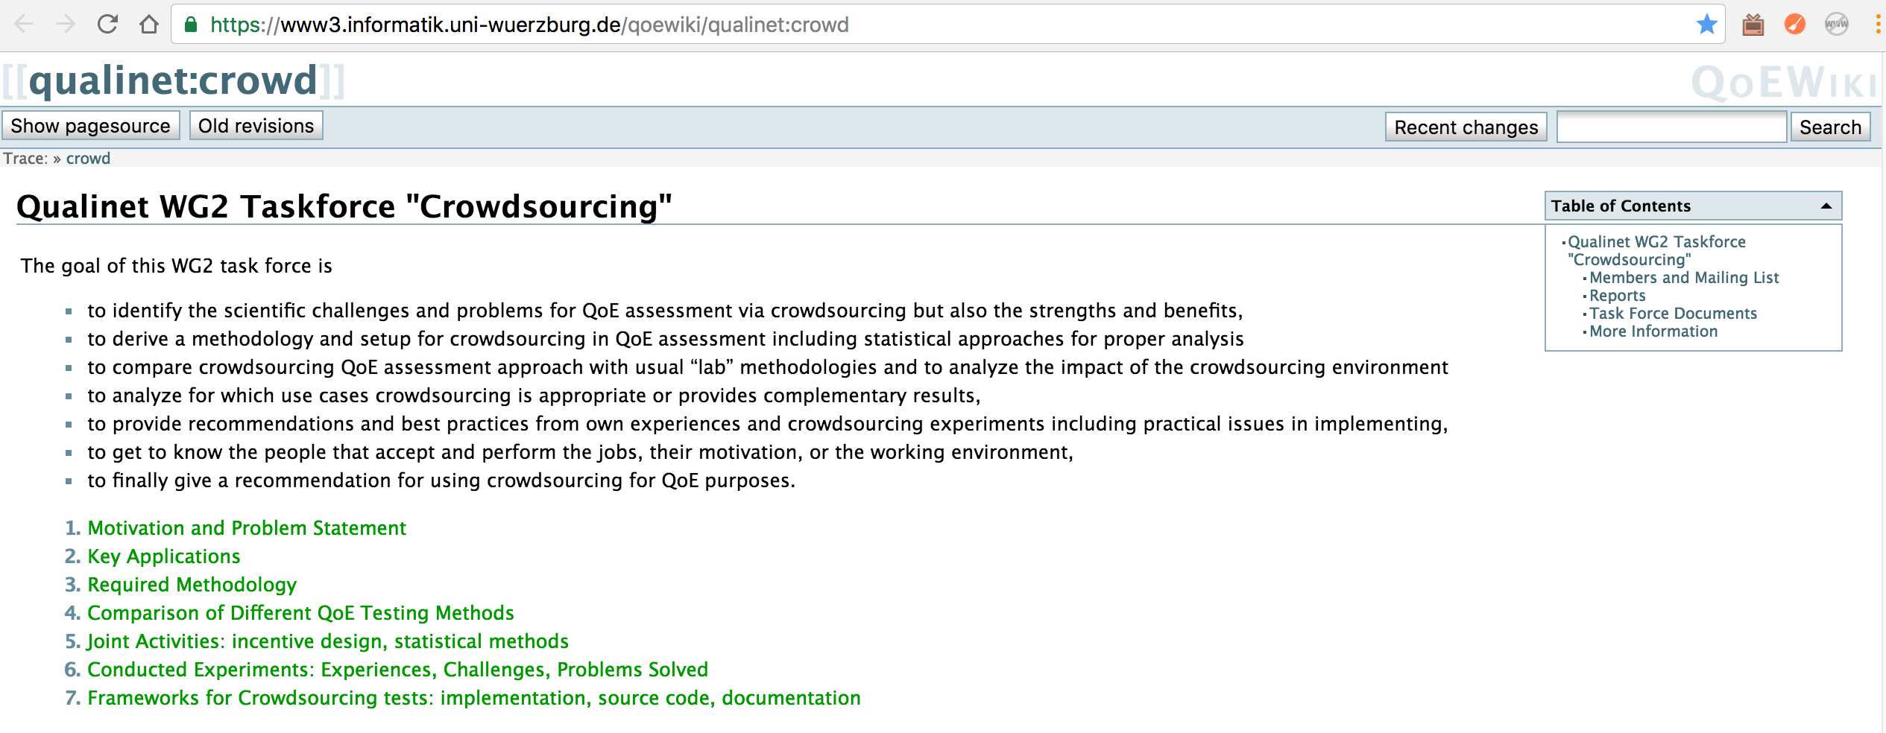
QUALINET Task Force on Crowdsourcing
ITU-T Standardization efforts in P.CROWD
  Comparison lab (P.800) & Crowdsourcing
    Dataset: used for P.863
    Analysis of CS platforms: Crowdee, Microworkers, Mturk, CrowdFlower
      Suitable for Speech QoE test?
    Reliability check?
Adaptive Crowdsourcing
https://www3.informatik.uni-wuerzburg.de/qoewiki/qualinet:crowd

Slide 17
Best Practices for Crowdsourced QoE Studies: QoE Crowdtesting
Samira Tavakoli, Tobias Hoßfeld

