Slide 1
Challenges in QoE Assessment of Adaptive Video Streaming
Samira Tavakoli, Tobias Hoßfeld

Slide 2
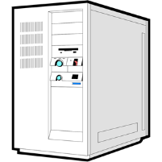



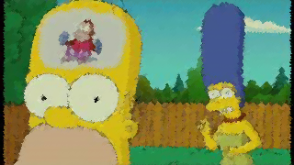
HTTP Adaptive Streaming
Quality
Level
3
2
1
Bits
Bit rate
Time
Bit rate 3
TCP throughput
Requested chunks
Bit rate 3
Bit rate 2
Time
Bit rate 2
Bit rate 1
Bit rate 1
Time
Time
stateless server
HTTP
manifest
stateful client

Slide 3
Observation Points for HAS QoE measurement
Server
HAS Client
Media output
End user
Observation
point 1
Observation
point 2
Observation
point 3
Example of OP1 metrics
Example of OP2 metrics
Example of OP3 metrics
Key | Description
Video Codec | H.264/HEVC
Adaptation set | Per-title encoding optimization
Key | Description
Client | - Video player - Video buffer
Adaptation logic | - QoS monitoring - Buffer fill - Bitrate estimation
Key | Description
Waiting time | Initial delay Stalling frequency Stalling duration
Video adaptation | Switching Behavior Quality dimension
Quality dimension | Spatial Temporal Image quality
Contextual factors | Device Content

Slide 4
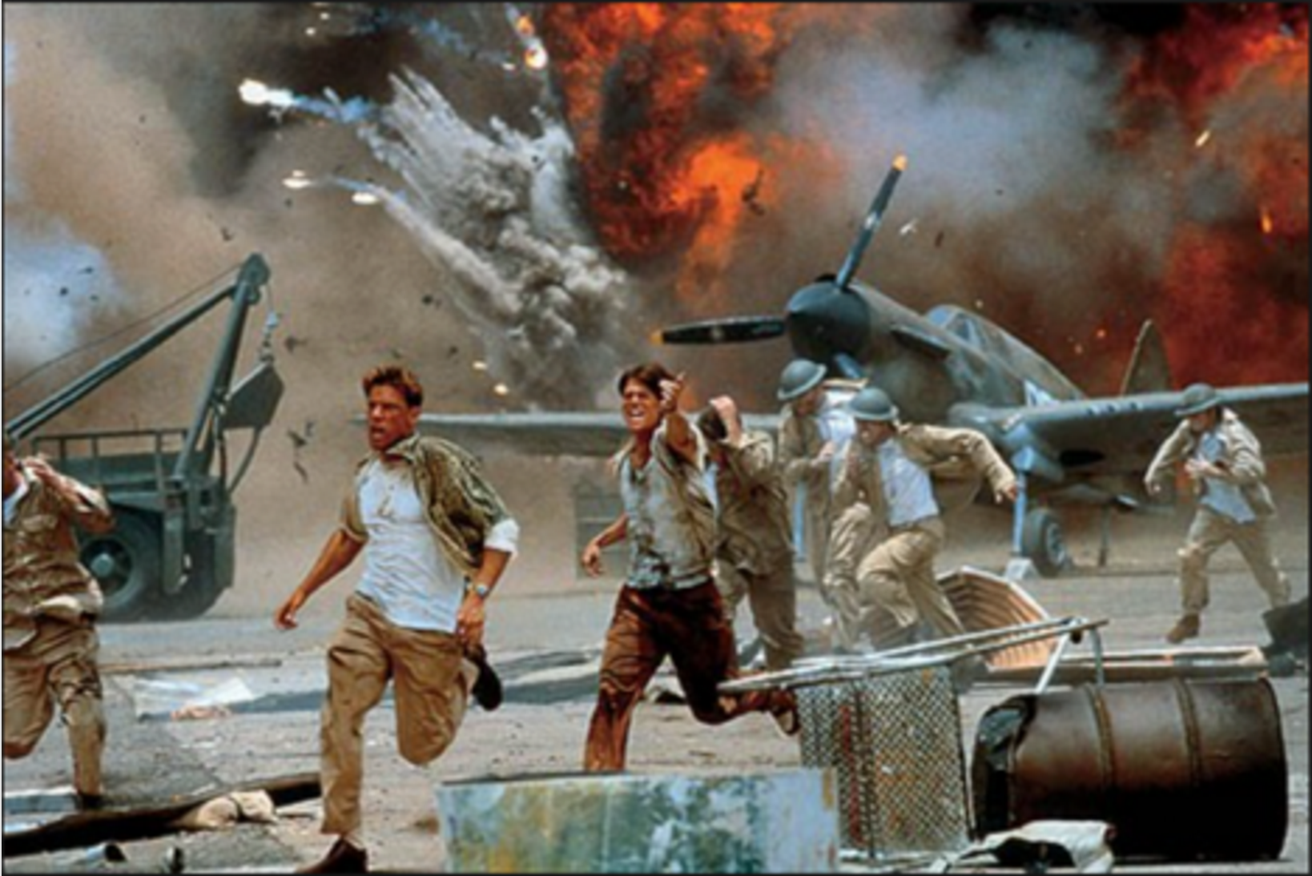
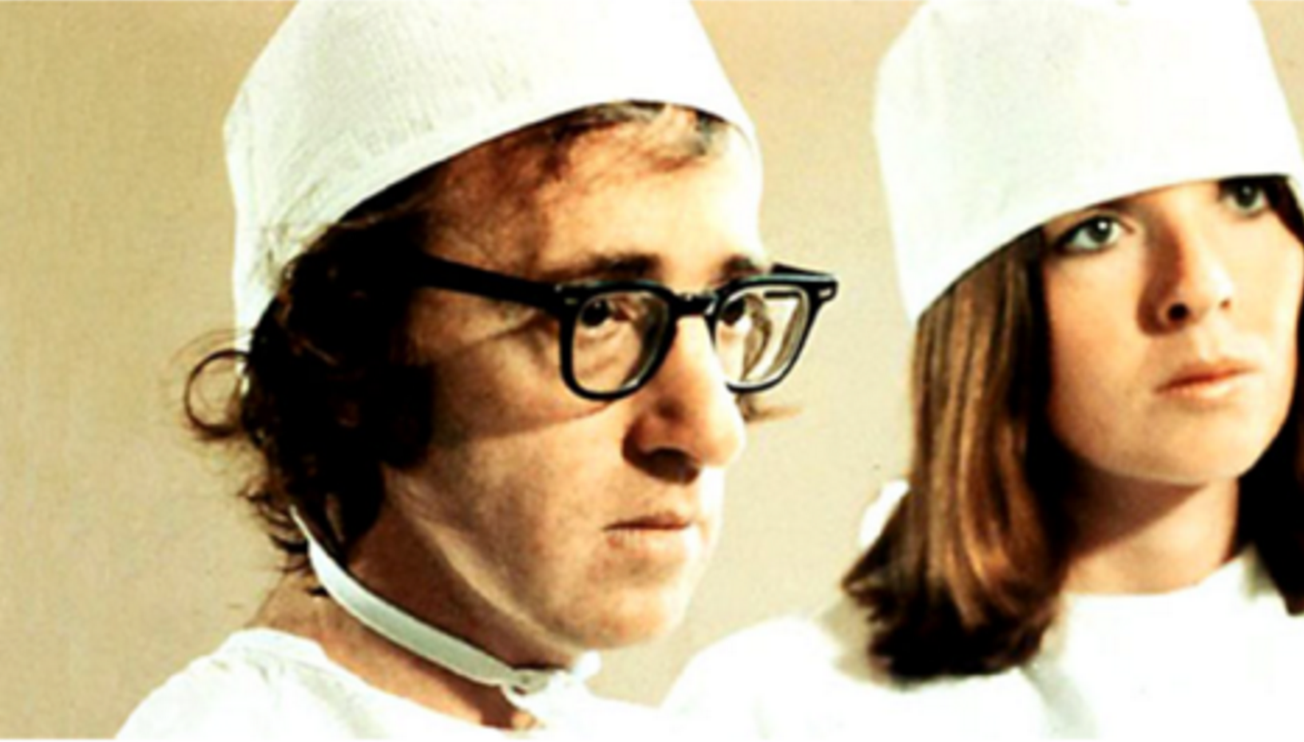

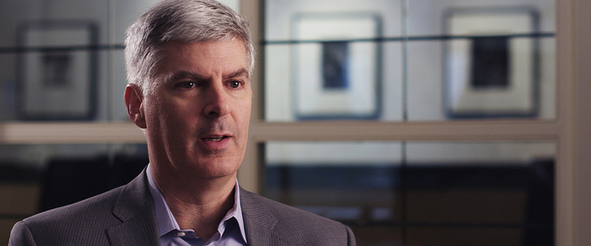
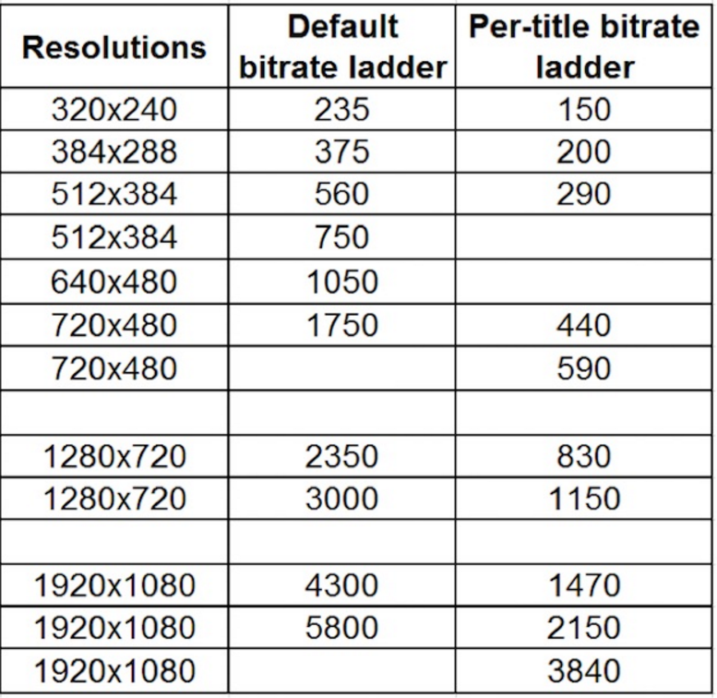
Different entities concern from different perspectives
Network Providers → Adaptation logic
  Real-time monitoring in the networks →Network planning
  Has been the major attention point in research
Content/Service Providers → Video generation
  Content-Aware Adaptive Streaming
    After a threshold, increasing encoding
    quality not lead to a better QoE
    By efficient selection of upper bound
    quality level and representation set
      Improves perceptual quality (>200%) while
      lowering bandwidth requirement (35%)
High motion content
Low motion content
Complex scene
Talking head scene
- Netflix Tech Blog, June 2016

Slide 5
Subjective Evaluation of
HAS QoE

Slide 6
Two Survey on HAS Subjective QoE Studies
Around 100 related works
Many aspects have been already addressed, mostly
  Effect: Waiting time (not switching strategies)
  Quality dimension: QP encoding
  Content: few number & short duration
  Testing method: single stimulus evaluation without audio
Garcia, M.-N.; De Simone, F.; Tavakoli, S.; Staelens, N.; Egger, S.; Brunnstrom, K.; Raake, A., “Quality of Experience and HTTP Adaptive Streaming: A Review of Subjective Studies,” Proc. 6th International Workshop on Quality of Multimedia Experience, QoMEX 2014
Seufert, M.; Egger, S.; Slanina, M.; Zinner, T.; Hoßfeld, T.; Tran-Gia, P., "A Survey on Quality of Experience of HTTP Adaptive Streaming," Communications Surveys & Tutorials, IEEE , vol.17, no.1, pp.469,492, 2015

Slide 7
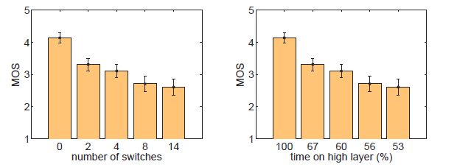
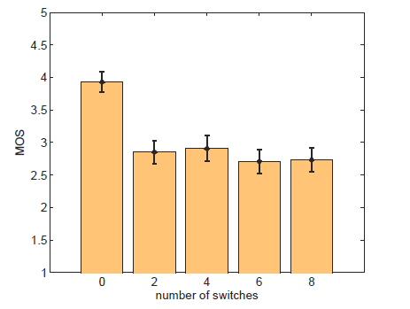
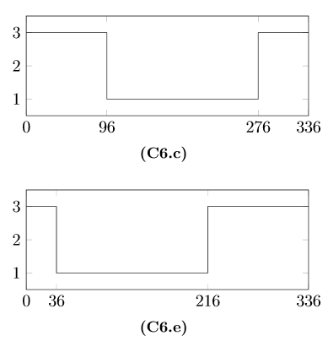
Example of contrary reported outcomes:
Switching Frequency vs. Time on Layer
In several works, switching frequency is reported to influence QoE
Often “number/frequency of switches” & “ time on layer”
→ correlated and change simultaneously
Keeping “time on layer”
constant ➔ no influence of
switching frequency
could be found
Hoßfeld, T., Seufert, M., et. Al."Assessing Effect Sizes of Influence Factors Towards a QoE Model for HTTP Adaptive Streaming," QoMEX 2014

Slide 8
Several Research Questions still Open
Questions due to lack of valid test data
  Limited number of test conducted to address a factor
    Effect of different quality dimension (spatial, temporal, QP encoding)
    Adaptation set: min number of quality layers, JND
  Shortcoming of reported studies
  Methodological shortcoming in terms of how test conducted
  Contradictory outcomes in respect to an identical factor
Never (or just recently in limited studies) tackled
  Multi-factor QoE
    e.g. stalling and initial delays/ waiting time and quality switches
  Live streaming
    HAS-type and UDP time-varying quality (e.g. stalling with and without frame skipping)

Slide 9
Challenges in performing subjective studies
Quality varies over periods up to several minutes
+ Lots of parameters to test
+ ITU limitation in test session duration
Lab experiment
Lack of Immersive testing methodology for time-varying quality videos
Full metric design not possible
We need bigger sample size (#observers) to find significance
  Crowdsourcing
Easily (and relatively cheap) increasing the sample size to compensate uncertainty
Long duration test videos and CS
Need to enhance towards more reliability

Slide 10
Objective models for
HAS QoE

Slide 11
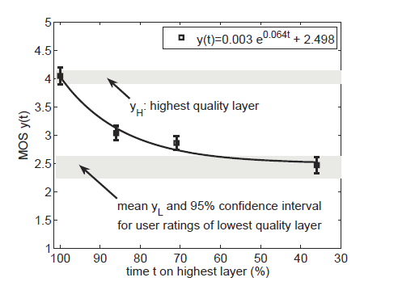
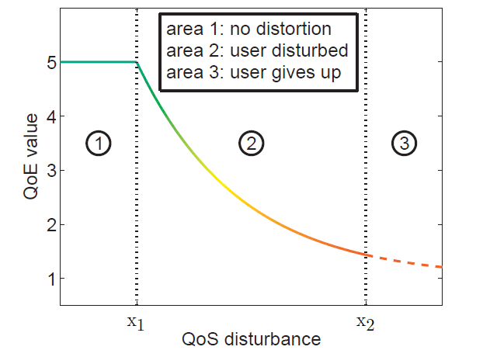

Simple QoE Model for Two Quality Layers
Simple QoE model based on two key influence factors
  Switching amplitude (quality layers gradient)
  Time on highest leyer
IQX provides a very good fit to the data points (R²=0.98)
IQX-Hypothesis
T. Hoßfeld; M. Seufert; C. Sieber; T. Zinner; “Assessing effect sizes of influence factors towards a QoE model for HTTP adaptive streaming,” Proc. 6th International Workshop on Quality of Multimedia Experience, QoMEX 2014

Slide 12
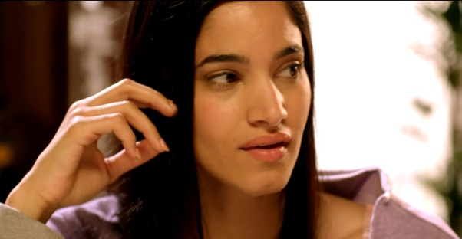
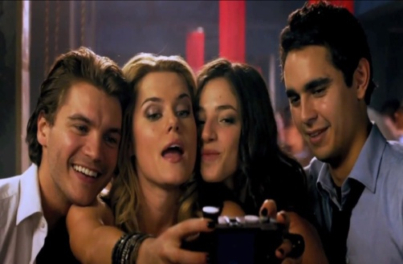
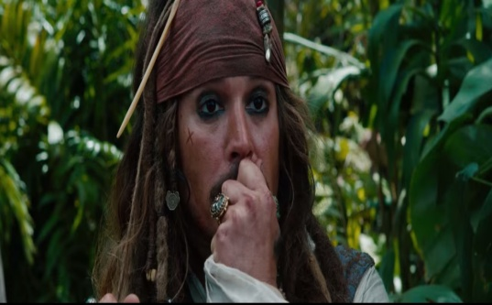
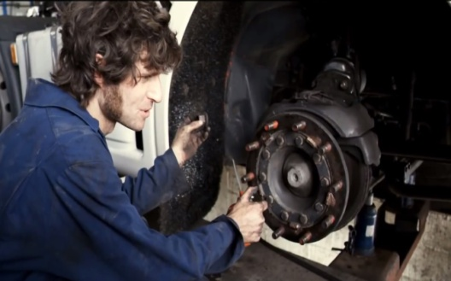

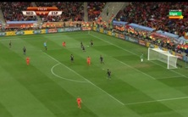
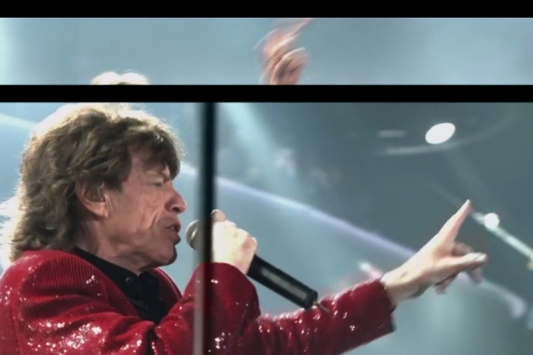
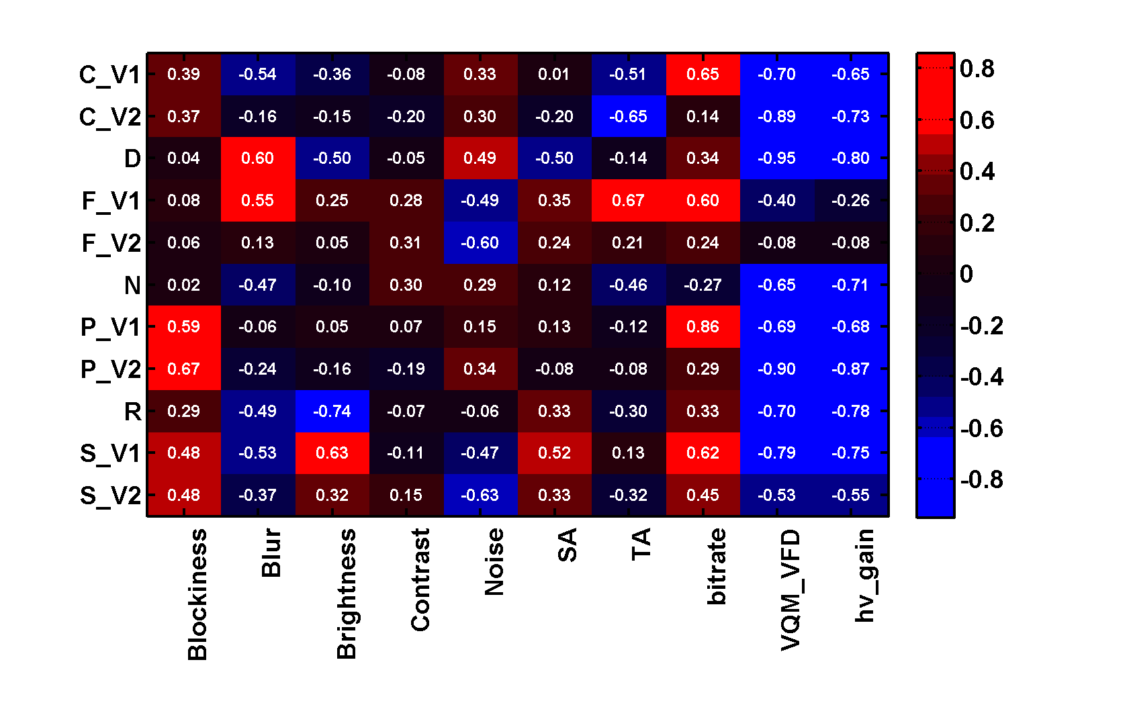
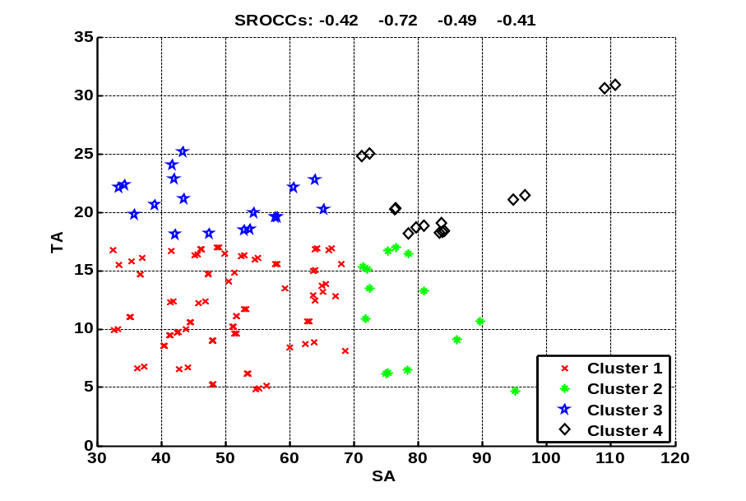
Objective Characterization of Adaptive Bitrate Videos
Relationship between perception of quality switching &
  Content spatiotemporal characteristics
  Pictorial degradations
SROCC Result: NR and FR measurement (average pooling) for each content
Cluster | SROCC blockiness-MOS
H Spatial-H Temporal | 0.71
L Spatial-H Temporal | 0.82
J. Sogaard; S. Tavakoli; K. Brunnstrom; N. Garcia; “Subjective Analysis and Objective Characterization of Adaptive Bitrate Videos,” Proc. IS&T International Conferrence on Human Vision and Electronic Imaging (HVEI), 2014

Slide 13
Challenges in QoE Modeling

Slide 14
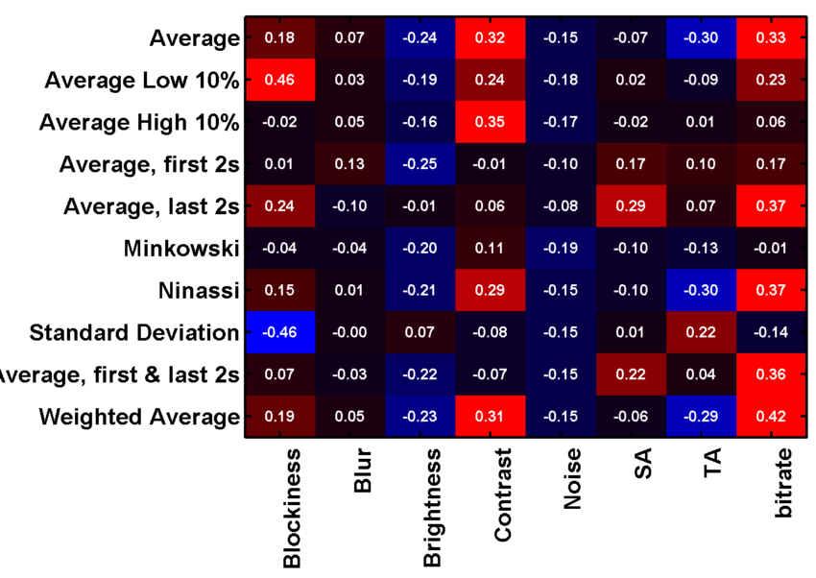
Which Temporal Pooling method to employ?
Video Quality metrics are frame-based
Majority of studies use “Average” pooling
A video with 90 high-quality minutes and 5 poor-quality minutes
  Very good average score
  A viewer would likely remember and weigh the poor-quality differently.
  “A pooling algorithm that gives more weight to lower scores may be more accurate towards human perception."
              - Netflix Tech Blog, June 2016

Slide 15
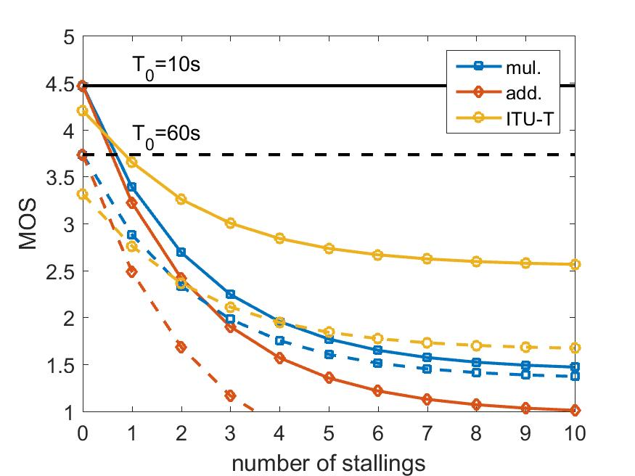

Multiple factors: Additive or Multiplicative relationship?
  Which parameters are significant? Network related, encoding related…?
Objective models depend on weighting factors determined by curve fitting
  No generic relationship
Is QoE additive or multiplicative?
Very different results!
Which model is correct?
T. Hoßfeld; L. Skorin-Kapov, P. E. Heegaard, M. Varela, K-T Chen; “On Additive andMultiplicative QoS-QoEModels forMultiple QoS Parameters,” Proc. 5th Workshop on Perceptual Quality of Systems, PQS 2016

Slide 16
Summary & Work Plan

Slide 17
Content Aware Adaptive Streaming (optimal adaptation set)
  Scene analysis and content characterization
  Encoding technique: QP encoding, CRF,…
  Perceptual quality mapping model: PSNR, SSIM, VQM,
  VMAF (Video Multimethod Assessment Fusion)?
  Number of quality levels, Just Noticeable Difference
On Subjective evaluation
Lab study:
  Developing Immersive testing methodology for time-varying quality videos
Crowdsourcing:
  Long duration test videos and CS
Different perspectives for QoE study & Several open RQs
Two survey on Subjective studies
  Open RQs identified
Nothing on HAS QoE modeling
  Several distinct models addressing identical factors
Survey on HAS QoE modeling
etc.
Video Quality
Adaptation
Behavior
Waiting Time
HAS
QoE

Slide 18
On Objective QoE Modeling
Single factor:
  Using different pooling methods to QoE model of whole sequence
Multiple factors:
  No straightforward solution to combine single-factor QoE models into multidimensional model
  Additive and Multiplicative model lead to different properties
  Lack of Subjective data
  Conducting subjective study for multi-factor QoE
    Waiting time related impairment and quality switches all happening in the same sequence
    Different number of stalling and different duration
  New sampling strategies required due to growth of parameter space
    Adaptive approaches for parameter selection

Slide 19
Challenges in QoE Assessment of
Adaptive Video Streaming
Samira Tavakoli, Tobias Hoßfeld

