Slide 1
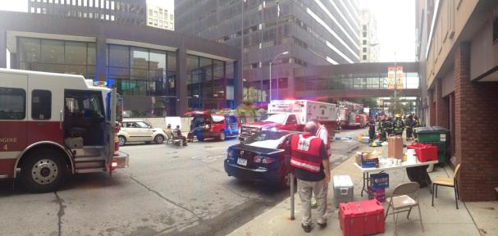
Image Quality for Public Safety
Margaret Pinson, NTIA/ITS

Slide 2
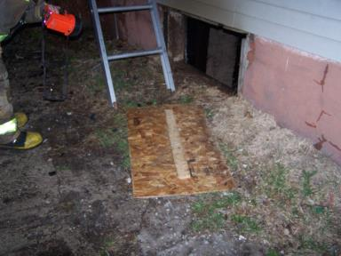
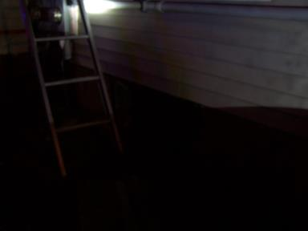
Evidence
All photos were provided by first responders.
These actual photos show recent cases

Slide 3
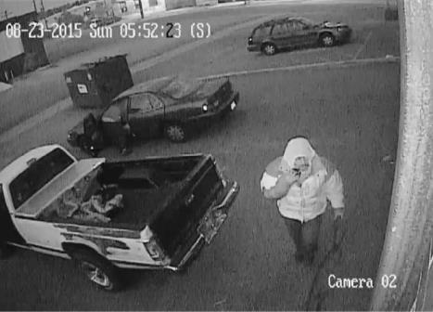
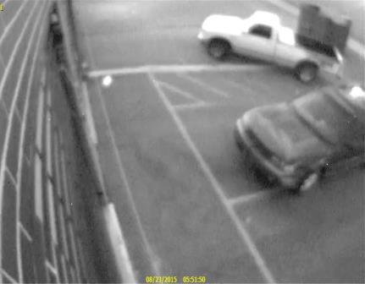
Surveillance systems

Slide 4
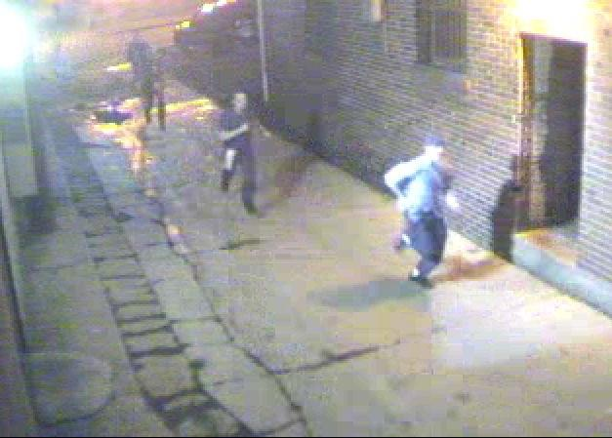

How do we avoid …

Slide 5
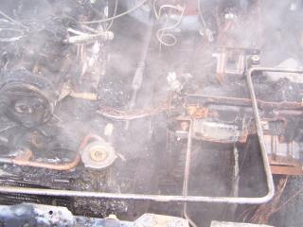
Mike Hartman
Assistant Chief and Fire Marshal
Muscatine, Iowa
Takes picture in field
Struggle with quality 75% of time
  Low light & bad weather
  Reshoot
  Miss problems
Impact
  Evidentiary needs not met
  Must retain all images regardless
  Time sink

Slide 6

Michael Bush
Denver Police Crime Lab
Forensic Imaging and Video Analysis
Photo from surveillance video
Monitor quality ≠ photo quality
  Export frame
  Face disappears
Struggle with quality 60% of time
  Need identifying marks

Slide 7
Project Summary
Collect images
  Realistic
Subjective test
Redistribute dataset
  www.cdvl.org
Future
  Objective model
  Video

Slide 8
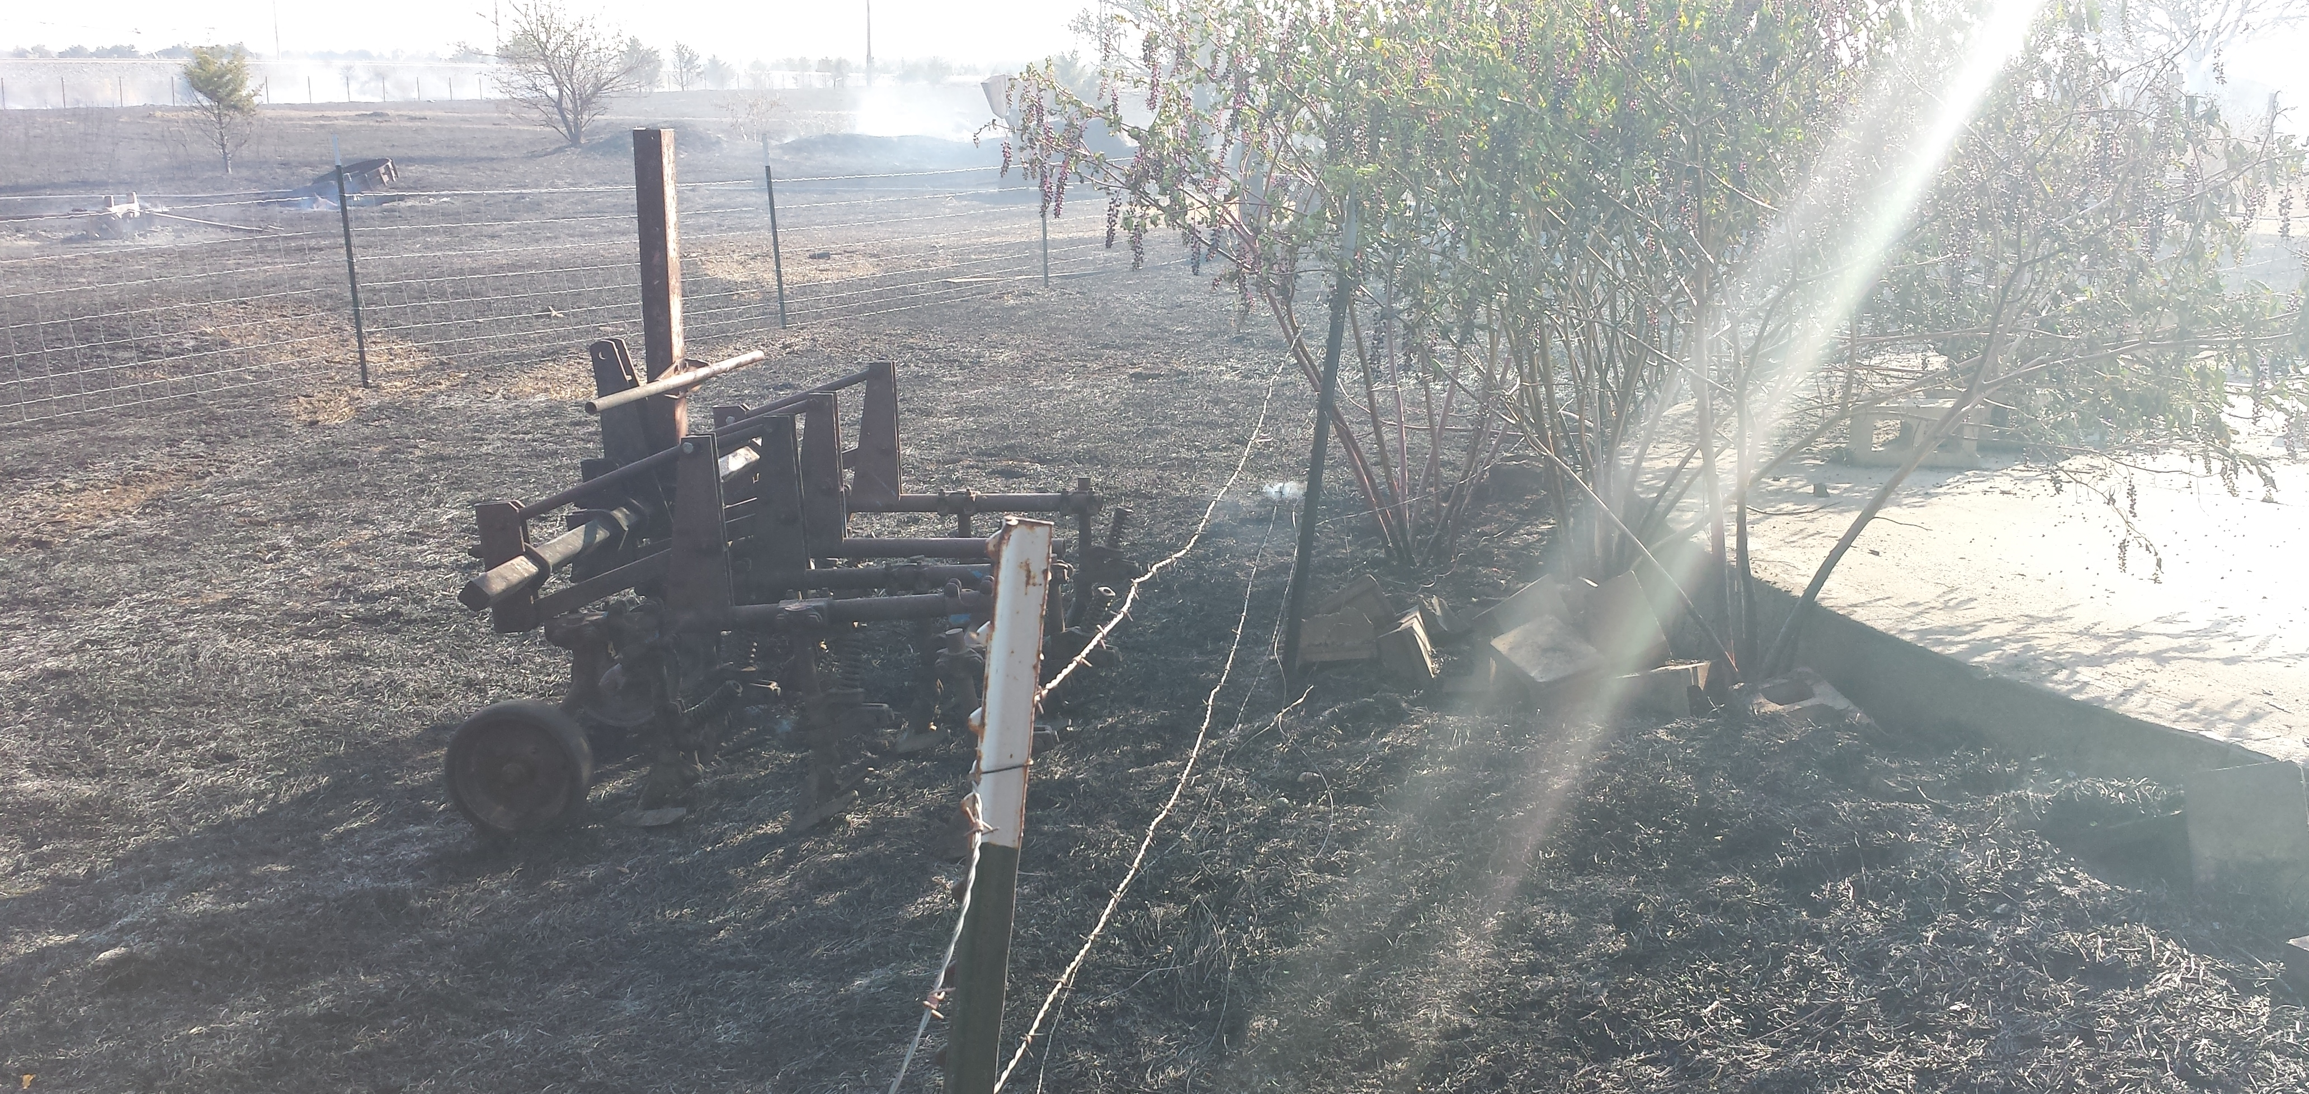
Rating Method

Slide 9
Rating Method Difficulty
ACR quality not appropriate
  Excellent, good, fair, poor, bad
  Does not indicate value for this application
Threshold not appropriate
  Residual information
Specialized audience
  Forensic video analysis
  Police officers are “lay people”

Slide 10
Ideal Objective Metric
Easy to interpret
  Numerical value
  Indicates likely value of system
Multiple values
  “Quality”
  Composition, camera placement
  Analysis of problems, can I get a better photo?

Slide 11
Subjective Options
Quantitative
  5-level scale, like MOS
  Yields nice statistics
Qualitative
  Broad questions, free response
  Statistics difficult

Slide 12
Subjective Options
Expert analysis
  Independent rating by 2 to 3 experts
  Follow procedure
  Some closed questions
  Some open questions (you missed this)

Slide 13
Objective Options
Video analytics
  Algorithm performance

Slide 14
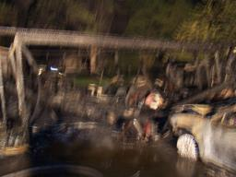
Ideas?

