Slide 1

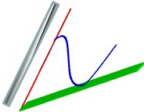
Overview of Operational Requirements for NRVQMs
Jorge Caviedes
March 2016
Image, Video and Usability (IVU) Lab
School of Electrical, Computer & Energy Engineering,
Arizona State University, Tempe, AZ 85287-5706, USA
https://ivulab.asu.edu/

Slide 2
Problem statement
For about 15 years, NRVQMs research has been focused on a simplification of the FRVQMs so that MOS scores can be emulated without the need for a reference. Other high payoff applications have not been pursued.
Evolution of the field towards QoE evaluation has not been fully embraced, and operational objectives related to the framework to which the metrics belong have not been addressed.
Work relevant to the areas of concern does exist but is mostly proprietary. The stakeholders (industry, academia and standards bodies), have not settled on updated standardization goals.

Slide 3
Summary
Beyond MOS
NRVQM drivers
QoE broad perspective
Test videos vs. test cases
System-driven operational goals
VQEG projects
Case studies of interest
Discussion

Slide 4
Beyond MOS
MOS gave rise to a methodology that cannot be applied to present day scenarios in visual communication which are aimed at QoE
The MOS framework does not require operational link between metric and any system component
The notion of neutral visual quality based on perception thresholds must evolve to support higher level models
R&D on NRVQMs is alive and well inside the enterprises, but lacks industry-level cooperation leading to standards that support operational objectives

Slide 5
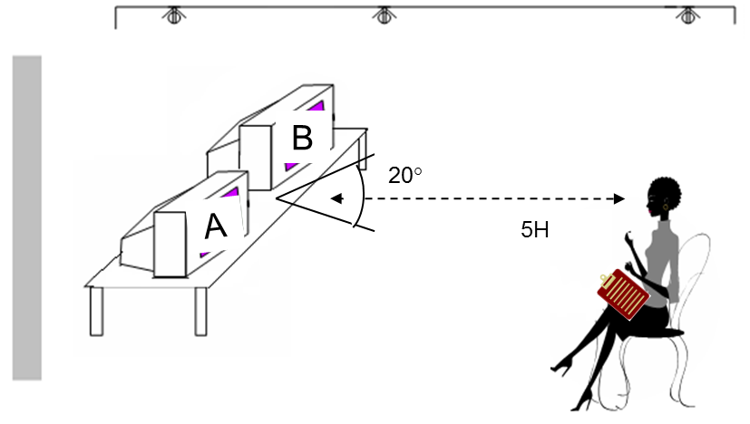




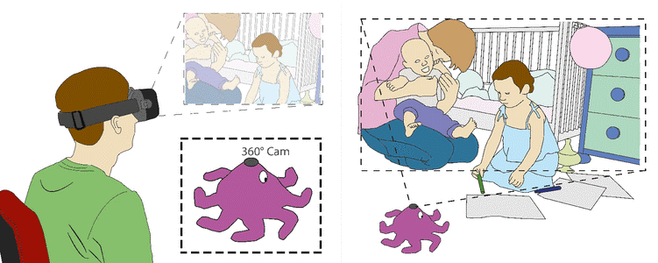
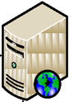
NRVQM Drivers
Q
MOS
Supporting QoE and the operational goals of the system and its components requires a fundamental change.
Decisions?
Network
QoE
-------
------
-----

Slide 6
QoE Broad Perspective
QoE is a complex measure with multiple components (visual, perceptual, cognitive, etc.)—models tend to be specific to usage and application
A broad QoE perspective incorporates 3 key elements: content, service, and delivery platform
System components are linked to QoE sub-metrics or their low level precursors (e.g. confusion or discomfort my be linked to non-natural motion which could be related to latency, or illegibility of text which may be related to blur)*
*the challenge is to build a model based on system parameters without having to ask the end user to do a technical evaluation (given that QoE dimensions are non-technical).

Slide 7
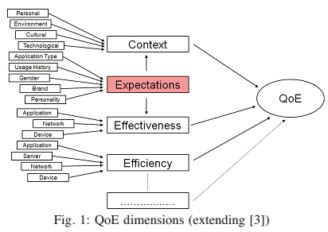
QoE Dimensions
[Egger et al 2009] Quality-of-Experience Beyond MOS: Experiences with a Holistic User Test Methodology
for Interactive Video Services

Slide 8
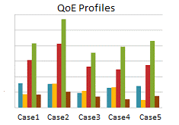
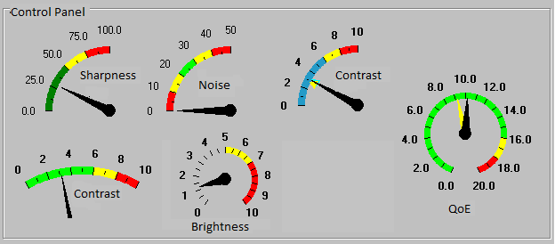
QoE Sensitivity Analysis
QoE does not have a unique profile
Content Production
Service Provider
Delivery Platform
QoE measured at the output
Which parameters of content, service, and platform affect QoE and by how much
  Source content quality (acquisition, processing, distribution)
  Service management (link type, communication model--point-to-point/multi-point, single/multi-modality)
  Platform parameters (decoding, processing, rendering) that affect user experience and the user task/objective (recognition, detection, convey feeling, etc.)

Slide 9
Test videos vs. test cases
The notion of developing metrics for neutral content is not suitable for QoE
Test videos must be selected taking into account content categories, and specific content of high relevance for the service
The notion of test videos should evolve into test cases linked to QoE (e.g. a counseling session via video conferencing, watching a football game at home or on the smart phone)
QoE evaluation involves the user goals/intentions and how they are met through the experience
QoE evaluation incorporates audio and video (at least)

Slide 10
System-driven operational goals-example
Video
NRVQM
Pass/Fail:
no further requirements
MOS
NRVQM
QoE_{est}
If QoE_{est} ≠ QoE_{obj} take corrective action
Video System
NRVQMs need to
support operational goals at system level
The actions taken range from off-line tune-up to real time control
End User
QoE_{obj}
Was QoE goal met?

Slide 11
VQEG Projects – general impression
VIME: video and image models for consumer content evaluation. The model is powerful and can potentially address more issues (end-to-end system wise), but presently, the main requirement is high correlation with MOS and the applicability is narrow, i.e. benchmark consumer devices.
MOAVI: monitoring of audiovisual quality by key indicators, aimed at selecting sets of key indicators for specific applications. Essentially, it provides a set of sub-metrics which can be used to build quality models. The orientation towards QoE is interesting, as it suggests a more complex requirement than MOS.
QART: quality assessment for recognition and task-based multimedia applications. It is notable that this project is related to an operational goal as it relates to a specific task (visual recognition). It expects to develop metrics, but so far appears limited to monitoring, without an operational objective.

Slide 12
Case studies that we could target
Building on the current related projects, we could address cases in these areas:
Video consumption on mobile platforms, per content category
Mobile AV communication
Visual understanding tasks (by human or machine)
  Consumer (recognizing emergency when looking at home surveillance app)
  Professional (security, medical, marketing)
  Always-on camera mode vs. recognition mode
Others (360 video, 3D video, gamming, AR, CV)

Slide 13
Discussion items
Start with a broad discussion:
NRVQMs have multiple ways to evolve
  Towards the system: support operational goals by developing suitable models and sub-metrics
  Towards the user: support QoE methodology and multi-dimensional subjective models
  Both
Defining operational objectives that can be endorsed by stakeholders, e.g. can standardized metrics support operational goals while allowing proprietary solutions, and competition?
What is the scope? E.g. QoS management, adaptive systems, power management, QoE management
What are the tasks/scenarios of interest?
What are the characteristics of signals and systems? E.g. 4K, HDR, 3D, local or remote content sources
What are the metric requirements? Scales? Resolution? Calibration?
Scope of test cases?

Slide 14
Thank You

