Slide 1
Automatic labelling of images from the VIME Flickr Group
Remigiusz Baran, WSTKT University of Computer Engineering and Telecommunications in Kielce
Mikołaj Leszczuk, AGH University of Science and Technology
Notes:
Slajd tytulowy – w Twojej gestii

Slide 2
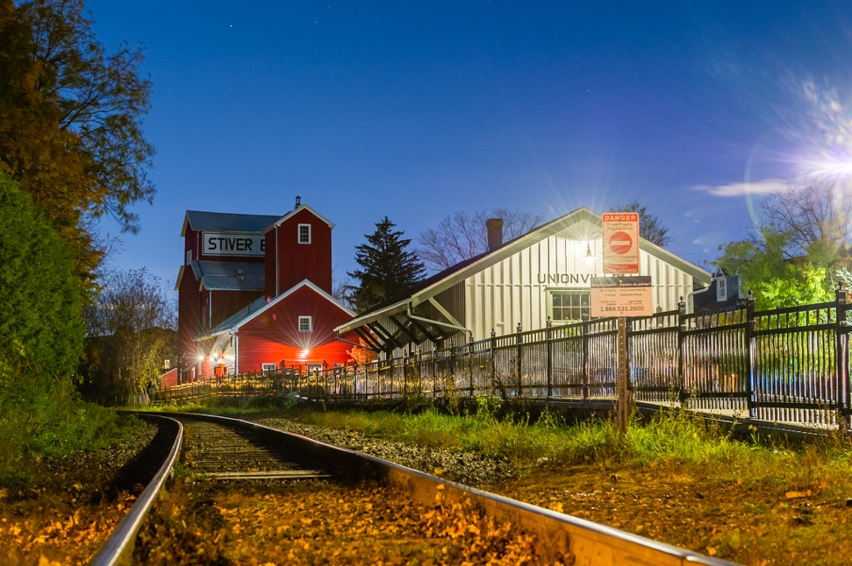
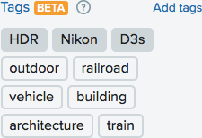
Need for more Flickr Machine Tags

Slide 3





IMCOP SYSTEM
Intelligent Multimedia System
for Web and IPTV Archiving – Digital Multimedia Content Analysis and Documentation
Notes:
ZOSTAWIAM, BO MOŻE COS WYKORZYSTASZ
The IMCOP Project is a joint, bilateral – Polish and Israeli - research and development project, which have been selected for funding in 2012.
The project is financed in part by the National Centre for Research and Development (NCBR) from Poland
and MATIMOP, the official National Agency for industrial R&D cooperation in Israel.
The IMCOP call, as well as other calls within this co-operation, were managed in line with the EUREKA Initiative procedures.
The title of the project is …..
The IMCOP consortium is consisted of
two telecommunications companies – Viacess Orca from Israel and DGT from Poland,
and two universities: AGH University of Science and Technology in Krakow and University of Computer Engineering and Telecommunications in Kielce.

Slide 4
WHAT Is IMCOP?
Outbrain (content discovery)
DataSift (data enrichment)
Orbeus (multimedia labelling)
Notes:
- content discovery platform similar to Outbrain: http://www.outbrain.com/
- data enrichment platform similar to DataSift: http://datasift.com/platform/data-enrichments/,
- multimedia indexing (labeling) tool like Orbeus: https://orbe.us/ (already closed)

Slide 5
System Architecture
Images
Tags

Slide 6

Face Detection & People Head-counting
Counting # of en-face faces in image
Based on Haar cascade
Output: people count
Service status: launched
“Talking heads” scenes recognition planned

Slide 7
Face Recognition
Extra requirement: pattern database
Output: recognised pattern
Service status: (nearly) launched

Slide 8
Text Detection and Recognition
Text:
  Detection
  Recognition (OCR)
Output: recognised text
Service status: launched

Slide 9
Logo Detection and Recognition
Extra requirement: logo pattern database
Logo:
  Detection
  Recognition
Output: recognised logo pattern
Service status: launched

Slide 10
Watermarks Detection/Recognition
Extra requirement: pattern database
Based on MPEG-7 Edge Histogram Descriptor
Output: recognised pattern
Service status: launched

Slide 11
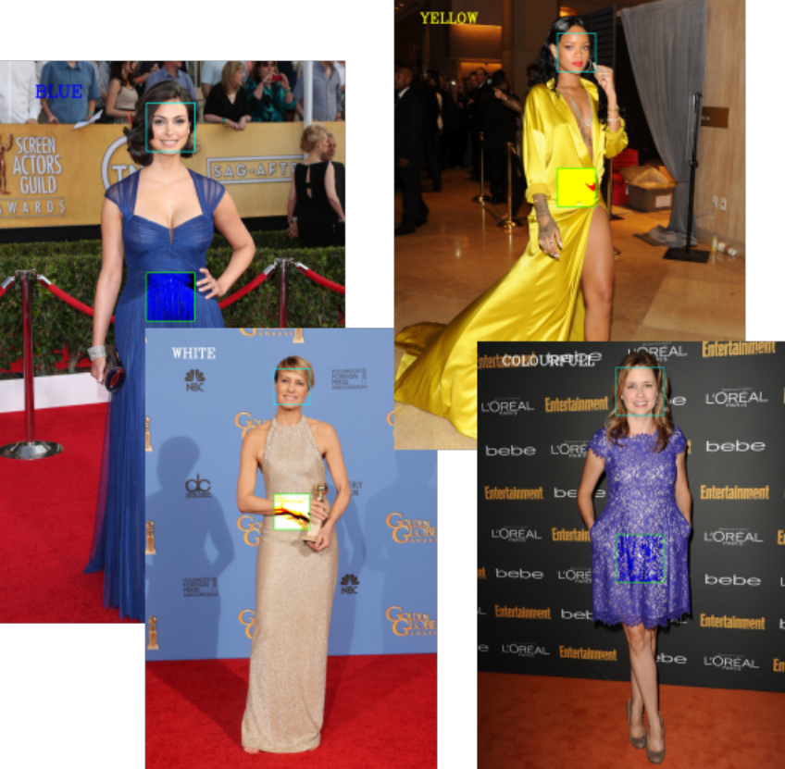
Dominant Colour of Clothes (Dresses)
Detecting actress dress colours
Designed for red-carpet pictures
Output:
  1 of 8 – basic colours (quantized)
  9 – colourful
Service status: launched

Slide 12
Near-Duplicates (Image Similarity)
Extra requirement: 2nd image
Goal: to cluster similar pictures
Output: % similarity
Service status: launched

Slide 13
Bokeh Effect Detector
Aesthetic blur in out-of-focus image parts
Produced by lens
Face detected on blurred background
Output:
  Binary (Bokeh effect, no Bokeh effect)
  Probability
Service status: launched

Slide 14
Profile/En face Classification
Based on:
  Support Vector Machines (SVM)
  Local Binary Patterns (LBP)
Output:
  Class (left, right, frontal)
  Probability
Service status: launched

Slide 15
Smile Detection
Classifier based on:
  SVM
  Haar Wavelets
Output:
  Binary (smile, non-smile)
  Probability
Service status: launched

Slide 16
Unshaved Faces
Based on skin colour probability and SVM
Moderate accuracy
Output:
  Binary (shaved, unshaved)
  Probability
Service status: launched

Slide 17
Red Eyes Detection
Algorithm:
  Finding pupils
  Red colour % calculated
Output: weighted redness probability
Service status: launched

Slide 18
Nudity Identification
Checking if image contains nudity or not
Based on colour and shape information
Output: % that image containing nudity
Service status: in preparation

Slide 19
MOAVI Image Quality Indicators
Quality indicators:
  Blackout
  Blockiness
  Block Loss
  Blur
  Contrast
  Exposure
  Interlacing
  Letter-boxing
  Noise
Quality indicators (cont’d):
  Pillar-boxing
  Slicing
Spatial activity (image characteristics)
Output:
  Vector of indicators
  Selected thresholds
Service status: in preparation

Slide 20

Dominant Colour Counter
Dominant image colours
Output – MPEG-7:
  N – # of dominant colours
  c – RGB values
  p – % of given colour
  v – colour variance (n/a)
  s – spatial coherency
Service status: in preparation

Slide 21
Landmark Object Recognition
Extra requirement: landmark object pattern database
Output: recognised landmark object pattern
Service status: launched

Slide 22
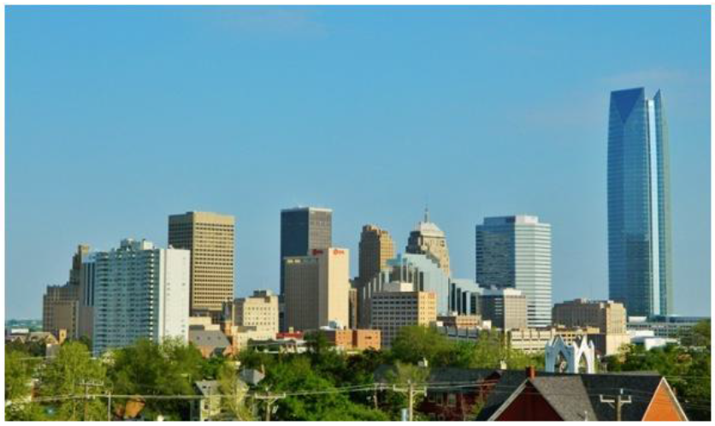

Sky(line) detection
Sky detection:
- Thresholding,
- Binary morphology
- CLD (Colour Layout
Descriptor)
- etc.
Service status: in preparation
Notes:
DOKŁADNIEJSZA ILUSTRACJA KILKU WYBRANYCH DETEKTORÓW, NP. Sky Indicator – CZY TAK MOŻE BYĆ?
MOGĘ TAK PRZEDSTAWIĆ DOKŁADNIEJ JESZCZE JEDEN LUB DWA WYBRANE MESY – JAK MYŚLISZ?
można wyróznić dwie fazy:
Sky detection – z użyciem operacji jak wyżej
Dodatkowe założenia – co do położenia, ciągłości oraz rozmiaru nieba na obrazie
This way Sky Indicator can be used to detect these images where landscapes are presented,

Slide 23
Emotion Detection
Emotions detected:
  Happiness
  Surprise
  Threat
  Sadness
  Anger
Output: emotion probabilities
Service status: in preparation

Slide 24
Age Classifier
Classify if face <18< years old
Age re-trainable
Output: probability than face >18
Service status: planned

Slide 25
Indoor/Outdoor
Recognising:
  Indoor scenes
  Outdoor scenes
Service status: planned

Slide 26
Day/Night
Recognising:
  Day scenes
  Night scenes
Service status: planned

Slide 27
Proceeding until June 2016
All “in preparation” services to become “launched”
IMCOP server maintenance ensured by WSTKT University
Exact technical ways of collaboration to be agreed – who is active party:
  VIME?
  IMCOP?
Action point: discussion needed!

Slide 28
Proceeding after June 2016
IMCOP server running mainly due to “inertia”:
  Simple maintenance tasks (e.g. reboots) still possible
  No new features or significant fixes possible
“Planned” services to be developed and implemented but:
  On slow schedule
  Without easy ways to get integrated with IMCOP server
Action point: discussion needed!

Slide 29
References
General:
  http://american-cse.org/csci2015/data/9795a143.pdf
  http://doi.org/10.1007/978-3-319-26404-2_1
Dominant colour of clothes (dresses):
  M. Grega, “Method for Automated Identification of Celebrity Dress Colour”, to appear soon
Near-Duplicates (image similarity):
  http://doi.org/10.1007/978-3-319-07569-3_6
  http://doi.org/10.1007/978-3-319-26404-2_11
Notes:
DLA ZAINTERESOWANYCH
In final conclusion, I want to emphasize that the IMCOP system can serve as a content delivery platform for variety of end-users.
With regard to the capabilities of its Web services within the scope of multimedia data analysis and metadata enhancement, the IMCOP system can be also cosidered as a data enrichment and content discovery platform.

Slide 30
References
Bokeh effect detector, smile detection, age classifier, nudity identification, face detection & people head-counting, red eyes detection as well as unshaved faces:
  http://doi.org/10.1007/978-3-642-38559-9_18
  http://doi.org/10.1007/s11042-014-2114-z
Profile/en face classification:
  http://doi.org/10.1007/978-3-642-21512-4_17
Notes:
DLA ZAINTERESOWANYCH
In final conclusion, I want to emphasize that the IMCOP system can serve as a content delivery platform for variety of end-users.
With regard to the capabilities of its Web services within the scope of multimedia data analysis and metadata enhancement, the IMCOP system can be also cosidered as a data enrichment and content discovery platform.

Slide 31



Thank you for your attention!
Notes:
ZOSTAWIAM, BO MOŻE COS WYKORZYSTASZ
The IMCOP Project is a joint, bilateral – Polish and Israeli - research and development project, which have been selected for funding in 2012.
The project is financed in part by the National Centre for Research and Development (NCBR) from Poland
and MATIMOP, the official National Agency for industrial R&D cooperation in Israel.
The IMCOP call, as well as other calls within this co-operation, were managed in line with the EUREKA Initiative procedures.
The title of the project is …..
The IMCOP consortium is consisted of
two telecommunications companies – Viacess Orca from Israel and DGT from Poland,
and two universities: AGH University of Science and Technology in Krakow and University of Computer Engineering and Telecommunications in Kielce.

