Slide 1
QART Revision of P.912
Mikołaj Leszczuk, Lucjan Janowski, Margaret Pinson, Jarosław Porzucek

Slide 2
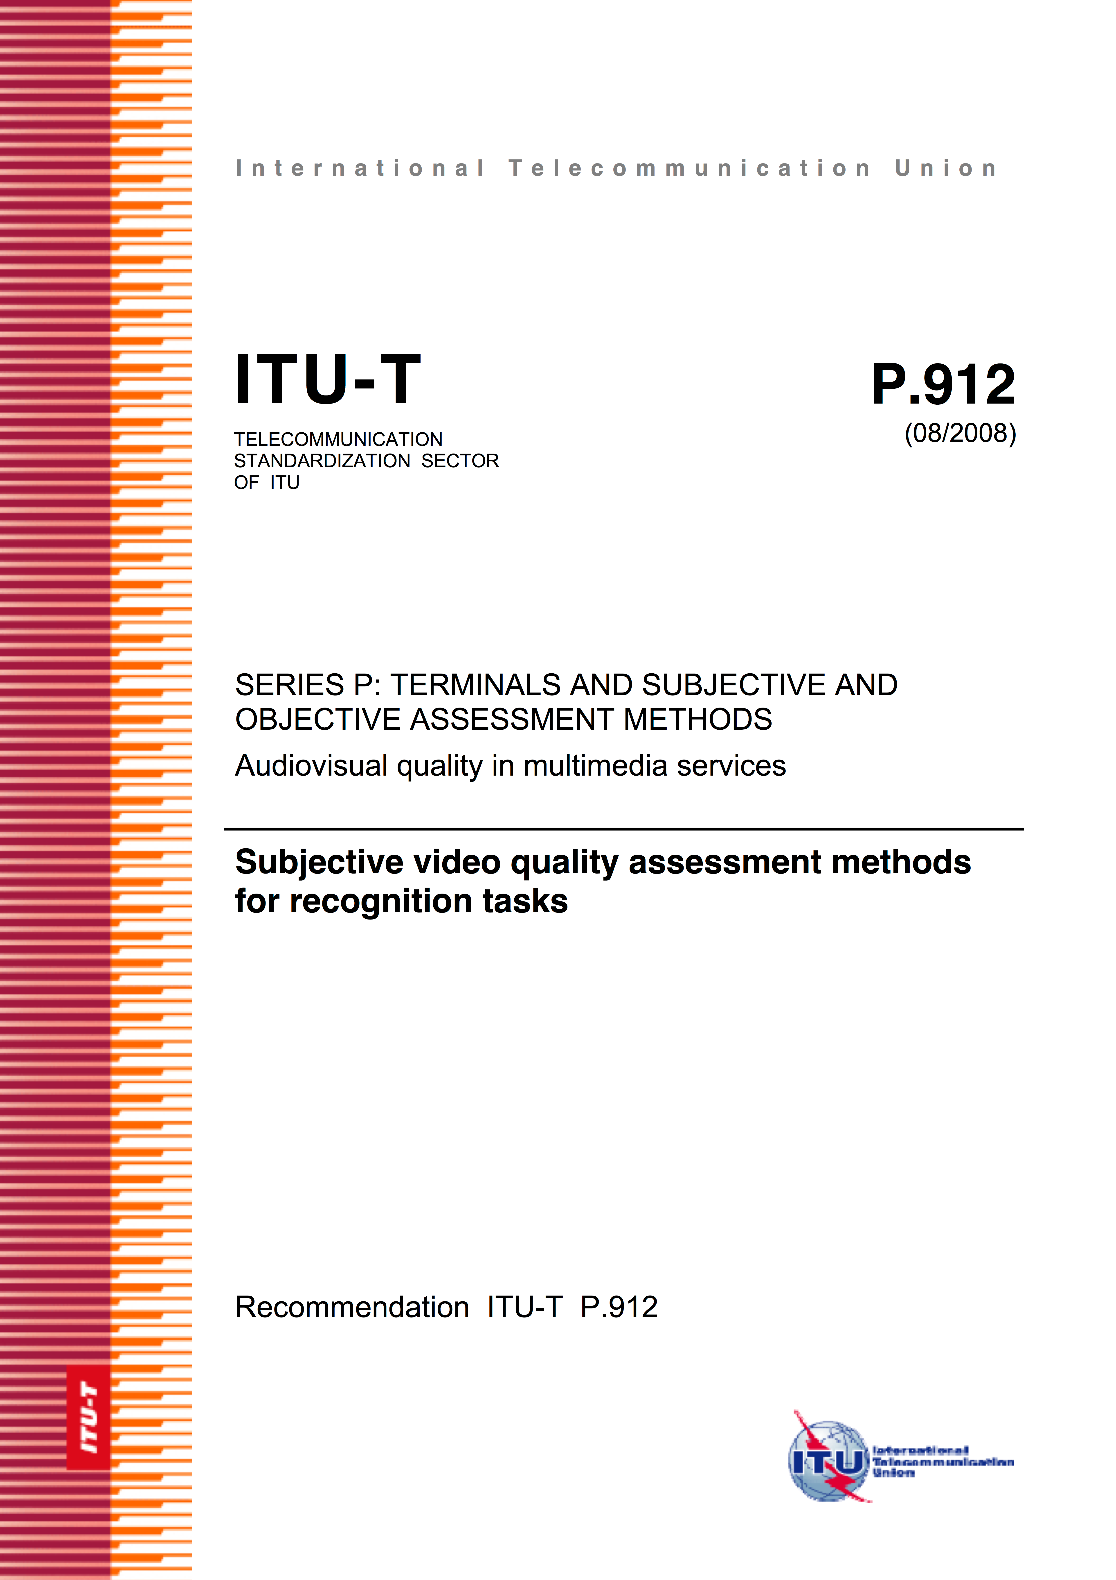
  ITU-T Recommendation P.912
Problems of quality evaluation procedures & measurements for Target Recognition Video partially standardized in ITU-T Recommendation P.912
Title: “Subjective Video Quality Assessment Methods for Recognition Tasks”
Published: 2008
Introducing:
  Basic definitions
  Methods of testing
  Psycho-physical experiments

Slide 3
  P.912 Revision (1/2)
Based on research & observations with Video Quality Experts Group (VQEG) => introduction of revisions to P.912
Formalized procedures for this purpose
Collaboration with Polish Ministry of Digital Affairs
Received nomination as delegate of Poland

Slide 4

  P.912 Revision (2/2)
ITU-T Study Group 9 (SG9)
SG9 Meeting, 21-28 Jan, Geneva:
  Clause 7.5 (“Crowdsourcing Environment”)
  Clause 8.1 (“Data Analysis”)
  Seeking for final consent (approving, closing)
Detailed scope of current P.912 revisions discussed in next slides…

Slide 5
  Last ITU SG9 Meeting Contributions
Data analysis (Clause 8.1)
  Subject Screening -> describing method to remove subjects:
    Not paying attention
    Not understanding task
  Recognition Probability as a Function -> describing method to estimate function for discrete answers
  Comparing Different Conditions -> describing methods for correct statistical conditions comparison such us deciding for which condition detecting probability is higher
Crowdsourcing Environment (Appendix)
  Crowdsourcing not described in previous version of Recommendation
  Proposed description to providing not only details but also basics
  Whole process described from software preparation to running experiment

Slide 6
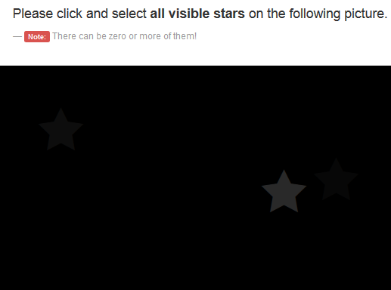
Crowdsourcing Preparation
Preliminary questions
Monitor test:
B. Gardlo, S. Egger, M. Seufert and R. Schatz, „Crowdsourcing 2.0: Enhancing execution speed and reliability of web-based QoE testing,” in Communications (ICC), 2014 IEEE International Conference on, Sydney, Australia, 10-14 June 2014.

Slide 7
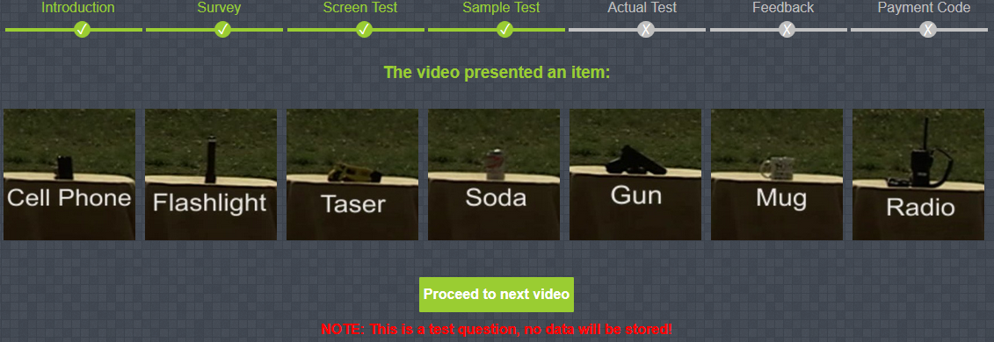
Crowdsourcing
Sample Test

Slide 8
Crowdsourcing
Sample Test
Than the test (12 sequences) was run
3 sequences are obvious
After the test additional questions were asked; one question was repeated from the starting questions
Last but not least, the subject obtained the payment code

Slide 9
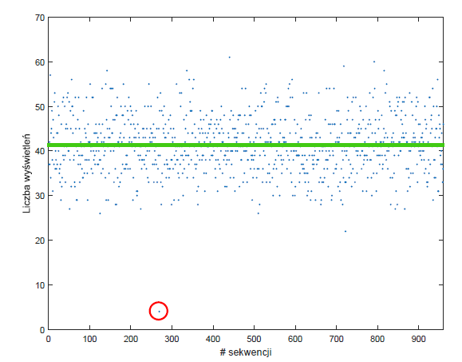
Crowdsourcing
Number of answers
Sequence ID

Slide 10
Crowdsourcing
Cleaning Data
All obvious sequences have to be correctly recognized
The monitor test has to be at least 85%
The questions from the beginning and the end of the test have to much
It the answer time for any sequence was longer than 30 seconds
The screen resolution has to be at least 1366px

Slide 11
Crowdsourcing
Buttons Placement
Hypothesis:
  The same settings for buttons can result in specific results (like better recognition of specific object)
The result:
  There is not influence of the buttons placement
  Subjects does not click a specific button more often

Slide 12
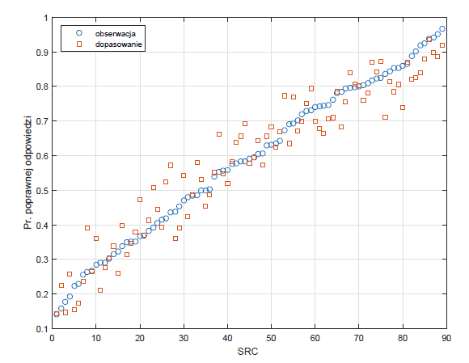
The Obtained Model
Observed
Model
Recognition probability

Slide 13
Model Analysis
Increase in bitrate by 100 kbps increase the recognition probability by 5.4%
Resolution CIF -> VGA changes the recognition probability by 64%
Ligating, changing dark to:
  Dime; recognition is 3.2 times better
  Bright; recognition is 11.9 times better
  Sun light; recognition is 38 times better
If object is farer by 1m the recognition drops by 25%
If object is still the recognition is better by 2.7 times comparing to the moving object

Slide 14
  Standardisation Summary
12 ITU-T contributions submitted on subjective methodologies (Rec. P.912):
  4 at Sep 2014, Geneva
  6 at Jun 2015, Beijing
  2 at Sep 2016, Geneva
Final procedures to take few months:
  Editing process to take several weeks
  Then, approval process with Member States to take 2-3 months

