Slide 1
VQEG
JEG-Hybrid
Marcus Barkowsky
Lucjan Janowski
Glenn Van Wallendael

Slide 2
Mission
To develop a robust no reference Hybrid Perceptual/Bit-Stream model.
Small set of subjective experiments
  Cause limited training
  Cause limited validation
How can we prove validity of a quality metric when it is only trained and validated on a small set of subjective experiments?

Slide 3
Strategy
What do we have? (Have a look at the state-of-the-art)
  Existing full-reference metrics
  Subjective tests
Try to identify shortcomings
  If there are none, use full-reference metrics as ground truth
  If there are, what set needs to be subj. evaluated ?

Slide 4
Quality metric development
Source Video
Sequence
Encoders
Packet Loss
Simulator
Robust Reference
Decoder
Standard Conforming
Decoders
Bitstream Information Extractor to XML
Subjective Assessment
FR Video Quality
Measurement
Quality Indicators (Video based)
Quality Indicators (Bitstream based)
Machine Learning and
Fusion algorithms
Hybrid Video Quality Estimation Algorithm

Slide 5
Quality metric development
Storage
Reproducible Processing
Source Video
Sequence
Encoder
parameters
Encoders
Original
Bitstreams
Packet Loss
Pattern Database
Packet Loss
Simulator
Robust Reference
Decoder
Corrupted bitstreams
Standard Conforming
Decoders
Bitstream Information Extractor to XML
Bitstream Information HMIX
Subjective Assessment
FR Video Quality
Measurement
Quality Indicators (Video based)
Quality Indicators (Bitstream based)
Bitstream based Quality indicators
Video based
Quality indicators
Estimated Video
Quality Score
Subjective
Annotation
Machine Learning and
Fusion algorithms
Hybrid Video Quality Estimation Algorithm

Slide 6
Quality metric development
Storage
Reproducible Processing
Source Video
Sequence
Encoder
parameters
Encoders
Original
Bitstreams
Packet Loss
Pattern Database
Packet Loss
Simulator
Robust Reference
Decoder
Corrupted bitstreams
Standard Conforming
Decoders
Bitstream Information Extractor to XML
Bitstream Information HMIX
Subjective Assessment
FR Video Quality
Measurement
Quality Indicators (Video based)
Quality Indicators (Bitstream based)
Bitstream based Quality indicators
Video based
Quality indicators
Estimated Video
Quality Score
Subjective
Annotation
Machine Learning and
Fusion algorithms
Hybrid Video Quality Estimation Algorithm

Slide 7
Why a large scale approach?
Analyzing the agreement of objective measurements with respect to various application scopes.
When does which FR-metric disagree?
Identification of insufficient algorithmic modeling precision OR missing perceptual features.
Reproducible verification is possible,
due to fully reproducible testset and
standardized performance algorithms

Slide 8

Where to start?
http://vqegjeg.intec.ugent.be/wiki/

Slide 9
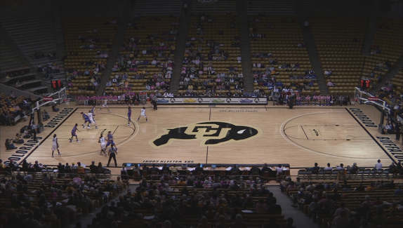
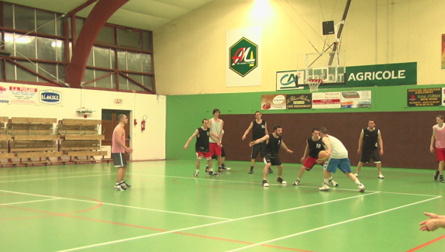
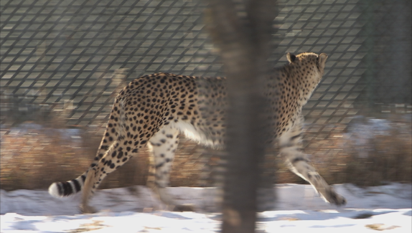


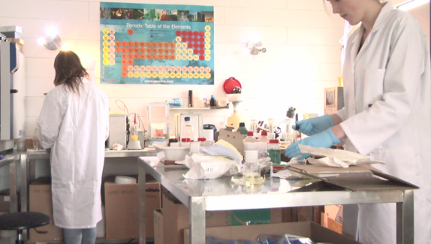

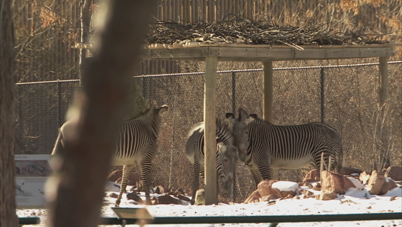
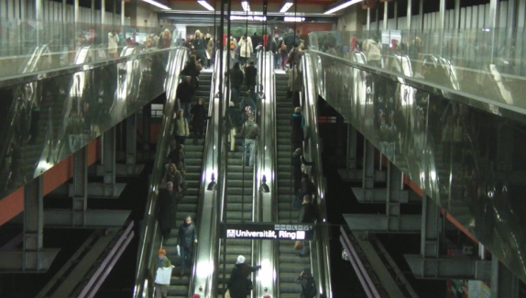

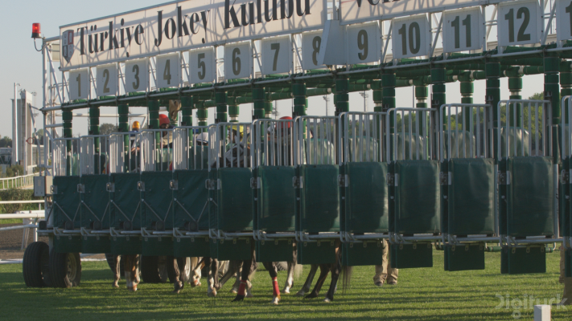
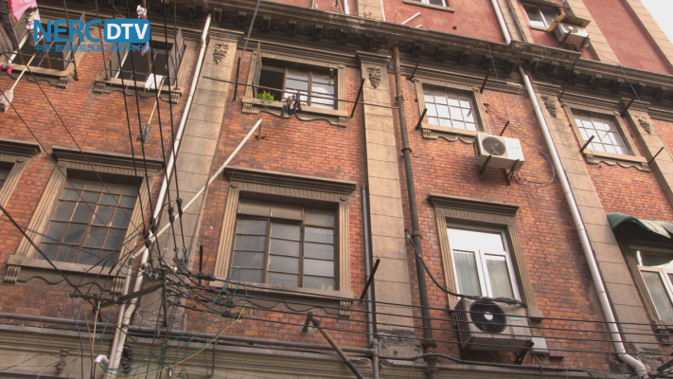

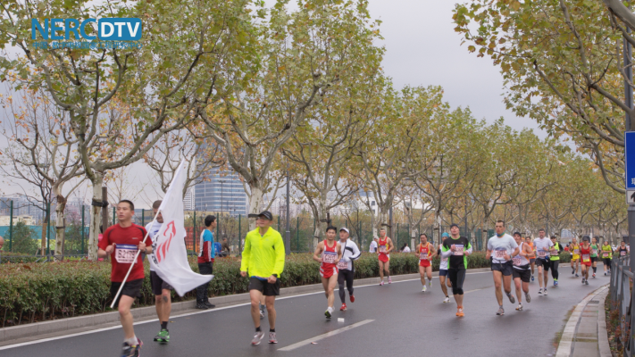
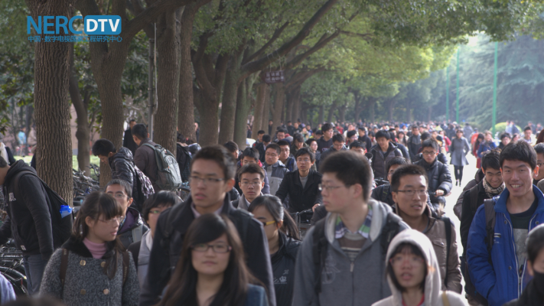
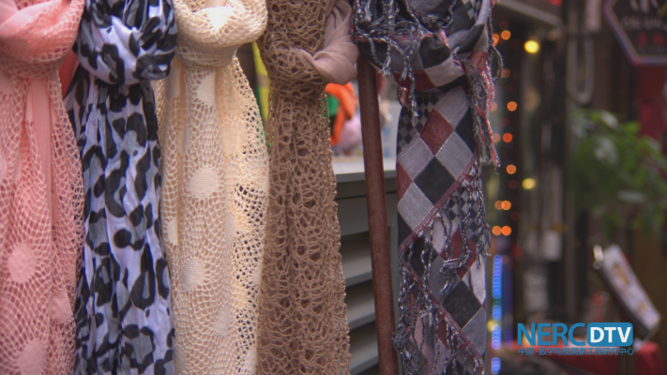


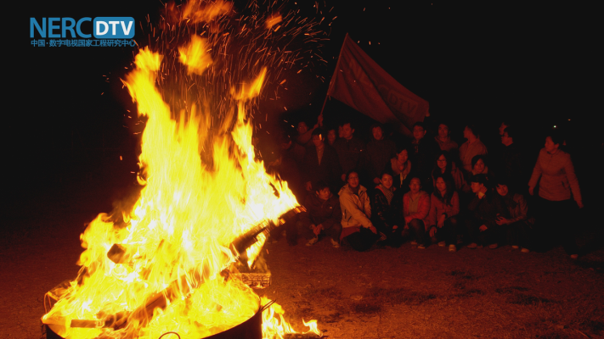


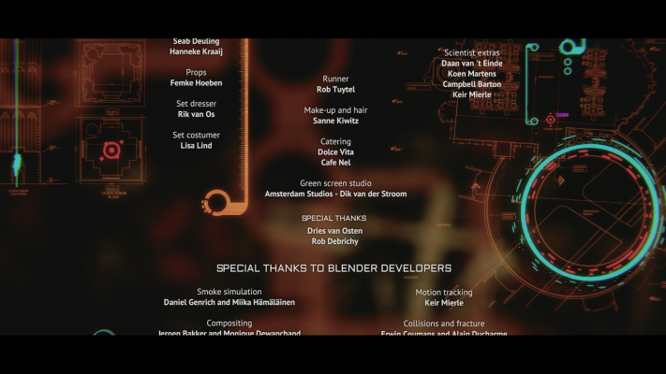
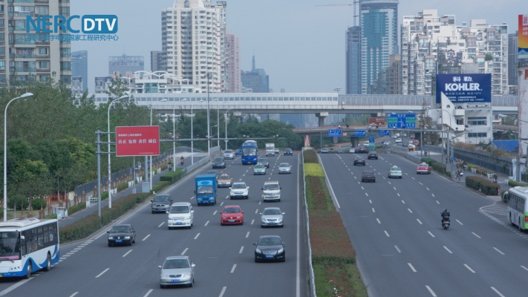
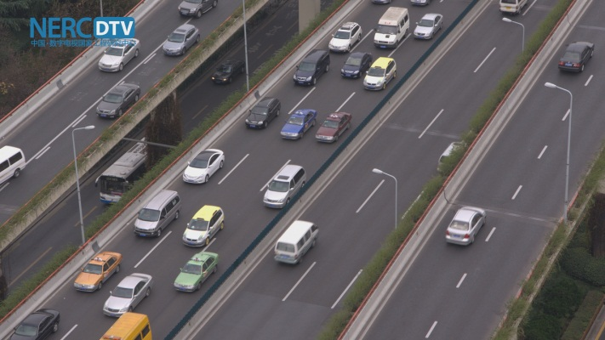



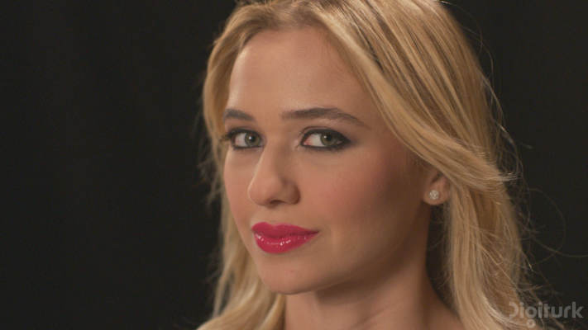


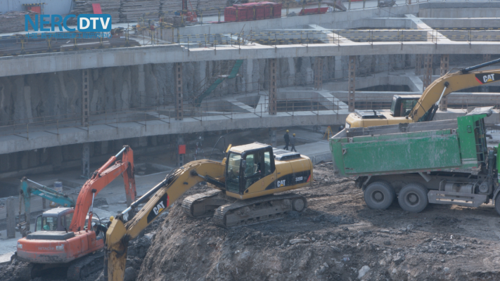

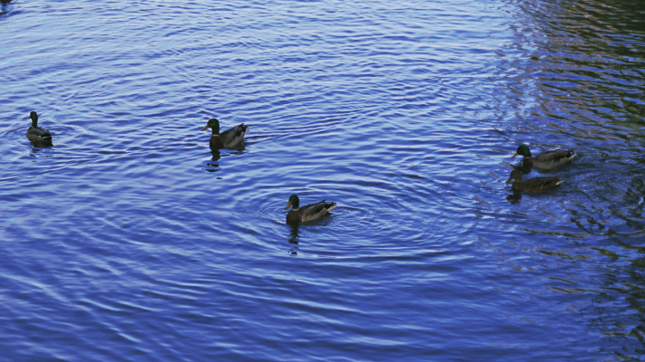




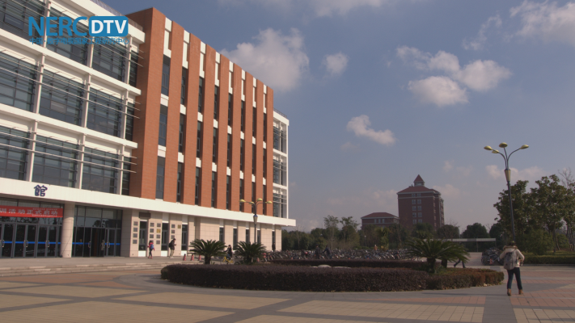
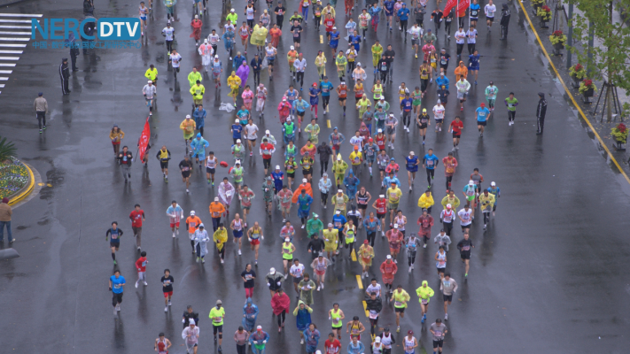


10 HD
31 UHD
Notes:
Thanks to Netflix (Ioannis Katsavounidis)

Slide 10
Databases and annotation
Coding: H.264, HEVC
12.960 AVC encoded HD video sequences database (10 SRC)
  Objective scores for each sequence:
  SSIM, PSNR, VQM, PVQM, P.1201.2
59.520 HEVC encoded HD video sequences database (10 SRC)
  Objective scores for each sequence:
  SSIM, PSNR, VQM, PVQM
40.000 HEVC encoded 4K video sequences database (31 SRC)
MySQL database creation for efficient access of the annotations, HRCs, and SRCs
(main contributor Marcus Barkowsky)

Slide 11
Packet loss simulation for AVC and HEVC
Robust reference decoder (Enrico Masala)
Advantage: this decoder, by construction, does not cause temporal misalignment between the processed video sequence (PVS) and the original one (SRC).
The decoder gets the original video stream and loss information. Pixels are slice copy concealed, motion information is never lost (not realistic, but robust).
(results: http://media.polito.it/jeg)
HEVC processing tool chain (open source) (Marie-Neige Garcia)
Advantage: realistic simulation

Slide 12
Objective indicators
Development of pixel based indicators
  Significant contribution from Mikołaj Leszczuk and the MOAVI group
Blockiness, Blur, Exposure time distortion, Interlace, Noise, Framing, Spatial activity, Temporal activity, Flickering, Blackout, Pillarboxing, Letterboxing, Brightness, Contrast, Slicing, Block loss
  Significant contribution from Ahmed Aldahdooh on content characterization
Spatial information, Chrominance Information, Contrast information, Spatial perceptual information, Colorfulness, Gray-Level Co- occurrence Matrix (GLCM), Normalized cross correlation, DCT based features, Laplacian based
Features, Temporal information, MPEG-7 Motion Activity

Slide 13
Objective indicators
Development of bitstream based indicators
    Significant contribution from Muhammad Shahid
  1 number_of_Cus The number of CUs a slice is divided into
  2 INTRA[%] Percentage of blocks coded as INTRA in a slice
  25 AvgMVy Average value of MV in direction y in a slice
  30 AvgQP Average value of QP in a slice
  …
    Significant contribution from Marie-Neige Garcia
  AvgQP, AvgMVy, AvgMVx, …

Slide 14
Statistical analysis
Statistical analysis of objective Full-Reference measures towards understanding which data needs to be subjectively evaluated
Initial analysis of the data performed:
Mikolaj Leszczuk; Lucjan Janowski; Marcus Barkowsky. Freely Available Large-scale Video Quality Assessment Database in Full-HD Resolution with H.264 Coding, Globecom 2013
Barkowsky, M., Masala, E., Van Wallendael, G., Brunnstrom, K., Staelens, N., & Le Callet, P. (2015). Objective Video Quality Assessment — Towards Large Scale Video Database Enhanced Model Development. IEICE Transactions on Communications, E-98b(1), 2–11.
Van Wallendael, G., Staelens, N., Masala, E., & Barkowsky, M. (2015). FullHD HEVC-Encoded Video Quality Assessment Database. Ninth International Workshop on Video Processing and Quality Metrics (VPQM)
Ahmed Aldahdooh et al. QoMEX 2016

Slide 15
Combination algorithms
contribution made by Muhammad Shahid
  Artificial Neural Network Model
Ahmed Aldahdooh
  SVM
Olivier Janssens and Glenn Van Wallendael
  gradient boosted regression trees (GBRTs)

Slide 16
Organization of reproducible research
  The intention is that every publication can be rerun easily
  http://vqegjeg.intec.ugent.be/wiki/
  Data, scripts, and virtualbox integration in order to redo all publications
A Virtualbox image is updated weekly at:
  ftp://ftp.ivc.polytech.univ-nantes.fr/
  Accessible through TeamViewer
  (ask credentials to Marcus Barkowsky)
Git repository (software versioning environment)
Identification of HRCs using a MySQL database

Slide 17
Available toolset
Virtual machine for QoE research including:
  Available encoders (HM, x264, x265)
  Packet loss simulation:
    Robust reference decoder (AVC and HEVC) (Enrico Masala)
    HEVC processing tool chain (open source) (Marie-Neige Garcia)
  Bitstream to machine readable XML
  FR metrics/indicators:
    Continuous updates of NR video indicators (MOAVI)
    (Mikołaj Leszczuk, Steve Sciandra)
    Python implementation of P.1201.2
    (Marie-Neige Garcia)

Slide 18
Ongoing work
Biweekly meetings will continue
Further statistics on the large scale database:
  Blind performance estimation of objective measurements
  Determining subset for subjective testing
Further inclusion of objective algorithms (ex. MOAVI)

Slide 19
Future work
Extending SRC variety drastically
Limiting scope
  Low delay transmission in error prone conditions
  Industrial relevant conditions?
Increased focus on pooling strategies

Slide 20
Challenge
Suggestions for good challenges?
Indicators able to identify out-of-scope behavior
  Detect error concealment behavior

Slide 21
Where can I get more information?
http://vqegjeg.intec.ugent.be/wiki/
(notably section resources, constantly updated, volunteers welcome!)
How may I get involved?
Subscribe to the VQEG-JEG mailing list
http://www.its.bldrdoc.gov/vqeg/email-reflectors.aspx
Join our biweekly conference call
(next dates: March 14, [Easter Monday], April 11, 4PM Paris time, reminders and more information sent to JEG mailing list)

Slide 22
What about collaborations (industry/industry research/industry research/research)?
Collaborations are welcome but financial issues are outside of the scope of this work
What about licenses, patents, etc?
The VQEG-JEG wiki contains a detailed section about this. We are open to patented work but licensing issues are out of scope of our discussions (similar to ITU-ISO/IEC).
What about evaluations of commercial products?
Some companies have offered commercial licenses to some JEG partners for evaluation purposes.

