Slide 1



Video quality assessment of HDR content
(and beyond)
Pr. Patrick Le Callet
www.irccyn.ec-nantes.fr\~lecallet

Slide 2
A HyperSpace of possibilities
Content type
SI
TI
DI
Color Info
Type of
Distortion
Distortion
level
« Selecting scenes for 2D and 3D subjective video quality tests », M. H. Pinson, M. Barkowsky, et P. Le Callet, J Image Video Proc., vol. 2013, no 1, p. 1‑12, Dec. 2013.

Slide 3
A HyperSpace of possibilities …and generalization?
Content type
Multifeature Space
TI
DI
Color Info
SI
Type of
Distortion
Distortion
level
Generalization: do we learn much?
« a metric is only valid under the conditions on which it has been tested » Phil Corriveau

Slide 4
A HyperSpace of possibilities: extension of the hyperspace a third meta dimension
Content type
New viewing Experience
(technology push)
HDR
S-3D
FTV
Distortion
level

Slide 5
Exploring the HyperSpace: a methodology
TI
DI
Color Info
SI
Type of
Distortion
Find weakness:
Identified systematic weakness can be eliminated
Understand how a QE performs in variety of situation
extending or limiting scope of validity: QE Profile, scalable QE …

Slide 6
Quality of Experience vs Video Quality?

Slide 7


Definition of Quality of Experience
Qualinet White Paper on Definitions of Quality of Experience (2012)
Available at http://www.qualinet.eu
A collective effort of more than 40 authors/contributors (COST Action IC 1003)
European Network on Quality of Experience in Multimedia Systems and Services
Quality of Experience (QoE) is the degree of delight or annoyance of the user of an application or service.
It results from the fulfillment of his or her expectations with respect to the utility and / or enjoyment of the application or service in the light of the user’s personality and current state.

Slide 8

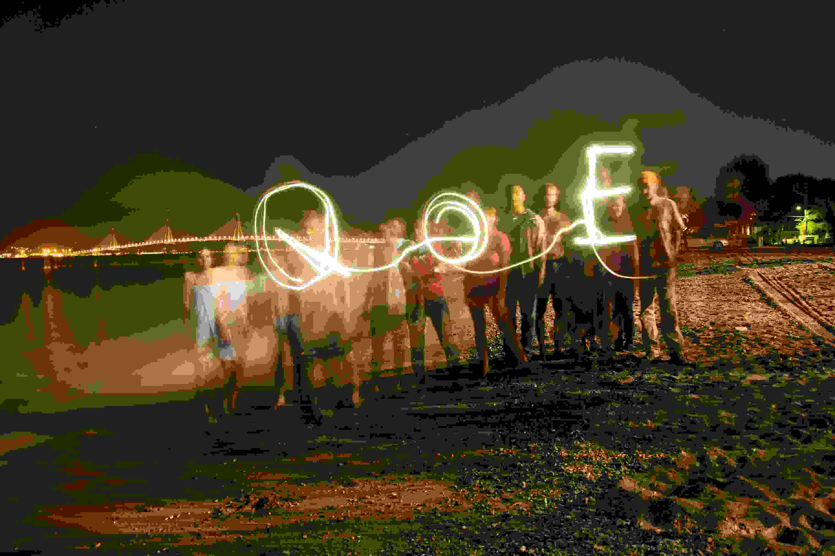
QoE or not QoE?
common over restriction
Image/Video quality assessment
system
Perceived (or perceptual) image quality

Slide 9
QoE or not QoE?
a model of 3D QoE
3D visual experience: Mutiple perceptual dimensions
Visual experience
2D Image quality
Depth quantity
Visual comfort
Depth rendering
Naturalness
… QoE should also include:
Cost, Expectations, Context…
[Chen, W., Fournier, J., Barkowsky, M., & Le Callet, P. (2012). Exploration
of Quality of Experience of Stereoscopic Images: Binocular Depth. VPQM]

Slide 10
A HyperSpace of possibilities: more (meta)dimensions
Content type
IDIOSYNCHRASY
New viewing Experience
(technology push)
Welcome to QoE!
Distortion
level
CONTEXT?

Slide 11
A HyperSpace of possibilities: extension of the hyperspace a third meta dimension
Content type
New viewing Experience
(technology push)
HDR
UHD
FTV
HFR
Distortion
level

Slide 12
why do we need to revisit?
The example of HDR video quality assessment

Slide 13
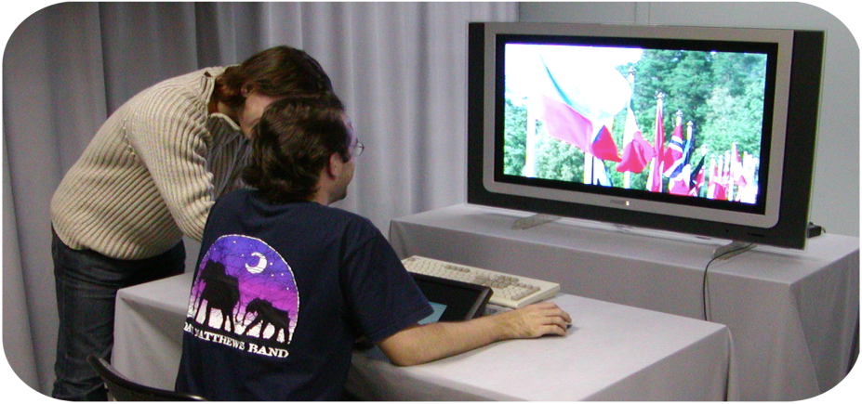
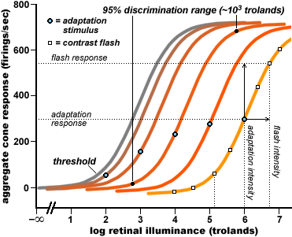
HDR and subjective quality assessment ?
To be revisited:
Viewing conditions
Adaptation
luminance
Peak Luminance | Env. Luminance
100 nits | 15 nits
500 nits | 75 nits
4000 nits | 600 nits
BT500-xx suitable for LDR displays
=> 15% of peak brightness

Slide 14
HDR and subjective quality assessment ?
To be revisited:
Viewing conditions
Env. Luminance too high: loss of HDR effect
Env. Luminance too low: risk of flashing effect and trigger visual annoyance
Content dependent => dynamic range of the content
=> Needs for trade off
Peak Luminance | Env. Luminance
100 nits | 15 nits
500 nits | 75 nits
4000 nits | 600 nits
BT500-xx suitable for LDR displays
=> 15% of peak brightness

Slide 15
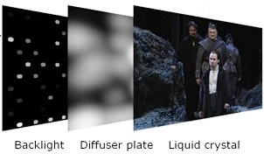
HDR and subjective quality assessment ?
To be revisited:
Viewing conditions
HDR display
there is no transparent HDR display
Needs for clear understanding of the display processing
dual modulation algorithm
temporal coherency preservation
Narwaria et al. “Dual modulation for LED-backlit HDR displays", to appear in High Dynamic Range Video From Acquisition to Display and Applications, Elsevier, 2015.

Slide 16
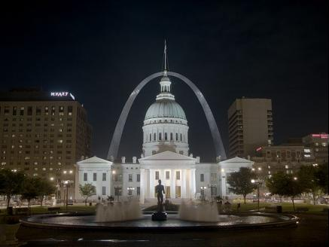
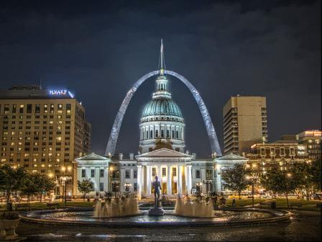
HDR and subjective quality assessment ?
To be revisited:
Viewing conditions
HDR display
there is « no true HDR » display => always a TMO in the viewing loop
Understand how it affects the quality …and the QoE
42 TMOs on the grill …
M. Narwaria, M. Silva, P. Callet and R. Pepion “Tone mapping Based High Dynamic Range Image Compression: Study of Optimization Criterion and Perceptual Quality”, Optical Engineering, vol. 52, no. 10, 2013.

Slide 17
HDR and subjective quality assessment ?
To be revisited:
Viewing conditions
HDR display
Content Selection
Content type
SI
TI
DI
Color Info
Distortion
level
M. Narwaria, C. Mantel, M. Perreira Da Silva, P. Le Callet, and S. Forchhammer, “An objective method for high dynamic range source content selection," in Sixth International Workshop on Quality of Multimedia Experience (QoMEX), pp. 13-18, Sept 2014.

Slide 18
HDR and subjective quality assessment ?
To be revisited:
Viewing conditions
HDR display
Content Selection
Methodology and use cases
M. Narwaria, C. Mantel, M. Perreira Da Silva, P. Le Callet, and S. Forchhammer, “An objective method for high dynamic range source content selection," in Sixth International Workshop on Quality of Multimedia Experience (QoMEX), pp. 13-18, Sept 2014.

Slide 19
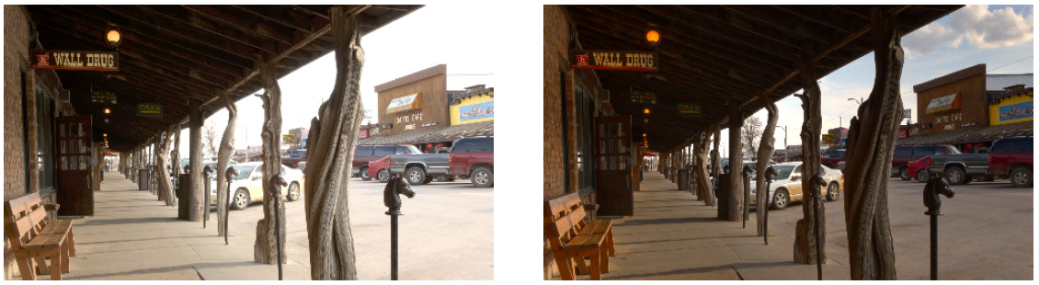
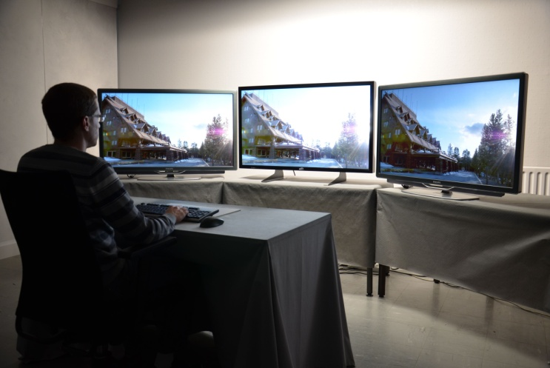
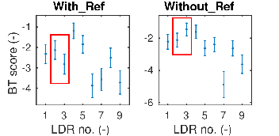
Methodology cares
LDR
HDR
LDR
L. Krasula, M. Narwaria, K Fliegel and P. Le Callet, “Influence of HDR Reference on Obervers Preference in Tone Mapped Images Evaluation," in Seventh International Workshop on Quality of Multimedia Experience (QoMEX), May 2015.

Slide 20
HDR and subjective quality assessment ?
To be revisited:
Viewing conditions
HDR display
Content Selection
Methodology and use cases
New QoE Model?
M. Narwaria, C. Mantel, M. Perreira Da Silva, P. Le Callet, and S. Forchhammer, “An objective method for high dynamic range source content selection," in Sixth International Workshop on Quality of Multimedia Experience (QoMEX), pp. 13-18, Sept 2014.

Slide 21




QoE: an artistic intention?
Transparent delivery chain?
Artist/
Content
Creator
Spectator
An emotion
to be triggered
An emotion to be conveyed

Slide 22
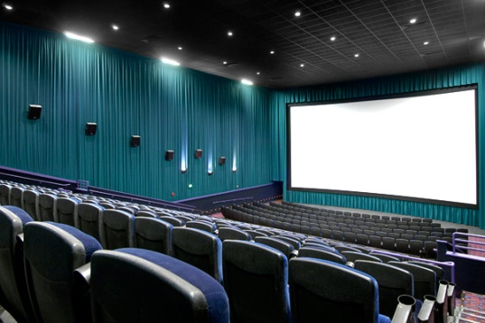
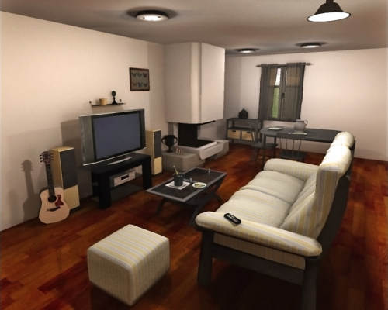
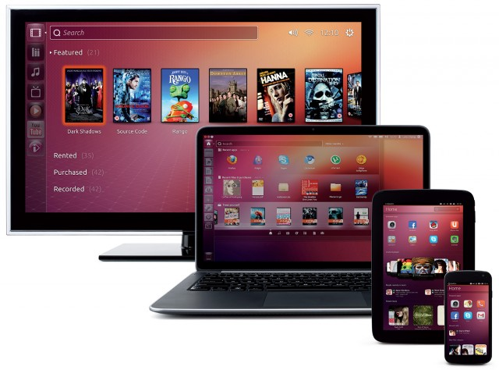
QoE &
Artistic intention
Non transparent
technology
Visual contents can be seen in various conditions
…that can even change the original artistic intention
(emotions, image reading …)

Slide 23
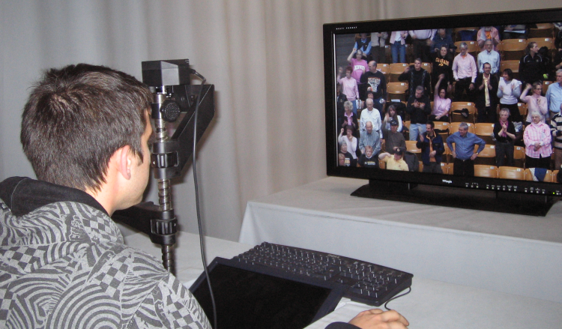
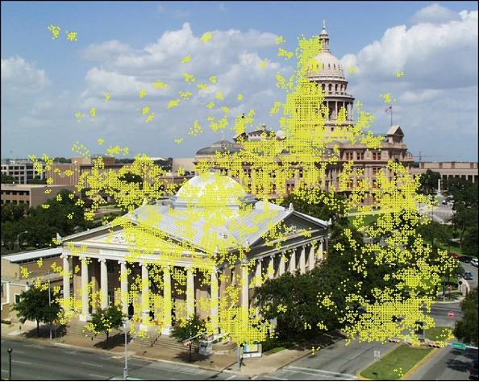
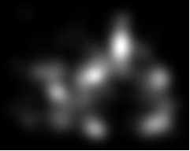
Effects on Visual Attention deployement

Slide 24

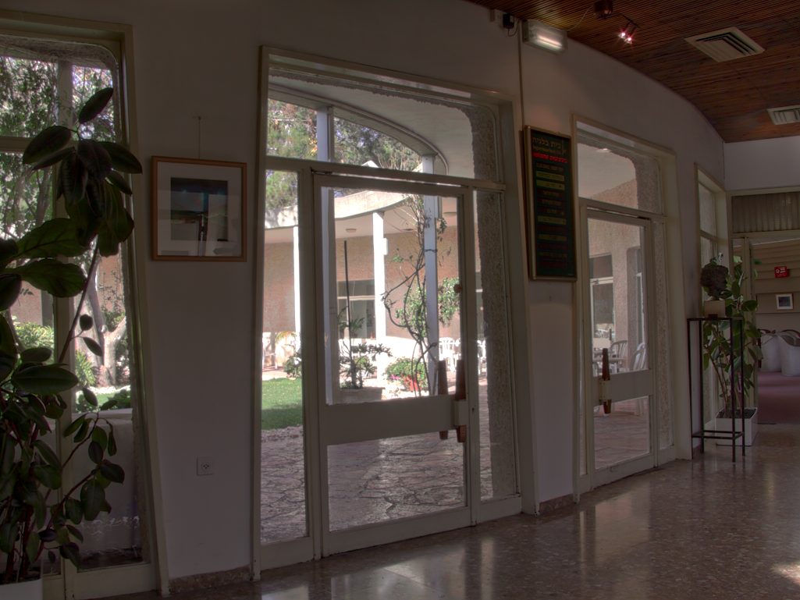

Effects of TMO on Visual Attention deployement
Saliency maps from 2 display conditions
M. Narwaria, M. Silva, P. Callet and R. Pepion “Tone mapping Based High Dynamic Range Compression: Does it Affect Visual Experience?”, Signal Processing: Image Communication (Special Issue on Recent Advances in High Dynamic Range Video Research), 2013

Slide 25
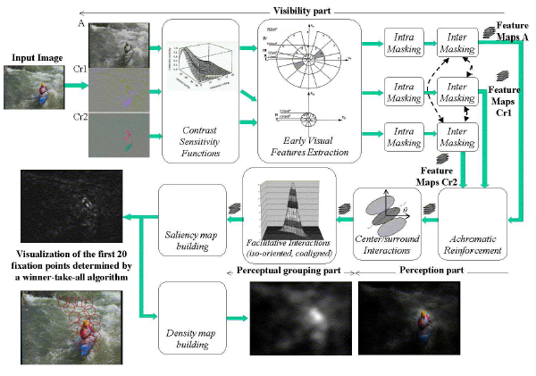
Artist intention: can visual attention models be helpful?
A coherent computational Approach to model the bottom-up visual attention
O. Le Meur, P. Le Callet and D. Barba, IEEE transactions on Pattern Analysis and Machine Intelligence (PAMI), Vol. 28, Issue 5, Pages:802-817 , May 2006

Slide 26
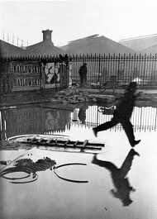
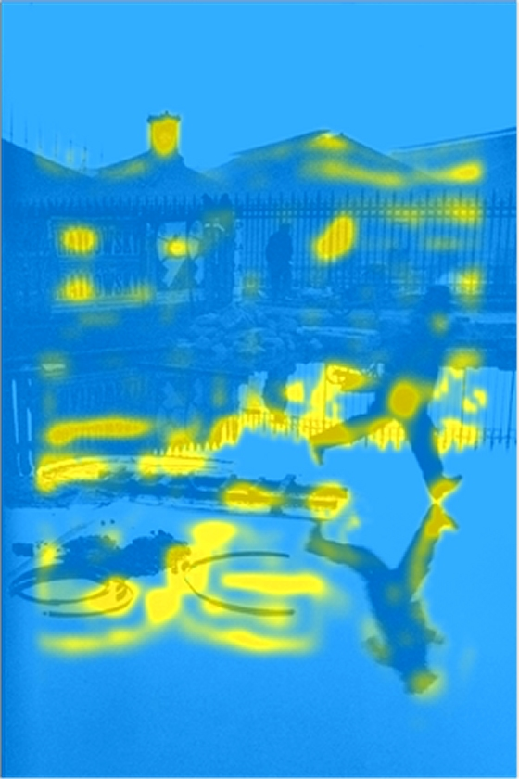
Artist intention: visual attention models can help!
On the role of artistic intent of image quality, Scott J. Daly, Electronic Imaging 2008

Slide 27
HDR video quality assessment
…few questions & studies
Objective Quality measures

Slide 28
Image Quality metrics (or measures): usual flow chart
Reference Image
Representation
&
Computation
of Distortions
Distortion
Pooling
Quality
Score
Image under Test
≈
Distorted Image

Slide 29
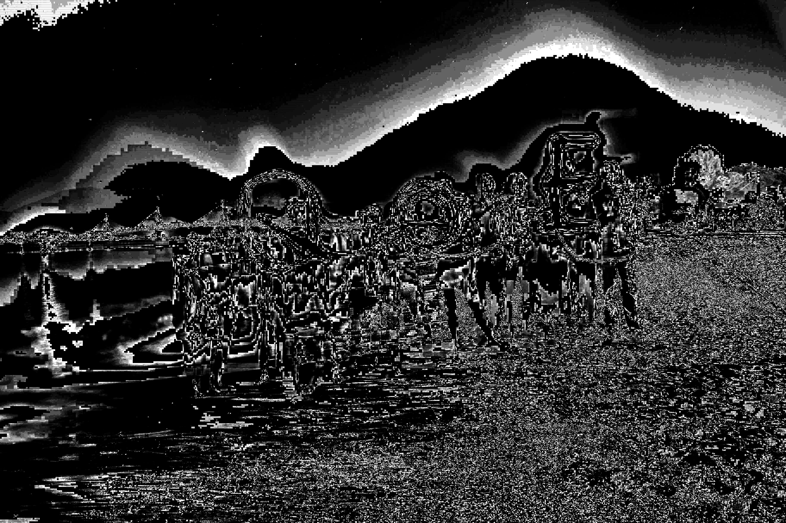
Image Quality metrics: PSNR
Reference Image
Representation & Computation of Distortion
Distortion
Pooling
+
Error
Map
Quality
Score
-
Image under Test
≈
Distorted Image

Slide 30
Image Quality metrics:
« System» based Approach => Artefacts (introduced by know system) driven
Ad hoc sophisticated pooling (train on specific systems/prior knowledge)
Reference
Image
Ad hoc distorsion measurements
(pre pooled or not)
JPEG : DCTune Watson 97,
PQS Miyahara 88
JPEG2000 : Horita 01
MPEG2 : Yamashita 01, Tan 98
Quality
Score
Distorted
Image
(Full) Perceptual Approach => Bottom-up modeling of Human Visual System
Reference
Image
VDP Daly 92
SARNOFF model Lubin 95
Teo et Heeger 94
Winkler 99
D’zmura 99
Computation of distortion in a Perceptual space => HVS modeling
Simple pooling
Minkowsky-like summation
Quality
Score
Distorted
Image

Slide 31
Perceptual based approach: Daly’s VDP
Projection of the Information in a perceptual space
Viewing distance is a parameter!
(unit in the visual space)
Model of the display
Normalization of errors according to the Visibility Thresholds (including Masking effects)
Partial Pooling:
Frequency and Orientation pooling only
Output= probablity of detection at each site
Minkowsky summation

Slide 32











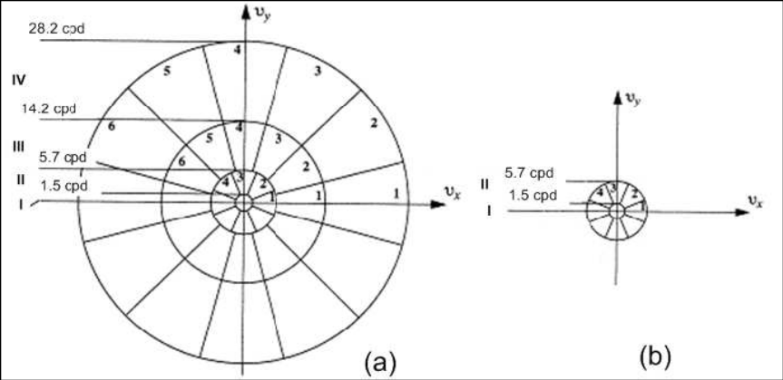






Perceptual based approach: a closer look
Viewing Distance
Model of
Display
Perceptual Error Maps:
Error normalized by visibility threshold
Reference
Image
From bits
to
Visual Unit
Visual
differences
& Normalization
Distorted
Image
From bits
to
Visual Unit
Pooling:
- Component (color)
- Orientation
Frequency
Spatial
- Temporal
Quality
Score
Modeling the annoyance/ the formation of quality judgement
From quantified visible errors to impact on visual quality

Slide 33
a third path: top down approaches
Perceptual Top Down factors => « agnostic» structural approach
paradigm shift: local errors take into account annoyance instead of visibility
Define what is what is annoying => Detect it
SSIM, VQEG Phase 2 (Yonsei’s model) …

Slide 34
Perceptual based approach and top down approach
Model of
Display
Viewing Distance
Structural Error Maps
=> Annoyance level
Reference
Image
Perceptual Error Maps:
Error normalized by visibility threshold
From bits
to
Visual Unit
Visual
differences
& Normalization
structural
differences
Distorted
Image
From bits
to
Visual Unit
Modeling the annoyance/ the formation of quality judgement
From quantified visible errors to impact on visual quality
Pooling:
-component (color)
-Orientation
-Frequency
- Spatial
- Temporal
Quality
Score
From local annoyance to global annoyance

Slide 35
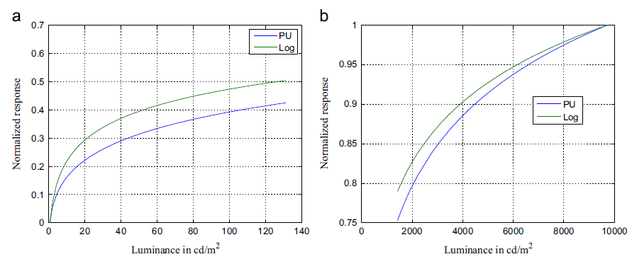
Extending existing objectives measures to cover HDR scenarios
Trivial extension:
Model of the display => transformation into emitted luminance
Perceptual Uniform Space => transformation into perceived luminance (different from LDR case)
Reference Image
Representation
&
Computation
of Distortions
Distortion
Pooling
Quality
Score
Image under Test
≈
Distorted Image
Can be done with any of the previous measures (PSNR, SSIM …)

Slide 36
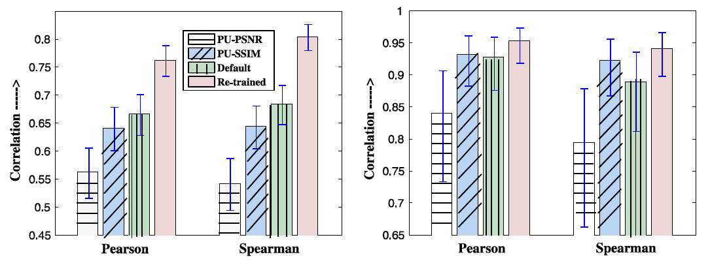
From HDRVDP2.0 to HDRVDP 2.2
Viewing Distance
Model of
Display
Reference
Image
From bits
to
Visual Unit
Visual
differences
& Normalization
Distorted
Image
From bits
to
Visual Unit
HDR-VDP-2.2: trained on various dynamic range from HDR to LDR conditions
Narwaria et al. “HDR-VDP-2.2: A calibrated method for objective quality prediction of high dynamic range and standard images”, Journal of Electronic Imaging, vol. 24, no. 1, p. 010501, 2015.
Software freely available at: http://hdrvdp.sf.net/
Pooling:
- Component (color)
- Orientation
Frequency
Spatial
- Temporal
Quality
Score

Slide 37
HDR VDP 2.x: strenght and limits
HDR-VDP : good at predicting local JND (Just Noticeable Difference) and overall JND with proper pooling …but:
not a video quality measure
likely not suitable for wide range of quality
(low to high bit rates)
complexity can be an issue

Slide 38
HDR-VQM (Video Qualty Model): a objective quality measure for video
Inter subband masking @supra
ST Local analysis
video
wide range of quality
(low to high bit rates)
with limited complexity
N
E
P
src
Transformation
src
src
src
Transformation into
Gabor
into emitted
perceived luminance
filtering
luminance
P
N
E
hrc
hrc
hrc
(
hrc
)
(
src
hrc
l
l
)
t
,
s
,
t
,
o
s
,
o
Spatio
-
temporal
Subband
Short and long
subband
errors
Spatio
errors
Subband
comparison,
-
HDR
temporal
-
VQM
pooling across scale,
term pooling
analysis
orientation
Spatio
-
temporal processing
@Scale of Visual fixation
Narwaria et al. “HDR-VQM: An Objective Quality Measure for High Dynamic Range Video”, Signal Processing: Image Communication, 2015.

Slide 39
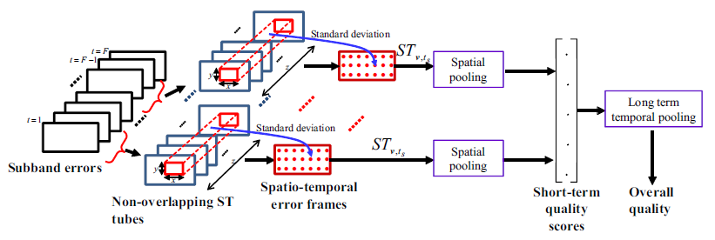
HDR-VQM: perceptual error spatio temporal pooling
display resolution
ST tube volume:
fixation duration
foveal vision
viewing distance
area of display
Narwaria et al. “HDR-VQM: An Objective Quality Measure for High Dynamic Range Video”, Signal Processing: Image Communication, 2015.

Slide 40
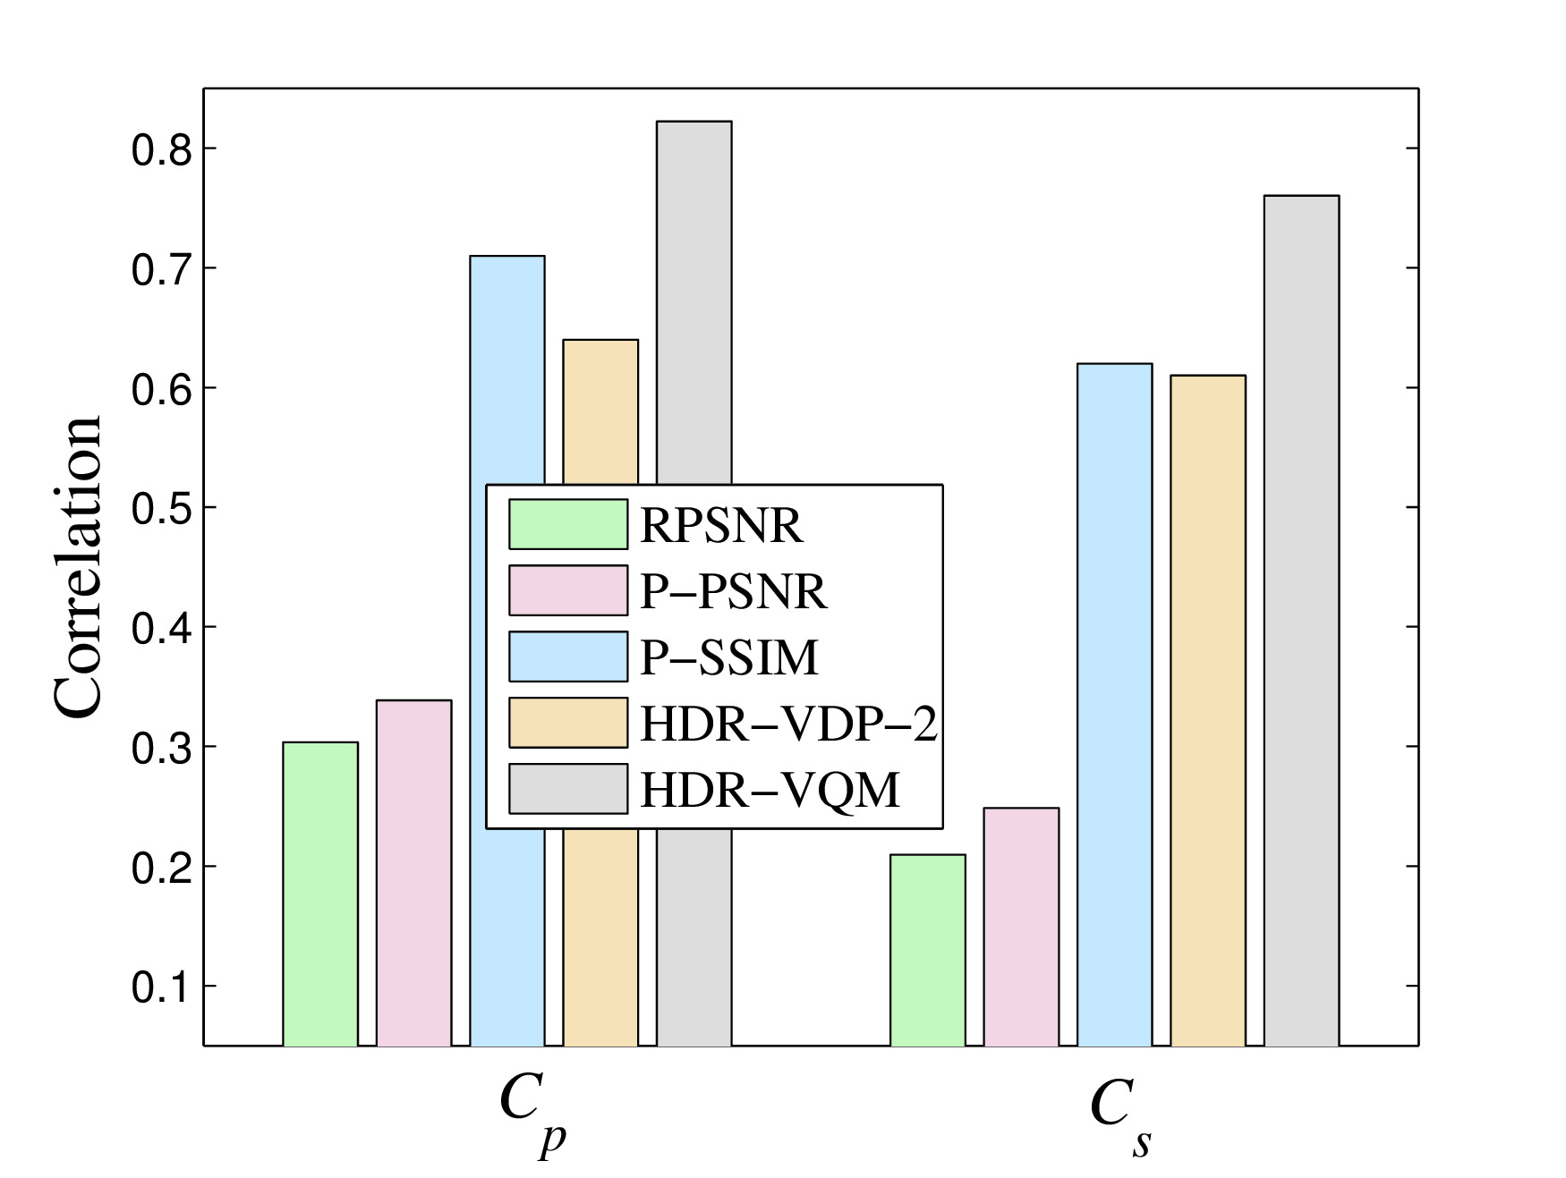
HDR-VQM: performance
Results on backward-compatible HDR video compression method
A. Koz & F. dufaux « Optimized tone mapping with perceptually uni-form luminance values for backward-compatible high dynamic range video compression
Narwaria et al. “HDR-VQM: An Objective Quality Measure for High Dynamic Range Video”, Signal Processing: Image Communication, 2015.

Slide 41
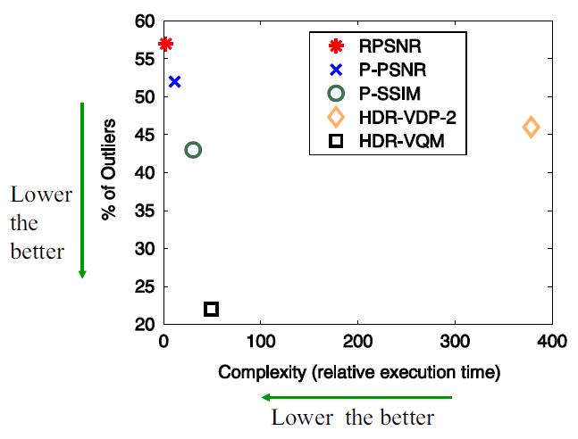
HDR-VQM: performance
Narwaria et al. “HDR-VQM: An Objective Quality Measure for High Dynamic Range Video”, Signal Processing: Image Communication, 2015.

Slide 42
On going …

Slide 43
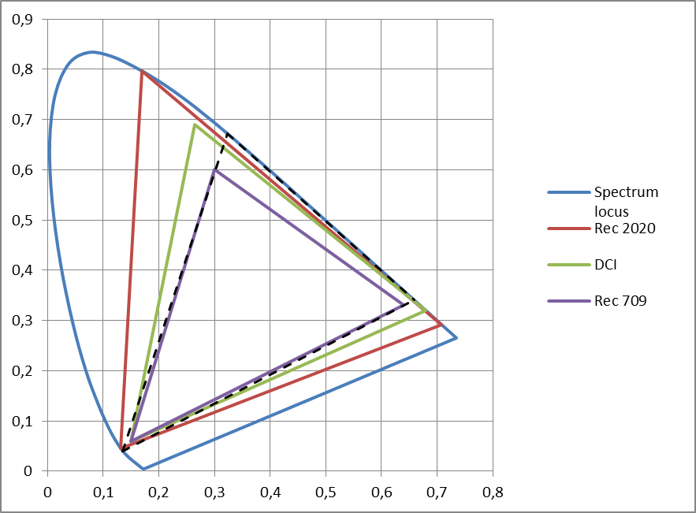
HDR/WCG
Rec. 2020 vs Rec.709: tone and color reproduction
Meta data: mastering Display info, maxFall, max CLL, color Remapping Info
Color volume conversion => New form of processing and …use case for quality assessment

Slide 44
Color Volume conversion and quality assessment
Can we reconciliate image Quality assessment with color vision science (Delta_E, CIECAM, …)?
small patch vs huge patch
new displays stressing standard observer model =>observer metamerism
Can we predict image naturalness (QoE formation)?
Subjective quality experiment: colorfulness, contrast, naturalness
objective measurement of Naturalness
  L. Krasula, K. Fliegel, P. Le Callet et M. Klima. “Objective evaluation of naturalness, contrast, and colorfulness of tone-mapped images” In Applications of Digital Image Processing XXXVII, Août, 2014

Slide 45

Video quality assessment of HDR content
(and beyond)
Pr. Patrick Le Callet
www.irccyn.ec-nantes.fr\~lecallet

