Slide 1
VQEG Liaison Report
- IEEE P1858 CPIQ Standard

Slide 2
What is CPIQ?
  CPIQ = Camera Phone Image Quality
  Image quality standards organization for mobile cameras (not just phones anymore)
  Launched in 2006 under International Imaging Industry Association (I3A)
  Transitioned in 2012 to IEEE standards development as Work Group P1858
‹#›

Slide 3
Who is CPIQ?
  Participating companies:
  Cross-industry:
Mobile carriers, OS vendors, handset manufactures, chipset vendors, component vendors, test labs, test software and equipment vendors, and others
  Global representation:
Currently >20 member companies representing Europe, US, and Asia
  Relationship to ISO:
Liaison relationship with ISO
Maintain consistency across imaging standards from different organizations
‹#›

Slide 4
IEEE P1858 CPIQ Standard
Standardizing means everyone measures the same way
Version 1 of CPIQ Standard for Image Quality Testing is planned to be published in 2016
Will include seven metrics:
Spatial frequency response
Lateral chromatic displacement
Chroma level
Color uniformity
Local geometric distortion
Visual noise
Texture blur
‹#›

Slide 5
CPIQ Next Steps
Version 2 of CPIQ Standard for Image Quality Testing targeted for 2017 publication
Will include:
Auto White Balance
Auto Exposure
Video
AF Consistency
Revised Texture Metric
Updates to Visual Noise
Updates to SFR Metric
‹#›

Slide 6
Backup Slides

Slide 7

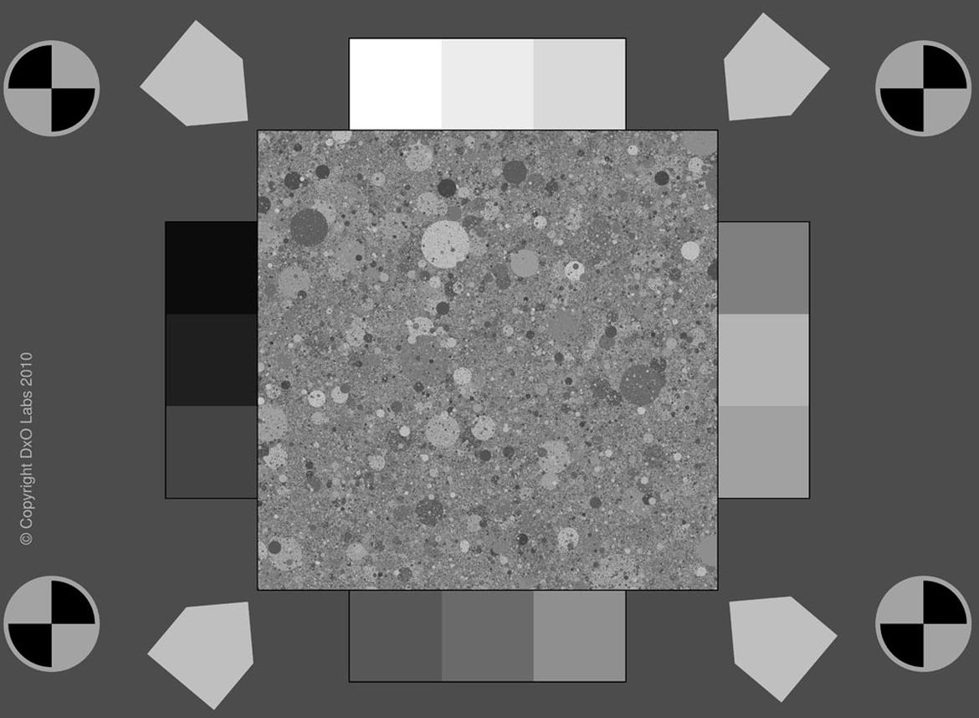
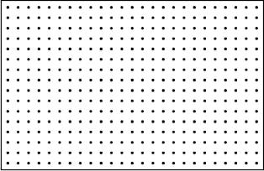
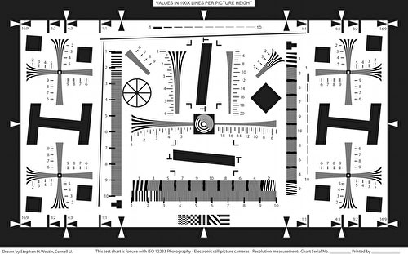
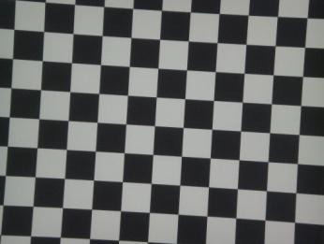
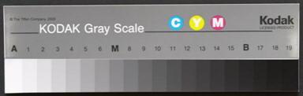
Use Known Targets
‹#›

Slide 8
Spatial Frequency Response (SFR)
Measure of resolution, sharpening, acutance and image sharpness
Derived from ISO 12233 – Photography Electronic Still Picture Imaging – Resolution and Spatial Frequency Response Measurements
Adds a method for calculating a visually correlated global sharpness measure (acutance)
Measured on a low-contrast slanted edge
Current version only calculates SFR of image center
  Continuing work planned to add corner/edge sharpness
‹#›

Slide 9
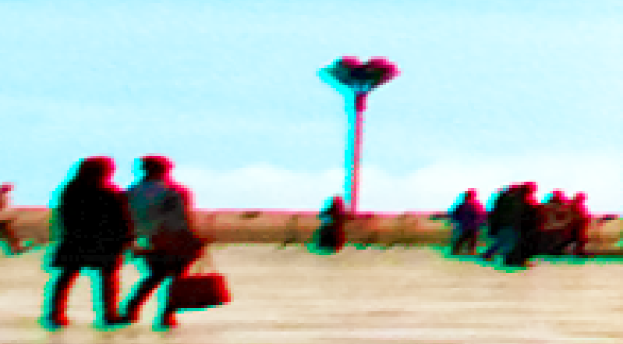
Lateral Chromatic Displacement
Caused by different wavelengths of light being focused at different positions in the focal plane
Measured on a target of black dots over a uniform white background
Reported as the worst case shift of color planes over the whole image as a proportion of the image height.
Adopted by ISO as International Standard 19084
‹#›

Slide 10
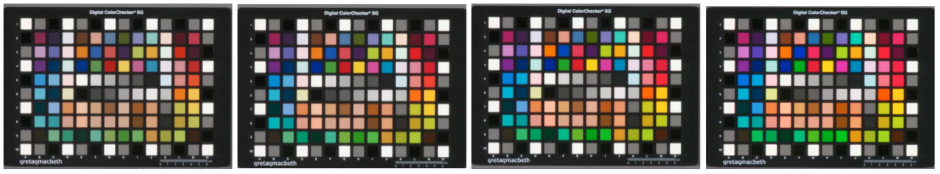
Chroma Level
Measures average scene colorfulness and links it to end users preference.
Chroma is often used to indicate color intensity and is used in this standard as an approximation of saturation.
Saturation measures deviation from accurate colorimetric reproduction, whereas Chroma Level is derived from user studies.
Measured on a 140 patch color target
Reported as percentage of the ratio of mean chroma between captured image and reference data
‹#›

Slide 11

Color Uniformity
Typically seen as radial color variation across an image
Can be caused by
  optical mismatch between sensor and lens
  spatially varying spectral transmittance differences from the IR filter
  spectral sensitivity differences across the sensor
Measured on neutral flat-field (uniform) target
Reported as the maximum color deviation from the scene average
Adopted by ISO as International Standard 17957
‹#›

Slide 12
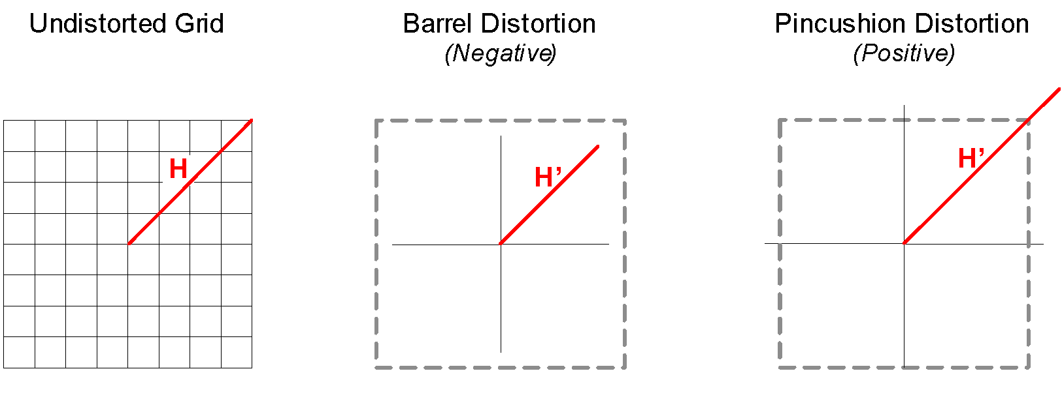
Local Geometric Distortion
Defined as the variation of magnification in the image field. (The most well known effect of distortion is that straight lines appear warped.)
Measured on a target of black dots over a uniform white background
Reported as the largest absolute value of the distortion in the image field
Adopted by ISO as International Standard 17850
‹#›

Slide 13


Visual Noise
Derived from ISO 15739:2013 – Noise measurements
Shows better correlation with visual perception of noise than ISO 15739.
Measured on a ISO 14524:2009 compliant OECF chart
Reported as base 10 logarithm of the weighted sum of the L*, a*, b* variances and L*a* covariance
Rewards for noise in blue-yellow axis due to –b* term
This & other aspects of metric planned to be refined for V2
‹#›

Slide 14
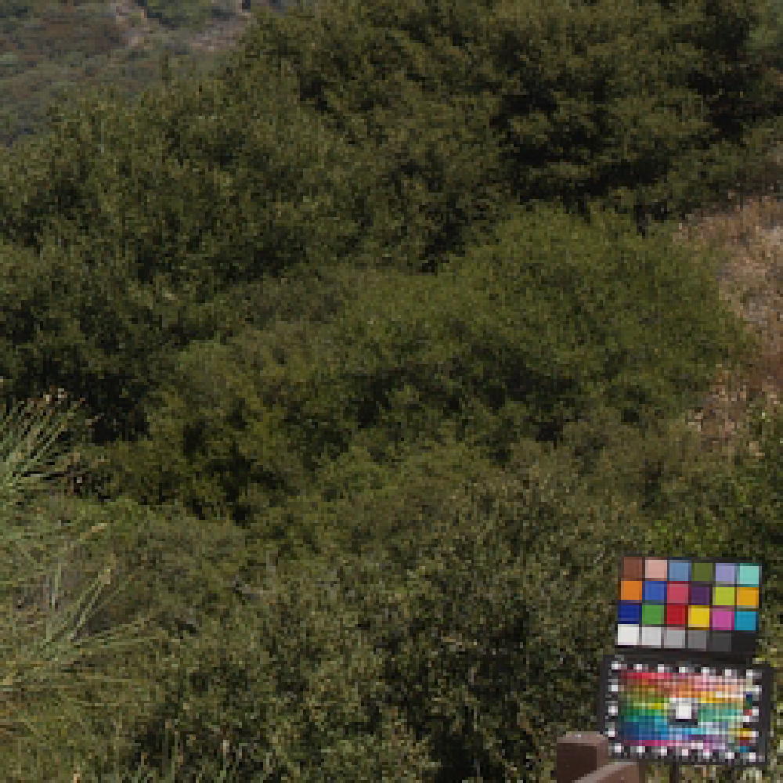
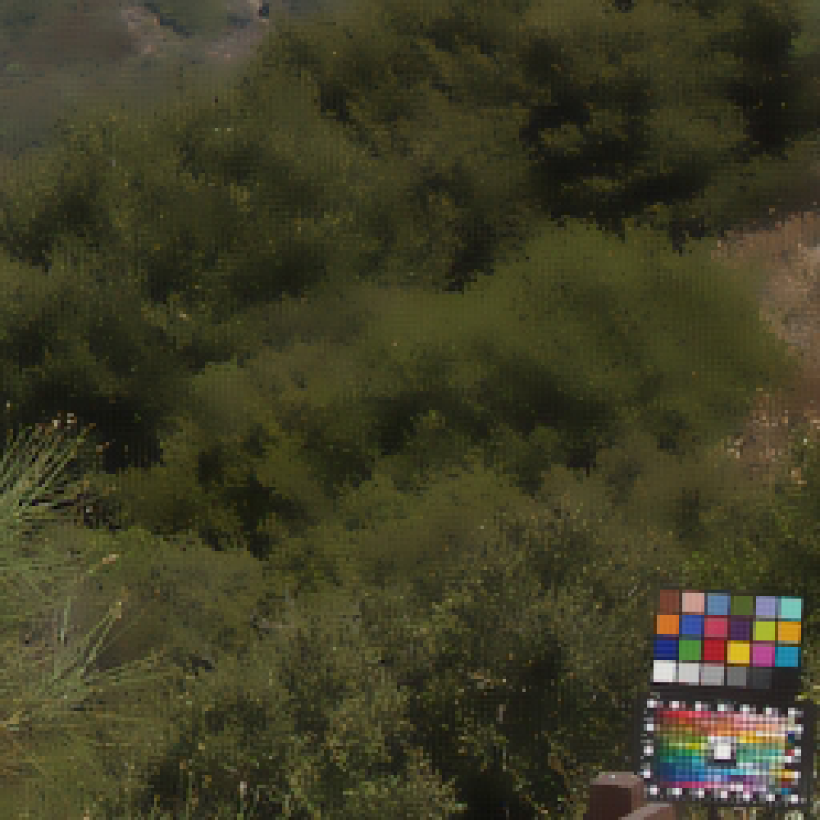
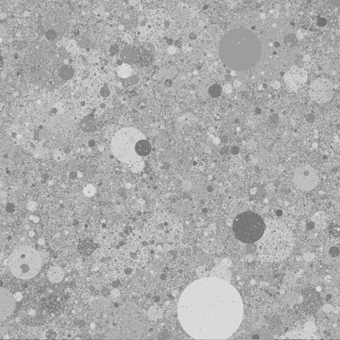
Texture Blur
Strong noise reduction can preserve edges (and hence give good SFR results) but destroy texture
Measured on “dead leaves” target
Reported as a ratio between the power spectral density (PSD) of the captured dead leaves patch minus the PSD of a flat field patch (in order to compensate for the noise), and the PSD of the ideal (reference) dead leaves target.
V1 may not provide accurate results for NR algorithms that apply localized NR strength based on image content
‹#›

