Slide 1
Michele A. Saad¹, Margaret H. Pinson², David G. Nicholas³, Niels Van Kets⁴, Glenn Van Wallendael⁴, Ralston Da Silva³, Ramesh V. Jaladi³, and Philip J. Corriveau⁵
¹ Intel Corp., Austin, TX, USA ² NTIA’s Institute for Telecommunication Sciences (NTIA/ITS), Boulder, CO, USA ³ Intel Corp., Santa Clara, CA, USA ⁴ Ghent University–iMinds, Ghent, Belgium ⁵ Intel Corp., Hillsboro, OR, USA
IMPACT OF CAMERA PIXEL COUNT AND MONITOR RESOLUTION PERCEPTUAL IMAGE QUALITY

Slide 2







Introduction
The research question: What is the joint impact of pixel count and display resolution on perceived quality?
Secondary goal(s):
  Identify variables that impact perceived image quality.
  Demonstrate a subjective design that can compare cameras.

Slide 3




Background
D1
D2
Available Data Sets
Simulated Impairments
Ideal for FR model’s
Limited resolution
Not representative of real world impairments
D3
R1
R1
X
User Perceive
User Form Opinion

Slide 4
Background
NO Reference Model
User Capture
User Upload
User Perceive
User Form Opinion

Slide 5
CCRIQ Database
CCRIQ Database: Consumer content resolution and image quality database
CCRIQ contains a wide range of image resolutions, and a well-balanced distribution among phones, tablets, point-and-shoots, and DSLRs is maintained for each image resolution category.
No simulated distortions (such as simulated blur, noise, compression, and transmission artifacts).
Impairments inherently introduced by commercially available cameras.
The types of artifacts present in CCRIQ are completely realistic and typical of consumer image-capture scenarios.
Range of image qualities is realistic, dictated by the quality of the cameras.

Slide 6
Approach

Slide 7


Subjective Test
OPTION A
The CCRIQ analyzes the quality of images that are captured by digital cameras and displayed on a digital monitor
The only intermediate processing was scaling the image to the monitor
We focus on two parameters
Pixel count of the image captured by a camera
Resolution of the display on which the image is viewed

Slide 8
Subjective Test
The CCRIQ analyzes the quality of images that are captured by digital cameras and displayed on a digital monitor
The only intermediate processing was
scaling the image to the monitor
We focus on two parameters
Pixel count of the image
captured by a camera
Resolution of the display on
which the image is viewed

Slide 9
Scope
Impact factors on perceptual quality:
Sensor size
Lighting conditions
Focal distance
Subject matter
Constrained variables:
Images in landscape orientation
Automatic camera settings
Maximum pixel count
Full screen display
Large high resolution displays
Subset of image content
No tripods

Slide 10
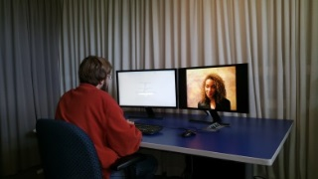
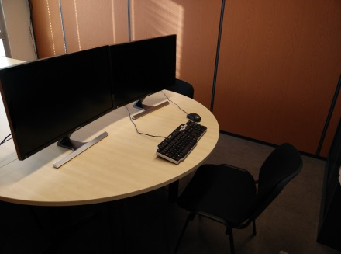
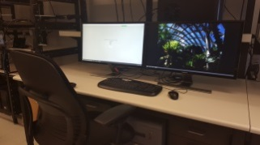
Subjective Method
Tradition:
  Source Image (SRC) x Impaired Image (HRC)
New experimental design:
  (Scene) x HRC) where HRC is a different camera.
CCRIQ uses ITU-T Rec. P.913 and the absolute category rating (ACR) scale.
  Illumination and viewing distance in compliance with ITU-T Rec P.913
  Also in compliance with P.913 a visual acuity and color deficient test was performed, no subjects were screened
  The scope of P.913 does not include image quality, however we believe this is an appropriate extension.
Subjective testing was performed by three laboratories:
Ghent University
ITS/NTIA
Intel
Environment:
  Quiet room dedicated to the task mix of natural and artificial light
  Images are displayed at random on matching Samsung monitors, 4k and 1080p respectively

Slide 11
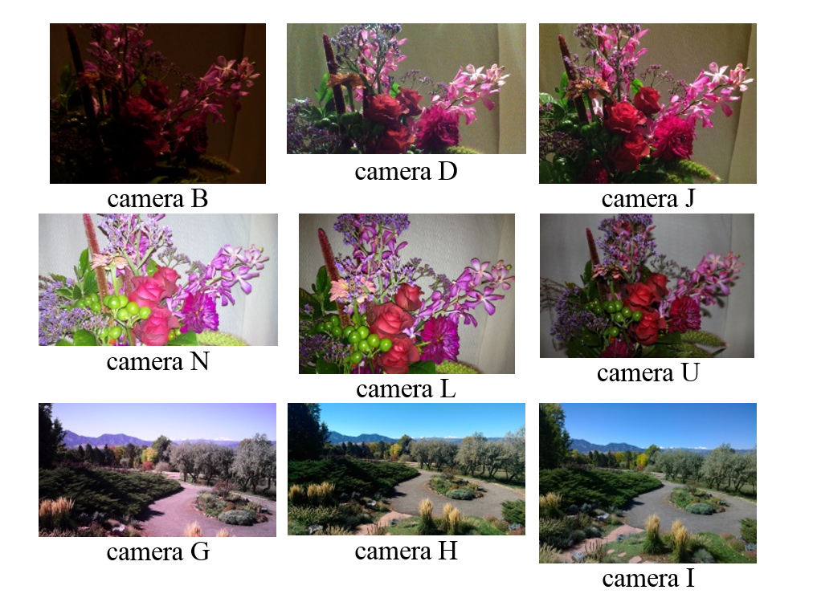
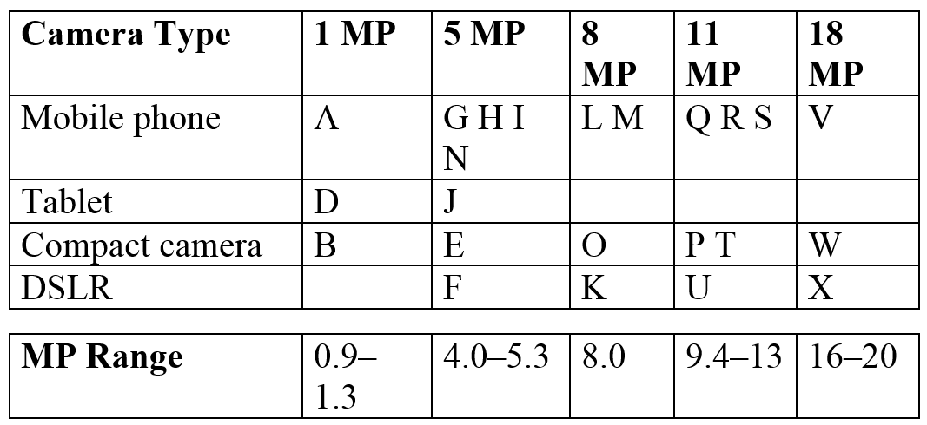
Cameras
Selection:
  Many factors impact image quality
  We selected a wide variety based on two characteristics:
Camera Type and Resolution
5MP Camera Phones

Slide 12


Scenes
18 scenes captured by 23 cameras
Categories:
  Flat Surfaces
  Landmarks at night
  Landscapes with good lighting
  Portraits
  Still life
Inherent differences with equivalent photos (aspect ratio, focal length)
Slight changes in scene, moving clouds subjects shifting and natural variation in lighting
BLUE pool of images
RED pool of images

Slide 13
Analysis and Conclusions

Slide 14
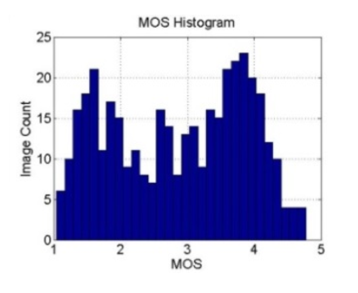
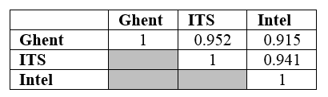
Image MOS Range and Lab to Lab Correlations
The Histogram shows a MOS span the range from 1 to 4.78.
  The lab to lab MOS comparison has a high Pearson correlation.
  The high correlations show that the MOS scores correlate well among the three labs.
Lab to Lab Pearson correlation

Slide 15
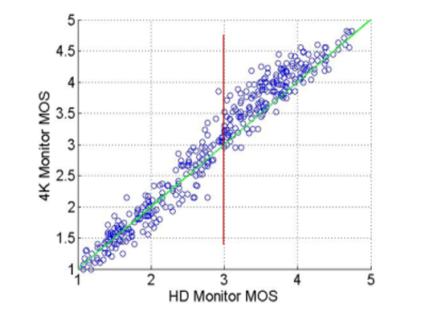
Correlation Between 1080p HD and 4k Ultra HD
The data show high linear correlation between MOS scores obtained from the HD monitor and the MOS scores from the 4K monitor.
  Pearson correlation = 0.979
  R2 0.958

Slide 16
Two-sided Student’s T-test Analysis
There is a statistically significant difference between HD and 4K MOSs in the higher quality range
  4K MOSs being on average 0.2 MOS points higher than the HD MOSs.
No statistical difference in the lower quality range
  Higher quality range mostly fall above the 45 degree line
  Lower quality range they are approximately symmetrically distributed around it.

Slide 17
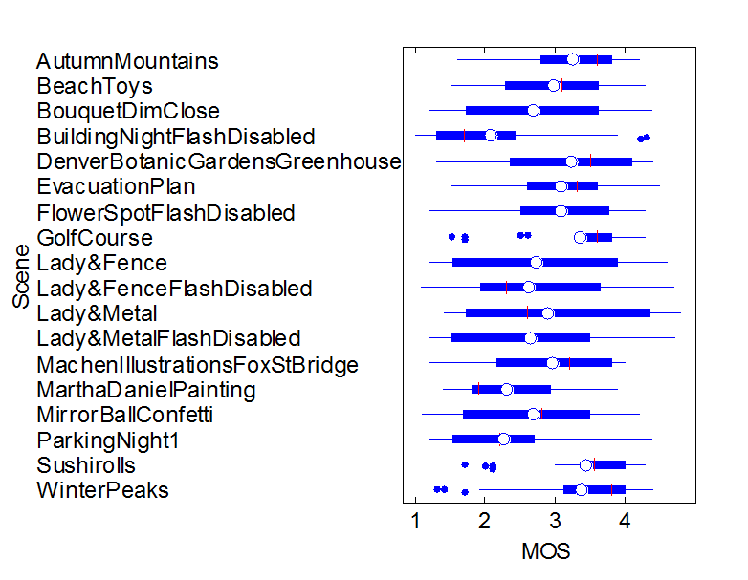
Image MOS Range
Rating trends via boxplots
  Averaging over all subjects, labs, and monitors.
  Blue box spans the 25th to 75th percentile.
  White dot in the center marks the MOS.
  Red vertical line marks the median.
  MOS values are rounded to one decimal place.

Slide 18
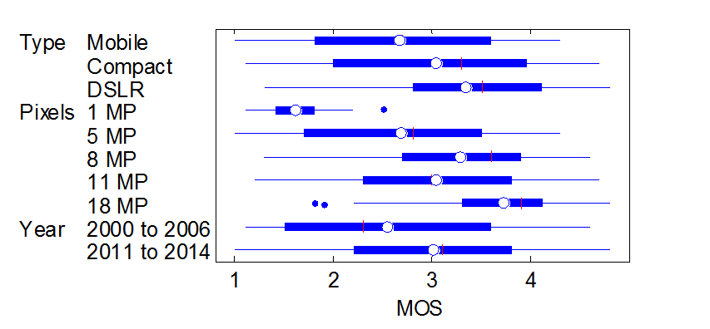
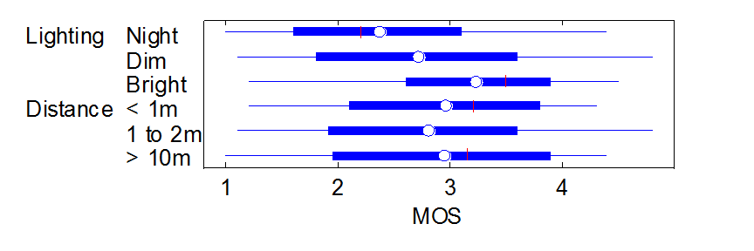
Range: Device, MP, Year, Lighting & Distance MOS

Slide 19
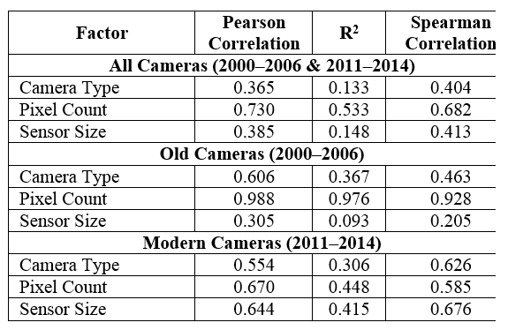
Factor Analysis

Slide 20
Conclusions
Focusing primarily on modern cameras, we reach the following conclusions:
Pixel count impacts ≈30% to 45% of camera quality.
Sensor size impacts ≈27% to 42% of camera quality.
The overall quality difference between DSLR cameras and mobile cameras is 0.67 MOS.
The overall quality difference between a 18 MP camera and a 5 MP camera is 1.0 MOS.

Slide 21
CCR on CDVL Site Now
The CCRIQ dataset is now available on CDVL. Either search for “CCRIQ” or go directly to http://www.cdvl.org/find-videos/details.php?id=2775

Slide 22
Acknowledgement
Margaret Pinson would like to thank the following companies for kindly allowing photographs of their artwork to be distributed:
  Sturtz & Copeland, the Denver Botanic Gardens and Machen Illustrations.
  “Martha Daniel Painting” depicts an oil painting portrait of Martha Daniel by Aurelius O. Revenaugh in an ornate, gilt frame, circa 1900. Mr. Revenaugh was a self-taught, American painter (1840-1908). Martha Daniel was Margaret Pinson’s great grandmother.

Slide 23
References
[1] H. R. Sheikh, Z. Wang, L. Cormack, and A. C. Bovik, “LIVE image quality assessment database release,” 2006, http://live.ece.utexas.edu/ research/quality/subjective.htm.
[2] N. Ponomarenko, V. Lukin, A. Zelensky, K. Egiazarian, M. Carli, F. Battisti, “TID2008 - A Database for Evaluation of Full-Reference Visual Quality Assessment Metrics,” Advances of Modern Radioelectronics, Vol. 10, pp. 30-45, 2009.
[3] E. C. Larson and D. M. Chandler, “Consumer subjective image quality database,” 2009, http://vision.okstate.edu/index.php?loc=csiq.
[4] P. Le Callet and F. Autrusseau, “Subjective quality assessment IRCCyN/IVC database,” 2005, http://www.irccyn.ec-nantes.fr/ivcdb/.
[5] Z. M. Parvez Sazzad, Y. Kawayoke, and Y. Horita, “MICT image quality evaluation database,” 2008, http://mict.eng.u-toyama.ac.jp/mictdb.html.
[6] S. Winkler:. "Analysis of public image and video databases for quality assessment" IEEE Journal on Selected Topics in Signal Processing, vol. 6, no. 6, Oct. 2012.
[7] Virtanen, T., Nuutinen, M., Vaahteranoksa, M., Oittinen, P. and Häkkinen, J. “CID2013: a database for evaluating no-reference image quality assessment algorithms,” IEEE Transactions on Image Processing, vol. 24, no. 1, pp. 390-402, Jan. 2015.
[8] M.A. Saad, P. Corriveau, and R. Jaladi, “Objective consumer device photo quality evaluation,” IEEE Signal Processing Letters, March 2015. (to appear).
[9] M.A. Saad, P. Corriveau, and R. Jaladi, “Consumer content framework for blind photo quality evaluation,” In Proc. 9th International Workshop on Video Processing and Quality Metrics for Consumer Electronics (VPQM), February, 2015
[10] M.A. Saad, P. Corriveau, and P. Le Callet, “Blind image quality assessment: unanswered questions and future directions in the light of consumers needs,” VQEG eLetter, no. 2, vol. 1, pp. 62-66. Available: http://www.vqeg.org/
[11] M. Pinson, M.A. Saad, D.G. Nicholas, G. Van Wallendae, R.V. Jaladi, P.J. Corriveau, “Consumer Content Resolution and Image Quality Dataset (CCRIQ): An image quality subjective test of pixel count and display resolution,” NTIA-TM, forthcoming.
[12] M. Pinson and L. Janowski, “A new subjective audiovisual & video quality testing recommendation,” VQEG eLetter, no. 2, vol. 1, 2014. Available: http://www.vqeg.org/
[13] M. Pinson and A. Webster, “T1A1 validation test database,” VQEG eLetter, no. 2, vol. 1, 2014. Available: http://www.vqeg.org/

