Slide 1
VIME Agenda
Glasgow, Scotland September 14 – 18, 2015

Slide 2
Topics (in no order)
Upload of the photos taken during this meeting to VIME database
  Coordinate collection, naming, upload, tagging of all images
    Images from photo session on Tuesday evening: coordinated upload before end of meeting
    Images from photo session on Friday afternoon: plan for coordinated upload after people have gone back home
Classification / Categorization / Tagging of Flickr VIME images
  Examples from Image-NET.org
  Use of WordNet Synsets for classificaction
Flickr VIME Policies
  Administration of database
  Use of scripts and access

Slide 3
Upload of photos captured on Tue 15th Sep
11 people participated in the photo session and took photos of the same scene with several cameras
There is a need to upload the photos in a coordinated way to help managing the VIME Flickr dataset
The following slides provide an example of how to coordinate the upload
The main goal is to make sure that
  Photos of the same scene have the same tags
  Use “machine tags” (see next slide)
  Use filenames with common naming for photos of a same scene

Slide 4
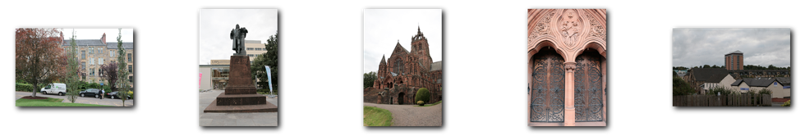
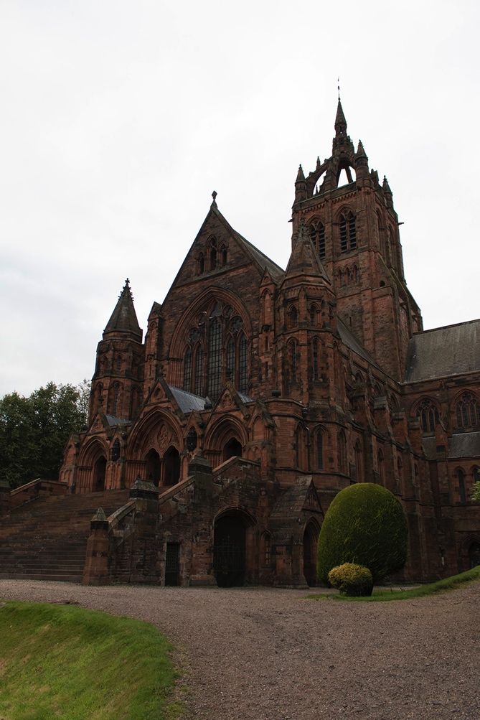
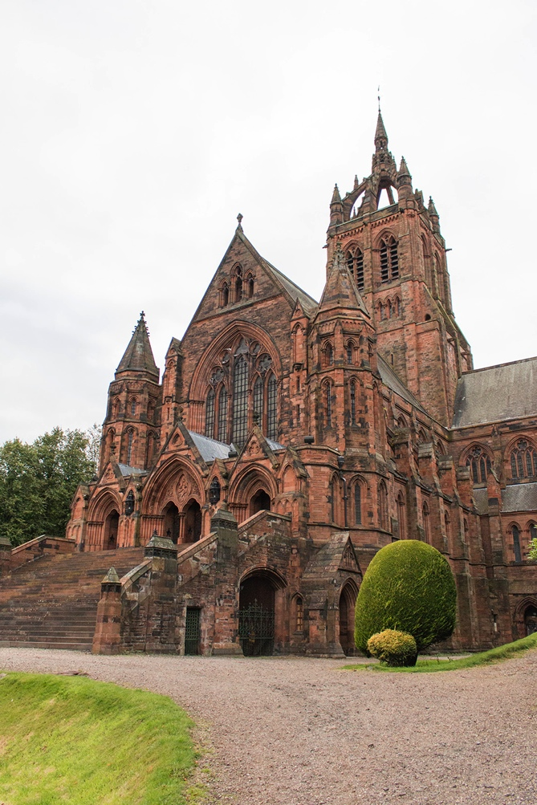
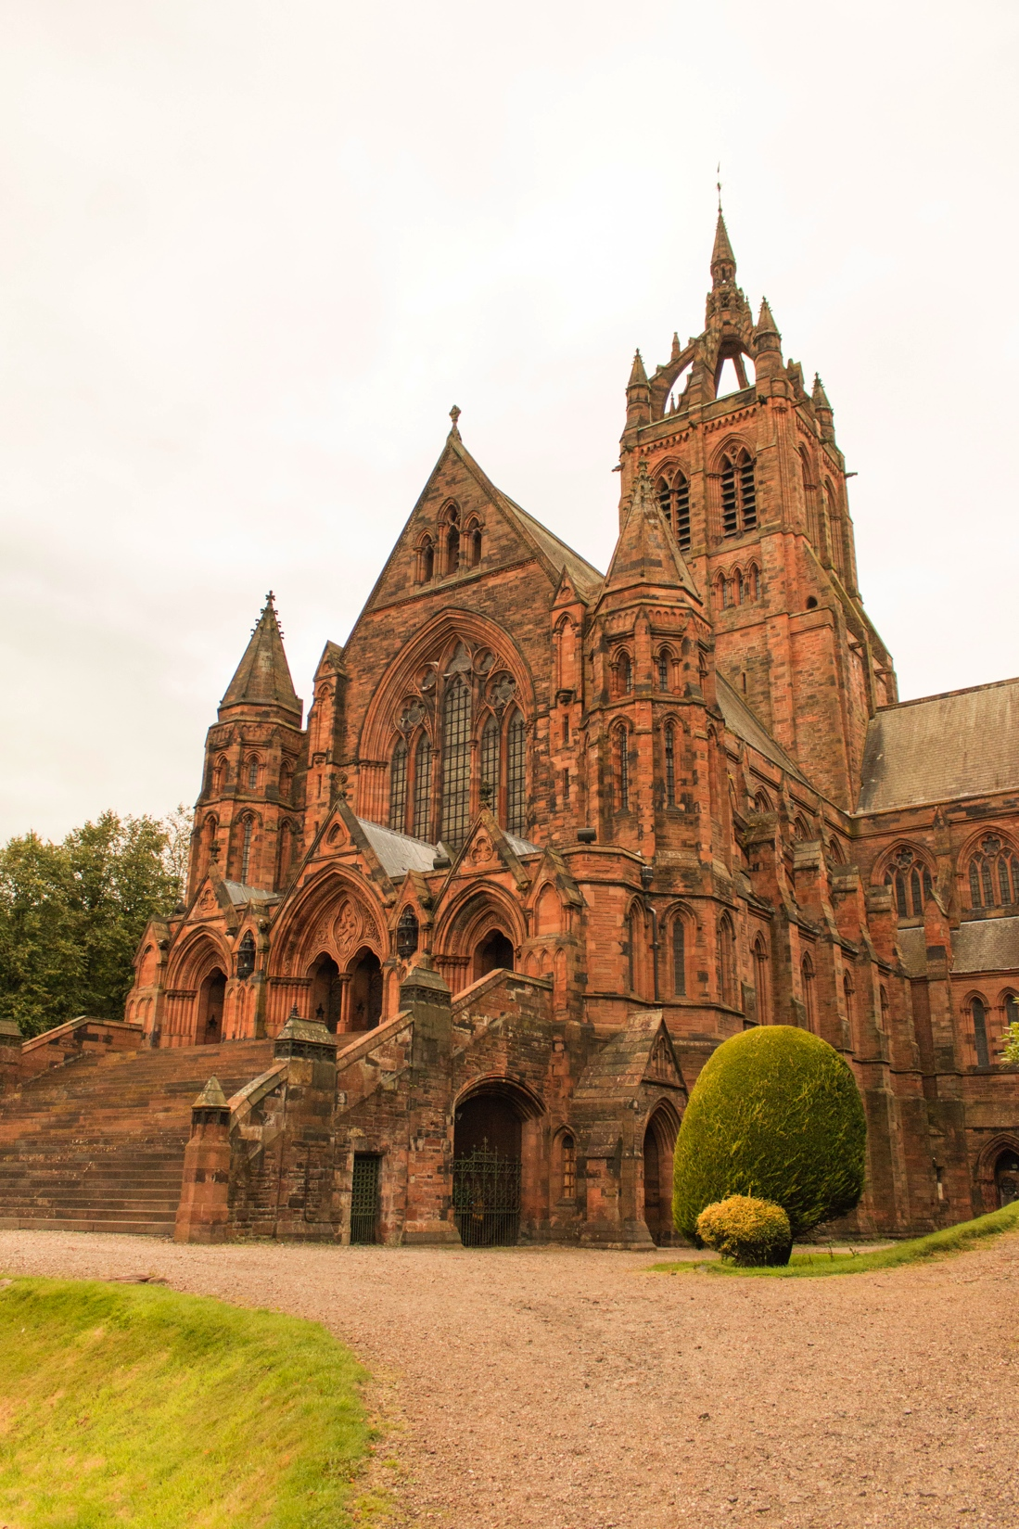
Upload of photos captured on Tue 15th Sep
Naming:
  Use a common root naming of images of the same scene captured by different cameras
    Examples:
      ImageName_PhotographerName
        ImageName is the same for all photos of that scene
        PhotographerName is different for each photographer
      ImageName_CameraID
        ImageName is the same for all photos of that scene
        CameraID is different for each camera used to capture the scene
Tagging:
  In the case of several photos of the same scene, use common tags for all the photos of the same scene
  Add also machine tags:
    vqegGlasgow:scene=scenename
    vqegGlasgow:device=cameraname
Example: ImageName = Glasgow_sc03
Glasgow_sc03_camXX
Where XX is the camera ID number
=> Glasgow_sc03_cam01
Example: ImageName = Glasgow_sc03
Glasgow_sc03_XXX
where XXX are initials of the photographer’s name
=> Glasgow_sc03_QHT
Example: all photos of this scene have the same tags: outdoor, building, church

Slide 5
Upload of photos captured on Tue 15th Sep
Each photographer uses a unique camera ID number or their initials:
Name | Camera ID | Initials
Quan | 01
Michele | 02
Glenn | 03
Chris | 04
James | 05
Margaret | 06
Andrew | 07
Silvio | 08
Florence | 09
Arthur | 10
Mikolaj | 11
Name | Example
Quan | Glasgow_sc03_cam01.jpg
Michele | Glasgow_sc03_cam02.jpg
Glenn | Glasgow_sc03_cam03.jpg
… | …
Mikolaj | Glasgow_sc03_cam11.jpg
Image name:

Slide 6
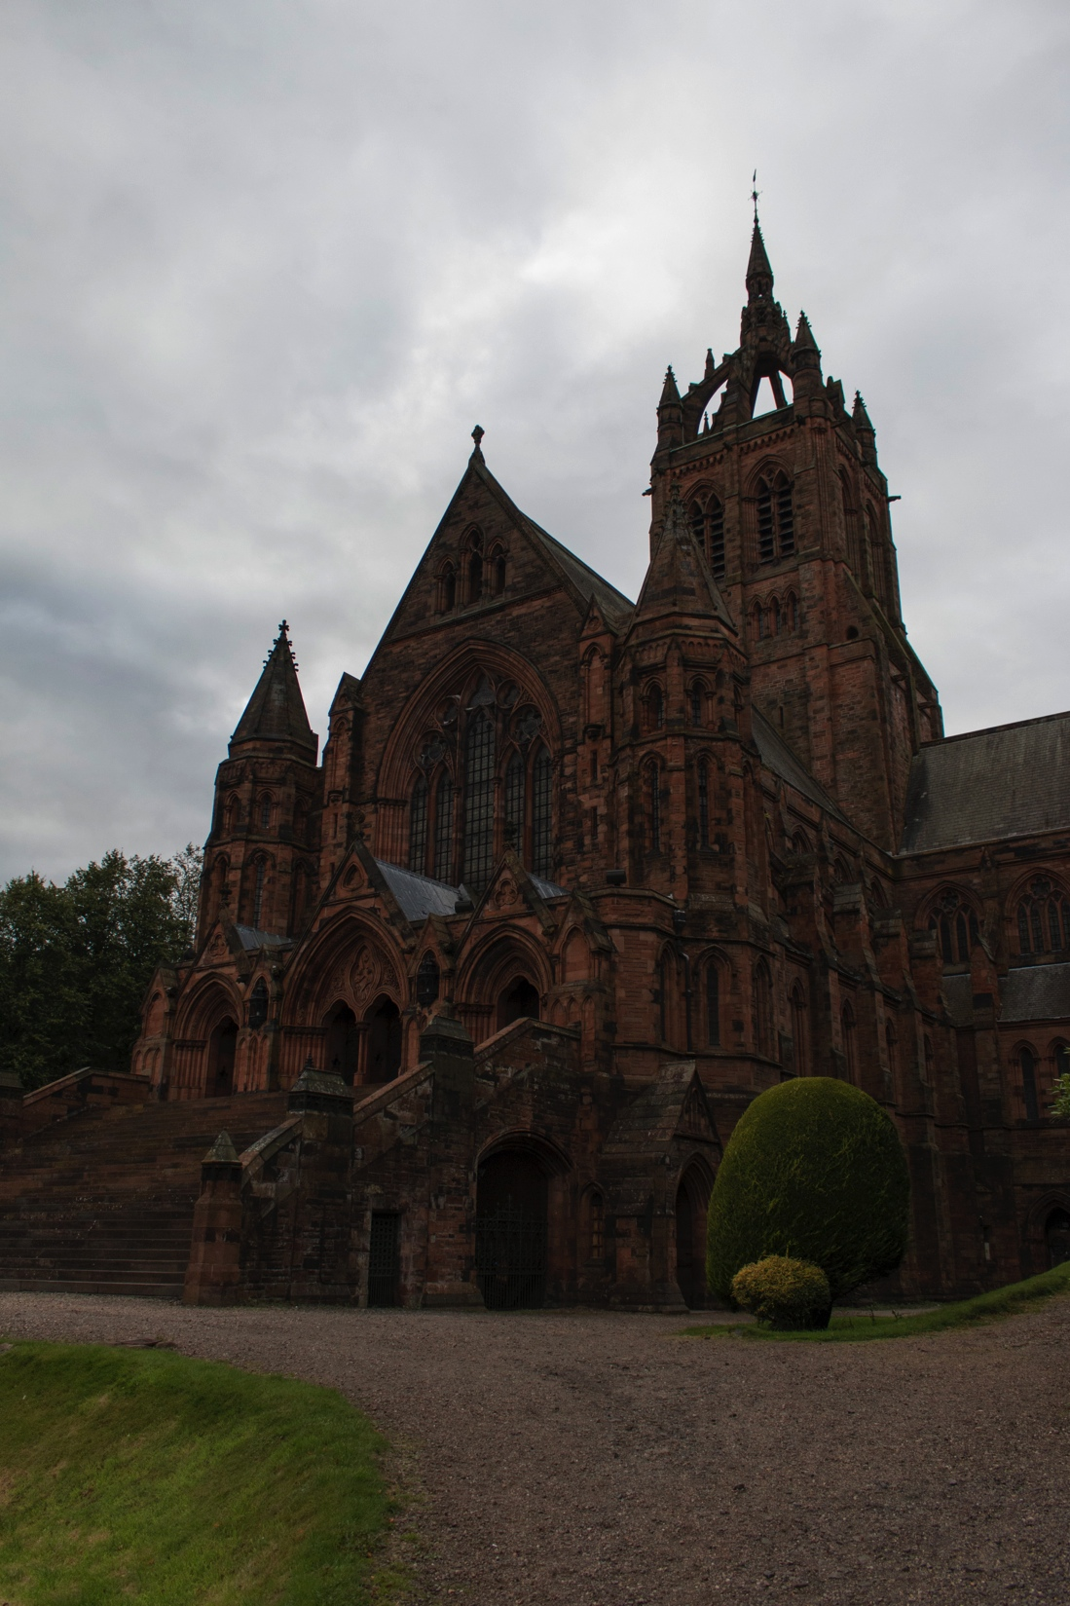
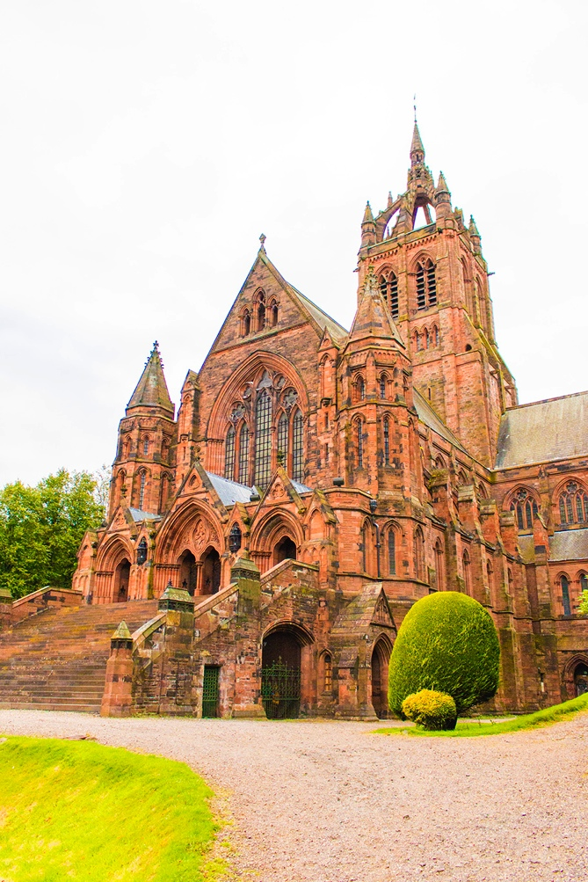
Upload of photos captured on Tue 15th Sep
If several versions are produced from the same camera (different RAW to JPEG processing): use the common filename and add extra information in the filename such as an extra digit at the end of the filename
Name | Example
Quan | Glasgow_sc03_cam01.jpg
Glasgow_sc03_cam011.jpg
Glasgow_sc03_cam013.jpg
Glasgow_sc03_cam015.jpg
Glasgow_sc03_cam012.jpg
Glasgow_sc03_cam014.jpg

Slide 7
Upload of photos captured on Tue 15th Sep
Glasgow_sc01_camXX
Glasgow_sc02_camXX
Glasgow_sc03_camXX
Glasgow_sc04_camXX
Glasgow_sc05_camXX
Tags:
outdoor
landscape
vqegGlasgow:scene=scene01
Tags:
Outdoor
statue
vqegGlasgow:scene=scene02
Tags:
Outdoor
Church
Architecture
vqegGlasgow:scene=scene03
Tags:
Outdoor
Church
Details
Door
architecture
vqegGlasgow:scene=scene04
Tags:
Outdoor
Landscape
Paisley
Buildings
vqegGlasgow:scene=scene05
Additionally to the tags above, for each image, add the following machine tag:
vqegGlasgow:device=cameraname, where cameraname is a unique identifier (e.g. name of your camera)
Examples:
vqegGlasgow:device=eos70D
vqegGlasgow:device=iphone5
XX: camera ID number

Slide 8
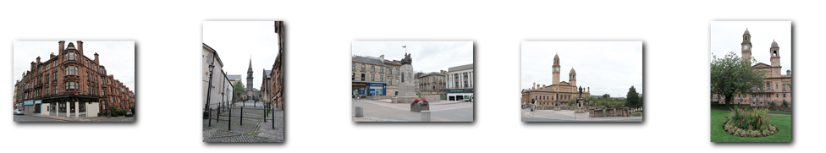
Upload of photos captured on Tue 15th Sep
Glasgow_sc06_camXX
Glasgow_sc07_camXX
Glasgow_sc08_camXX
Glasgow_sc09_camXX
Glasgow_sc10_camXX
Tags:
Outdoor
Building
Architecture
Corner
vqegGlasgow:scene=scene06
Tags:
Outdoor
Street
Church
Spire
cobblestone
vqegGlasgow:scene=scene07
Tags:
Outdoor
Town
Statue
Building
vqegGlasgow:scene=scene08
Tags:
Outdoor
Town
Building
statue
vqegGlasgow:scene=scene09
Tags:
Outdoor
Building
Garden
clock
vqegGlasgow:scene=scene10
Additionally to the tags above, for each image, add the following machine tag:
vqegGlasgow:device=cameraname, where cameraname is a unique identifier (e.g. name of your camera)
Examples:
vqegGlasgow:device=eos70D
vqegGlasgow:device=iphone5
XX: camera ID number

Slide 9
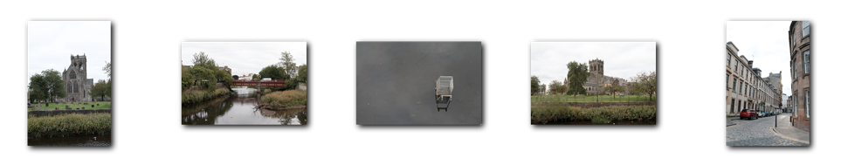
Upload of photos captured on Tue 15th Sep
Glasgow_sc11_camXX
Glasgow_sc12_camXX
Glasgow_sc13_camXX
Glasgow_sc14_camXX
Glasgow_sc15_camXX
Tags:
Outdoor
Church
Graveyard
landscape
vqegGlasgow:scene=scene11
Tags:
Outdoor
River
Bridge
landscape
vqegGlasgow:scene=scene12
Tags:
Outdoor
Water
Reflection
Shopping_cart
Shopping_trolley
River
abstract
vqegGlasgow:scene=scene13
Tags:
Outdoor
Church
Landscape
garden
vqegGlasgow:scene=scene14
Tags:
Outdoor
Street
Cobble
Architecture
buildings
vqegGlasgow:scene=scene15
Additionally to the tags above, for each image, add the following machine tag:
vqegGlasgow:device=cameraname, where cameraname is a unique identifier (e.g. name of your camera)
Examples:
vqegGlasgow:device=eos70D
vqegGlasgow:device=iphone5
XX: camera ID number

Slide 10
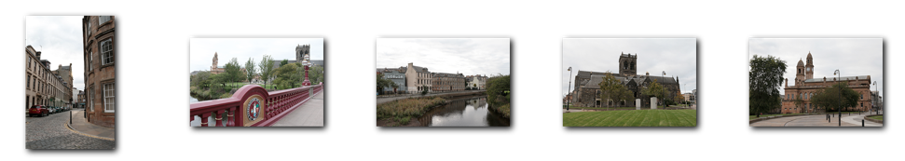
Upload of photos captured on Tue 15th Sep
Glasgow_s16_camXX
Glasgow_sc17_camXX
Glasgow_sc18_camXX
Glasgow_sc19_camXX
Glasgow_sc20_camXX
Tags:
Tags:
Outdoor
bridge
vqegGlasgow:scene=scene17
Tags:
Outdoor
river
Landscape
reflection
vqegGlasgow:scene=scene18
Tags:
Outdoor
Church
Grass
Architecture
building
vqegGlasgow:scene=scene19
Tags:
Outdoor
Building
Architecture
Town_hall
vqegGlasgow:scene=scene20
Additionally to the tags above, for each image, add the following machine tag:
vqegGlasgow:device=cameraname, where cameraname is a unique identifier (e.g. name of your camera)
Examples:
vqegGlasgow:device=eos70D
vqegGlasgow:device=iphone5
XX: camera ID number

Slide 11
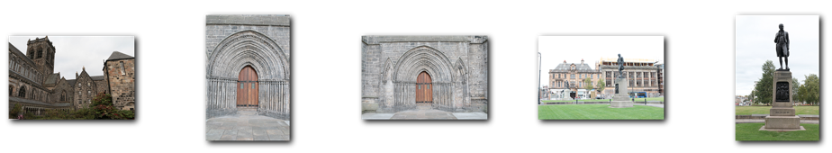
Upload of photos captured on Tue 15th Sep
Glasgow_s21_camXX
Glasgow_sc22_camXX
Glasgow_sc23_camXX
Glasgow_s24_camXX
Glasgow_sc25_camXX
Tags:
Outdoor
Building
architecture
vqegGlasgow:scene=scene21
Tags:
Outdoor
Building
Architecture
door
vqegGlasgow:scene=scene22
Tags:
Outdoor
Building
Architecture
door
vqegGlasgow:scene=scene23
Tags:
Outdoor
Building
Statue
grass
vqegGlasgow:scene=scene24
Tags:
Outdoor
Statue
grass
vqegGlasgow:scene=scene25
Additionally to the tags above, for each image, add the following machine tag:
vqegGlasgow:device=cameraname, where cameraname is a unique identifier (e.g. name of your camera)
Examples:
vqegGlasgow:device=eos70D
vqegGlasgow:device=iphone5
XX: camera ID number

Slide 12
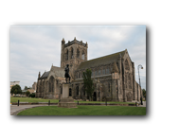
Upload of photos captured on Tue 15th Sep
Glasgow_s26_camXX
Tags:
Outdoor
Building
architecture
vqegGlasgow:scene=scene26
Additionally to the tags above, for each image, add the following machine tag:
vqegGlasgow:device=cameraname, where cameraname is a unique identifier (e.g. name of your camera)
Examples:
vqegGlasgow:device=eos70D
vqegGlasgow:device=iphone5
XX: camera ID number

