Slide 1
Ultra HD Project

Slide 2
J.q-uhd
Needs for UHDTV service references and measurement tools
In order to effectively evaluate and monitor these UHDTV qualities, it is desirable to study tools and methods for UHDTV equipment.
Need to evaluate UHDTV video quality of output signals produced by encoder, editing tools, and decoders at the receiver.
Distortions due to cameras, viewing distances, viewing angles and movements.
Need to develop subjective methodologies to measure various UHDTV signal characteristics.

Slide 3
Three Subjective Test Results for UHD Signals
1. Still images
2. Still images
3. Video Sequences

Slide 4
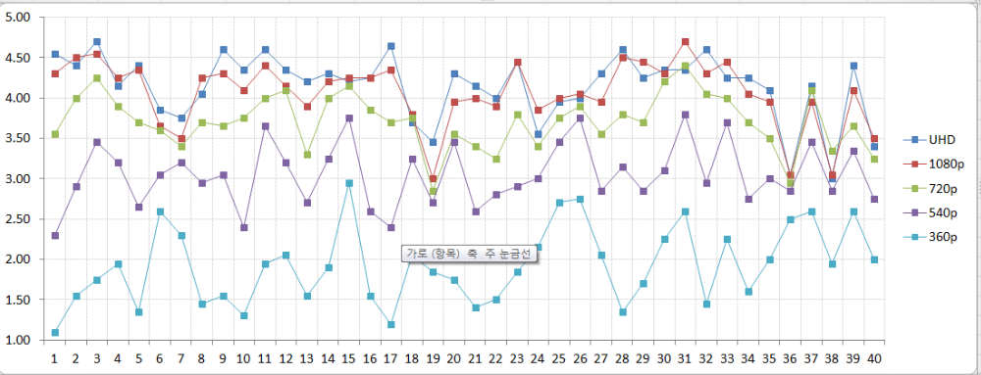
EXP #1 (STILL IMAGES)

Slide 5
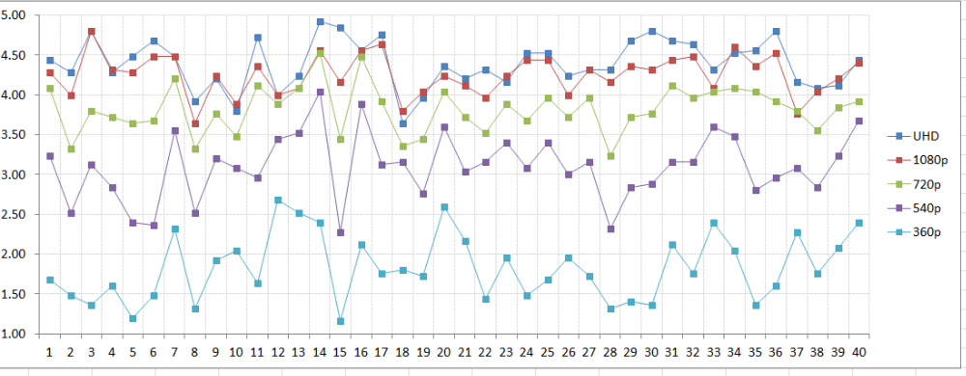
EXP #2 (STILL IMAGES)

Slide 6
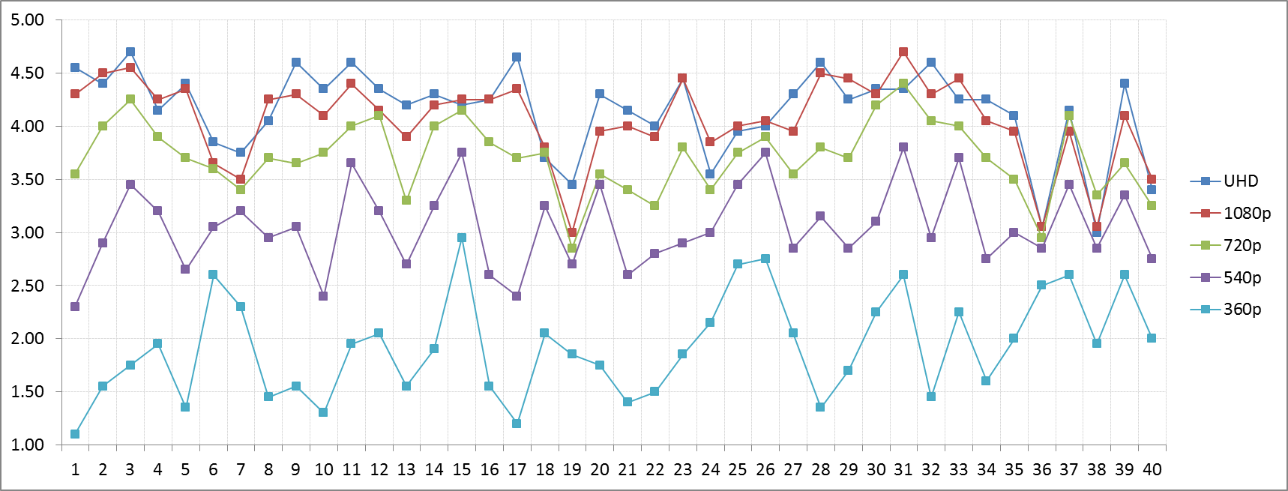
EXP #3 (VIDEO)

Slide 7
Exp #1: STILL IMAGES

Slide 8
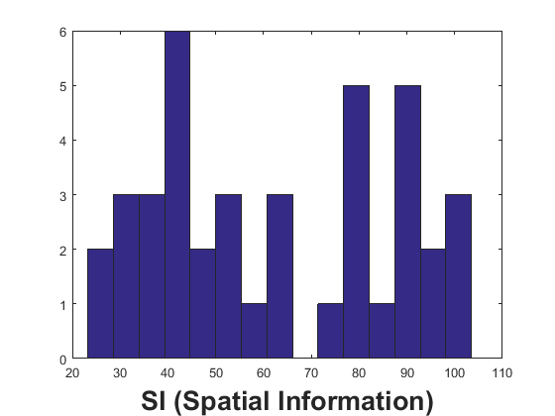
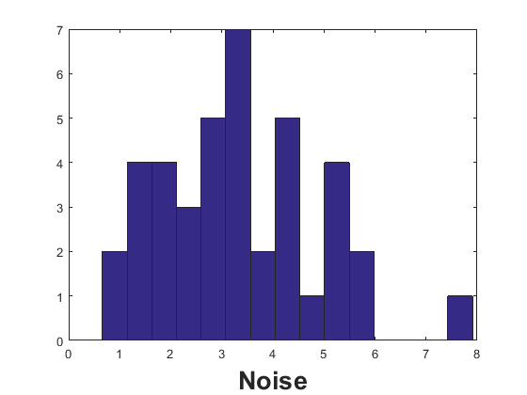
  SRC distribution (SI & Noise)
UHD is better
1080p is better
  Histograms

Slide 9
  Noise Measurement Algorithm
  Tai, Shen-Chuan, and Shih-Ming Yang "A fast method for image noise estimation using Laplacian operator and adaptive edge detection," Communications, Control and Signal Processing, ISCCSP 2008. 3rd International Symposium on. IEEE, 2008.

Slide 10
  Works to be done
  UHD sources and subjective tests
  New Recommendation: J.q-uhd
    Tools to measure UHD signals
    Methods to monitor UHD signals
  New/Revised Recommendations for UHD/HDR
    Display requirements
    Source availability
    Revision or new competition

