Slide 1
RICE Project
Sebastian Arndt, Eva Cheng, Kjell Brunnström, Ulrich Engelke, Yasuhiro Inazumi

Slide 2
Outline
Introduction in EEG
Previous research
Ideas for joint study

Slide 3
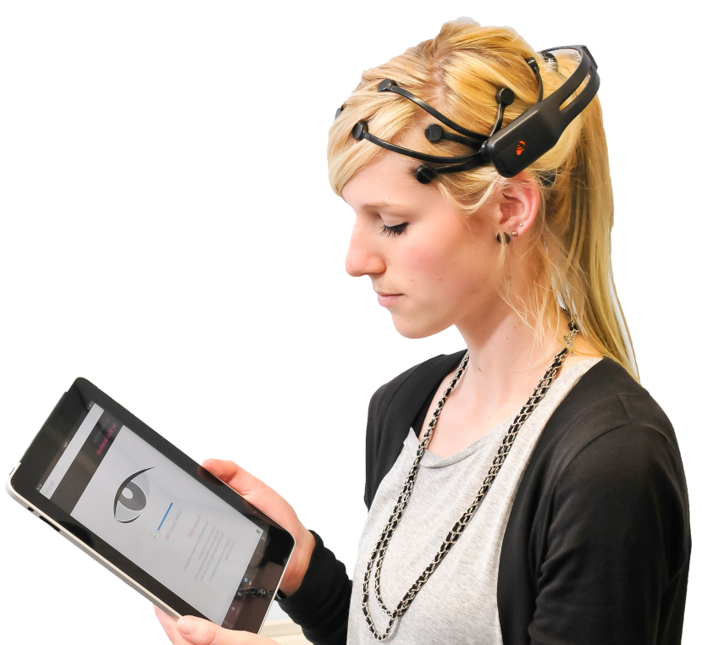
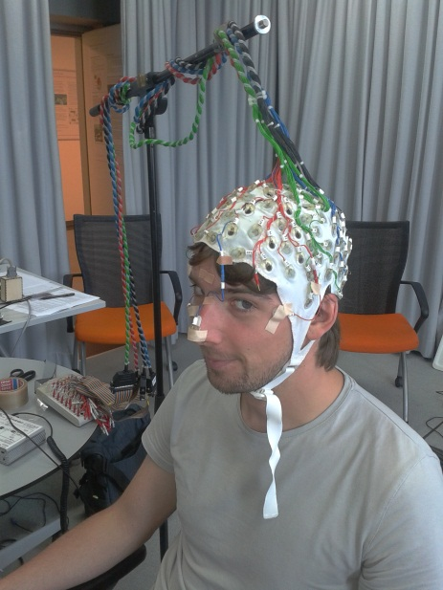
What is EEG?
Measures brain activity using electrodes

Slide 4
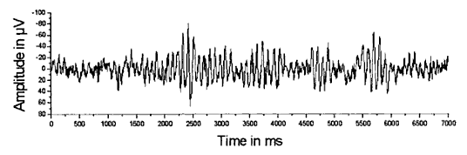
Analyzing technique
Analyzing frequency band power
Different frequency bands indicate different cognitive states
Band | Frequency [Hz] | Functionality
Theta | 4 – 8 | Drowsiness, impaired information processing
Alpha | 8 – 13 | Alertness decrease, fatigue

Slide 5
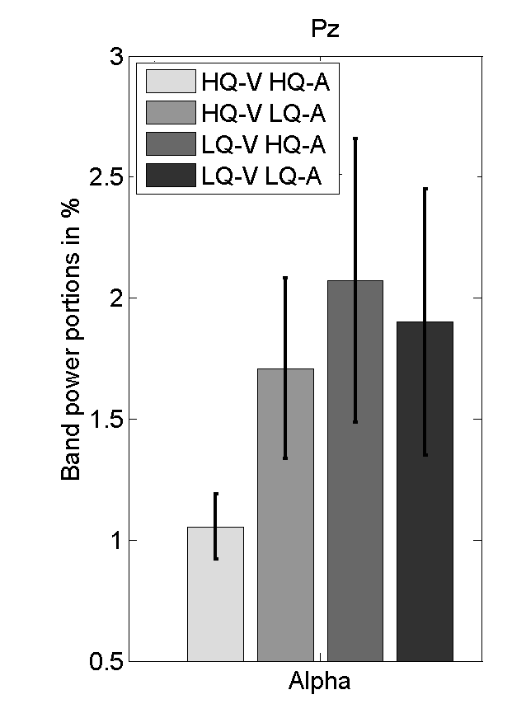
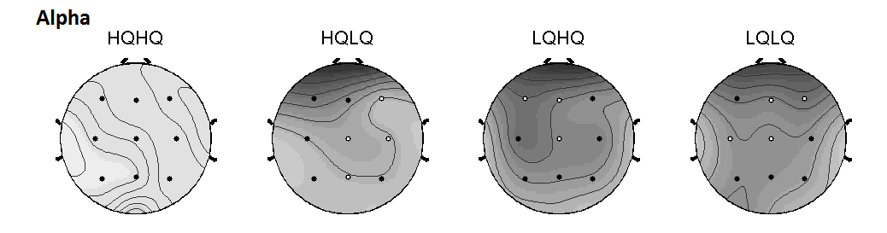
Previous research
Varying quality (audio and video) showed increase in α for LQ sequences
→ increased fatigue for LQ
  compared to HQ

Slide 6
RICE study

Slide 7
Goal
Interlab study
Having different grade EEG devices
Transfer methodology to very realistic stimuli on already evaluated sequences
Show feasibility using different devices and labs

Slide 8
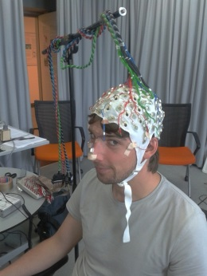

Devices
Clinical devices
  @ approx. US$1000/channel
  Very high data quality
  Very expensive
Consumer grade products (e.g. https://emotiv.com/)
  @ US$400
  Poor data quality
  Quite cheap

Slide 9
Possible Stimulus Material
5min stimulus material
Several sources (approx. 5)
3 levels of distortion (none, medium, highly distorted)
Constant bit rate
→ perform frequency analysis on EEG data

Slide 10
Experiment
Subjective quality rating after each video
Approx. 10s baseline before each trial (add. 5min baseline at the beginning of experiment)
→ ~80min testing time
→ including questionnaires, and preparation <2h for one experimental session

Slide 11
Idea
some labs testing on clinical devices, some on consumer grade devices
TUB testing on both devices → bringing best transferability of the interlab/interdevice study

Slide 12
Points for Discussion
Source video: 5 min length; open source; approx. 5 sequences
Resolution: at least 1080p
Coding: Which codecs? Can anyone help encoding the videos?
Subjective method: probably ACR
Number of test subjects: approx. 24 per lab
Relevant ITU Rec.: ITU-T Rec. P.913 for subjective method;
No Standards for EEG testing
Viewing condition: Lab, ideally P.911 conform room
Inventory of Labs with equipment: did last time but reiterate
Inventory of Labs with interest to participate: did last time but reiterate
Ethical approval: each lab needs to check individually

Slide 13
Open Questions (From Last Meeting)
Who has open source video material to provide for this study?
Who would be interested in participating?
  So far:
Lab | Consumer Device | Clinical Device
ACREO
CSIRO
RMIT | X | X
TU Berlin | X | X

