Slide 1
Monitoring of Audio-Visual Quality by Key Indicators (MOAVI)
Mikołaj Leszczuk, Jakub Nawała and Kais Rouis

Slide 2
  Presentation Plan
Reminder on MOAVI
Report for 2015H1
Plans for 2015H2

Slide 3
Reminder on QART and Target Recognition Video (TRV)

Slide 4
  VQEG’s Subproject: MOAVI
Mission:
“To collaboratively develop No-Reference (NR) models for monitoring individual audio-visual service quality artefacts”
Goals:
  To develop set of key indicators describing service quality in general and by removing implementation constraint
  To select subsets for each potential application
  To concentrate on models based on key indicators contrary to models predicting overall visual quality

Slide 5
  MOAVI Co-Chairs
Silvio Borer
  SwissQual, Zuchwil, Switzerland
  Silvio.Borer@rohde-schwarz.com
Mikołaj Leszczuk
  AGH University of Science and Technology, Krakow, Poland
  leszczuk@agh.edu.pl

Slide 6
  Signal-Based, NR Indicators for Artefacts of Various Origin
Capturing Artefacts: blurriness, exposure, interlace, etc.
Processing Artefacts: blockiness, blurriness, flickering, reduced spatial and temporal resolution, etc.
Transmission Artefacts: blackout, block loss, freezing, slicing, etc.
Displaying Artefacts: blackout, slicing,
etc.

Slide 7
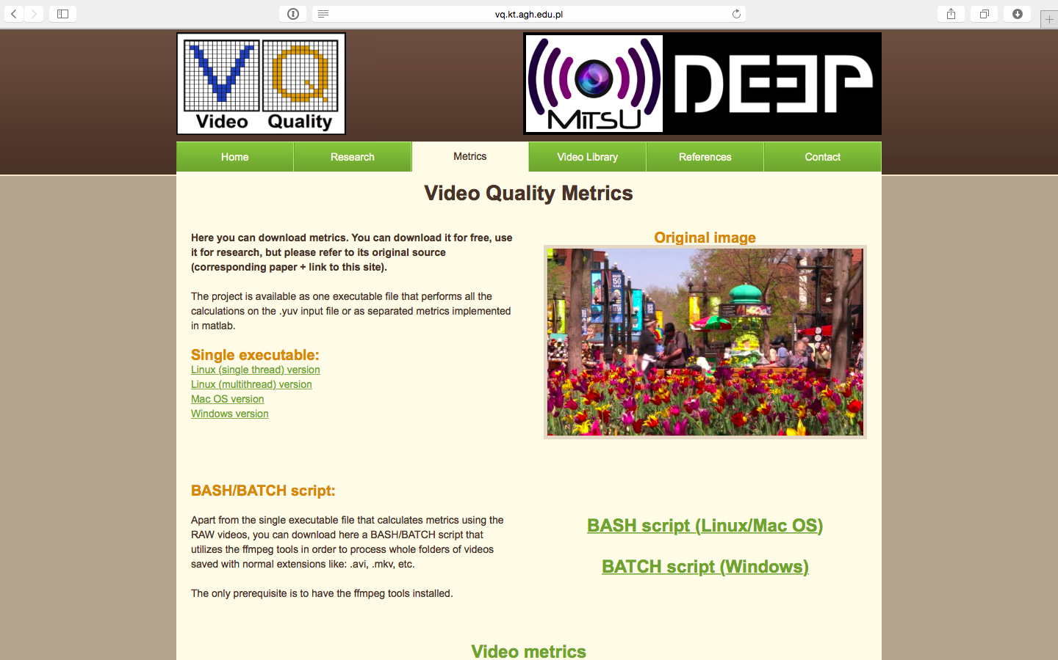
  Free Audio-Video Quality Indicators Online at http://vq.kt.agh.edu.pl/

Slide 8
Report for 2015H1

Slide 9
  Major Changes for Selected Indicators
Normalization of results returned by Interlace indicator
New Flickering indicator algorithm
  Based on: “Perceptual Quality Assessment for H.264/AVC Compression” (P. Romaniak et al.)
  Indicator counts on following N frames, where N is parameter defined in code allowing to change scope of implementation
New Contrast indicator algorithm
  Based on: “Contrast in Complex Images” (E. Peli)
  New indicator proved to be more independent from content present in picture
  Indicator normalized so as to be independent of resolution

Slide 10
  Optimizing Performance of All Metrics by Improving Algorithms
Blackout
Block loss
Blockiness
Bluriness
Contrast
Brightness (now merged with Blackout to achieve even better execution times)
Exposure
Freezing
Interlace
Letter-box
Noise
Pillar-box
Slicing
Spatial Activity
Temporal Activity

Slide 11
  Multiplatform, Multithread Implementation in C
Optimization by transferring implementation from C++ to C
Porting to most popular platforms:
  Linux
  Windows
  Mac OS
Using C macros – enough to change compiler and put flag to compile for target platform
Development of multithreaded version of project
  Creation of multi-threaded version significantly reducing execution time, using POSIX Threads library
  This version, for compatibility reasons with abovementioned standard, available only on UNIX platforms:
    Linux
    Mac OS

Slide 12
  Creating User-Friendly Bash and Batch Shell Scripts for Counting Indicators
Using FFmpeg package to enable user of calculating indicators on files in format other than YUV
Using FFmpeg package to automate indicators counting process for remote reading out video features:
  Width
  Height
  Frames Per Second (FPS)
Recording results in Comma Separated Values (CSV) in order to allow their analysis in e.g. spreadsheets
Enabling counting indicators on all video files present in specified folder

Slide 13
  Maintenance of Webpage: http://vq.kt.agh.edu.pl/
Merging “Science” tab with “Video Library” tab
Upgrading existing references to scientific papers
Removing references to non-existent indicators
Adapting “Metrics” tab by:
  Broadening its content with user-friendly scripts to facilitate use of indicators, and
  Attaching executable files counting indicators for video sequences in YUV format
Refreshing Webpage multimedia content (mostly attachments in form of video sequences from official account on YouTube)
Updating content contained on Webpage (descriptions of bookmarks/sub-tabs)

Slide 14
  Inclusion of MOAVI Source Codes and Scripts to JEG-Hybrid Virtual Machine
Creating documentary short description for each indicator
Description given as comment at beginning of each source file

Slide 15
  Experimenting with High Efficiency Video Coding (HEVC) Compression
Experimenting with existing H.264 quality assessment indictors for HEVC
Objectively estimated perceptual quality of set of processed video sequences
Typical distortions introduced by HEVC block-based coding approaches:
  Blockiness
  Blurriness
Correlation between NR quality indicators and Video Quality Model (VQM), performed to validate accuracy
Quick, basic experiment – 1 month only

Slide 16
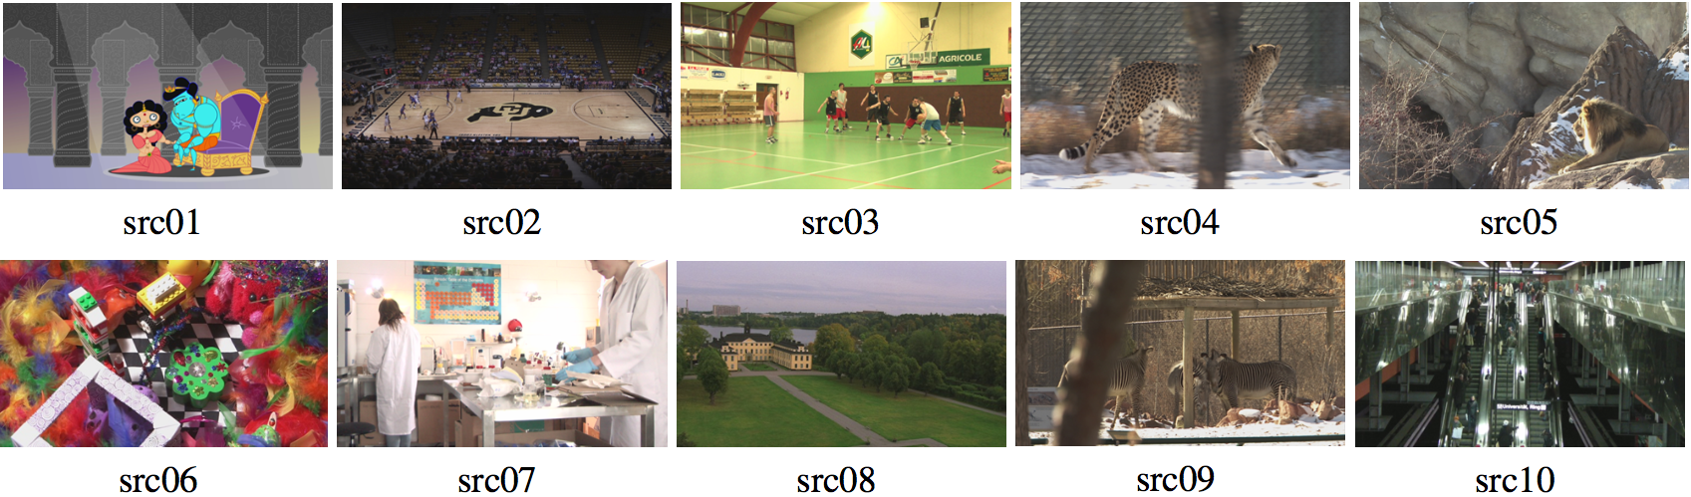
  Source Reference Circuits for HEVC Experiment
10 SRC video sequences
Based on: “Subjective Experiment Dataset for Joint Development of Hybrid Video Quality Measurement Algorithms” (M. Barkowsky et al.)

Slide 17
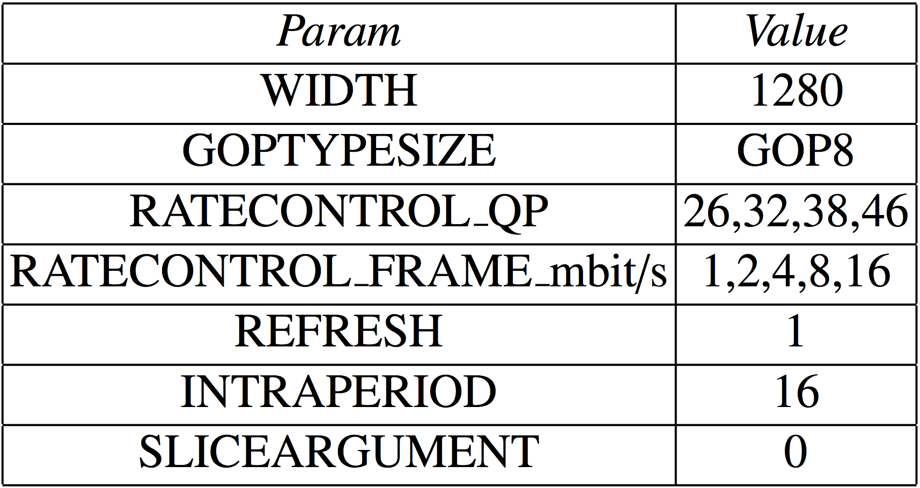
  Hypothetical Reference Circuits for HEVC Experiment
9 HRC video compression scenarios
Based on: “Full-HD HEVC-Encoded Video Quality Assessment Database” (G. Van Wallendael et al.)

Slide 18
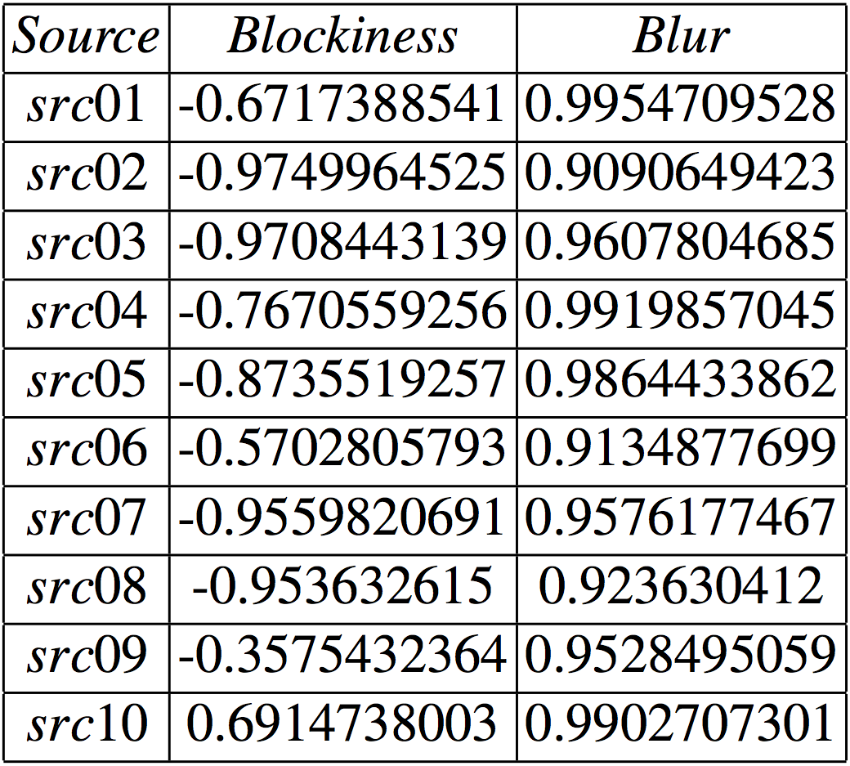
  Pearson Correlation Coefficients with VQM for HEVC Experiment

Slide 19
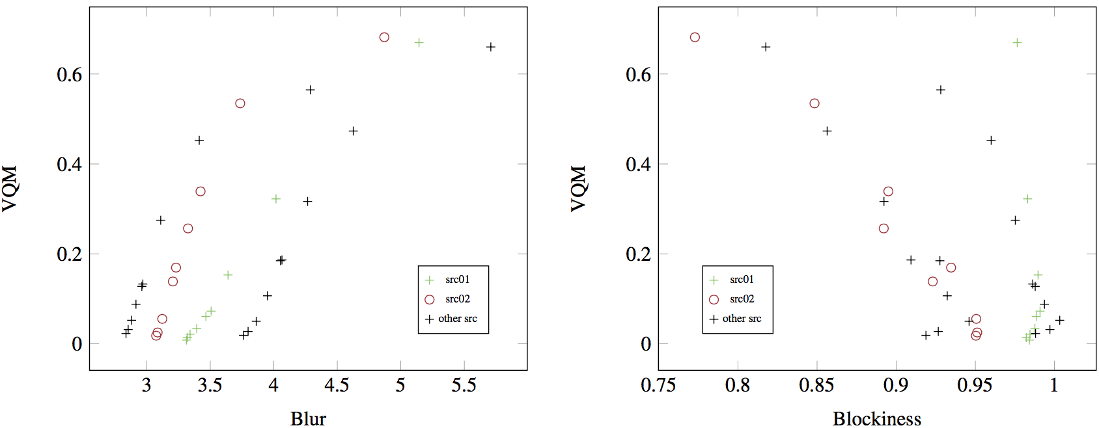
  Correlation with VQM for Selected vs. Other SRC for HEVC Experiment

Slide 20
  Cooperation with External Students, PhD Students and Other Academics
Hamed Ahmadi, University of Tehran, Iran
David Cassany Viladomat, i2Cat, Spain
Steve Sciandra, freelancer, USA
Helard A. Becerra Martinez, Universidade de Brasilia, Brasil
Kais Rouis, Université de Tunis El Manar, Tunisia
Jacob Søgaard, Technical University of Denmark, Denmark

Slide 21
Plans for 2015H2

Slide 22
  Plans for 2015H2
…
Further experimenting with HEVC

Slide 23
Thank You!
http://mitsu-project.eu/

