Slide 1
Video HDR Camera Characterization
Report
Elaine Jin, Hanan Alnizami, & Philip Corriveau
Intel Corp
September, 2015

Slide 2



Definition of HDR Scene
Real world scenes can exceed 200dB in dynamic range. However, current CMOS sensors can only capture up to 60dB (10bit).
In this context, a real-world scene is called high dynamic range (HDR) scene if the luminance contract ratio of the scene exceeds 60dB, as illustrated below.
118dB
100dB
102dB
Image source: http://rit-mcsl.org/fairchild/HDRPS/HDRthumbs.html

Slide 3
Definition of HDR Capture
Scene-based definition
  The resolvable scene dynamic range for a HDR capture is higher than that for a regular (i.e. SDR) capture.
Image-based definition
  HDR capture preserves more of highlight and shadow details than a SDR capture while the mid-tone contrast gets reduced.
Process-based definition
  HDR capture uses two or more exposures to form a compost image/video with the goal of extending the capture dynamic range.

Slide 4

Dynamic Range Test Chart
Patch 1 - white
TE 241
OECF – 20 patches
Transmissive target
80dB (10,000:1)
Patch 20 - black

Slide 5
Test Devices – 3 Smartphones
Device ID | Type | Release Year | World-facing Camera | User-facing Camera
#1 | Global Tier1 | 2015 | 16MP Video HDR On/Off | 5MP Video HDR Neutral
#2 | Global Tier1 | 2014 | 8MP Video HDR Neutral | 1MP Video HDR Neutral
#3 | Regional OEM | 2014 | 13MP Video HDR On/Off | 8MP Video HDR Neutral
* Video HDR Neutral means when using video mode there is no HDR ON/OFF switch.

Slide 6
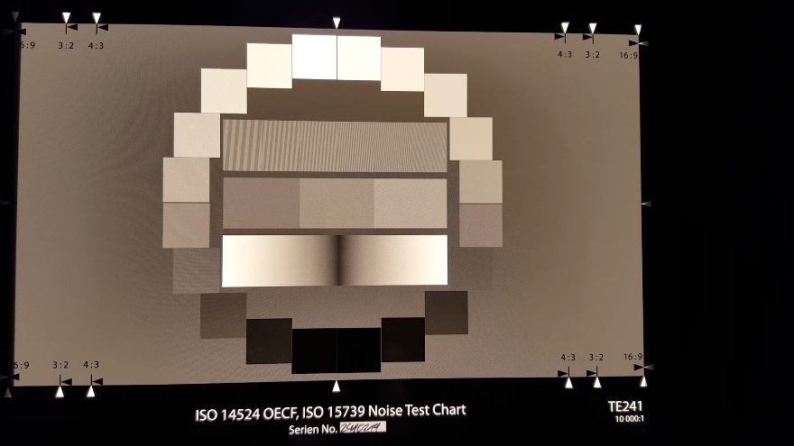
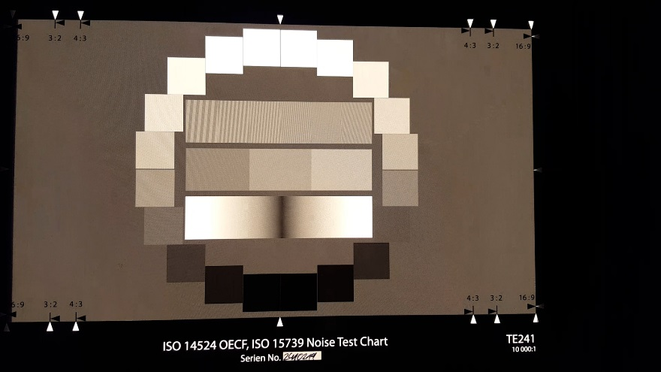
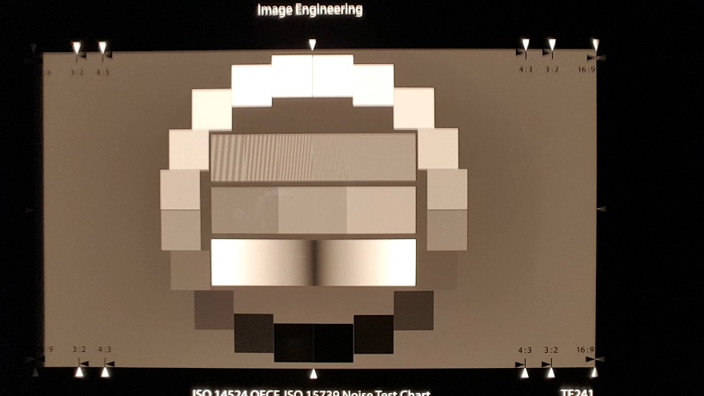
Test Device #1 Images
World-facing HDR ON
World-facing HDR OFF
User-facing HDR Neutral

Slide 7
Test Device #1 Results
World-facing camera has strong HDR effect
User-facing camera has marginal HDR effect
Smooth tone curve indicating high tonal quality

Slide 8
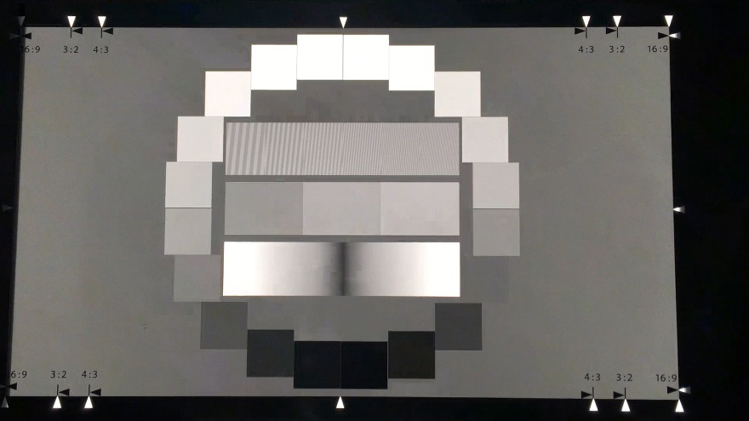
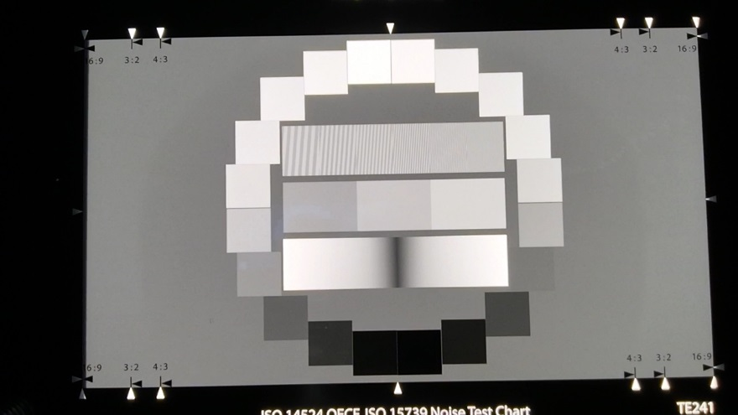
Test Device #2 Images
World-facing HDR Neutral
User-facing HDR Neutral

Slide 9
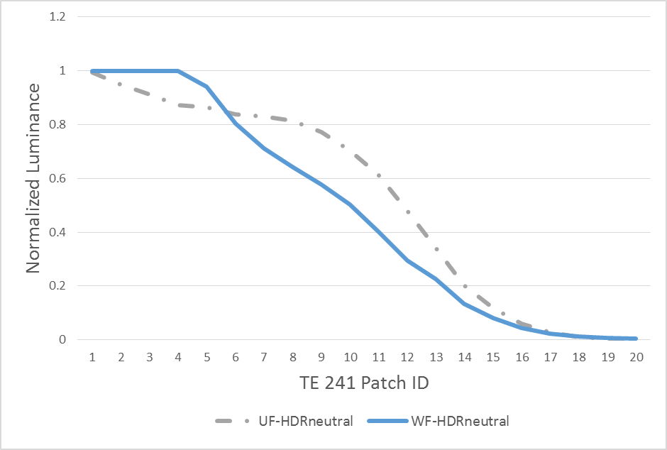
Test Device #2 Results
World-facing camera has no visible HDR effect
User-facing camera has strong HDR effect, tuned for applications such as video conferencing?
Smooth tone curve indicating high tonal quality

Slide 10

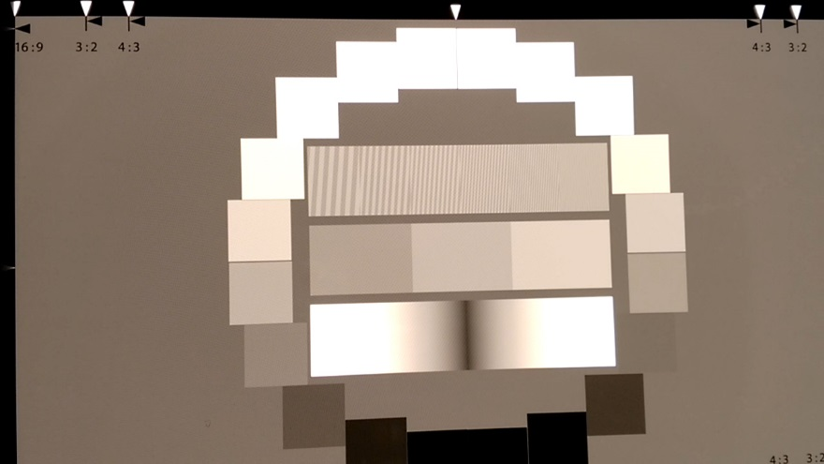
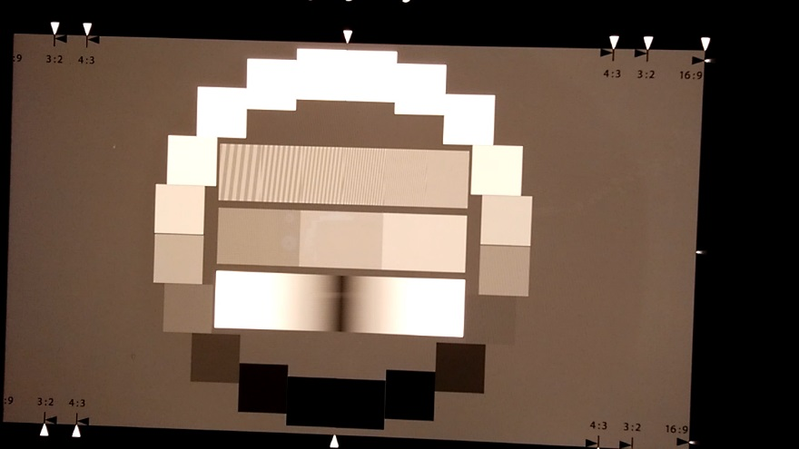
Test Device #3 Images
World-facing HDR ON
World-facing HDR OFF
User-facing HDR Neutral

Slide 11
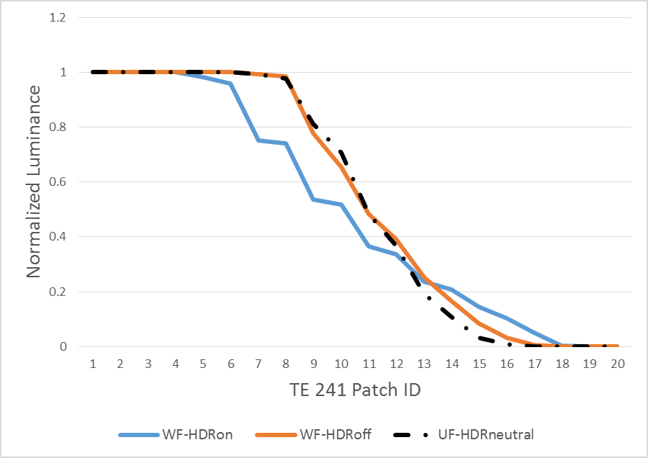
Test Device #3 Results
World-facing camera has strong HDR effect
User-facing camera has no HDR effect
Jagged tone curve indicating low tonal quality

Slide 12
Summary of Results
Device | Camera | HDR Effect | Comments
#1 | World-facing | Strong
 | User-facing | Marginal
#2 | World-facing | None
 | User-facing | Strong | Optimized for video conferencing?
#3 | World-facing | Strong | Bad tonal quality
 | User-facing | None

Slide 13
Conclusions
Currently different smartphone OEMs seem to adopt different strategies for implementing the video HDR feature
  Some OEMs use video HDR on world-facing cameras, while others use video HDR on user-facing cameras.
There is strong evidence showing that video HDR is tuned for specific applications, i.e. video conferencing.
The differentiation of quality of video HDR is determined by the resolvable scene dynamic range as well as the smoothness of the tone curve.

