Slide 1
Experiment Report for
GroTruQoE3D phase I
Jing LI
Marcus Barkowsky
University of Nantes, France

Slide 2
Scope and goals
Establish a ground truth database for Quality of Experience in 3DTV (GroTruQoE3D) measurement methodologies
Standardization of subjective assessment methodology for different degradations in 3DTV

Slide 3
Video sequences-SRC
11 SRC
Cover a wide range of different content features
coding complexity
motion
brightness
3D effect
maximum disparity range
YUV422, Full HD, 25fps, 16seconds (except “Umbrella” 13 seconds)
Comfortable viewing

Slide 4
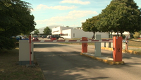



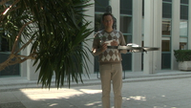
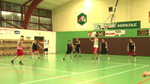
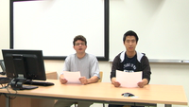

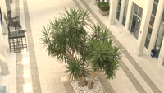

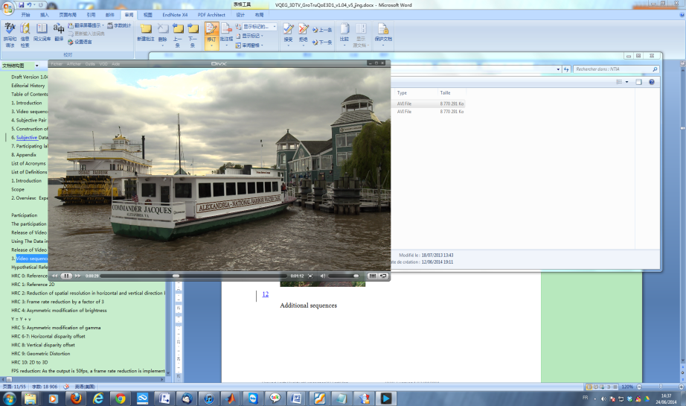
1
2
3
4
5
6
7
8
9
10
11
Sequences are from:
UdN+UPM
NICT
NTIA
Notes:
Sequences are from University of Nantes, NICT (National Institute of Information and Communication Technology), and NTIA (National Telecommunications and Information Administration)

Slide 5
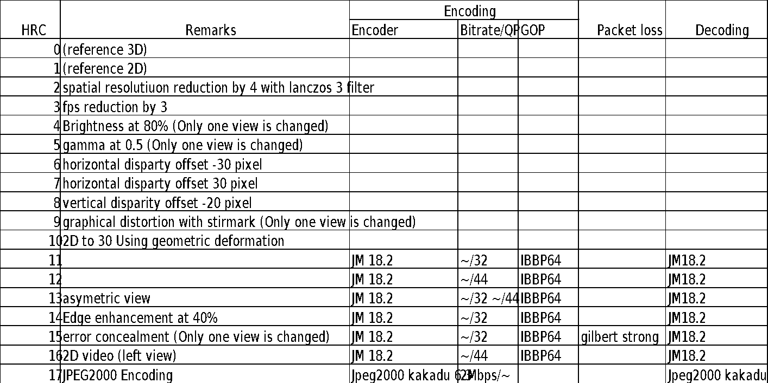
Video sequences-HRC
18 HRC: Selected based on three scales: “image quality”, “visual comfort” and
“depth quantity” *
*The selection was performed based on votes from experts from the Mid Sweden University (MIUN)
Details see https://docs.google.com/spreadsheet/ccc?key=0ArzgrjHcemZYdHk3ZGhOZ0w0VzFHblA1M0ROLTJCQ1E#gid=2

Slide 6
Participating labs – phase I
 | Display | Technology | Size | Number of Observer | Test method | Viewing distance
IRCCyN/IVC | 'Philips 46PFL9705H 46' | Shutter glasses | 46' 1920*1080 | 40 | Side by Side | 3h
UPM | 'LG DM2350D-PZ' | Polarized | 23' 1920*1080 | 40 | Side by Side | 4.5h
Yonsei | - | - | - | 40 | Time-sequential | 3h
Tlabs | 'Samsung UE40ES8000/8090' | Shutter glasses | 101cm 1920*1080 | 40 | Time-parallel on one screen | 3h
INSA | samsung SMART LED-TV | Shutter glasses | 40’ 1920*1080 | 40 | Time-sequential | 3h
Display information is unknown for Yonsei university

Slide 7
Experimental results
Analysis on common set, i.e.
- SRC1, SRC2
- 9HRCS: HRC5, 6, 7, 8, 9, 10, 12, 14, 16
18 HRC pairs * 2 SRCs = 36 pairs
Each pair is compared by 20 observations

Slide 8
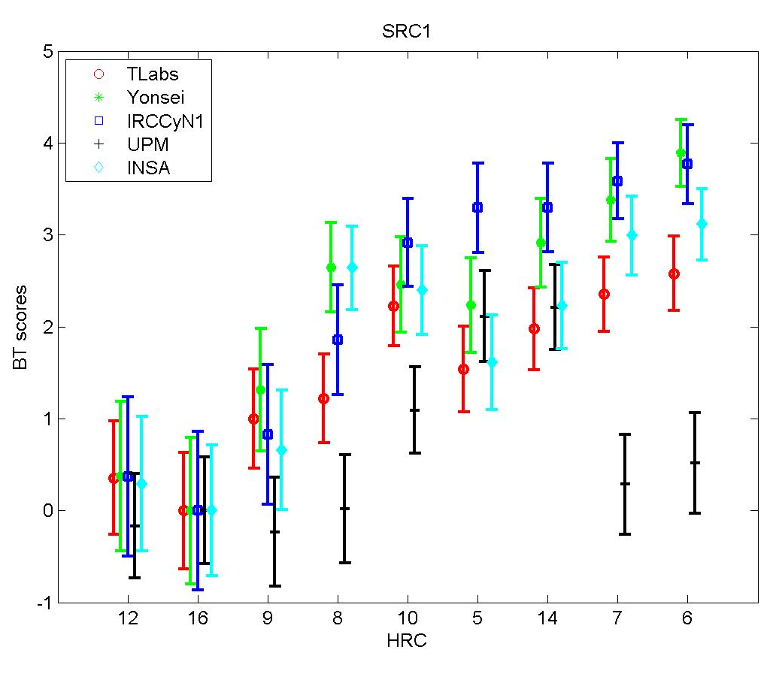
Results: Bradley-Terry score SRC1
RMSE | Yonsei | IVC | UPM | INSA
Tlabs | 0.38 | 0.23 | 0.59 | 0.45
Yonsei |  | 0.47 | 0.70 | 0.21
IVC |  |  | 0.59 | 0.41
UPM |  |  |  | 0.43
PLCC | Yonsei | IVC | UPM | INSA
Tlabs | 0.95 | 0.99 | 0.75 | 0.91
Yonsei |  | 0.94 | 0.62 | 0.98
IVC |  |  | 0.75 | 0.93
UPM |  |  |  | 0.92
ROCC | Yonsei | IVC | UPM | INSA
Tlabs | 0.92 | 0.95 | 0.63 | 0.90
Yonsei |  | 0.93 | 0.55 | 0.95
IVC |  |  | 0.68 | 0.85
UPM |  |  |  | 0.43
HRC16 set as reference → BT score = 0

Slide 9
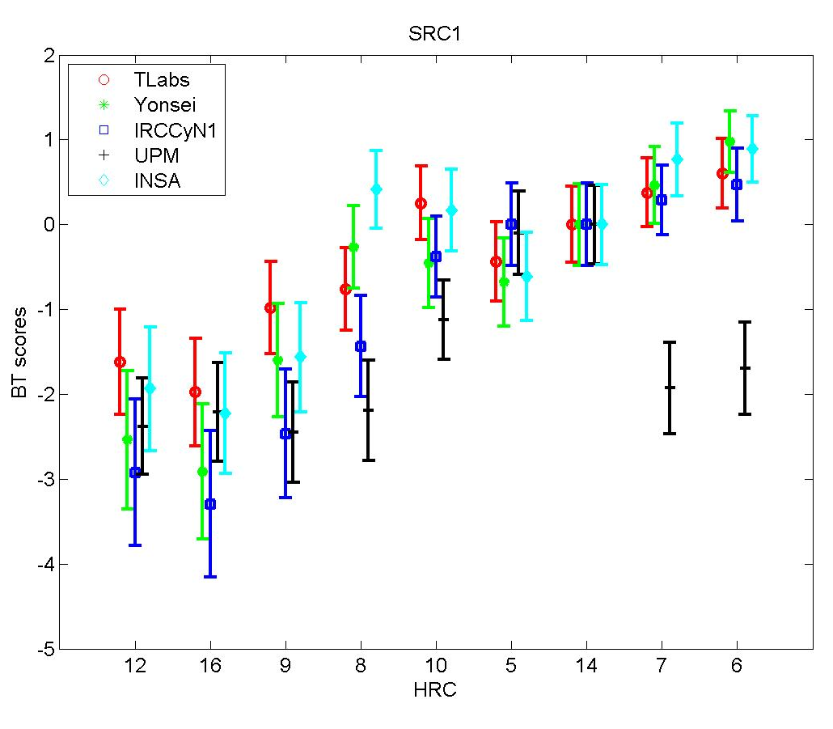
Results: Bradley-Terry score SRC1
HRC16 set as reference → BT score = 0
HRC14 set as reference → BT score = 0
HRC16: 2D left view, jm18.2, QP44
Previous cross-lab studies have shown high correlation for 2D coding only
HRC14: edge enhancement 40%, jm18.2, QP32
This is supposed to be the highest quality
Another possible solution: minimize the average distance between the BT scores of labs.
Notes:
Found out the reference which gives the least distance among
Min sum_labx,laby,hrcv(m[labx,hrcy]-m[laby,hrcv])

Slide 10
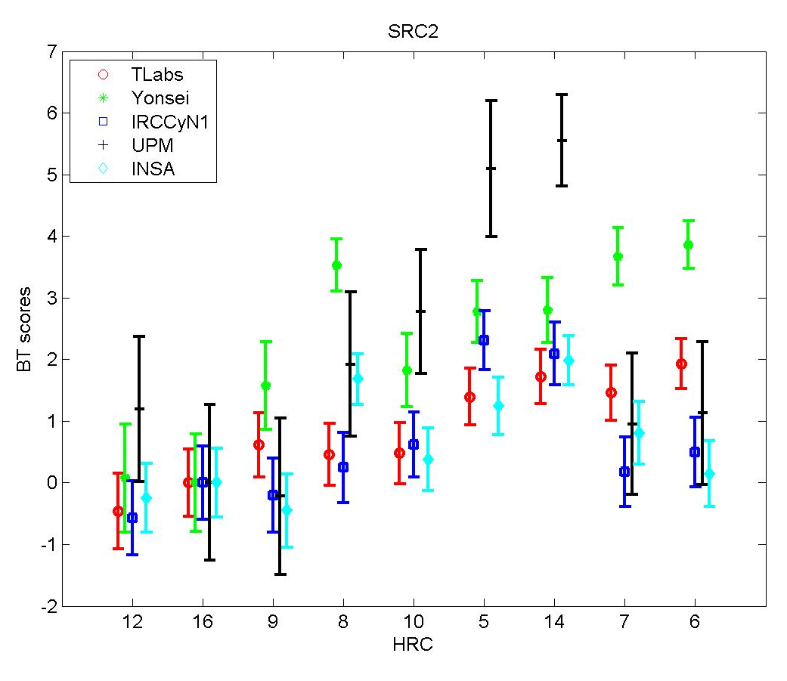
Results: Bradley-Terry score SRC2
RMSE | Yonsei | IVC | UPM | INSA
Tlabs | 0.69 | 0.69 | 1.67 | 0.70
Yonsei |  | 0.71 | 1.52 | 0.49
IVC |  |  | 0.85 | 0.55
UPM |  |  |  | 0.51
PLCC | Yonsei | IVC | UPM | INSA
Tlabs | 0.86 | 0.67 | 0.52 | 0.51
Yonsei |  | 0.65 | 0.62 | 0.79
IVC |  |  | 0.90 | 0.74
UPM |  |  |  | 0.78
ROCC | Yonsei | IVC | UPM | INSA
Tlabs | 0.77 | 0.58 | 0.20 | 0.40
Yonsei |  | 0.47 | 0.23 | 0.57
IVC |  |  | 0.78 | 0.77
UPM |  |  |  | 0.77

Slide 11
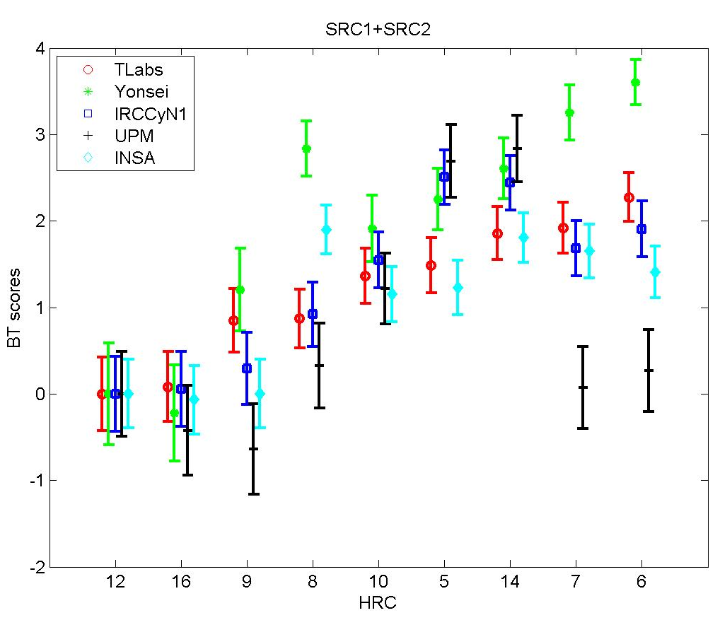
Results: Bradley-Terry score SRC1+SRC2
RMSE | Yonsei | IVC | UPM | INSA
Tlabs | 0.49 | 0.31 | 0.88 | 0.47
Yonsei |  | 0.44 | 0.94 | 0.16
IVC |  |  | 0.45 | 0.23
UPM |  |  |  | 0.23
PLCC | Yonsei | IVC | UPM | INSA
Tlabs | 0.92 | 0.94 | 0.68 | 0.79
Yonsei |  | 0.88 | 0.62 | 0.98
IVC |  |  | 0.93 | 0.95
UPM |  |  |  | 0.95
ROCC | Yonsei | IVC | UPM | INSA
Tlabs | 0.88 | 0.85 | 0.53 | 0.67
Yonsei |  | 0.67 | 0.45 | 0.85
IVC |  |  | 0.78 | 0.62
UPM |  |  |  | 0.63
Notes:
Today I have been checking the sequences and they seem to show what they should. I have watched them in the small polarized screen that we used in the tests and also in a bigger screen with active shutter glasses. To me, it seems that in the TV with active shutter glasses they are less annoying (maybe easier to converge), but also I have noticed that with the small polarized screen you can perceive more crosstalk (and it changes with small movements of the head). I'm not so sure about this, but maybe, this also influenced the observers, and apart from the size and viewing distance, also the technology may affect.

Slide 12

Analysis on BT scores
The sig. diff. part of BT scores among all labs are:
HRC6, HRC7, and HRC8
Yonsei: Observers much preferred HRC6,7,8
UPM: Observers much unpreferred HRC6,7,8
Notes:
Today I have been checking the sequences and they seem to show what they should. I have watched them in the small polarized screen that we used in the tests and also in a bigger screen with active shutter glasses. To me, it seems that in the TV with active shutter glasses they are less annoying (maybe easier to converge), but also I have noticed that with the small polarized screen you can perceive more crosstalk (and it changes with small movements of the head). I'm not so sure about this, but maybe, this also influenced the observers, and apart from the size and viewing distance, also the technology may affect.

Slide 13
Barnard’s exact test
Compare each two labs’ pair comparison data
→ how many pairs are sig. different between the two labs
We have 36 common set pairs in total:
For SRC1 → 18 pairs
For SRC2 → 18 pairs

Slide 14
Data analysis
Common set
→ cross-lab results verification
Barnard’s exact test
Ratio of significant
different pairs
HRC pair | Lab 1 | Lab2 | Sig.diff
5 vs 7 | 5/20 | 6/20 | NO
5 vs 8 | 8/20 | 7/20 | NO
6 vs 7 | 10/20 | 10/20 | NO
6 vs 8 | 7/20 | 9/20 | NO
7 vs 10 | 3/20 | 9/20 | YES
7 vs 12 | 14/20 | 13/20 | NO
8 vs 9 | 11/20 | 10/20 | NO
…

Slide 15
Raw pair comparison data
HRC pair |  | IVC | INSA | UPM | TLAB | YONSEI
16 | 14 | 0 | 2 | 2 | 3 | 2
16 | 10 | 8 | 10 | 9 | 6 | 5
14 | 10 | 29 | 26 | 31 | 27 | 29
12 | 6 | 7 | 7 | 15 | 3 | 2
12 | 7 | 7 | 9 | 19 | 8 | 3
6 | 7 | 20 | 16 | 22 | 20 | 22
9 | 8 | 13 | 4 | 11 | 22 | 5
9 | 5 | 5 | 11 | 1 | 15 | 9
8 | 5 | 6 | 23 | 4 | 14 | 24
16 | 12 | 23 | 19 | 12 | 22 | 15
16 | 9 | 18 | 22 | 23 | 17 | 10
12 | 9 | 17 | 18 | 25 | 11 | 4
14 | 6 | 22 | 20 | 38 | 12 | 9
14 | 8 | 32 | 20 | 39 | 28 | 17
6 | 8 | 30 | 12 | 18 | 31 | 28
10 | 7 | 18 | 19 | 32 | 16 | 9
10 | 5 | 13 | 16 | 6 | 17 | 19
7 | 5 | 10 | 29 | 4 | 25 | 30
All labs have similar preference on HRC14 vs HRC10
In INSA,
2 out of 40 observations chose HRC16
INSA’s preference on HRC8 is much higher than UPM
For the pair HRC16 vs HRC14, in IVC, 0 out of 40 observations chose HRC16.

Slide 16
Barnard’s test: ratio of sig. diff. pairs
SRC1 | Yonsei | IVC | UPM | INSA
Tlabs | 0.05 | 0.24 | 0.41 | 0.11
Yonsei |  | 0.17 | 0.58 | 0.05
IVC |  |  | 0.41 | 0.23
UPM |  |  |  | 0.53
SRC2 | Yonsei | IVC | UPM | INSA
Tlabs | 0.29 | 0.24 | 0.58 | 0.35
Yonsei |  | 0.64 | 0.71 | 0.42
IVC |  |  | 0.41 | 0.23
UPM |  |  |  | 0.47
All | Yonsei | IVC | UPM | INSA
Tlabs | 0.17 | 0.24 | 0.49 | 0.23
Yonsei |  | 0.41 | 0.64 | 0.23
IVC |  |  | 0.41 | 0.23
UPM |  |  |  | 0.50
This table shows that between 17% and 64% of pairs lead to two statistically sig. different percentage values of preference
Does not mean an inversion of preference for the two compared conditions
Voting errors are not taken into consideration

Slide 17
Schedule
2014
2015
2016
Sept
Nov
Mar
July
Sept
Oct
Dec
Jan
Mar
May
Preparation of test setup, distribution of playlist
Preparation
Selected labs which have rich experiences on 3D test
Lab group1
Analysis of
Group1’s
results
Preliminary-evaluation on test results
Lab group2
(the rest)
All the rest labs
Data exchange and analysis
Data analysis
Report
Release

Slide 18
Participating labs
LAB | YES/NO | Method* | Phase I | Phase 2
Yonsei | Y | S | X
UPM | Y | P | X
IVC | Y | P | X
INSA | Y | S | X
T-labs | Y | P* | X
Vittorio | Y | S |  | X
IVC | Y | P |  | X
NTIA | Y | S |  | X
BskyB | Y | S |  | X
?
*Method: time-parallel (P) or time-sequential (S)

