Slide 1
RICE Project
Sebastian Arndt, Kjell Brunnström,
Ulrich Engelke, Yasuhiro Inazumi

Slide 2
Outline
Introduction in EEG
Previous research
Ideas for joint study

Slide 3
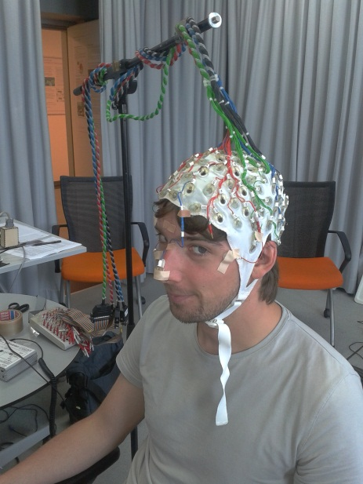
What is EEG?
Measures brain activity using electrodes

Slide 4
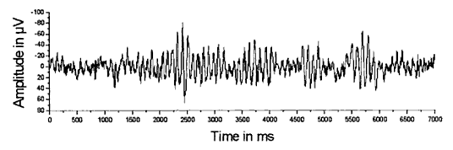
Analyzing technique
Analyzing frequency band power
Different frequency bands indicate different cognitive states

Slide 5
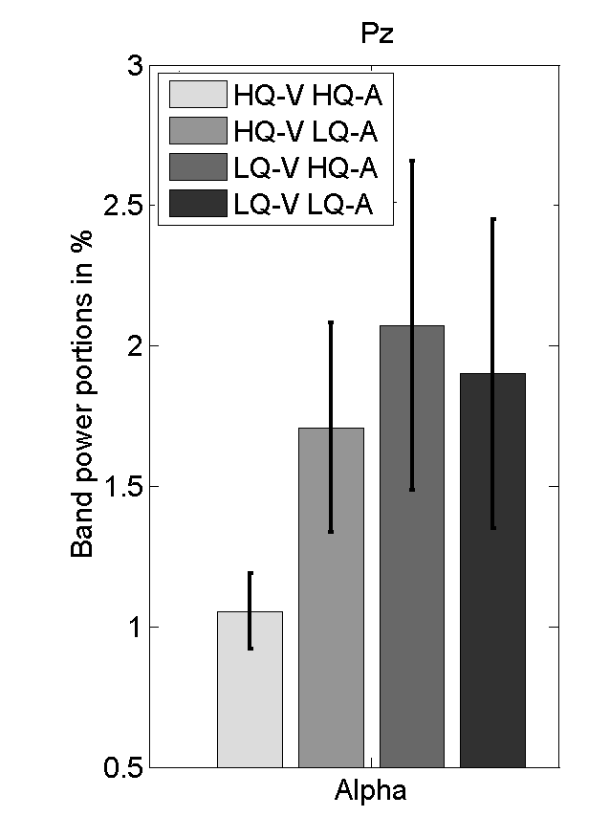
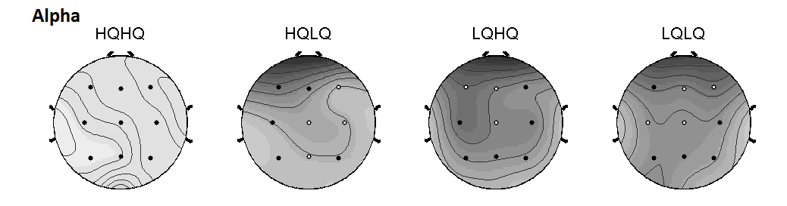
Previous research
Varying quality (audio and video) showed increase in α for LQ sequences
→ increased fatigue for LQ
compared to HQ

Slide 6
RICE study

Slide 7
Goal
Interlab study
Having different grade EEG devices
Transfer methodology to very realistic stimuli on already evaluated sequences
Show feasibility using different devices and labs

Slide 8
Devices
Clinical devices
  @ approx. US$1000/channel
  Very high data quality
  Very expensive
Consumer grade products (e.g. https://emotiv.com/)
  @ US$400
  Poor data quality
  Quite cheap

Slide 9
Possible Stimulus Material
5min stimulus material
Several sources (approx. 5)
3 levels of distortion (none, medium, highly distorted)
Constant bit rate
→ perform frequency analysis on EEG data

Slide 10
Experiment
Subjective quality rating after each video
Approx. 10s baseline before each trial (add. 5min baseline at the beginning of experiment)
→ ~80min testing time
→ including questionnaires, and preparation <2h for one experimental session

Slide 11
Idea
some labs testing on clinical devices, some on consumer grade devices
TUB testing on both devices → bringing best transferability of the interlab/interdevice study

Slide 12
Timeline
Sept 2015: having test plan ready
Oct 2015: starting subjective tests

Slide 13
Open Questions
Who has open source video material to provide for this study?
Who would be interested in participating?
  So far:
Lab | Consumer Device | Clinical Device
TU Berlin | X | X
ACREO
CSIRO

