Slide 1
UHD Activity in MPEG
Naeem Ramzan
TK Tan
Marta Mrak
Vittorio Baroncini
(MPEG document: m33518)

Slide 2
HEVC Verification test
subjective evaluation to verify the status of HEVC compression performances
HEVC Main profile vs. AVC High profile
Twenty video clips.
Resolutions ranging from 480p to Ultra HD (UHD)
HEVC at half (or less) the bit rate of the AVC
Comparable quality in 86% of the cases

Slide 3
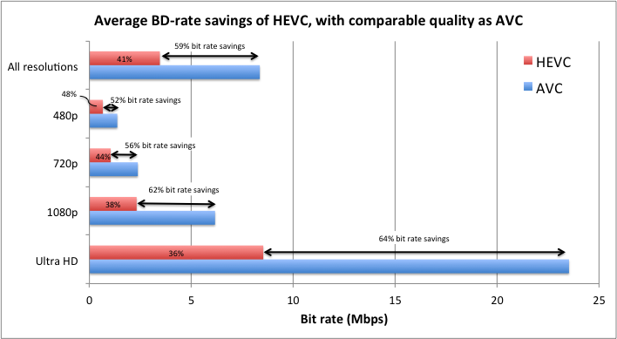
UHD results (!!)

Slide 4
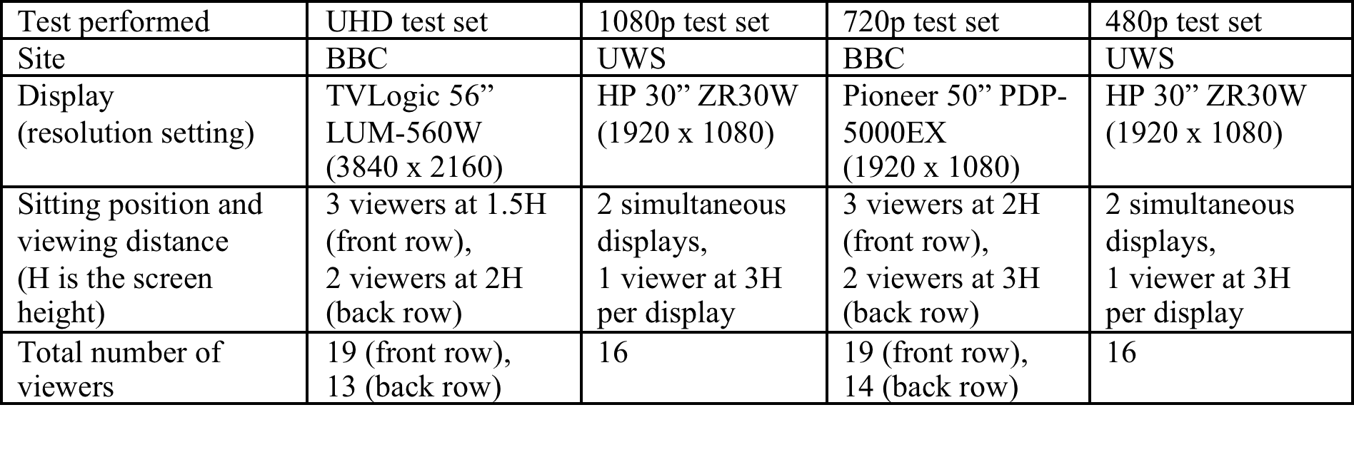
Test Performed

Slide 5
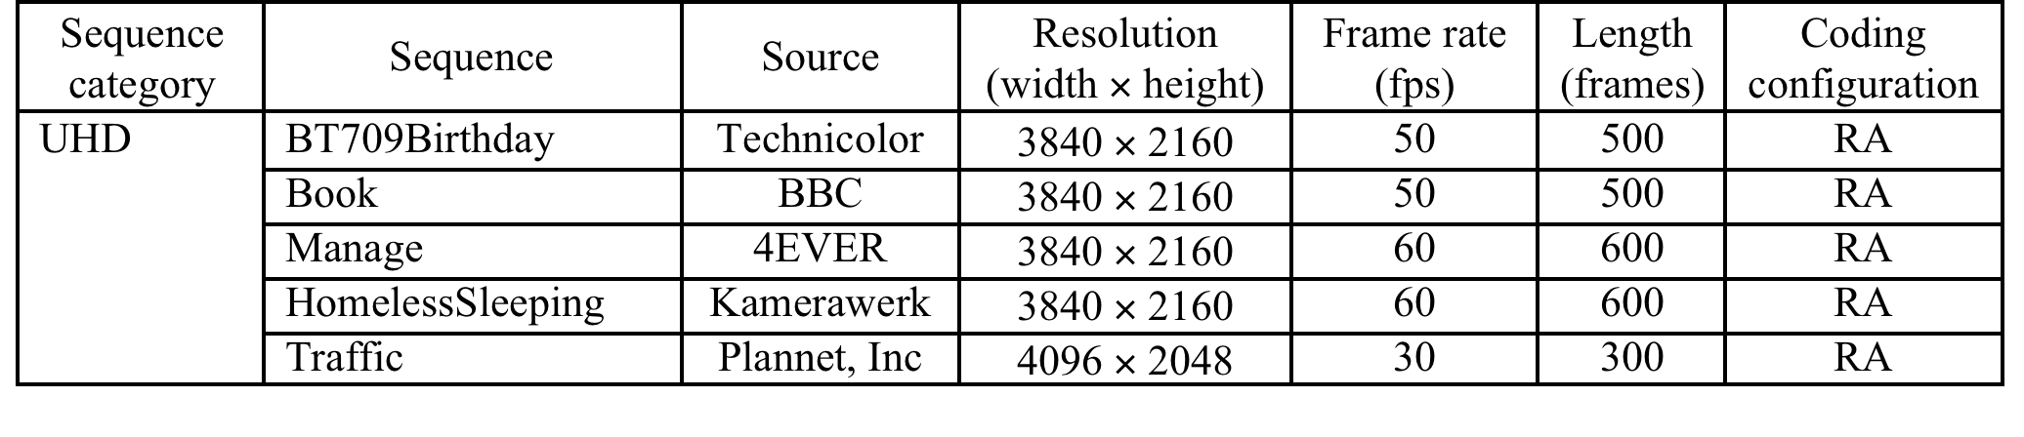
Test material

Slide 6
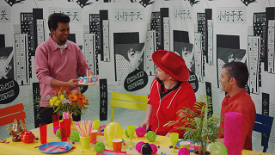



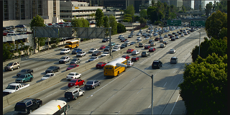
Test material

Slide 7
Laboratory set-up
According P.910 to except for the selection of the display and the video play-out server
YUV MPEG Player
UHD resolution: 3840x2160, 4096x2048
Viewing distance 1.5H / 2.5H

Slide 8
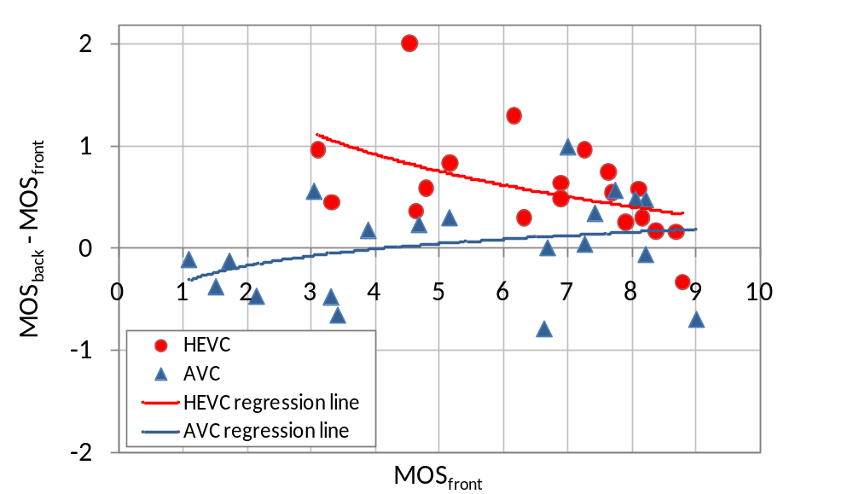
Influence of viewing distance

Slide 9
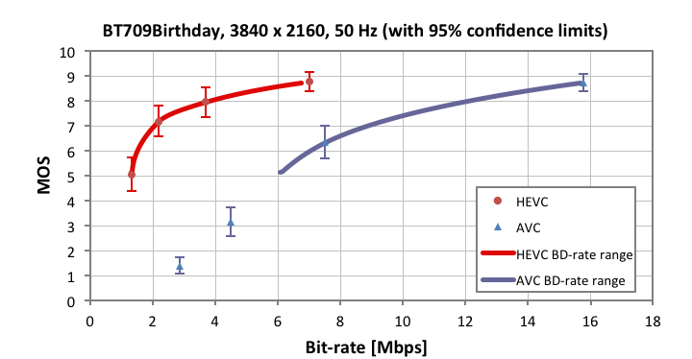
UHD results

Slide 10
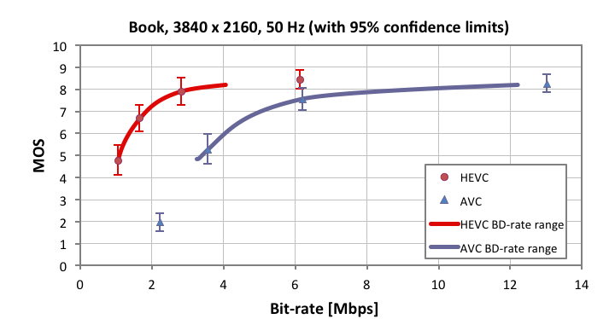
UHD results

Slide 11
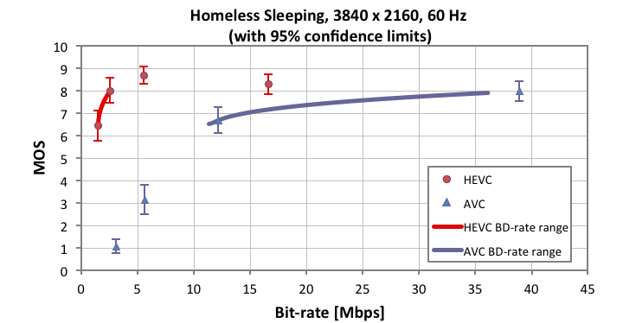
UHD results

Slide 12
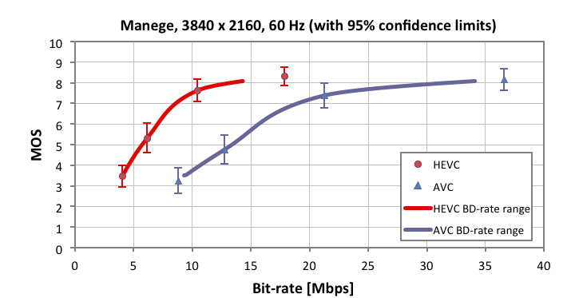
UHD results

Slide 13
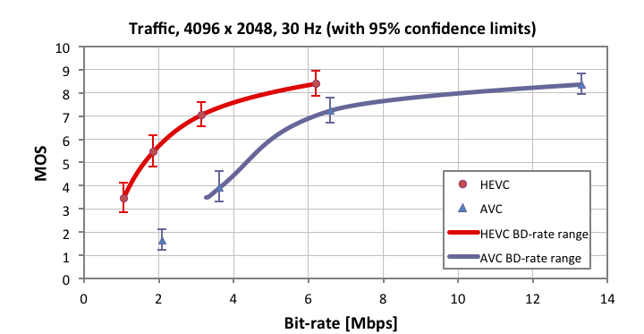
UHD results

