Slide 1

(JEG) HDR Project: update from IRCCyN
July 2014
Patrick Le Callet-Manish Narwaria

Slide 2
Our recent activities on HDR
1. Single Exposure vs Tone Mapped High Dynamic Range Images: A Study Based on Quality of Experience
2. An Objective Method For High Dynamic Range Source Content Selection

Slide 3
Recent results on HDR
Single Exposure vs Tone Mapped High Dynamic Range Images: A Study Based on Quality of Experience

Slide 4
Study on HDR Visualization
Some form of tone mapping needs to be deployed to view HDR
True even for an HDR display!
Tone mapping is not transparent (loss of fidelity, naturalness, visual attention modification)
Goal: do some TMOs lead to more faithful representation of HDR than others?

Slide 5
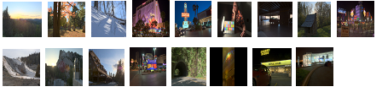
Study on HDR Visualization
17 reference HDR content
3 TMOs + Single exposure content = 4 TMOs
38 observers
Paired Comparison (PC) method

Slide 6
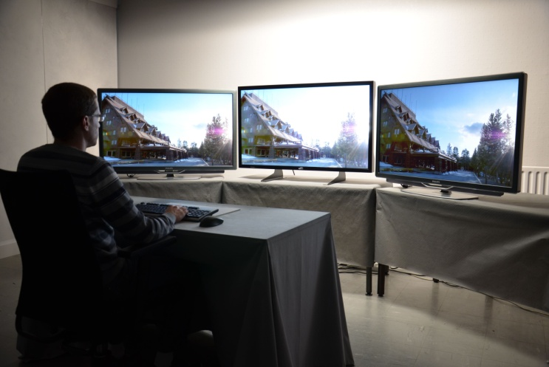
Study on HDR Visualization
Test set-up: HDR display flanked by two similar LDR displays
Specific instructions:
  "Please choose the image (left or right) that is more similar to the reference image (center) ".
  "Why did you discard this image?". (3 choices: low fidelity of colors / luminance, loss of details, lack of naturalness)
LDR
HDR
LDR

Slide 7
Study on HDR Visualization
Room illumination was adjusted based on the test set-up
the illumination at the center (just above the HDR display) was set to 100 cd/m²
diffused light (about 50 cd/m²) made up the illumination for each LDR display
Observers were comfortable while viewing both HDR and LDR stimuli simultaneously

Slide 8
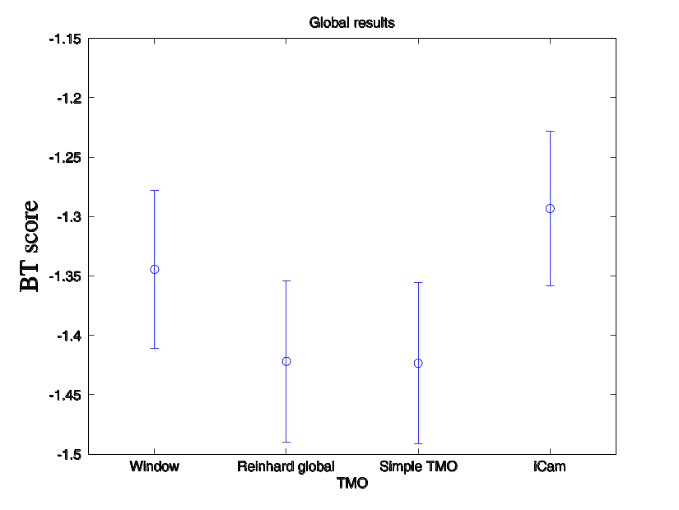
Study on HDR Visualization
PC data transformed using Bradley Terry (BT)model
Results:
No TMO was overall statistically superior to others
Even single exposure content was statistically at par with tone mapped!
Single Reinhard Linear Icam06

Slide 9
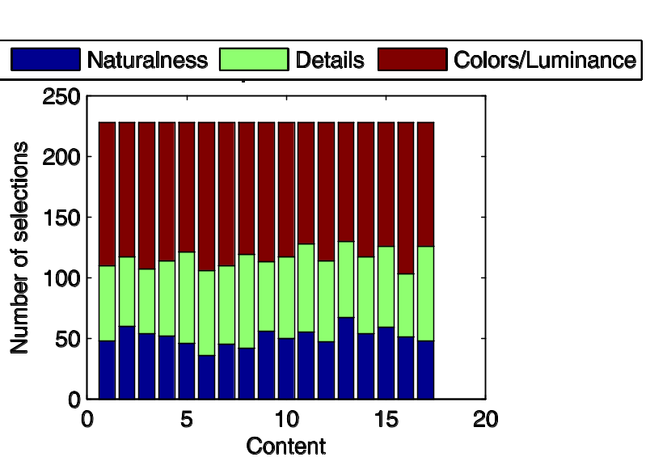
Study on HDR Visualization
Color/luminance appeared the dominant factor in user preference

Slide 10
Recent results on HDR
An Objective Method For High Dynamic Range Source Content Selection

Slide 11
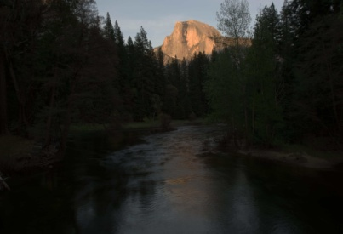
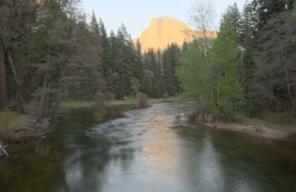
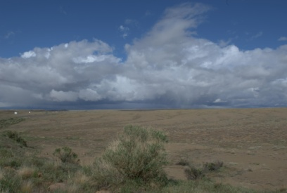
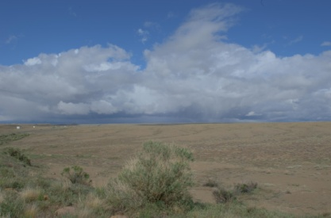
Content selection
Selection of source HDR content important
Affects the conclusions of the study conducted
Eg. For validating TMOs
Different visual quality levels for these images
Processed by TMO1 Processed by TMO2
Similar visual quality levels for these images (despite being processed by different TMOs
Processed by TMO1 Processed by TMO2

Slide 12
Content selection
We proposed objective method to assist content selection
Basis of method: an HDR scene with higher contrast encapsulated will be more challenging
Analysis of perceptual error due to incremental contrast reduction
HDR-VDP-2 as measure of perceptual error + data mining to extract meaningful information

Slide 13
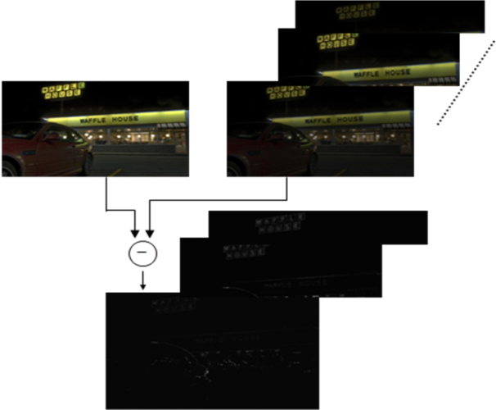
Content selection
Generate a series of successive
contrast-reduced images
Perceptual error
Compute perceptual error visibility maps
Compute KLD between the error visibility maps
Analyze the difference matrix via data mining
Overview of the proposed method

Slide 14
Content selection
Objective method NOT meant to entirely replace subjective opinion
But a first step by conveniently implementing and executing on a software platform
Allowing the flexibility to test a very large pool of potential source HDR content

Slide 15
References
  M. Narwaria, M. Silva, P. Callet and R. Pepion “Tone mapping Based High Dynamic Range Compression: Does it Affect Visual Experience?”, Signal Processing: Image Communication, 2013.
  M. Narwaria, M. Silva, P. Callet and R. Pepion “Tone mapping Based High Dynamic Range Image Compression: Study of Optimization Criterion and Perceptual Quality”, Optical Engineering, vol. 52, no. 10, 2013.
  M. Narwaria, M. Silva, P. Callet and R. Pepion “Impact of Tone Mapping In High Dynamic Range Image Compression”, Proc. Eighth International Workshop on Video Processing and Quality Metrics for Consumer Electronics (VPQM), 2014.
  M. Narwaria, M. Silva, P. Callet and R. Pepion “On Improving the Pooling in HDR-VDP-2 Towards better HDR Perceptual Quality Assessment”, SPIE Human Vision and Electronic Imaging (HVEI 2014), 2014.
  M. Narwaria, M. Silva, P. Callet and R. Pepion, “Adaptive Contrast Adjustment for Postprocessing of Tone Mapped High Dynamic Range Images”, IEEE International Symposium on Circuits and Systems (ISCAS 2013), 2013.
  M. Narwaria, M. Silva, P. Callet and R. Pepion, “Effect of Tone Mapping on Visual Attention Deployment”, SPIE Conference on Applications of Digital Image Processing XXVII , vol. 8499, 2012.

Slide 16
Datasets
HDR databases/resources for research community from IRCCyN IVC:
  Eye-tracking on HDR and tone mapped images : the ETHyma database
  Available at http://www.irccyn.ec-nantes.fr/spip.php?article1194&lang=en
  HDR quality databases:
  http://www.irccyn.ec-nantes.fr/spip.php?article1447

