Slide 1

(JEG) HDR Project
Boulder meeting
January 2014
Phil Corriveau-Patrick Le Callet-Manish Narwaria

Slide 2
Agenda
Progress
  State-of-the-art objective quality measurement methods for HDR
  Progress on HDR database development
  HDR QoE: Visual quality, visual attention, naturalness…
Possible outreaching items with other groups
  HDR Compression: Activities within JPEG XT & evaluation issues
  Other related aspects in HDR: Privacy and security possible link with QART

Slide 3
Progress
  State-of-the-art objective quality measurement methods for HDR
  Manish NARWARIA

Slide 4
HDR quality: Recent objective methods
HDR-VDP [Mantiuk et al. – SPIE 2005]
  Based on Visual Detection Predictor
Dynamic Range Independent Metric (DRIM) [Aydin - Siggraph 2008]
  Enables comparison of the images with different dynamic range
  Output – three distortion maps (loss of visible contrast, amplification of invisible contrast and reversal of visible contrast)
  – overall distortion map (combination)
  No single quality index provided
HDR-VDP-2 [Mantiuk et al. – Siggraph 2011]
  Complete revision of the previous algorithm
  Two features – Visibility of Differences and Quality
Improved HDR-VDP-2 [Narwaria et al. – HVEI 2014]
  Better pooling parameter optimization with HDR database
Tone-Mapped Image Quality Index (TMQI) [Yeganeh and Wang – TIP, 2013]
  Based on SSIM for HDR-LDR comparison (not suitable for HDR quality measurement)
Graphics community
more active!

Slide 5
Agenda
Progress
  Progress on HDR database development
  Manish NARWARIA

Slide 6
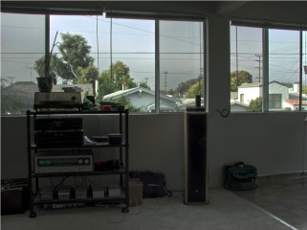
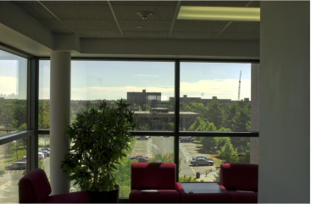
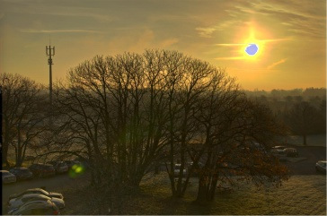

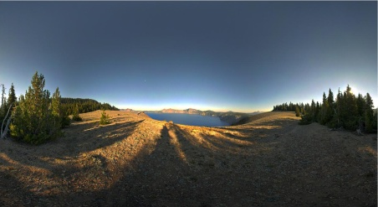
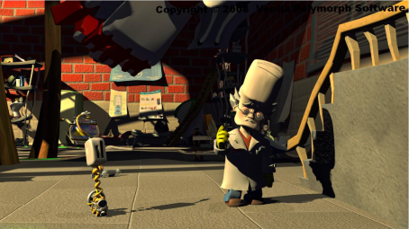
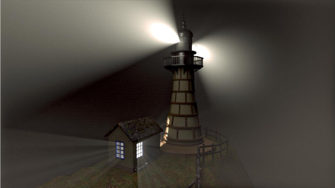
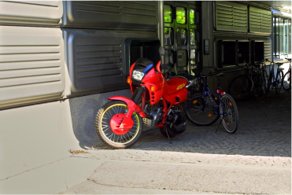
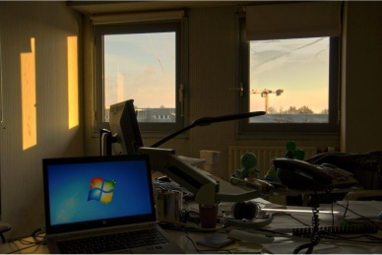
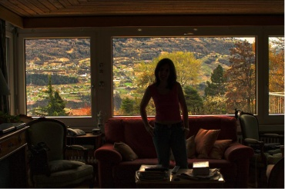
Progress on HDR database development
Subjective studies at IRCCyN IVC
10 SRCs (indoor and outdoor scenes)
SIM2 HDR47E S 4K display (max luminance of 4000 cd/m²)

Slide 7
Progress on HDR database development
Study 1:
  JPEG compression (7 bit rates)
  One TMO
  2 codec optimization criterion (MSE and SSIM)
  14 HRCs
  Totally 150 HDR stimuli (10 SRC * 14 HRC +10 SRC)
  27 observers (ACR-HR)
Study 2:
  JPEG 2000 compression (7 bit rates)
  5 TMOs
  35 HRCs
  Totally 216 HDR stimuli (6 SRC * 35 HRC + 6 SRC)
  29 observers (ACR-HR)
Narwaria et al. “Tone mapping Based High Dynamic Range Image Compression: Study of Optimization Criterion and Perceptual Quality”, Optical Engineering, 52(10), 2013.
Narwaria et al. “Impact of Tone Mapping In High Dynamic Range Image Compression”, VPQM, 2014.

Slide 8
Progress on HDR database development
150 + 216 = 366 HDR images (with corresponding subjective ratings)
To be made available soon through CDVL, Qualinet…
HDR database to be exploited for improving and calibrating HDR-VDP-2
Validation of HDR objective methods
LDR objective methods (MSE, SSIM etc.) ineffective for HDR (statistically worse than HDR-VDP-2)
    Assume perceptually uniform pixel values
    No more the case with HDR (pixels related to physical luminance)

Slide 9
Agenda
Progress
  HDR QoE: Visual quality, visual attention, naturalness…

Slide 10
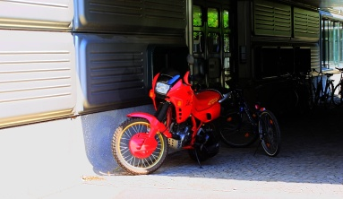


HDR QoE : Other aspects
Visual quality: one aspect of overall HDR experience
  Artifacts and error prediction (2D visibility error map)
  Overall quality score with feature pooling
Visual attention
  More visual details available
  Larger no. of attention points as compared to LDR
LDR LDR VA map HDR VA map
Naturalness in HDR processing
  TMO tend to damage naturalness
  Can affect the user experience despite more visual details

Slide 11
Agenda
Possible outreaching items with other groups
  HDR Compression: Activities within JPEG XT & evaluation issues
  Other related aspects in HDR: Privacy and security possible link with QART

Slide 12

JPEG XT and Qualinet activities
Goal – verify that all the proposed profiles behave as they are expected (the quality grows with increasing bpp)
Done by objective testing
  5 operating points – 1 bpp, 2 bpp, 3 bpp, 4 bpp, 5 bpp
  5 HDR images
  3 measures – SNR, MRSE (Mean Relative Square Error), HDR-VDP-2
Results
  SNR and MRSE found suitable for this kind of test
  HDR-VDP-2
    Not obvious choice of parameters
    Estimated MOS values not very suitable
    Visibility measure found better for this purpose

Slide 13

HDR in Privacy & Security
Added value – more visual information in scenes with lack/excess of illumination, extreme contrast, etc.
Good for security but brings more issues in terms of privacy intrusion
Questions being addressed
  Which Tone-Mapping Operator is the best from the security point of view?
  Does the usage of an HDR display bring any additional information to the security compared to the TMOs?
  Preparation of dataset with security/privacy related
  HDR images
Relevant to QART

Slide 14
Summary
HDR attracting attention in academia and industry
JPEG coming up with HDR image compression standard
Research groups (like IRCCyN IVC) and industries involved in HDR research
HDR Project in VQEG
Focus on different aspects such as quality, visual attention, compression, security…
Design on standardized protocols for subjective testing with HDR

Slide 15
Summary
HDR database development at IRCCyN IVC:
  Visual attention
    How tone mapping affects human attention
    Modification of artistic intent
    Comprehensive evaluation of objective methods and solid statistical analysis
  Visual quality
    Study of tone mapping operators for quality
    Quality issues in ocal and global HDR codec optimization
    HDR database with corresponding subjective scores
    Useful to validate objective methods for HDR quality assessment

Slide 16
Summary
HDR databases/resources for research community from IRCCyN IVC:
  Eye-tracking on HDR and tone mapped images : the ETHyma database
  Available at http://www.irccyn.ec-nantes.fr/spip.php?article1194&lang=en
  HDR quality databases: to be released shortly

Slide 17
Research dissemination
  M. Narwaria, M. Silva, P. Callet and R. Pepion “Tone mapping Based High Dynamic Range Compression: Does it Affect Visual Experience?”, Signal Processing: Image Communication, 2013.
  M. Narwaria, M. Silva, P. Callet and R. Pepion “Tone mapping Based High Dynamic Range Image Compression: Study of Optimization Criterion and Perceptual Quality”, Optical Engineering, vol. 52, no. 10, 2013.
  M. Narwaria, M. Silva, P. Callet and R. Pepion “Impact of Tone Mapping In High Dynamic Range Image Compression”, Proc. Eighth International Workshop on Video Processing and Quality Metrics for Consumer Electronics (VPQM), 2014.
  M. Narwaria, M. Silva, P. Callet and R. Pepion “On Improving the Pooling in HDR-VDP-2 Towards better HDR Perceptual Quality Assessment”, SPIE Human Vision and Electronic Imaging (HVEI 2014), 2014.
  M. Narwaria, M. Silva, P. Callet and R. Pepion, “Adaptive Contrast Adjustment for Postprocessing of Tone Mapped High Dynamic Range Images”, IEEE International Symposium on Circuits and Systems (ISCAS 2013), 2013.
  M. Narwaria, M. Silva, P. Callet and R. Pepion, “Effect of Tone Mapping on Visual Attention Deployment”, SPIE Conference on Applications of Digital Image Processing XXVII , vol. 8499, 2012.

Slide 18
Other References
Rafał Mantiuk, Scott Daly, Karol Myszkowski, Hans-Peter Seidel. Predicting Visible Differences in High Dynamic Range Images - Model and its Calibration . In: Proc. of Human Vision and Electronic Imaging X, IS&T/SPIE's Symposium on Electronic Imaging, pp. 204-214, 2005.
Tunç O. Aydin, Rafał Mantiuk, Karol Myszkowski, Hans-Peter Seidel. Dynamic Range Independent Image Quality Assessment . In: ACM Transactions on Graphics, 27(3), article no. 69, 2008.
R. Mantiuk, K. Jim, A. Rempel and W. Heidrich. HDR-VDP-2: A calibrated visual metric for visibility and quality predictions in all luminance conditions. In: ACM Transactions on Graphics, 30(4), Article no. 40.
H. Yeganeh and Z. Wang, “Objective Quality Assessment of Tone-Mapped Images”, IEEE Transactions on Image Processing, vol. 22, no. 2, pp. 657-667, 2013.

