Slide 1
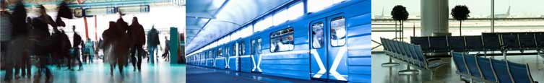
Quality of Videosurveillance Streams with
Traditional Encoders and Decoders
QART Presentation– July 2013

Slide 2
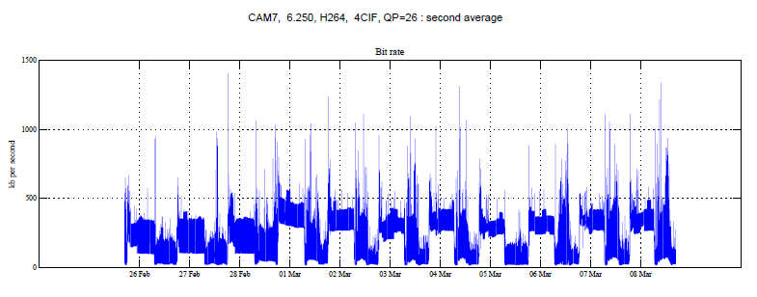
Videosurveillance Streams
Rate Time Series
Videosurveillance Streams, when encoded with traditional H.264 encoders, at a given spatial resolution (HD, SD, 4CIF, CIF, other), constant frame frequency, and constant quantizer step, exhibit highly variable bit rates

Slide 3
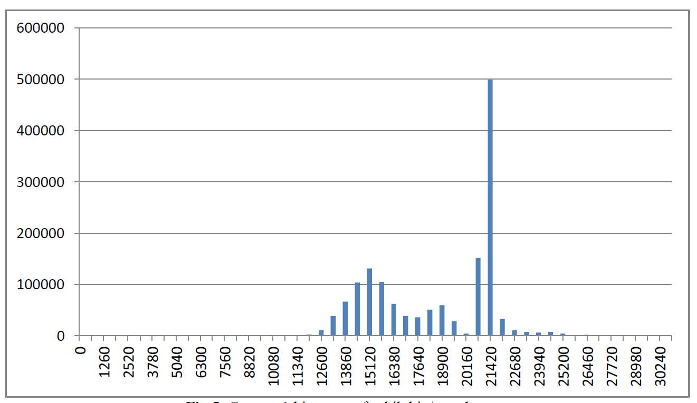
Videosurveillance Streams
Rate Histograms
When making a rate histogram, multimodal distributions are not exceptional, especially when there are two (or more) modes of operation (day/night, week/weekend)

Slide 4
Videosurveillance Streams
Rate Control
Spectral analyses of the rate time series often contain very slow components (seasonal, weekly, daily)
Uncontrollable operating parameters (weather, lighting) add to the variability and unpredictability of the rate
The traditional approach to “absorb” the high variations consists in using CBR or VBR control mechanisms, that control the quantization parameter in closed loop
  Increasing QP to reduce the rate, when the (uncontrolled) rate tends to grow (because of noise, or motion/change content)
  Limiting variations in VBR (often to a factor less than 2)
Consequence
  Degradation of the image quality, when one needs a good image (important when the images changes, or contains motion)
  Waste of bandwidth when the streams contains no useful information, to achieve a CBR

Slide 5
Videosurveillance Streams
Alternative Rate Control
Alternative 1: control other stream parameters (spatial resolution, frame rate) affecting the rate
  Acceptable in Videosurveillance, not in broadcast
Alternative 2: allow high rate variations, but absorb these variations in the network switches (at least at the first level) by statistical multiplexing
  Specially designed managed switches
Alternative 3: use rate control algorithms (upstream throttling) based on overall transmission channel parameters, especially congestion measures (downstream)
  Similar to TCP-IP, but affecting other parameters
Alternative 4: use rate control algorithms based on end-to-end Image Quality measures specialized for Videosurveillance Streams

Slide 6
Videosurveillance Streams
Image Quality Measures for VS
Videosurveillance Streams are defined by (essentially) three encoder parameters
  Spatial resolution
  Frame frequency
  Q quantizer step
A measure of quality should be based on the following concepts (at least)
  Sharpness (mainly affected by spatial resolution)
  Fluidity; this is a complex concept, brought about by
    Frame frequency
    Frame frequency or phase jitter (very common in “low quality” VS systems)
    Frame dropping
  Latency
All “dimensions” of the Quality Measure are affected by the encoder, the network transport mechanism, and the decoder

