Slide 1

Quality Assessment for Recognition Tasks (QART)
Mikołaj Leszczuk, Lucjan Janowski,
Sergio Garcia, Łukasz Dudek
Faculty of Computer Science, Electronics and Telecommunications
Department of Telecommunications
Ghent, 7/9/2013

Slide 2
Quality Assessment for Recognition Tasks (QART)
Mission
  “To study effects of resolution, compression and network effects on quality of video used for recognition tasks”
Goals
  To perform series of tests to study effects and interactions of
    Compression
    Scene characteristics
  To test existing or develop new objective measurements that will predict results of subjective tests of visual intelligibility
  Propose subjective test methodology for recognition tasks

Slide 3
QART
Data acquisition
Data processing
Modeling

Slide 4
Large-Scale Video Quality Modeling (Ongoing)
Tasks in Videos:
License plate recognition
Vehicle maker recognition
Vehicle color recognition
Object recognition

Slide 5
Data Processing
126 SRCs
40 HRCs
1860 PVS
193 subjects
69236 answers
Database
MATLAB

Slide 6
Modeling (I)
EXPERIMENT | PROBABILITY OF CORRECT RECOGNITION (%)
License plate recognition, AGH | 64.22
Object recognition, ITS, experts, no pause option | 79.9
Object recognition, ITS, non experts, not laboratory, no pause option | 72.56
Object recognition, AGH, laboratory, no pause option | 64.62
Object recognition, ITS, experts, laboratory, pause option | 80.63
Object recognition, ITS, non experts, laboratory, pause option | 80
Probability of correct recognition
MODELING

Slide 7
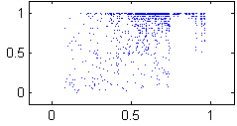
Modeling (II)
Correlation?

Slide 8
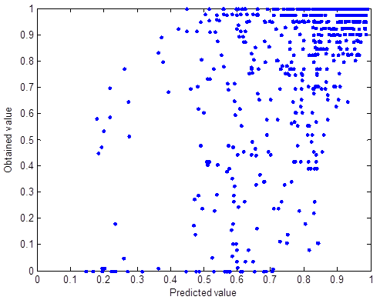
Modeling (III)
Correlation?
Linear models?

Slide 9
Modeling (IV)
Correlation?
Linear models?
NEURAL NETWORKS

Slide 10
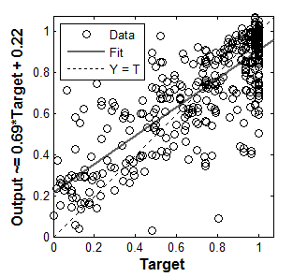
Modeling (V)
Accuracy obtained: R² = 78.7%

Slide 11
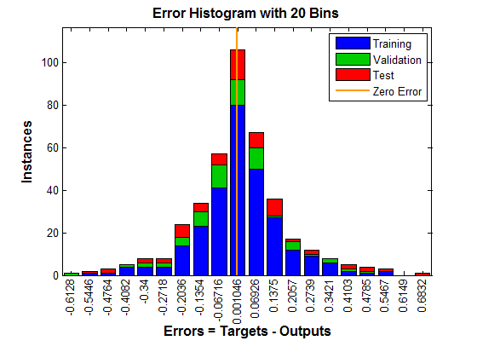
Modeling (VI)
Accuracy obtained: R² = 78.7%

Slide 12
Problems and Plan (1/2)
There is still some a lot of room for improvement:
Limited number of scenarios?
  More contributions needed!
Low accuracy (78.7%)?
  Crowdsourcing!

Slide 13
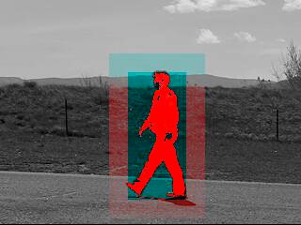
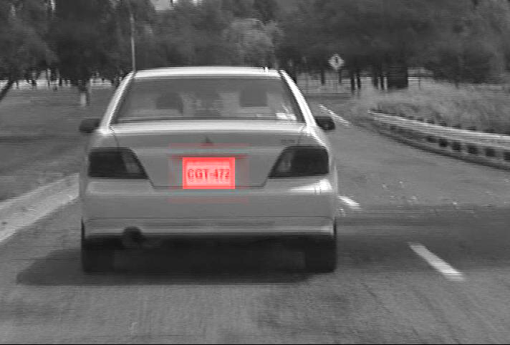
Problems and Plan (2/2)
Low stability (Neural Networks)?
Object tracing by optical flow!

