Slide 1

Monitoring Of Audio Visual Quality From Key Indicators (MOAVI)
Mikołaj Leszczuk, Lucjan Janowski,
Ignacio Blanco, Mateusz Hanusiak
Faculty of Computer Science, Electronics and Telecommunications
Department of Telecommunications
Ghent, 7/7/2013

Slide 2
Monitoring Of Audio Visual Quality From Key Indicators (MOAVI)
Mission
  “To collaboratively develop No-Reference models for monitoring audio-visual service quality”
Goals
  To develop set of key indicators describing service quality in general
  To select subsets for each potential application
  To concentrate on models based on key indicators contrary to models predicting overall quality

Slide 3
Monitoring Of Audio Visual Quality From Key Indicators (MOAVI)
RECENT WORK:
MUTE
AUDIO METRICS
CLIPPING
VOICE ACTIVITY
LIP SYNC
LIP MOTION
VIDEO METRICS
BLOCKINESS
BLURRINESS

Slide 4
Mute and Clipping Metrics
CHARACTERISTICS
Most frequent audio artifacts
Easy to detect
Execution of the metrics and setting a threshold provides a key indicator for each impairment

Slide 5
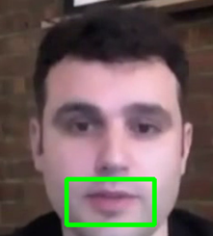

Lip Activity Metric on OpenCV
Haar Cascades to detect the mouth region of interest
Optical Flow and Edge Detector to detect the movement of the lips
And to discriminate them from movements of the whole face
White lines in the region of the mouth
Lip activity

Slide 6
Voice Activity Metric
Detection of several indicators of the presence of a voice signal in an audio wave
Results compared to ground truth obtained manually
  Accuracy = 95.8%
  F1 metric = 96.4%
  Specifity = 72.3%

Slide 7
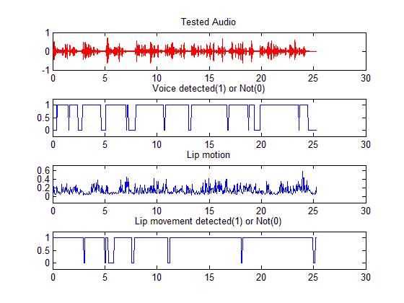
Lip Sync Metric
REAL DELAY
-800ms
DETECTED DELAY
-750ms

Slide 8
Lip Sync Metric
Characteristics of the set of videos
  Frontal view of talking faces
  Duration around 20s
Real delay introduced to make the tests compared with the delay detected by the metric
  Average deviation = 130 milliseconds
  The metric discriminates positive and negative delays

Slide 9

Blockiness
The probability of correct classification: 98.48%

Slide 10

Blurriness
The probability of correct classification: 80.52%

Slide 11
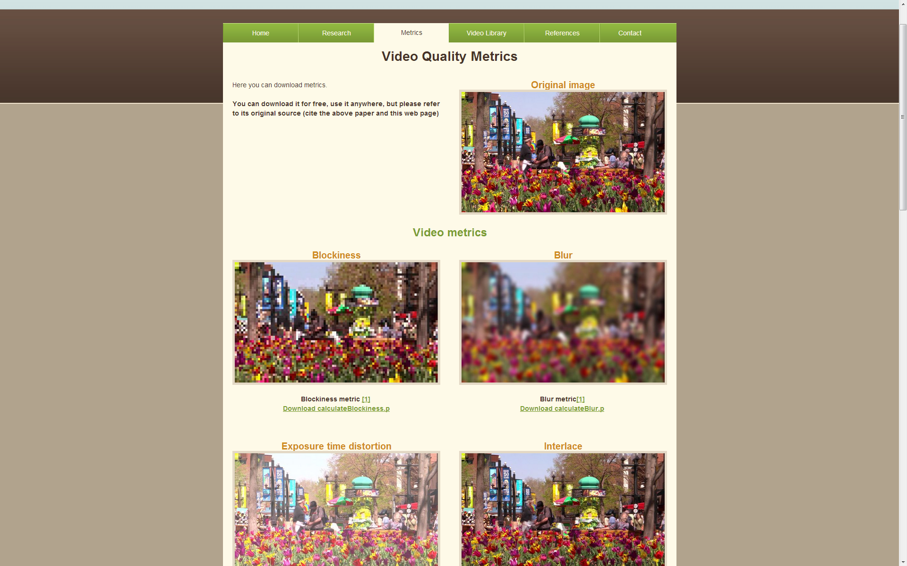
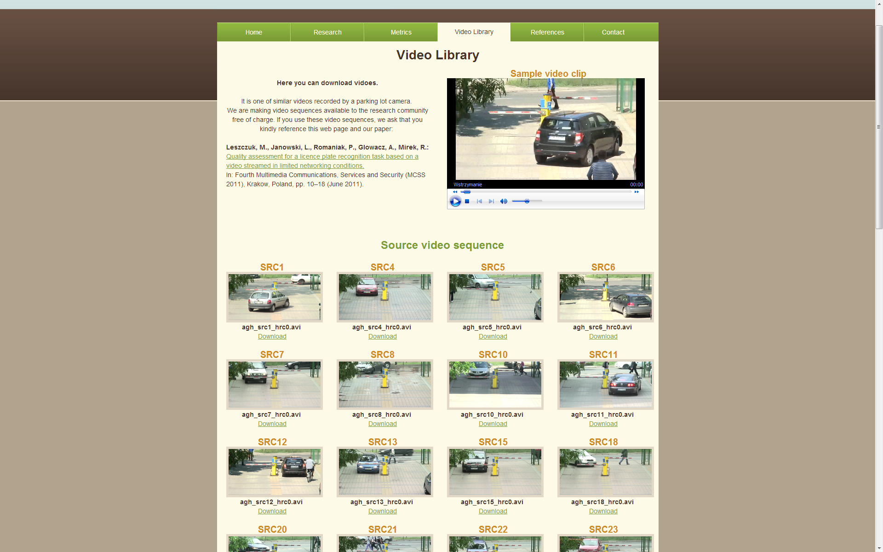
Some Resources Available Online at http://vq.kt.agh.edu.pl/ – Product Placement
Video Quality Metrics
Video Library

