Slide 1


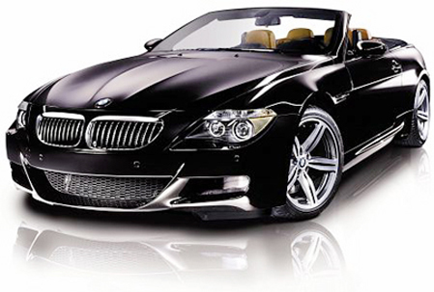

JEG-Hybrid: Automotive Image Quality
Anthony Winterlich
Vladimir Zlokolica
Edward Jones
Martin Glavin
Connaught Automotive Research Group
Electrical & Electronic Engineering
National University of Ireland, Galway

Slide 2

Current Applications
Junction View

Slide 3
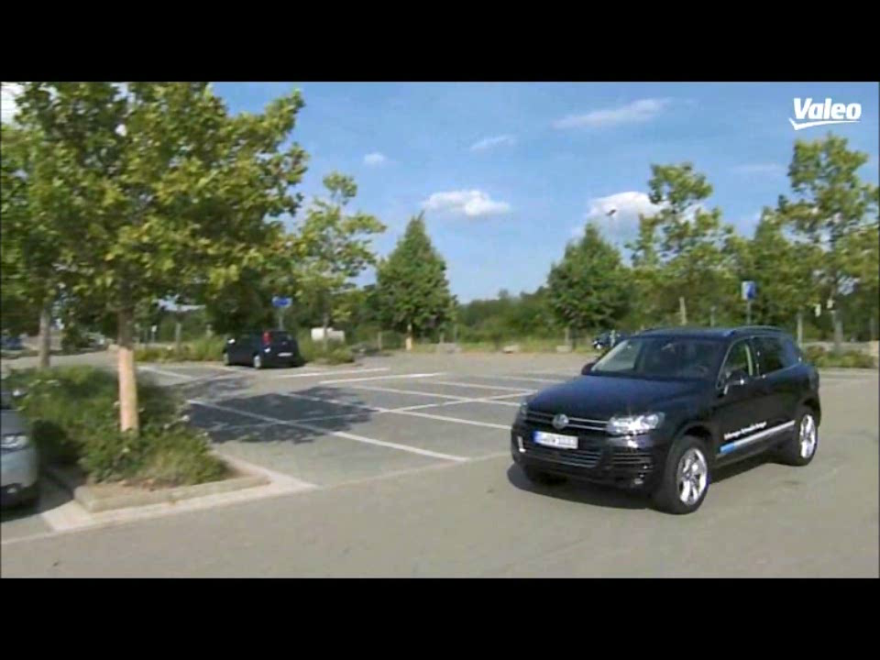
Current Applications
Park Assist

Slide 4
Subjective testing challenges
    Fish-eye distortion
    Sharpness
    Visual Saliency
    Colour balance and contrast (HDR scenes)
    Noise in high & low light conditions

Slide 5
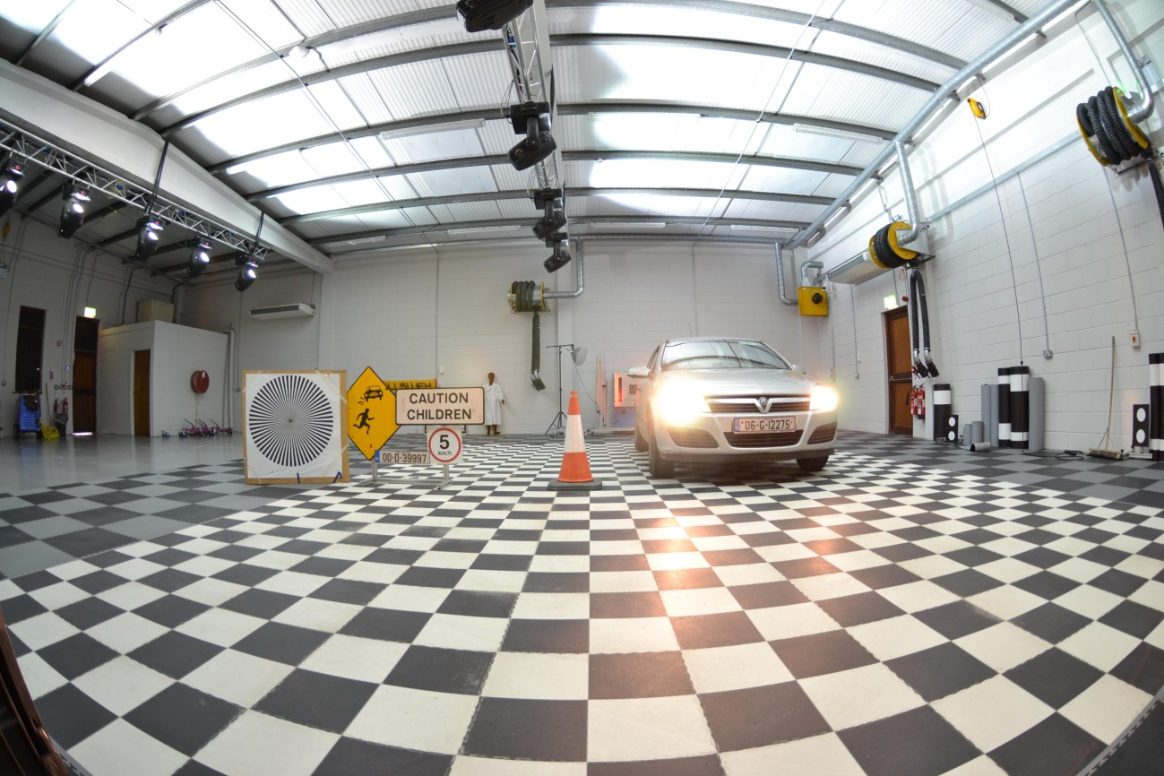
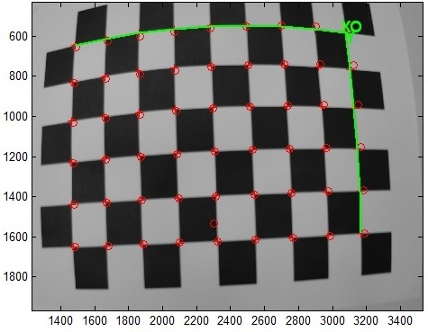
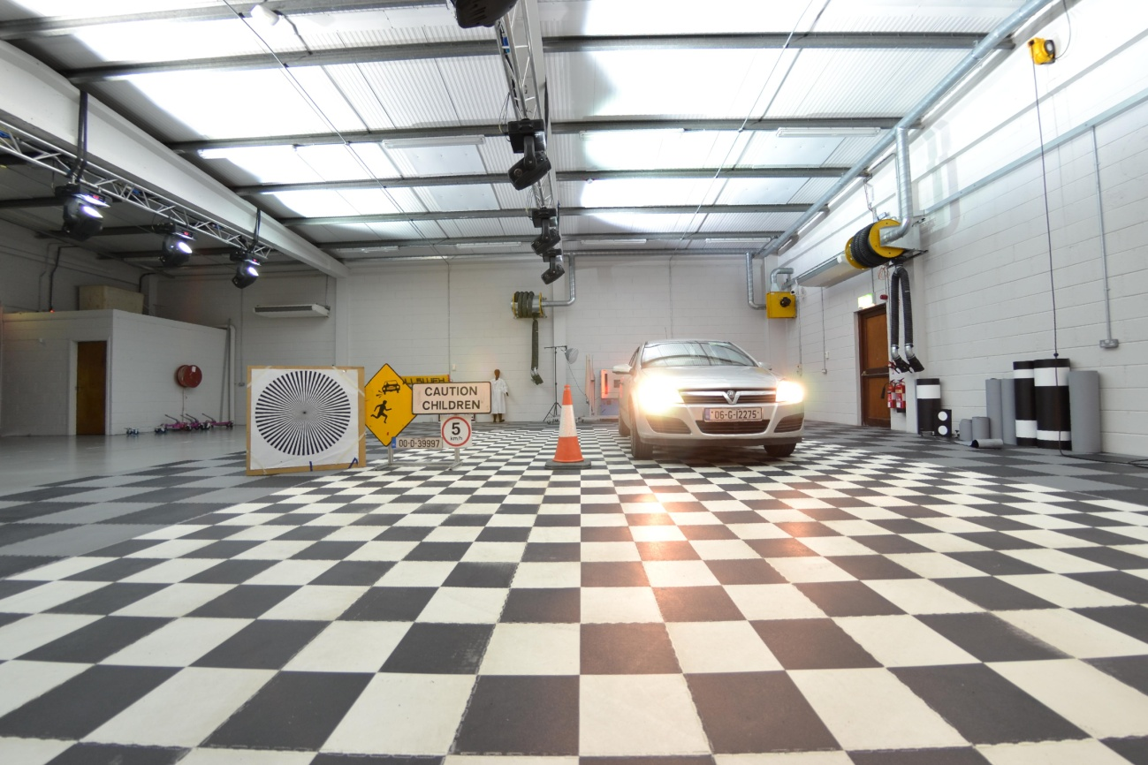


Slide 6
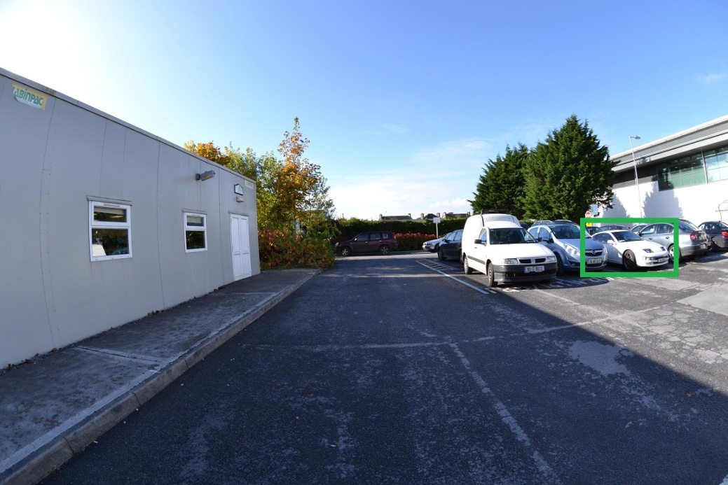
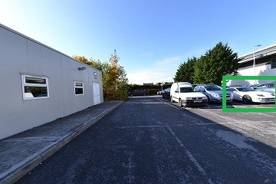
LOWER SPATIAL RESOLUTION AT THE EDGE OF AN IMAGE RESULTS IN A LOSS OF PERCEPTUAL QUALITY

Slide 7
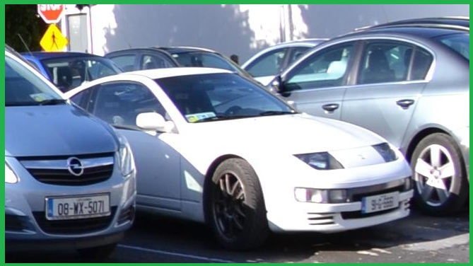
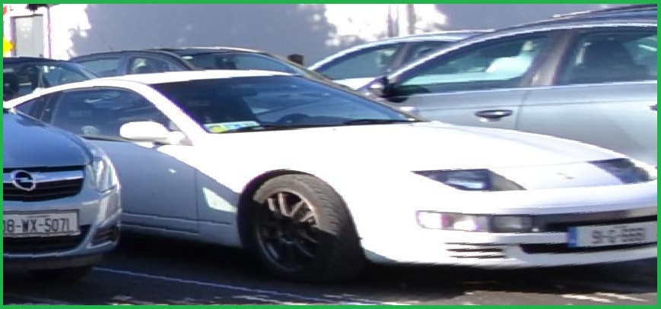
LOWER SPATIAL RESOLUTION AT THE EDGE OF AN IMAGE RESULTS IN A LOSS OF PERCEPTUAL QUALITY

Slide 8
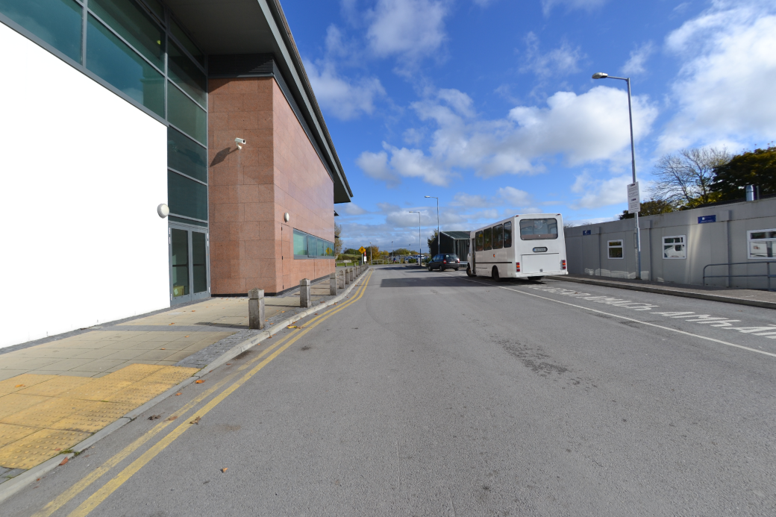
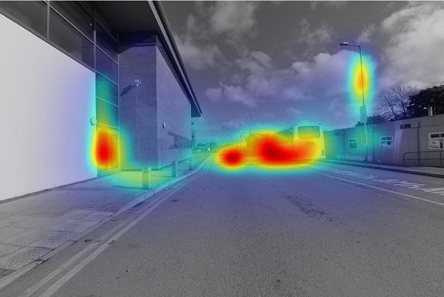
FEATURE VECTORS ARE EXTRACTED TO DETERMINE SALIENCY

Slide 9
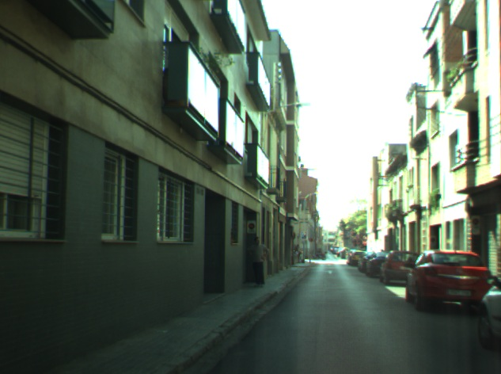
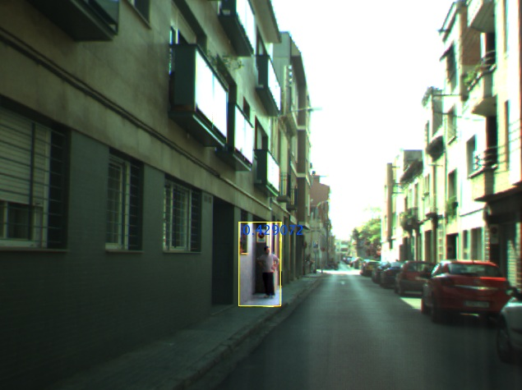
HDR and contrast

Slide 10
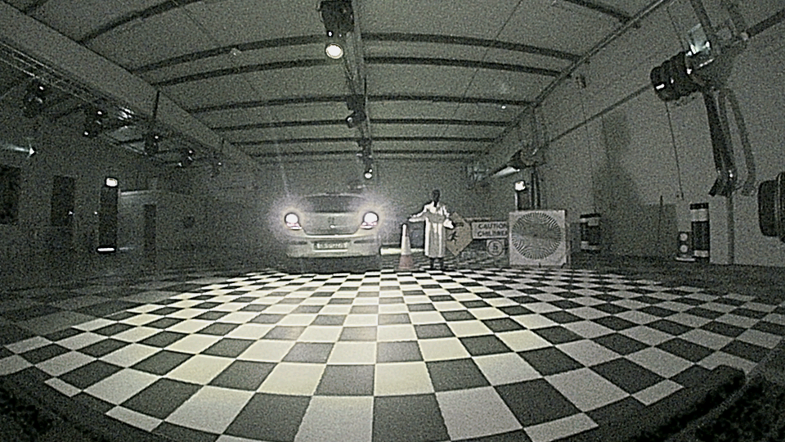
Quality in low light conditions
Notes:
Noise is not necessarily bad if it means we can see further! Trade off – naturalness/usefulness

Slide 11
Existing subjective testing standards
ITU-R Recommendation BT.500-11, “Methodology for the subjective assessment of the quality of television pictures,”
General viewing conditions for subjective assessments in laboratory environment
  Not appropriate for automotive vision systems!
The absence of defects in the reference part of the presentation pair is crucial to obtain stable results.
  Fish-eye images are not free of defects!

Slide 12
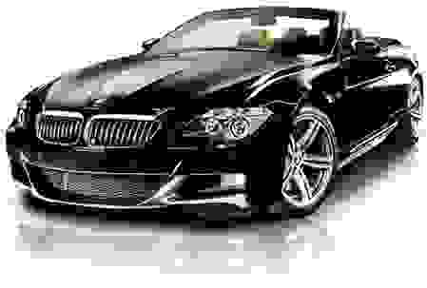
Thank You!
SSIM : 0.7134

