Slide 1
Video Quality Subjective Testing
Proposed Variant
Concept developed by Marc Sullivan of AT&T

Slide 2

Video Quality Subjective Testing
Psychophysics
    Can you see a difference?
Notes:
BT.500, P.910
Psychophysics, JND
Benefits:
compare SRC and HRC
train and test objective models

Slide 3
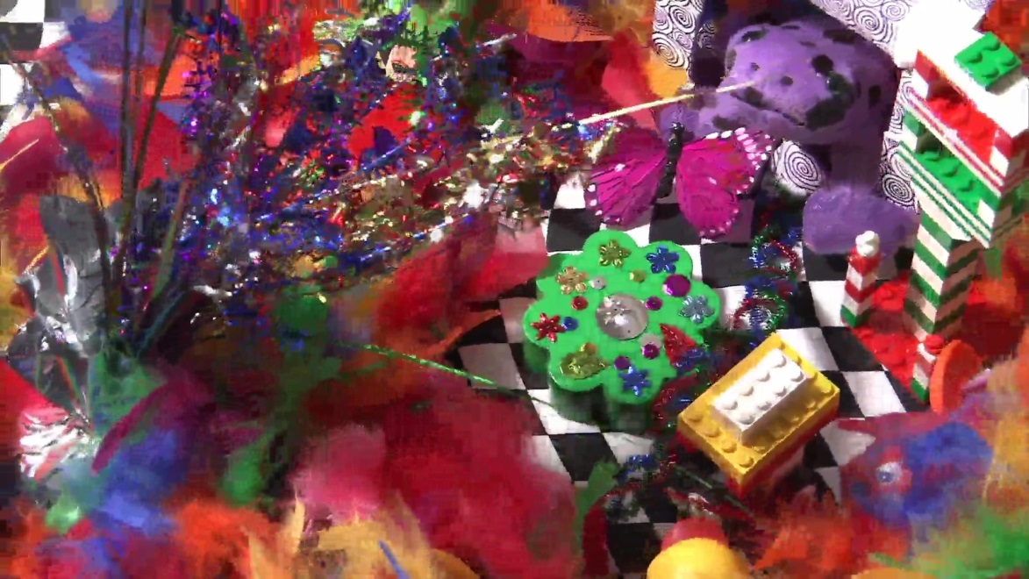

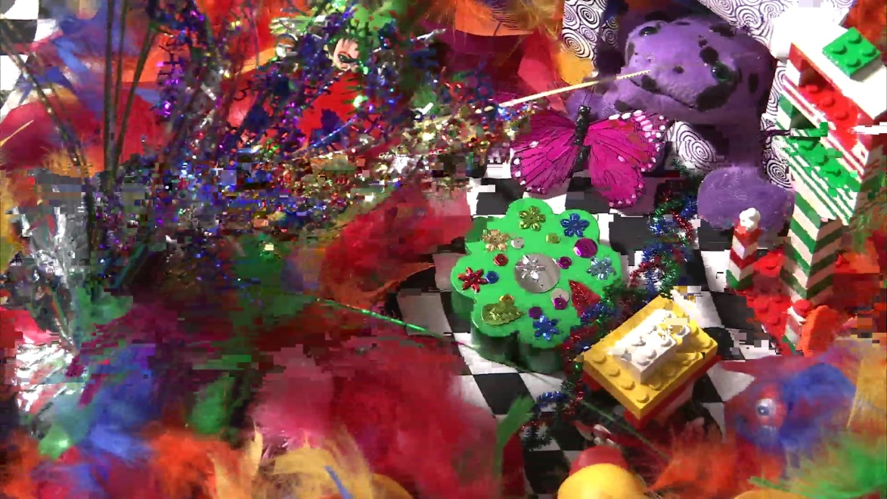
Notes:
Repetitious
see each SRC many times
boring
Choose scene for coding characteristics
Color
Rotation
Types of edges

Slide 4

Objective Models
Notes:
Many questions answered by objective models
objective models
replace video quality subjective test today
JND
Accurate enough many uses
Improve with time

Slide 5
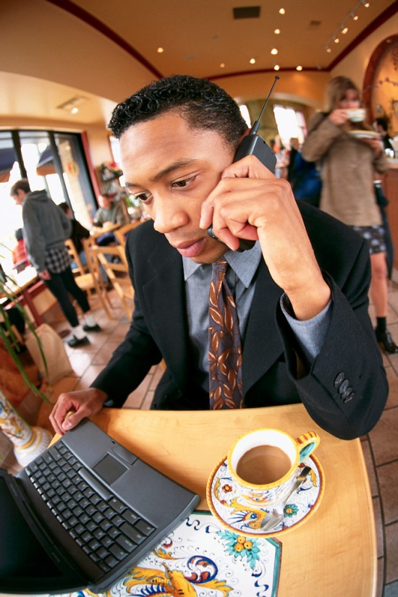
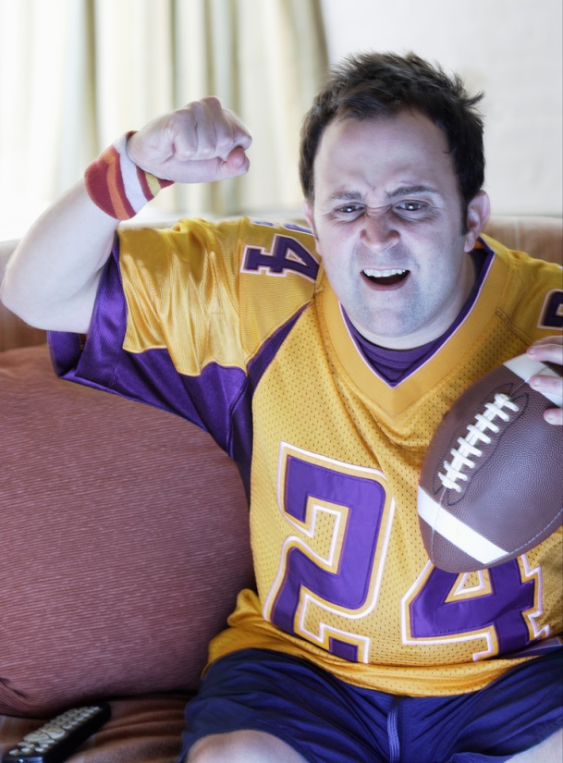
What is Missing?
Usability
Immersion
Notes:
appropriate or not for task or use
threshold
price / performance
sale
immersion
learn scene
1st to 2nd to 3rd viewing
question bias answer

Slide 6
Unique SRC x HRC Mapping
subject 1
hrc 1
hrc 2
hrc 3
subject 2
hrc 2
hrc 3
hrc 1
subject 3
hrc 3
hrc 1
hrc 2
Notes:
same SRC
same HRC
different map each subject

Slide 7

Immersion
Audiovisual
1 minute SRC
Distractor questions
35-40 subjects
Notes:
Audiovisual content
Real environment
Distractor questions
Same 5-6 questions each SRC
Increase subjects
≈ 30 SRC
5-6 HRC
4-5 SRC

Slide 8
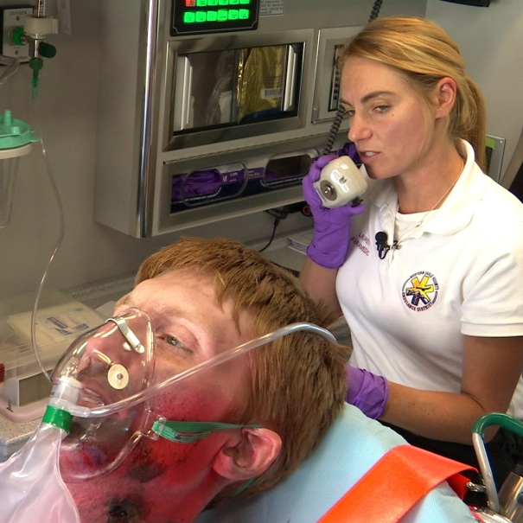
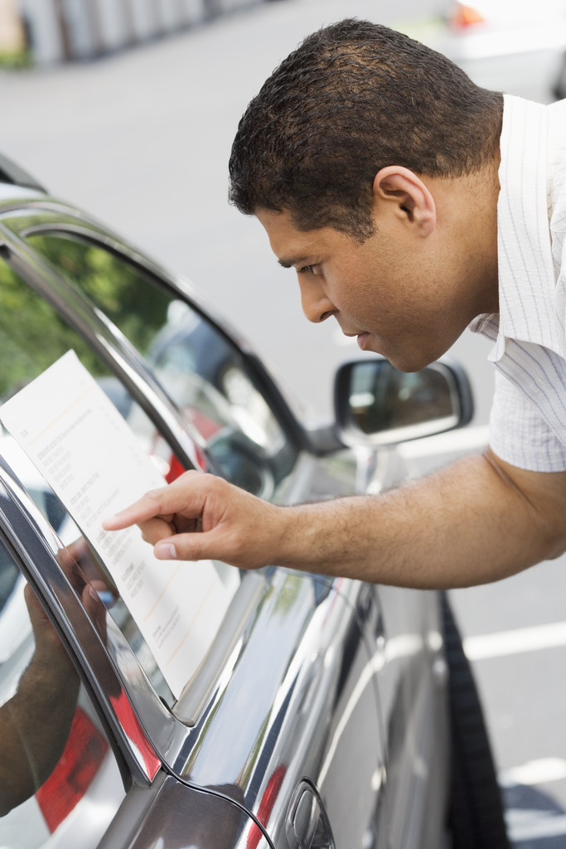
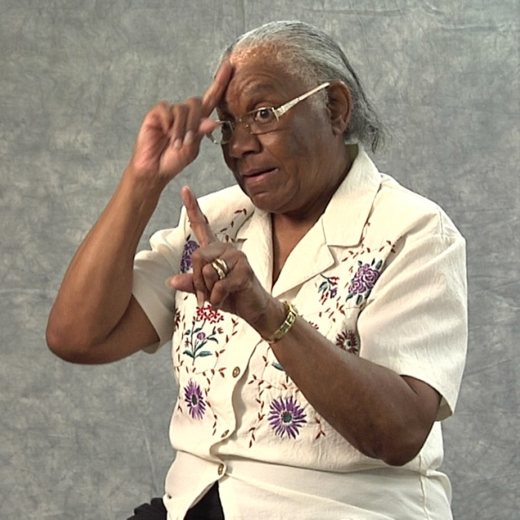
Threshold
Usability
Notes:
Product threshold
Service bit-rate
Resolution compare
Usability maybe?
Natural content
Sign language
Telemedicine
Not model testing

Slide 9
Thoughts?
Sample Experiments
Collaboration
Notes:
My psychology student
Try sample test
Sample experiments
Try technique
Define
Publish
ITU Rec for credibility

